Slide 1
8. Multiple Continuous Random Variables
Prof. Hong Xu
Credit to Prof. Andrej Bogdanov

Slide 2
One random variable review
PMF f(x)
PDF f(x)
P(X ≤ a)
∑_{x ≤ a} f(x)
∫_{x ≤ a} f(x)dx
E[X]
∑_{x} x f(x)
∫_{x} x f(x)dx
E[X²]
∑_{x} x² f(x)
∫_{x} x² f(x)dx
Var[X]
E[(X – E[X])²] = E[X²] – E[X]²

Slide 3
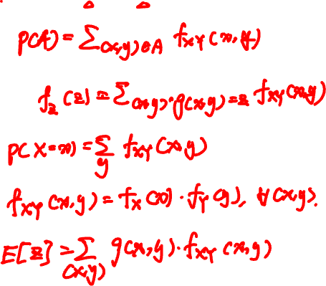
Discrete two variables review
joint PMF f_{XY}(x, y) = P(X = x, Y = y)
Probability of A
Derived RV Z = g(X, Y)
Marginals
Independence
Expectation

Slide 4
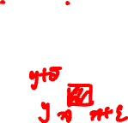
Continuous random variables
A pair of continuous random variables X, Y can be specified either by their joint c.d.f.
F_{XY}(x, y) = P(X ≤ x, Y ≤ y)
or by their joint p.d.f.
∂
∂
f_{XY}(x, y)
=
F_{XY}(x, y)
∂x
∂y
P(x < X ≤ x + ε, y < Y ≤ y + δ)
=
lim
ε, δ → 0
εδ

Slide 5

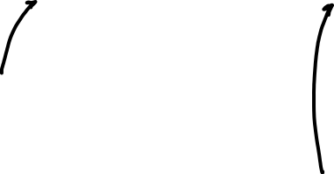
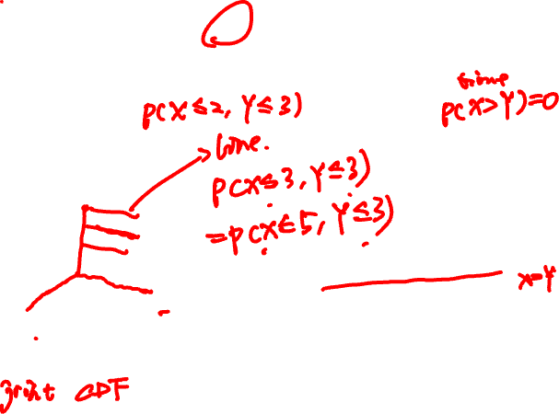
Rain drops at a rate of 1 drop/sec. Let X and Y be the arrival times of the first and second raindrop.
X
Y
F(x, y) = P(X ≤ x, Y ≤ y)
f(x, y)
=
∂
∂
F(x, y)
∂x
∂y

Slide 6
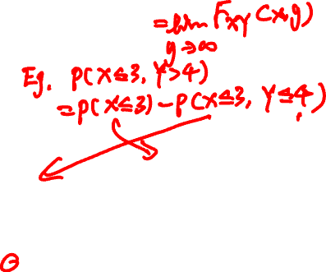
Continuous marginals
Joint CDF F_{XY}(x, y) = P(X ≤ x, Y ≤ y)
Marginal CDF:
F_{X}(x) = P(X ≤ x)
P(X ≤ x)
Exponential(1)

Slide 7


the continuous cheat sheet
X, Y continuous with joint p.d.f. f_{XY}(x, y)
Probability of A
P(A) = ∫∫_{A} f_{XY} (x, y) dxdy
Derived RV Z = g(X, Y)
f_{Z}(z) = ∫_{(x, y): g(x, y) = z} f_{XY}(x, y) dxdy
Marginals
∞
f_{X}(x) = ∫_{-∞} f_{XY}(x, y) dy
Independence
f_{XY}(x, y) = f_{X}(x) f_{Y}(y) for all x, y
Expectation
E[Z] = ∫∫ g(x, y) f_{XY}(x, y) dxdy

Slide 8
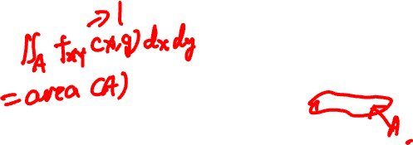

Independent uniform random variables
Let X, Y be independent Uniform(0, 1).
1
if 0 < x, y < 1
f_{XY}(x, y) = f_{X}(x) f_{Y}(y) =
0
if not
f_{XY}(x, y)
P(A) =

Slide 9
Romeo and Juliet have a date between 9 and 10.
The first to arrive will wait for 15 minutes and leave if the other isn’t there.
What is the probability they meet?

Slide 10
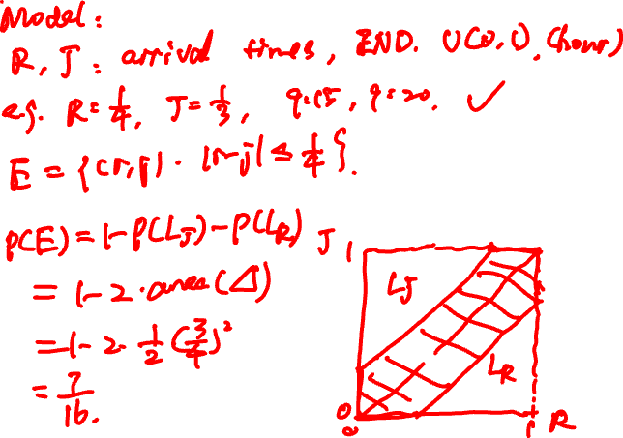

Slide 11
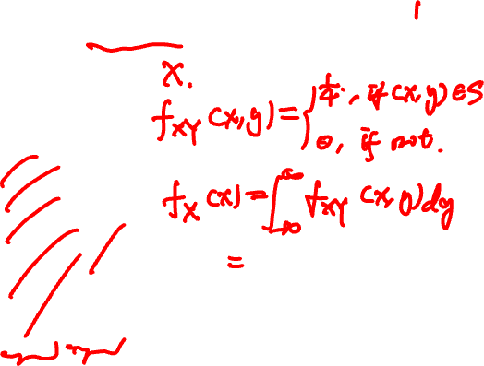
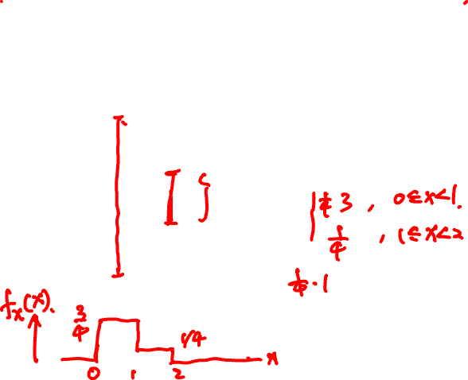
Joint PDF of X, Y is uniform over S.
What are the marginals?
y
3
2
S
1
0
x
0
1
2

Slide 12
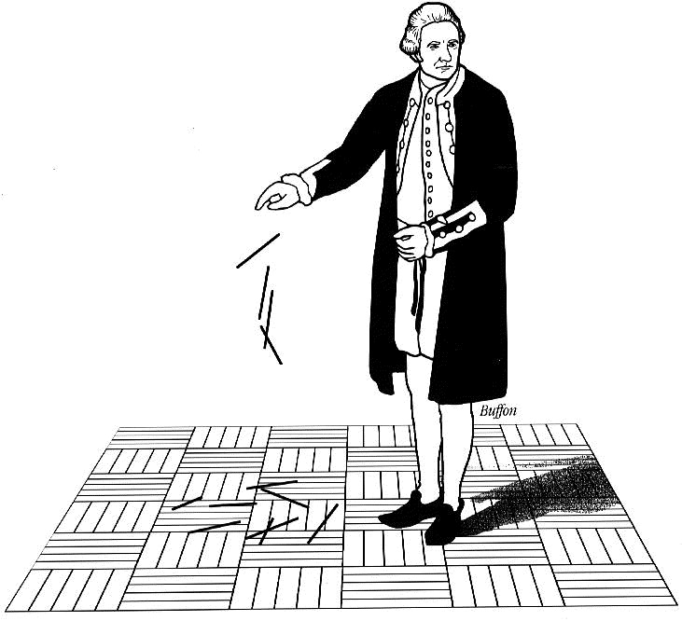
Buffon’s needle
A needle of length l is randomly dropped on a ruled sheet.
What is the probability that the needle hits one of the lines?

Slide 13
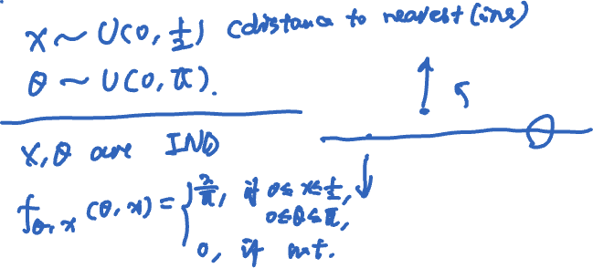
Probability model
X
Θ
1

Slide 14

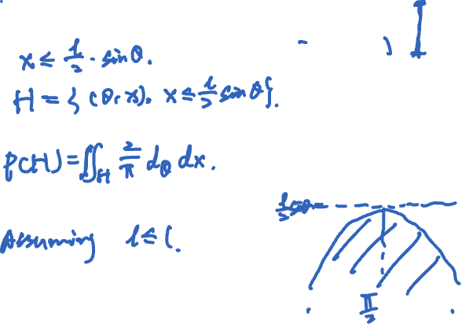
Buffon’s needle
l/2
Event H :
X
Θ
1
½
x
0
0
θ
π

Slide 15
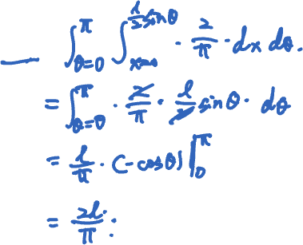
Buffon’s needle
Assume l ≤ 1 (short needle)
P(H) =

Slide 16
Conditioning
Y
discrete
continuous
X
P(X = x, Y = y)
discrete
P(X = x | Y = y) =
P(Y = y)
continuous

Slide 17
Conditioning
Y
discrete
continuous
X
discrete
P(X ≤ x | A) =
P(X ≤ x | Y ≤ y) =
continuous

Slide 18
Rain drops at a rate λ = 1/sec.
You walk for 2 sec, no drop yet.
What is the arrival time of first drop?
Exponential(λ) CDF

Slide 19
T
Memorylessness of Exponential(λ):

Slide 20
Alice arrives 8.10 - 8.30.
2760A
Given she caught the first bus, what is her arrival time?
8.15 AM
8.30 AM

Slide 21
Conditioning a continuous RV on an event
f_{X}(x)
PDF:
f_{X | E} (x) =
when x ∈ E
P(E)
f_{X}(x)
x
E
CDF:
P(X ≤ x | E) =

Slide 22
Arrival time is Uniform(10, 30)
2760A
Conditional arrival time PDF:
8.15 AM
8.30 AM

Slide 23
Conditioning
X
discrete
continuous
Y
discrete
f_{XY}(x, y)
f_{Y|X}(y | x) =
f_{X}(x)
continuous

Slide 24
Joint PDF of X, Y is uniform over S.
What are the conditional PDFs?
y
3
2
S
1
0
x
0
1
2

Slide 25
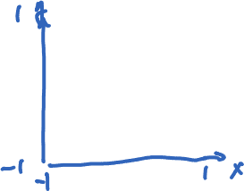
Joint PDF of X, Y is uniform over S.
What are the marginal and conditional PDFs?
S

Slide 26
Total probability theorem:
f_{X}(x) = ∑_{y} f_{X|Y}(x | y) f_{Y}(y)
Y discrete
f_{X}(x) = ∫ f_{X|Y}(x | y) f_{Y}(y) dy
Y continuous
Total expectation theorem:
E[X] = ∑_{y} E[X | Y = y] f_{Y}(y)
Y discrete
E[X] = ∫ E[X | Y = y] f_{Y}(y) dy
Y continuous

Slide 27
Arrival time is Uniform(10, 30)
2760A
Unconditional waiting time PDF:
8.15 AM
8.30 AM

Slide 28
👮‍♂️
50
🚙
Y = Normal(X, X/10)
X = Exponential(1/50)
E[Y] =

