Slide 1
종합설계 프로젝트 계획서
1294033 이준범
1394016 김우재
1594024 유보람

Slide 2
INDEX
Idea 1 소개
Idea 2 소개
Idea 3 소개

Slide 3
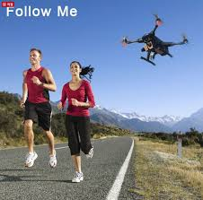
아기 보호 드론
Explanation
Concept
Function
Practicality
Problem
Drone Dragonfly

Slide 4
1. 개요
Explanation
Concept
Function
Practicality
Problem

Slide 5
2. 기능
Explanation
Concept
Function
Practicality
Problem

Slide 6
3. 차별화
Explanation
Concept
Function
Practicality
Problem

Slide 7
4. 문제점
Explanation
Concept
Function
Practicality
Problem

Slide 8
Explanation
Concept
Function
Practicality
Problem

Slide 9
1. 개요
Explanation
Concept
Function
Practicality
Problem

Slide 10
2. 기능
Explanation
Concept
Function
Practicality
Problem

Slide 11
3. 차별화
Explanation
Concept
Function
Practicality
Problem

Slide 12
4. 문제점
Explanation
Concept
Function
Practicality
Problem

Slide 13
Explanation
Concept
Function
Practicality
Problem

Slide 14
1. 개요
Explanation
Concept
Function
Practicality
Problem

Slide 15
2. 기능
Explanation
Concept
Function
Practicality
Problem

Slide 16
3. 차별화
Explanation
Concept
Function
Practicality
Problem

Slide 17
4. 문제점
Explanation
Concept
Function
Practicality
Problem

