Slide 1
이준형 System Semiconductor Engineering University of Sangmyung
Final Project Template
Fall 2022

Slide 2
Contents
 | 학습횟수 | 학습률 | 은닉층 | 가중치 | 활성함수 | 필터 | train | test
twoLay | 10000 | 0.1 | 100 | 0.01 | relu | x | 0.47162 | 0.4374
 | 10000 | 0.1 | 100 | 0.01 | elu | x | 0.4928 | 0.4541
 | 10000 | 0.1 | 100 | 0.01 | luck_relu | x
 | 100000 | 0.1 | 100 | 0.01 | relu | x | 0.73142 | 0.4842
 | 100000 | 0.1 | 100 | 0.01 | elu | x | 0.73996 | 0.4894
threeLay | 10000 | 0.1 | 100 | 0.01 | relu | x | 0.4522 | 0.443
 | 100000 | 0.1 | 100 | 0.01 | relu | x | 0.6672 | 0.5185
 | 10000 | 0.1 | 100 | 0.01 | elu | x
 | 100000 | 0.1 | 100 | 0.01 | elu | x
four | 10000 | 0.1 | 100 | 0.01 | relu | x | 0.1987 | 0.1976
 | 100000 | 0.1 | 100 | 0.01 | relu | x | 0.44899 | 0.4435
 | 500000 | 0.1 | 100 | 0.01 | relu | x | 0.62422 | 0.5135
 | 500000 | 0.1 | 100 | 0.01 | elu | x | 0.63496 | 0.5217
 | 500000 | 0.3 | 100 | 0.01 | elu | x | 0.6805 | 0.5138
 | 500000 | 0.3 | 200 | 0.01 | elu | x | 0.88248 | 0.5034
five | 500000 | 0.1 | 100 | 0.01 | elu | x | 0.30792 | 0.3025
cnn | 10000 | 0.1 | 480 | 0.01 | relu | o | 0.65462 | 0.5869

Slide 3
Network Structure
CIFAR-10
Elu
Affine
Elu
Affine
Elu
Affine
Sofamax
output
Input
Conv +
MaxPool
Conv +
MaxPool
Conv
Relu
Hidden layer
Hidden layer
Output layer

Slide 4
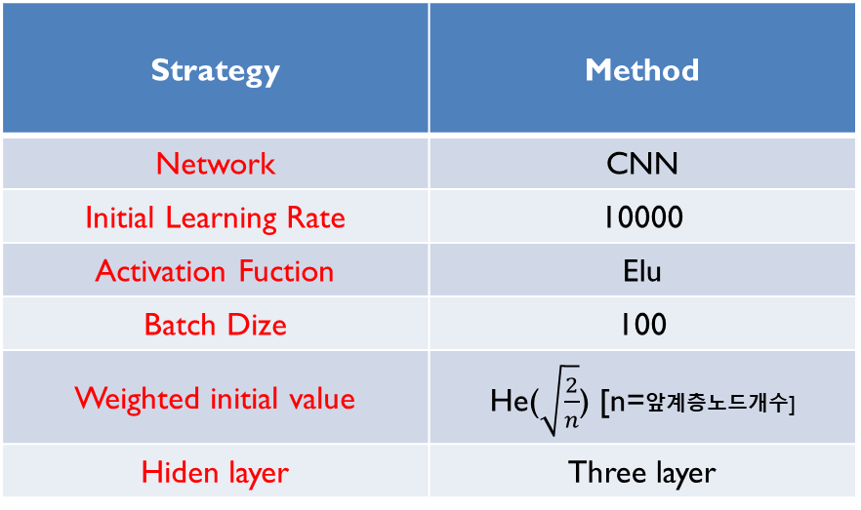
Training Method
CIFAR-10
Strategy | Method
Network | CNN
Initial Learning Rate | 10000
Activation Fuction | Elu
Batch Dize | 100
Weighted initial value | He($\sqrt{\frac{2}{n}}$) [n=앞계층노드개수]
Hiden layer | Three layer

Slide 5
Accuracy Results
CIFAR-10 정확도
 | Accuracy | Difference
Protjcet | 66.22 | 14
Two_layer_net | 48.42 | 25
Three_layer_net | 51.85 | 15

Slide 6
Reference
https://m.blog.naver.com/fbfbf1/222425792443
http://www.incodom.kr/%ED%99%9C%EC%84%B1%ED%99%94%ED%95%A8%EC%88%98

