Slide 1
RISC-V rv32i CPU
설계 및 simulation
이준형

Slide 2
목차
RISC – V 개요
B/D
Type별 동작 방식
R -type
I -type
S -type
IL -type
B -type
U -type
J -type
C to Assembler 분석
Trouble Shooting

Slide 3
1. RISC – V 개요
RISC-V 란:
오픈 소스 명령어 집합 아키텍처(ISA)로,
최소한의 필수 명령어만 유지하는 것이 특징
RISC- V rv32i
명령어 set |  | 32bit 고정 길이
Register file |  | 32개 구성
아키텍처
방식 | Von Neuman아키텍처 |  | Harvard 아키텍처
특징 | Data와 명령어가 하나의 메모리에 저장 |  | Data와 명령어 메모리가 분리되어 저장

Slide 4
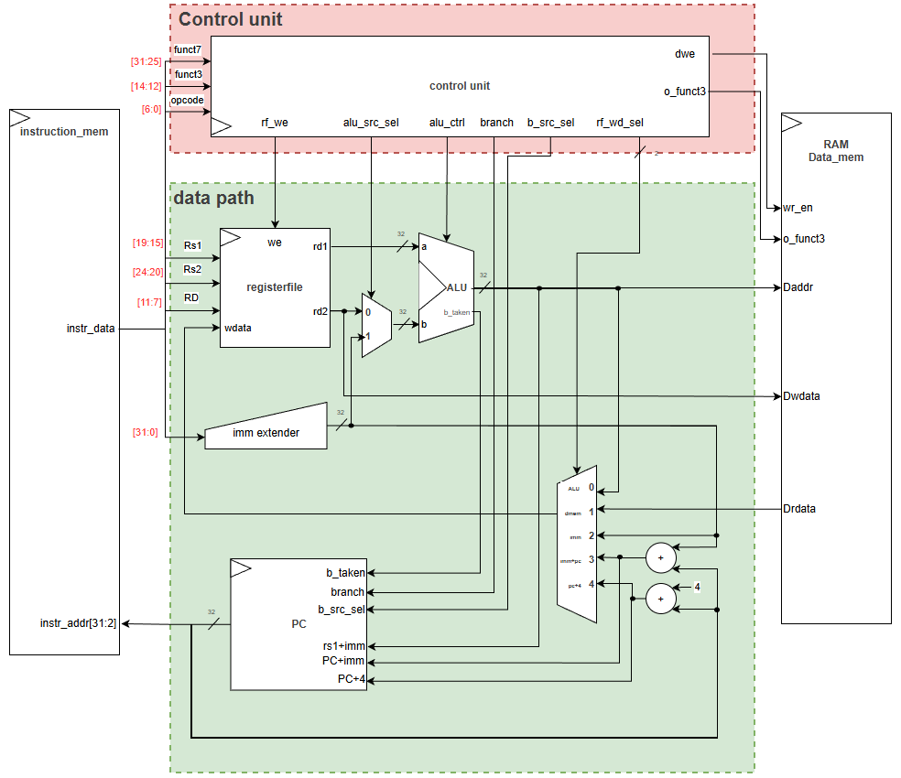
2. B/D
2
 | Module | part | 기능
1 | Instruction Mem | ROM | 실행 명령어 메모리
2 | Control Unit | Control Unit | 전체적인 System 제어
3 | Register File | Data path | ALU 연산을 위한 register
4 | 5-input MUX |  | Register File Write Data MUX
5 | Imm Extender |  | 32 bit 상수로 변환
6 | ALU |  | 연산처리 & 분기 확인
7 | PC |  | Instruction Mem 다음 주소 지정
8 | DATA memory | RAM | Load & STORE data 메모리 (word addressing)
1
8
3
6
5
4
7

Slide 5


3. Type 별 동작 방식
 | 설명순서j
1 | R – type
2 | I - type
3 | S - type
4 | IL - type
5 | B - type
6 | U - type
7 | J - type
01
02
DATA Flow
simulation

Slide 6
3. R-type
 | ADD | SUB | SLL | SLT | SLTU | XOR | SRL | SRA | OR | AND
Funct7 [5] | 0 | 1 | 0 |  |  |  |  | 1 | 0
funct3 | 0 |  | 1 | 2 | 3 | 4 | 5 |  | 6 | 7
• Rs1, Rs2을 산술 연산하는 명령어
• 연산자는 Funct3, Funct7에 의해 결정
R-type | Funct7 | Rs2 | Rs1 | Funct3 | Rd | OPCODE(R-type)

Slide 7
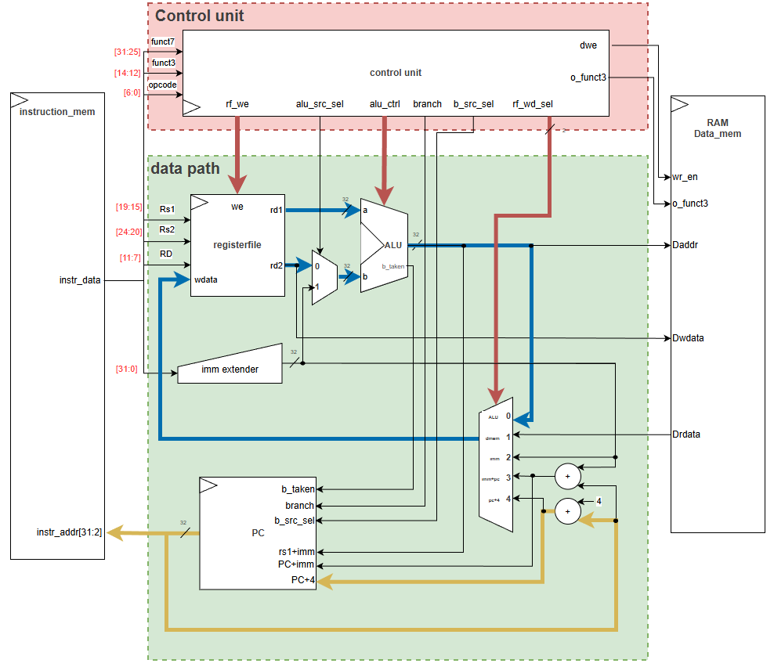
3. R-type
• DataFlow
control_unit
OUTPUT | R_type
rf_we | 1
alu_src_sel | 0
rf_wd_sel | 0
alu_control | 0,funct7[5],funct3
[b_taken,ALU_ctrl]
b_src_sel | 0
branch | 0
o_funct3 | 0
dwe | 0
1
alu_ctrl
0
ALU_result
PC+4
R-type | Funct7 | Rs2 | Rs1 | Funct3 | Rd | OPCODE(R-type)

Slide 8
3. R-type
• DataFlow
1
alu_ctrl
0
ALU
ALU_control |  | ADD | SUB | SLL | SLT | SLTU | XOR | SRL | SRA | OR | AND
[4] | branch | 0
[3] | Funct7 [5] | 0 | 1 | 0 |  |  |  |  | 1 | 0
[2:0] | funct3 | 0 |  | 1 | 2 | 3 | 4 | 5 |  | 6 | 7
output
Result |  | a + b | a - b | a<<b | (a<b)?1:0 | (a<b) | a ^ b | a>>b | a>>>b | a | b | a & b
Signed |  |  |  |  | S |  |  |  | S
B_taken |  | 0
ALU_result
PC+4
R-type | Funct7 | Rs2 | Rs1 | Funct3 | Rd | OPCODE(R-type)

Slide 9
3. R-type
• simulation (시나리오)
INSTR MEM
PC | INSRT | Result(DEX)
0 | ADD | 100
1 | SUB | -300
2 | SLL | -400
3 | SLT | 1
4 | SLTU | 0
5 | XOR | -172
6 | SRL | 1073741799
7 | SRA | -25
8 | OR | -36
9 | AND | 136
 | Register File
addr | name | value | 용도
1 | rs1 | -100 | Full case
2 | rs2 | 200 | Shfit 연산을 제외한 나머지 case
3 | Shift | 2 | SLL, SRL,SRA
4 | rd | Alu_result
R-type | Funct7 | Rs2 | Rs1 | Funct3 | Rd | OPCODE(R-type)

Slide 10
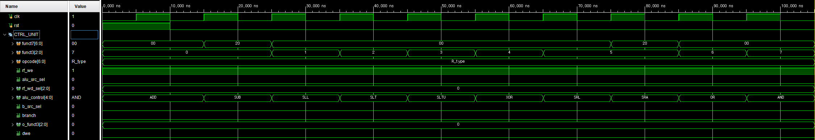
3. R-type
• simulation(Control Unit)
control_unit
OUTPUT | R_type
rf_we | 1
alu_src_sel | 0
rf_wd_sel | 0
alu_control | 0,funct7[5],funct3
[b_taken,ALU_ctrl]
b_src_sel | 0
branch | 0
o_funct3 | 0
dwe | 0
1
0
0
0
0
0
0

Slide 11
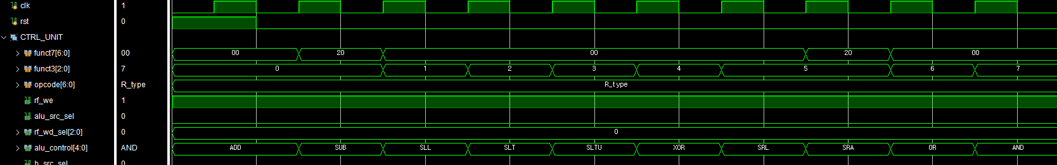
3. R-type
• simulation(Control Unit)
 | ADD | SUB | SLL | SLT | SLTU | XOR | SRL | SRA | OR | AND
funct7[5] | 0 | 1 | 0 |  |  |  |  | 1 | 0
funct3 | 0 |  | 1 | 2 | 3 | 4 | 5 |  | 6 | 7
Funct7 [5] = 1

Slide 12
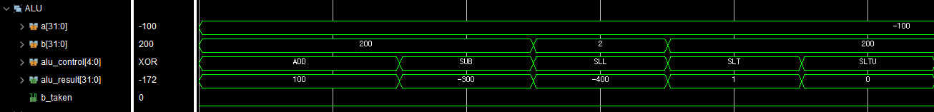
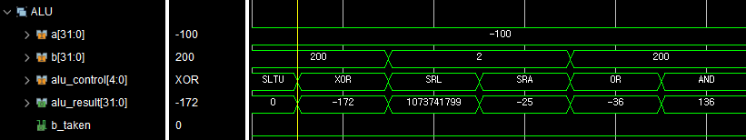
3. R-type
• simulation(ALU)
- ADD ~ SLTU
INSTR MEM
PC | INSRT | Result(DEX)
0 | ADD | 100
1 | SUB | -300
2 | SLL | -400
3 | SLT | 1
4 | SLTU | 0
5 | XOR | -172
6 | SRL | 1073741799
7 | SRA | -25
8 | OR | -36
9 | AND | 136
- XOR ~ AND

Slide 13
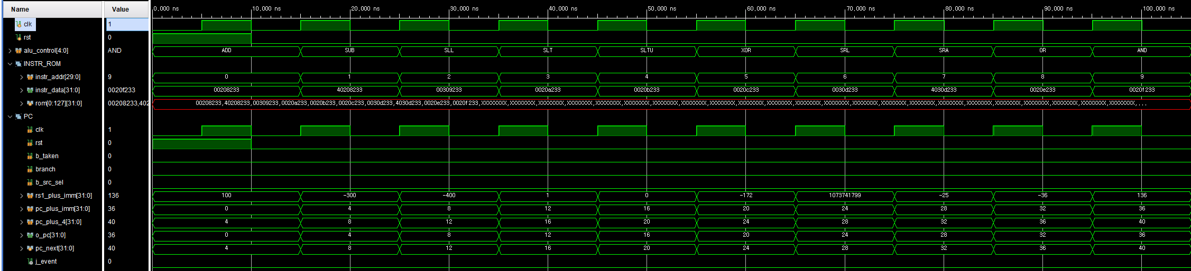
3. R-type
• simulation(INSTR mem & PC)
+ 1씩 증가
PC + 4 출력
O_pc[31:2]

Slide 14
3. I-type
 | ADDI | SLLI | SLTI | SLTUI | XORI | SRLI | SRAI | ORI | ANDI
funct7[5] | x | 0 | x |  |  | 0 | 1 | x
funct3 | 0 | 1 | 2 | 3 | 4 | 5 |  | 6 | 7
• Rs1, 상수 imm을 산술 연산하는 명령어
• shift 연산자 이외의 명령어는 Funct3 의해 결정
• Shift 연산자는 Funct7,Funct3에 의해 결정
I-type | Imm[11:0] | Rs1 | Funct3 | Rd | OPCODE(I-type)
I - shift 명령어 | funct7 | shamt | Rs1 | Funct3 | Rd | OPCODE(I-type)

Slide 15
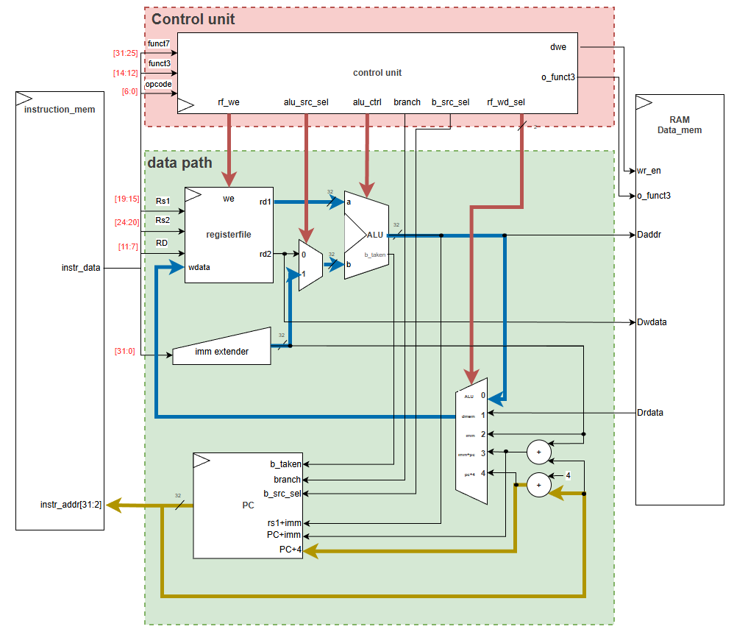
3. I-type
• DataFlow
control_unit
OUTPUT |  | I_type
rf_we |  | 1
alu_src_sel |  | 1
rf_wd_sel |  | 0
alu_control | SLL, SRL,SRA | 0,funct7[5],funct3
[b_taken,ALU_ctrl] | other | 0,0,funct3
b_src_sel |  | 0
branch |  | 0
o_funct3 |  | 0
dwe |  | 0
1
1
alu_ctrl
0
shift 명령어:
funct7[5]의해 동작
other 명령어:
funct7[5] 관계없음
ALU_result
PC+4
I-type | Imm[11:0] | Rs1 | Funct3 | Rd | OPCODE(I-type)
I-shift 명령어 | funct7 | shamt | Rs1 | Funct3 | Rd | OPCODE(I-type)

Slide 16
3. I-type
• DataFlow
1
1
alu_ctrl
0
ALU
ALU_control |  | ADD | SLL | SLT | SLTU | XOR | SRL | SRA | OR | AND
[4] | branch | 0
[3] | Funct7 [5] | 0 |  |  |  |  |  | 1 | 0
[2:0] | funct3 | 0 | 1 | 2 | 3 | 4 | 5 |  | 6 | 7
output
Result |  | a + b | a<<b | (a<b)?1:0 | (a<b) | a ^ b | a>>b | a>>>b | a | b | a & b
Signed |  |  |  | S |  |  |  | S
B_taken |  | 0
ALU_result
PC+4
I-type | Imm[11:0] | Rs1 | Funct3 | Rd | OPCODE(I-type)
I-shift 명령어 | funct7 | shamt | Rs1 | Funct3 | Rd | OPCODE(I-type)

Slide 17
3. I-type
• simulation(시나리오)
INSTR MEM
PC | INSRT | Result(DEX)
0 | ADDI | 100
1 | SLTI | 1
2 | SLTUI | 0
3 | XORI | -172
4 | ORI | -36
5 | ANDI | 136
6 | SRLI | 1073741799
7 | SRAI | -25
 | Register File
addr | name | value | 용도
1 | rs1 | -100 | Full case
2 | rs2 | 200 | Shfit 연산을 제외한 나머지 case
3 | Shfit | 2 | SLTI,SLTUI,SRLI,SRAI
4 | rd | Alu_result
I-type | Imm[11:0] | Rs1 | Funct3 | Rd | OPCODE(I-type)
I-shift 명령어 | funct7 | shamt | Rs1 | Funct3 | Rd | OPCODE(I-type)

Slide 18
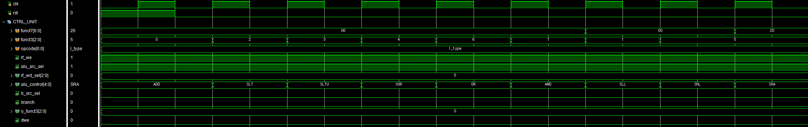
3. I-type
• simulation(Control Unit)
control_unit
OUTPUT |  | I_type
rf_we |  | 1
alu_src_sel |  | 1
rf_wd_sel |  | 0
alu_control | SLL SRL,SRA | 0,funct7[5],funct3
[b_taken,ALU_ctrl] | other | 0,0,funct3
b_src_sel |  | 0
branch |  | 0
o_funct3 |  | 0
dwe |  | 0
1
1
0
0
0
0
0

Slide 19
3. I-type
• simulation(Control Unit)
 | ADD | SLL | SLT | SLTU | XOR | SRL | SRA | OR | AND
funct7[5] | x | 0 | x |  |  | 0 | 1 | x
funct3 | 0 | 1 | 2 | 3 | 4 | 5 |  | 6 | 7
Funct7 [5] = 0
Funct7 [5] = 1
funct7
funct3
OPCODE
ALU_Ctrl

Slide 20
3. I-type
• simulation(imm_extender)

Slide 21
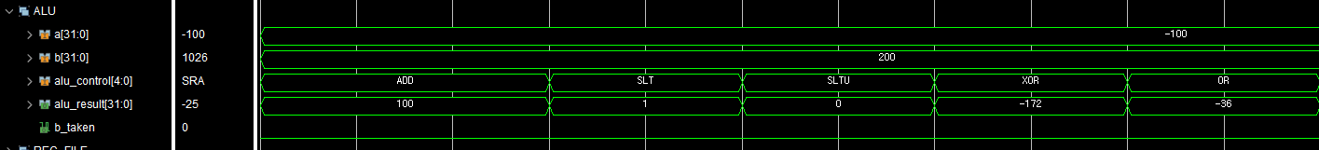
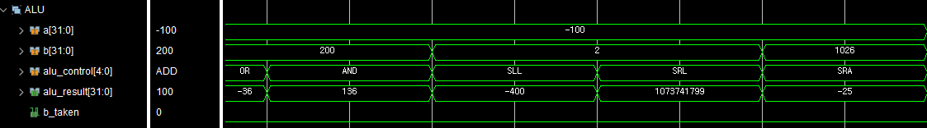
3. I-type
- ADD ~ SLTU
• simulation(ALU)
imm
INSTR MEM
PC | INSRT | Result(DEX)
0 | ADDI | 100
1 | SLTI | 1
2 | SLTUI | 0
3 | XORI | -172
4 | ORI | -36
5 | ANDI | 136
6 | SRLI | 1073741799
7 | SRAI | -25
- AND ~ SRA
Shift = 2
imm
32’h42

Slide 22
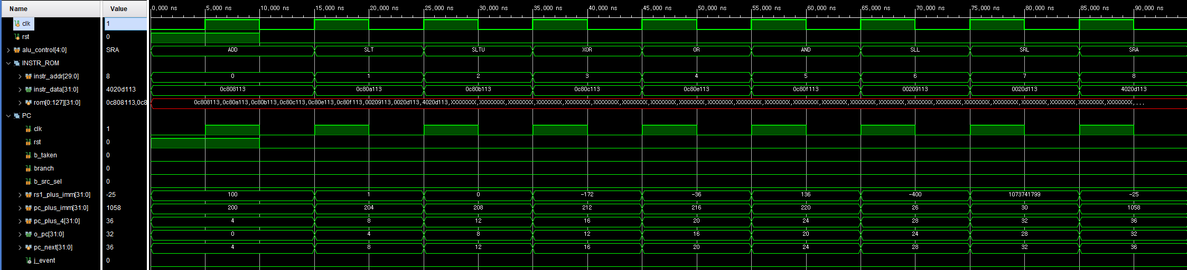
3. I-type
• simulation
+ 1씩 증가
PC + 4 출력
O_pc[31:2]

Slide 23
3. S-type
 | SB | SH | SW
funct3 | 0 | 1 | 2
• S-type 명령어 : Dmem[rs1 + imm] = rs2
• SB : byte addressing
• SH : half-word addressing
• SW: word addressing
S-type | Imm[11:5] | Rs2 | Rs1 | Funct3 | Imm[4:0] | OPCODE(S-type)

Slide 24
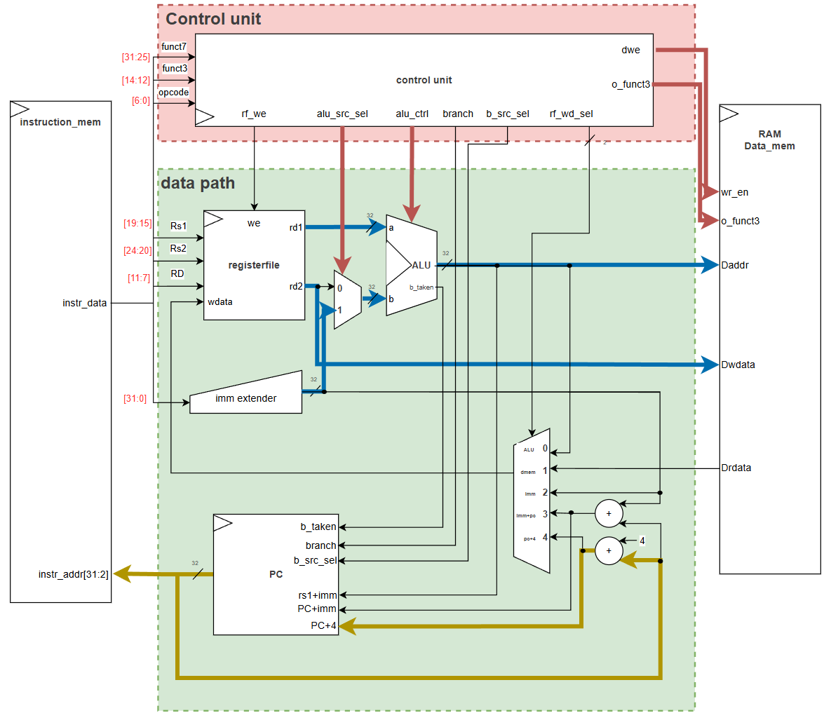
3. S-type
• DataFlow
1
control_unit
OUTPUT | S_type
rf_we | 0
alu_src_sel | 1
rf_wd_sel | 0
alu_control | ADD
[b_taken,ALU_ctrl]
b_src_sel | 0
branch | 0
o_funct3 | funct3
dwe | 1
1
ADD
funct3
Imm+rs1
rs2
PC+4
S-type | Imm[11:5] | Rs2 | Rs1 | Funct3 | Imm[4:0] | OPCODE(S-type)

Slide 25
3. S-type
• DataFlow
1
1
ADD
funct3
DATA MEM
INSRT | 설계 | Write 조건 | Funct3 | Addr scale
SB | SL word addressing | dwe = 1 | 3’h0 | Byte
SH |  |  | 3’h1 | Half word
SW |  |  | 3’h2 | word
Imm+rs1
rs2
PC+4
S-type | Imm[11:5] | Rs2 | Rs1 | Funct3 | Imm[4:0] | OPCODE(S-type)

Slide 26
3. S-type
INSTR MEM
PC | INSRT | (byte_addr 기준) | Dmem[0] (32’hx 초기화)
0 | SB | Dmem[0+0] = 32’h44 | xx_xx_xx_44
1 |  | Dmem[0+1] = 32’h33 | xx_xx_33_44
2 |  | Dmem[0+2] = 32’h22 | xx_22_33_44
3 |  | Dmem[0+3] = 32’h11 | 11_22_33_44
4 | SH | Dmem[0+0] = 32’h44 | 11_22_00_44
5 |  | Dmem[0+1] = 32’h33 | 11_22_00_33
6 |  | Dmem[0+2] = 32’h22 | 00_22_00_33
7 |  | Dmem[0+3] = 32’h11 | 00_11_00_33
8 | SW | Dmem[0+0] = 32’h44 | 00_00_00_44
9 |  | Dmem[0+1] = 32’h33 | 00_00_00_33
10 |  | Dmem[0+2] = 32’h22 | 00_00_00_22
11 |  | Dmem[0+3] = 32’h11 | 00_00_00_11
• simulation(시나리오)
 | Register File
addr | name | value
28 | Store Data | 32’h44
29 |  | 32’h33
30 |  | 32’h22
31 |  | 32’h11
Dmem[Rs1+imm] = Rs2
Rs1 : 0
Imm : 0~3
Rs2 : x28 ~ x31

Slide 27
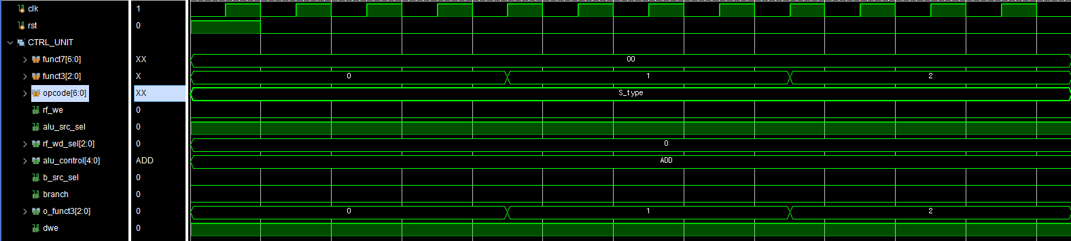
3. S-type
• simulation(Control Uint)
control_unit
OUTPUT | S_type
rf_we | 0
alu_src_sel | 1
rf_wd_sel | 0
alu_control | ADD
[b_taken,ALU_ctrl]
b_src_sel | 0
branch | 0
o_funct3 | funct3
dwe | 1
0
o_funct3 = funct3
1
0
ADD
0
0
1

Slide 28
Dmem[Rs1+imm] = Rs2
Rs1 : 0
Imm : 0~3
Rs2 : x28 ~ x31
3. S-type
• simulation(imm_extender & ALU)
rs1
imm
daddr
SB
SH
SW

Slide 29
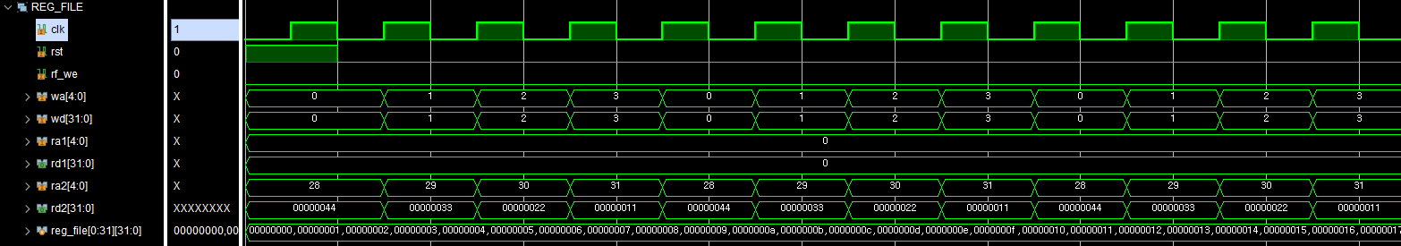
 | Register File
addr | name | value
28 | Store Data | 32’h44
29 |  | 32’h33
30 |  | 32’h22
31 |  | 32’h11
3. S-type
• simulation(Register File)
rs2
dwdata
SB
SH
SW

Slide 30
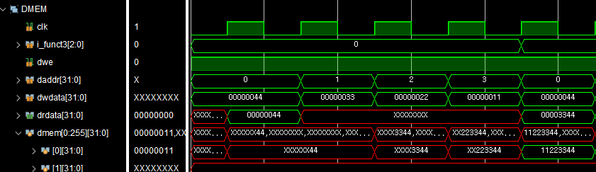
Dmem[Rs1+imm] = Rs2
Rs1 : 0
Imm : 0~3
Rs2 : x28 ~ x31
3. S-type
• simulation(Data mem)
SB
INSTR MEM
PC | INSRT | Dmem[0] = Result
0 | SB | 00_00_00_44
1 |  | 00_00_33_44
2 |  | 00_22_33_44
3 |  | 11_22_33_44
dwe =1
@(posedge clk)

Slide 31
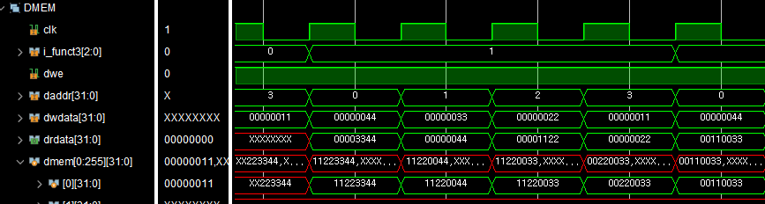
Dmem[Rs1+imm] = Rs2
Rs1 : 0
Imm : 0~3
Rs2 : x28 ~ x31
3. S-type
• simulation(Data mem)
SH
INSTR MEM
PC | INSRT | Dmem[0] = Result
0 | SH | 11_22_00_44
1 |  | 11_22_00_33
2 |  | 00_22_00_33
3 |  | 00_11_00_33
dwe = 1
@(posedge clk)

Slide 32
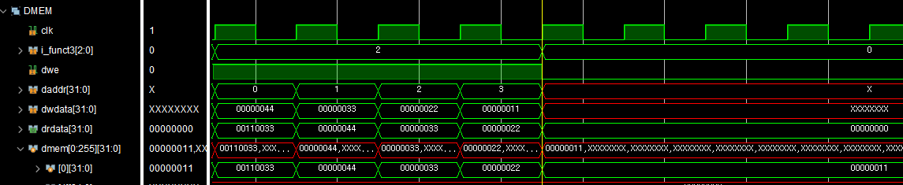
Dmem[Rs1+imm] = Rs2
Rs1 : 0
Imm : 0~3
Rs2 : x28 ~ x31
3. S-type
• simulation(Data mem)
INSTR MEM
PC | INSRT | Dmem[0] = Result
0 | SW | 00_00_00_44
1 |  | 00_00_00_33
2 |  | 00_00_00_22
3 |  | 00_00_00_11
SW
dwe = 1
@(posedge clk)

Slide 33
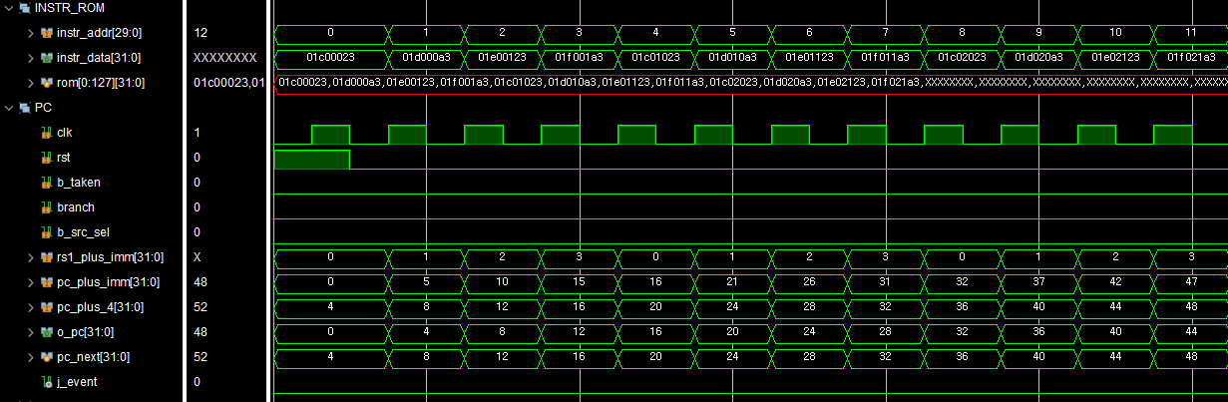
3. S-type
• simulation(PC)
+ 1씩 증가
O_pc[31:2]
PC + 4 출력

Slide 34
3. IL-type
 | LB | LH | LW | LBU | LHU
funct3 | 0 | 1 | 2 | 3 | 4
signed | S |  |  | U
• IL-type 명령어 : rd = Dmem[rs1 + imm]
• I-type의 Load 명령어는 I-type의 산술 명령어와 기능적 분리하여 설계
IL-type | Imm[11:0] | Rs1 | Funct3 | Rd | OPCODE(IL-type)

Slide 35
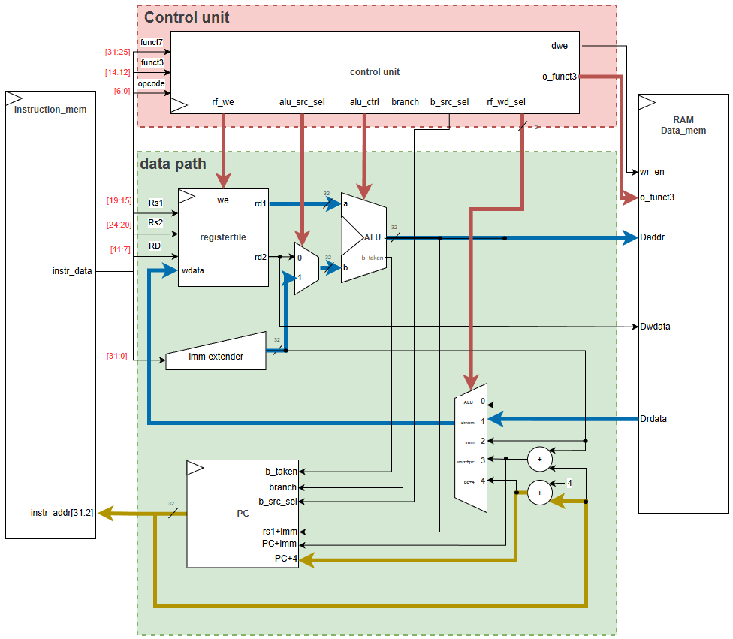
3. IL-type
• DataFlow
funct3
control_unit
OUTPUT | IL_type
rf_we | 1
alu_src_sel | 1
rf_wd_sel | 1
alu_control | ADD
[b_taken,ALU_ctrl]
b_src_sel | 0
branch | 0
o_funct3 | funct3
dwe | 0
1
ADD
Imm+rs1
Drdata
PC+4
IL-type | Imm[11:0] | Rs1 | Funct3 | Rd | OPCODE(I-type)

Slide 36
3. IL-type
• DataFlow
funct3
DATA MEM
INSRT | 설계 | Funct3 | Addr scale | Signed
LB | CL word addressing | 3’h0 | Byte | Signed
LH |  | 3’h1 | Half word | Signed
LW |  | 3’h2 | word | Signed
LBU |  | 3’h3 | Byte | Unsigned
LHU |  | 3’h4 | Half word | Unsigned
1
ADD
Imm+rs1
Drdata
PC+4
IL-type | Imm[11:0] | Rs1 | Funct3 | Rd | OPCODE(I-type)

Slide 37
3. IL-type
• simulation(시나리오)
INSTR MEM
PC | INSRT | (byte_addr 기준) | reg file[x1]
0 | LB | Dmem[0+0] = 32’h01 | 00_00_00_01
1 |  | Dmem[0+1] = 32’hf2 | ff_ff_ff_f2
2 |  | Dmem[0+2] = 32’hf3 | ff_ff_ff_f3
3 |  | Dmem[0+3] = 32’h04 | 00_00_00_04
4 | LH | Dmem[0+0] = 32’h01 | ff_ff_f2_01
5 |  | Dmem[0+1] = 32’hf2
6 |  | Dmem[0+2] = 32’hf3 | 00_00_04_f3
7 |  | Dmem[0+3] = 32’h04
8 | LW | Dmem[0+0] = 32’h01 | 04_f3_f2_01
9 |  | Dmem[0+1] = 32’hf2
10 |  | Dmem[0+2] = 32’hf3
11 |  | Dmem[0+3] = 32’h04
INSTR MEM
PC | INSRT | (byte_addr 기준) | reg file[x1]
12 | LBU | Dmem[0+0] = 32’h01 | 00_00_00_01
13 |  | Dmem[0+1] = 32’hf2 | 00_00_00_f2
14 |  | Dmem[0+2] = 32’hf3 | 00_00_00_f3
15 |  | Dmem[0+3] = 32’h04 | 00_00_00_04
16 | LHU | Dmem[0+0] = 32’h01 | 00_00_f2_01
17 |  | Dmem[0+1] = 32’hf2
18 |  | Dmem[0+2] = 32’hf3 | 00_00_04_f3
19 |  | Dmem[0+3] = 32’h04
Rd = Dmem[Rs1+imm]
Rs1 : 0
Imm : 0~3
Rd : x1
DATA MEM
addr | value
0 | 32’h04_f3_f2_01
Register File
x1 | load data

Slide 38
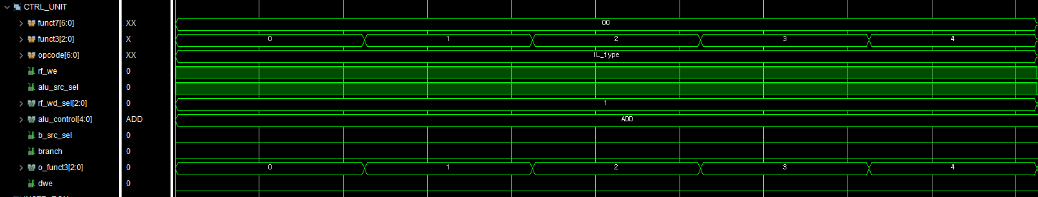
3. IL-type
• simulation(ALU)
control_unit
OUTPUT | IL_type
rf_we | 1
alu_src_sel | 1
rf_wd_sel | 1
alu_control | ADD
[b_taken,ALU_ctrl]
b_src_sel | 0
branch | 0
o_funct3 | funct3
dwe | 0
1
o_funct3 = funct3
1
1
ADD
0
0
0

Slide 39
3. IL-type
Rd = Dmem[Rs1+imm]
Rs1 : 0
Imm : 0~3
Rd : x1
• simulation(ALU)
rs1
imm
ADD
daddr
LB
LH
LW
LBU
LHU

Slide 40
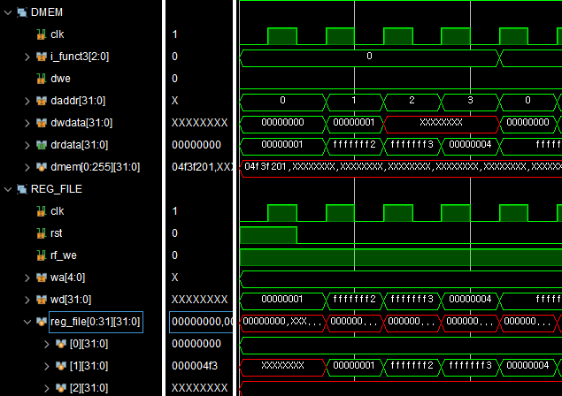
3. IL-type
Rd = Dmem[Rs1+imm]
Rs1 : 0
Imm : 0~3
Rd : x1
• simulation(Data mem & register file)
LB
read
INSTR MEM
PC | INSRT | (byte_addr 기준) | reg file[x1]
0 | LB | Dmem[0+0] = 32’h01 | 00_00_00_01
1 |  | Dmem[0+1] = 32’hf2 | ff_ff_ff_f2
2 |  | Dmem[0+2] = 32’hf3 | ff_ff_ff_f3
3 |  | Dmem[0+3] = 32’h04 | 00_00_00_04
@(posedge clk)
write
1

Slide 41
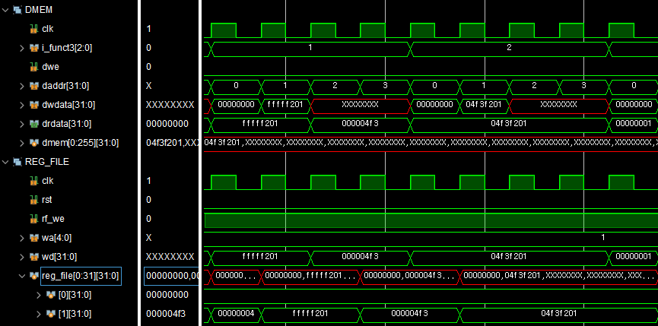
3. IL-type
Rd = Dmem[Rs1+imm]
Rs1 : 0
Imm : 0~3
Rd : x1
• simulation(Data mem & register file)
LH
LW
INSTR MEM
PC | INSRT | (byte_addr 기준) | reg file[x1]
4 | LH | Dmem[0+0] = 32’h01 | ff_ff_f2_01
5 |  | Dmem[0+1] = 32’hf2
6 |  | Dmem[0+2] = 32’hf3 | 00_00_04_f3
7 |  | Dmem[0+3] = 32’h04
8 | LW | Dmem[0+0] = 32’h01 | 04_f3_f2_01
9 |  | Dmem[0+1] = 32’hf2
10 |  | Dmem[0+2] = 32’hf3
11 |  | Dmem[0+3] = 32’h04
read
write
@(posedge clk)
1

Slide 42
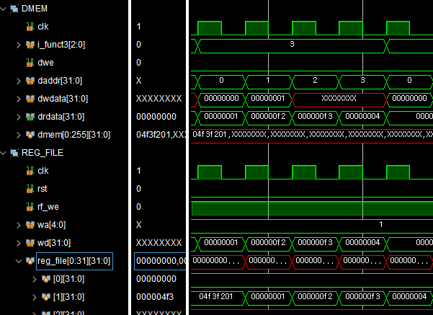
3. IL-type
Rd = Dmem[Rs1+imm]
Rs1 : 0
Imm : 0~3
Rd : x1
• simulation(Data mem & register file)
LBU
read
INSTR MEM
PC | INSRT | (byte_addr 기준) | reg file[x1]
12 | LBU | Dmem[0+0] = 32’h01 | 00_00_00_01
13 |  | Dmem[0+1] = 32’hf2 | 00_00_00_f2
14 |  | Dmem[0+2] = 32’hf3 | 00_00_00_f3
15 |  | Dmem[0+3] = 32’h04 | 00_00_00_04
@(posedge clk)
write
1

Slide 43
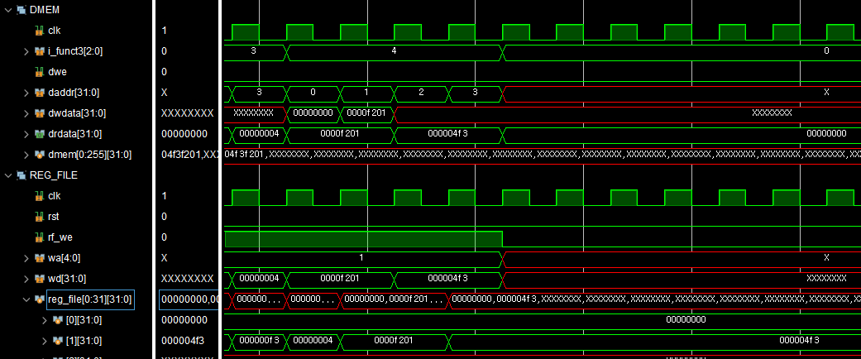
3. IL-type
Rd = Dmem[Rs1+imm]
Rs1 : 0
Imm : 0~3
Rd : x1
• simulation(Data mem & register file)
LHU
read
INSTR MEM
PC | INSRT | (byte_addr 기준) | reg file[x1]
16 | LHU | Dmem[0+0] = 32’h01 | 00_00_f2_01
17 |  | Dmem[0+1] = 32’hf2
18 |  | Dmem[0+2] = 32’hf3 | 00_00_04_f3
19 |  | Dmem[0+3] = 32’h04
@(posedge clk)
write
1

Slide 44
3. B-type
 | BEQ | BNE | BLT | BGE | BLTU | BGEU
Funct3 | 0 | 1 | 4 | 5 | 6 | 7
a == b | a != b | a < b | a >= b | a < b | a >= b
• B-type은 rs1, rs2에 대해 비교 연산자를 사용
• 참일 경우, PC는 PC + imm으로 이동(Jump)
B-type | Imm[12,10:5] | Rs2 | Rs1 | Funct3 | Imm[4:1,11] | OPCODE(B-type)

Slide 45
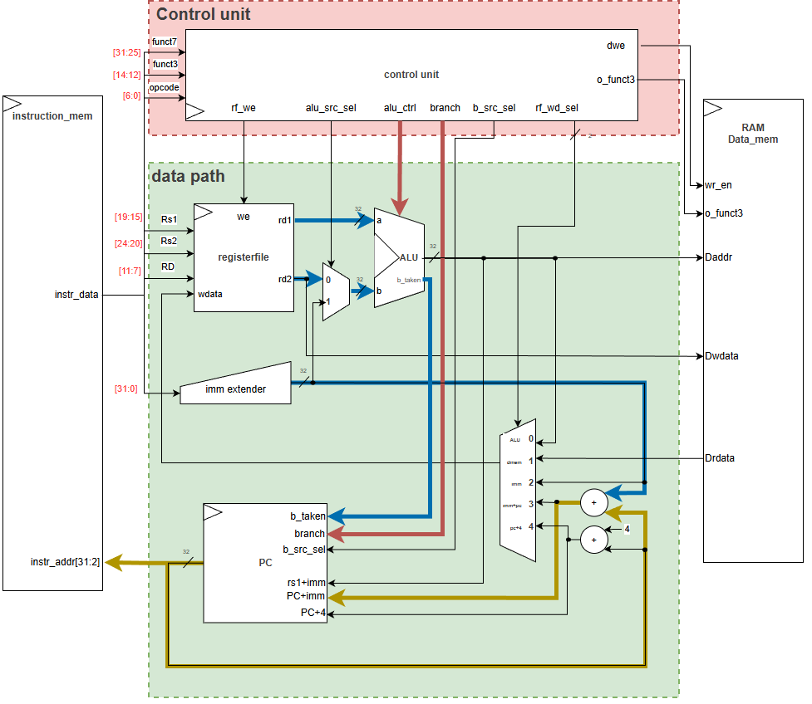
3. B-type
• DataFlow
control_unit
OUTPUT | B_type
rf_we | 0
alu_src_sel | 0
rf_wd_sel | 0
alu_control | 1,0,funct3
[b_taken,ALU_ctrl]
b_src_sel | 0
branch | 1
o_funct3 | 0
dwe | 0
PC
Case문 |  | OUTPUT
j_event | b_src_sel | (pc_next)
0 | x | PC + 4
1 | 0 | PC + imm
1 | 1 | rs1 + imm
ADD
1
1 or 0
PC+imm
B-type | Imm[12,10:5] | Rs2 | Rs1 | Funct3 | Imm[4:1,11] | OPCODE(B-type)

Slide 46
3. B-type
• DataFlow
ALU
Ctrl |  | BEQ | BNE | BLT | BGE | BLTU | BGEU
[4] | branch | 1
[3] | Funct7 [5] | 0
[2:0] | Funct3 | 0 | 1 | 4 | 5 | 6 | 7
OUTPUT
ALU |  | a == b | a != b | a < b | a >= b | a < b | a >= b
signed |  | S |  |  |  | U
b_taken |  | T/F
ADD
1
PC
Case문 |  | OUTPUT
j_event | b_src_sel | (pc_next)
0 | x | PC + 4
1 | 0 | PC + imm
1 | 1 | rs1 + imm
PC+imm,
Pc+4
1 or 0
B-type | Imm[12,10:5] | Rs2 | Rs1 | Funct3 | Imm[4:1,11] | OPCODE(B-type)

Slide 47
3. B-type
• simulation(시나리오)
True case
false case
if(rs1 비교 rs2) PC += imm
INSTR MEM
PC | imm | INSRT | ALU |  |  | T/F | signed
0 | 2*4 | BEQ | -1 == -1 |  |  | T | S
2 |  | BNE | 0 != -1
4 |  | BLT | -1 < 0
6 |  | BGE | 0 >= -1 | >
8 | 6*4 |  | -1 >= -1 | ==
14 | -2*4 | BLTU | 0 < |-1| |  |  |  | U
12 |  | BGEU | |-1| >= 0 |  | >
10 | 8*4 |  | |-1| >= -1 |  | ==
INSTR MEM
PC | imm | INSRT | ALU |  | T/F | signed
18 | 30*4 | BEQ | -1 == 0 |  | F | S
19 |  | BNE | 0 != 0
20 |  | BLT | 0 < -1 | <
21 |  |  | 0 < 0 | ==
22 |  | BGE | -1 >= 0
23 |  | BLTU | |-1| < 0 | < |  | U
24 |  |  | 0 < 0 | ==
25 |  | BGEU | 0 >= |-1|
26 |  | SUB | x2 = (-1) – (-1)
PC += 2
register file
addr | value
x0 | 0
x1 | -1
x2 | SUB 값
PC += 6
PC += -2
PC += 8
PC += 30*4

Slide 48
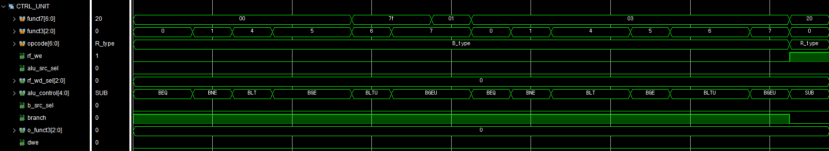
BEQ | BNE | BLT | BGE | BLTU | BGEU
1
0
0 | 1 | 4 | 5 | 6 | 7
3. B-type
• simulation(Control Unit)
control_unit
OUTPUT | B_type
rf_we | 0
alu_src_sel | 0
rf_wd_sel | 0
alu_control | 1,0,funct3
[b_taken,ALU_ctrl]
b_src_sel | 0
branch | 1
o_funct3 | 0
dwe | 0
0
0
0
0
1
0
0

Slide 49
3. B-type
• simulation(ALU)
True Case
Falue Case
b_taken = 1

Slide 50
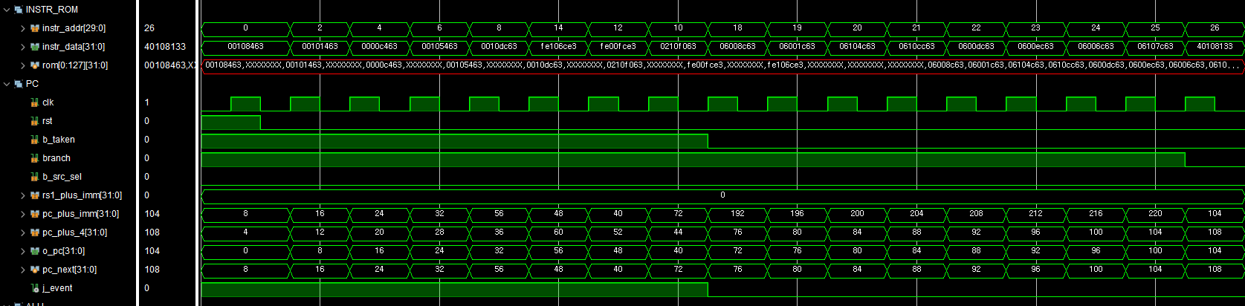
3. B-type
• simulation(PC)
INSTR MEM
PC | imm | INSRT
0 | 2*4 | BEQ
2 |  | BNE
4 |  | BLT
6 |  | BGE
8 | 6*4
14 | -2*4 | BLTU
12 |  | BGEU
10 | 8*4
branch = 1
branch = 0
b_taken = 1
24++
32++
8++
8--
b_taken && branch

Slide 51
3. U-type
OPCODE | INSTR
7’b011_0111 | LUI | Rd = imm
7’b001_0111 | AUIPC | Rd = PC + imm
• OPCODE의 차이로 LUI,AUIPC 구별
U-type | Imm[31:12] | Rd | OPCODE(U-type)

Slide 52
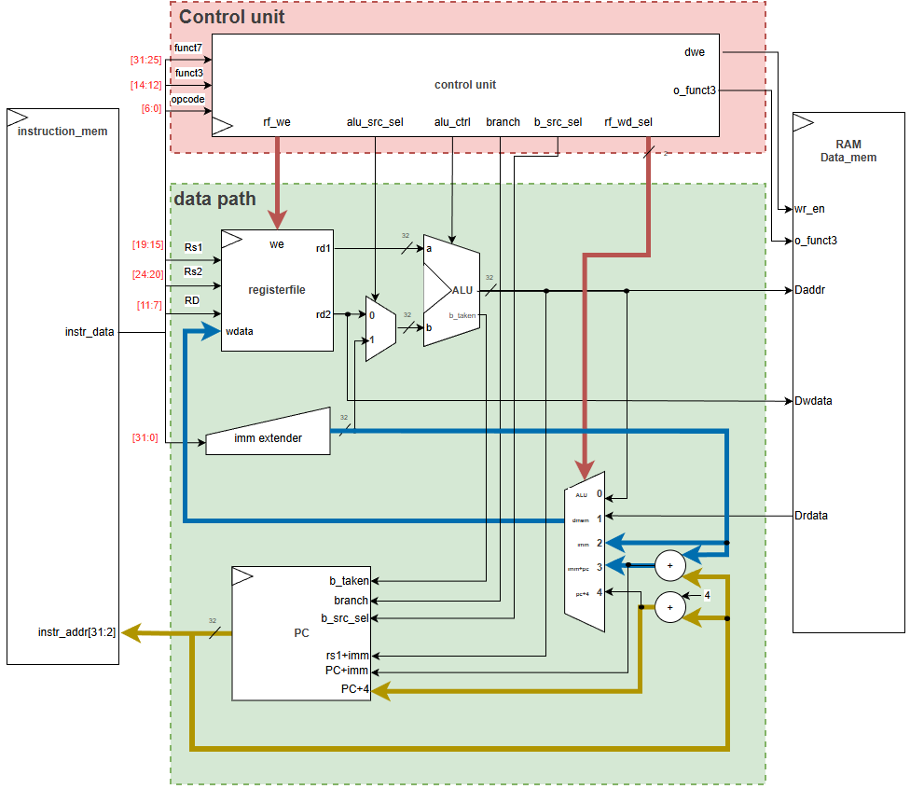
3. U-type
• DataFlow
control_unit
OUTPUT | LUI_type | AUIPC_type
rf_we | 1
alu_src_sel | 0
rf_wd_sel | 2 | 3
alu_control | ADD
[b_taken,ALU_ctrl]
b_src_sel | 0
branch | 0
o_funct3 | 0
dwe | 0
1
2 or 3
PC + imm or imm
PC+4
U-type | Imm[31:12] | Rd | OPCODE(U-type)

Slide 53
3. U-type
• simulation(시나리오)
LUI : rd = imm
AUIPC : rd = PC + imm
INSTR MEM
PC | INSRT | 설명 | imm
0 | BEQ | if(0 == 0)? PC += 2*4
2 | LUI | x1 = -10 | -10
3 | AUIPC | x1 = 3*4 + 10 | 10
register file
addr | 용도
x1 | rd (LUI, AUIPC 저장소)
검증할 부분
추가한 이유
U-type는 0번 PC에서 simulation을 진행할 시,
imm과 imm+PC의 값이 동일하여 DATAFLOW 명확하게 확인 불가

Slide 54
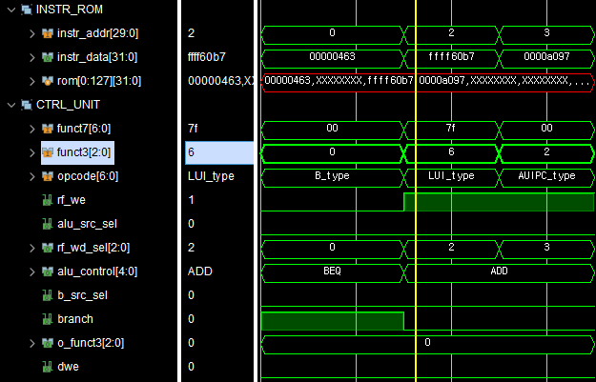
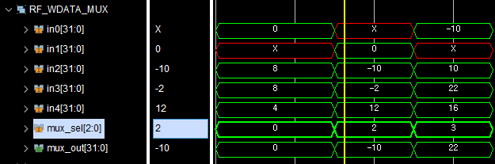
3. U-type
• simulation(control Unit & RF Wdata MUX)
control_unit
OUTPUT | LUI_type | AUIPC_type
rf_we | 1
alu_src_sel | 0
rf_wd_sel | 2 | 3
alu_control | ADD
[b_taken,ALU_ctrl]
b_src_sel | 0
branch | 0
o_funct3 | 0
dwe | 0
alu_result
Drdata
imm
INSTR MEM
PC | INSRT | register file | imm
2 | LUI | x1 = -10 | -10
3 | AUIPC | x1 = 22 | 10
PC + imm
PC + 4

Slide 55
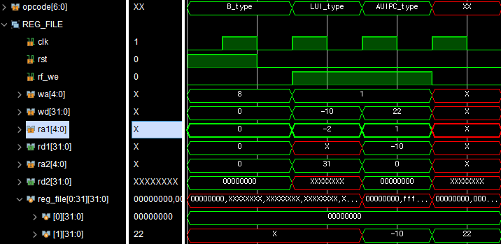
3. U-type
• simulation(Register File)
INSTR MEM
PC | INSRT | register file | imm
2 | LUI | x1 = -10 | -10
3 | AUIPC | x1 = 3*4 + 10 | 10
x1

Slide 56
3. J-type
OPCODE | INSTR | Rd | PC
7’b110_1111 | JAL | Rd = PC + 4 | PC += imm
7’b110_0111 | JALR |  | PC = Rs1 + imm
• J-type은 OPCODE로 구별
• PC는 무조건 Jump
JAL 명령어: | Imm[20,10:1,11,19:12] | Rd | OPCODE(JAL)
JALR명령어: | Imm[11:0] | rs1 | funct3 | Rd | OPCODE(JALR)

Slide 57
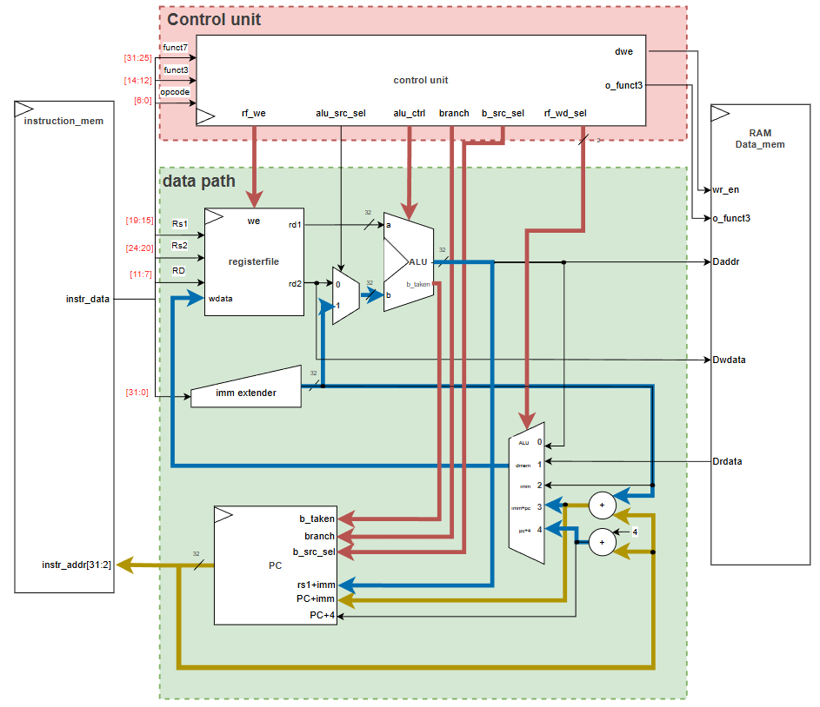
3. J-type
• DataFlow
control_unit
OUTPUT | JAL_type | JALR_type
rf_we | 1
alu_src_sel | 0 | 1
rf_wd_sel | 4
alu_control | JUMP B_taken:1 ALU:ADD
[b_taken,ALU_ctrl]
b_src_sel | 0 | 1
branch | 1
o_funct3 | 0
dwe | 0
PC
Case문 |  | OUTPUT
j_event | b_src_sel | (pc_next)
0 | x | PC + 4
1 | 0 | PC + imm
 | 1 | rs1 + imm
1
ADD
1
0 or 1
4
PC + 4
j-event
Rs1 + imm,
PC +imm
JAL 명령어: | Imm[20,10:1,11,19:12] | Rd | OPCODE(JAL)
JALR명령어: | Imm[11:0] | rs1 | funct3 | Rd | OPCODE(JALR)

Slide 58
3. J-type
• simulation(시나리오)
JAL : rd = PC + 4; PC += imm
JALR : rd = PC + 4; PC = rs1 + imm
register file
addr | 용도
x1 | JAL 저장소
x2 | JALR 저장소
x3 | SUB 값 저장소
x5 | JALR rs1 값 4*4
INSTR MEM
PC | INSRT | registerFile | PC | imm
0 | JAR | x1 = 0 + 4 | PC = 0 + 3*4 = 3*4 | 3*4
3 | JALR | x2 = 3*4 + 4 | PC = x5(4*4) + 3*4 = 7*4
7 | SUB | x3 = x2 – x1 = 12

Slide 59
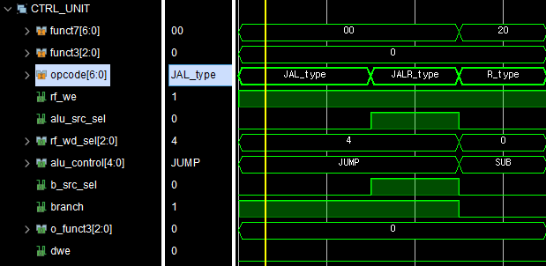
3. J-type
• simulation(Control Unit)
control_unit
OUTPUT | JAL_type | JALR_type
rf_we | 1
alu_src_sel | 0 | 1
rf_wd_sel | 4
alu_control | JUMP B_taken:1 ALU:ADD
[b_taken,ALU_ctrl]
b_src_sel | 0 | 1
branch | 1
o_funct3 | 0
dwe | 0
0
1
0
1

Slide 60
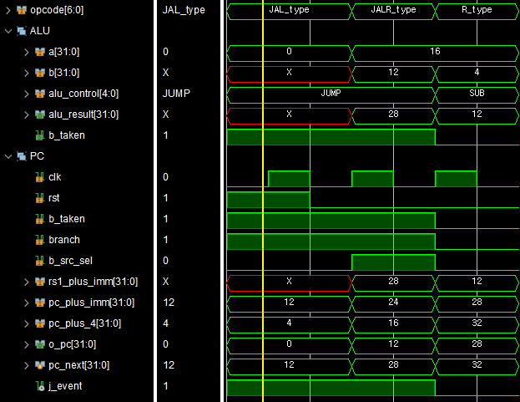
3. J-type
• simulation(ALU & PC)
PC
Case문 |  | OUTPUT
j_event | b_src_sel | (pc_next)
0 | x | PC + 4
1 | 0 | PC + imm
1 | 1 | rs1 + imm
b_taken = 1
0
1
INSTR MEM
PC | INSRT | registerFile | PC
0 | JAR | x1 = 4 | PC = 3*4
3 | JALR | x2 = 16 | PC = 7*4
7 | SUB | x3 = 12
Rs1 + imm
PC + imm
PC +4
현재PC
1
j_event= branch && b_taken

Slide 61
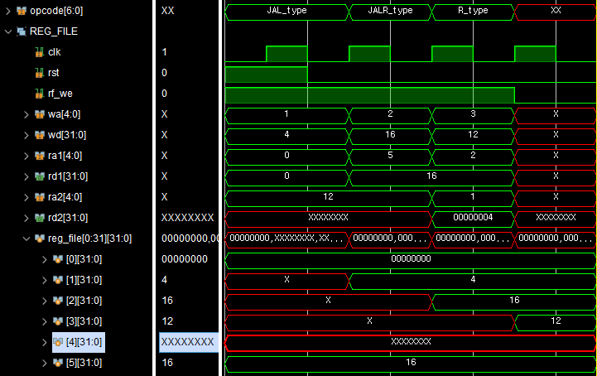
3. J-type
• simulation(Register File)
JAL
JALR
SUB
INSTR MEM
PC | INSRT | registerFile | PC
0 | JAR | x1 = 4 | PC = 3*4
3 | JALR | x2 = 16 | PC = 7*4
7 | SUB | x3 = 12

Slide 62
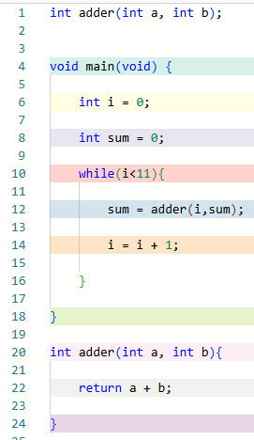
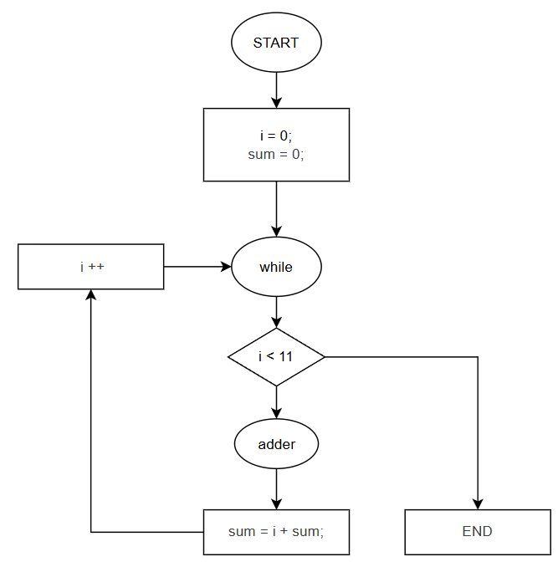
4. C to Assembler
• 누적 sum program

Slide 63
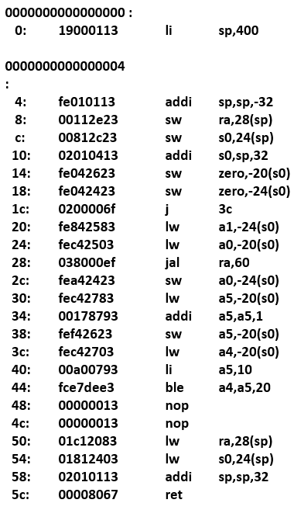
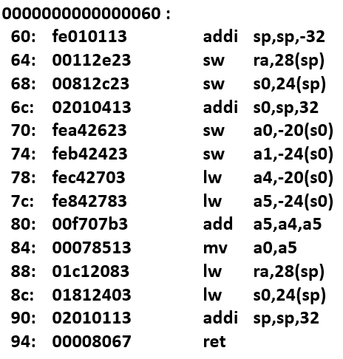
4. C to Assembler
start
➔
➔
➔
➔
while
➔
• 누적 sum program
전처리
함수
후처리
END
start
Adder 함수
함수 호출 전처리
함수 return 후처리
While문
End

Slide 64
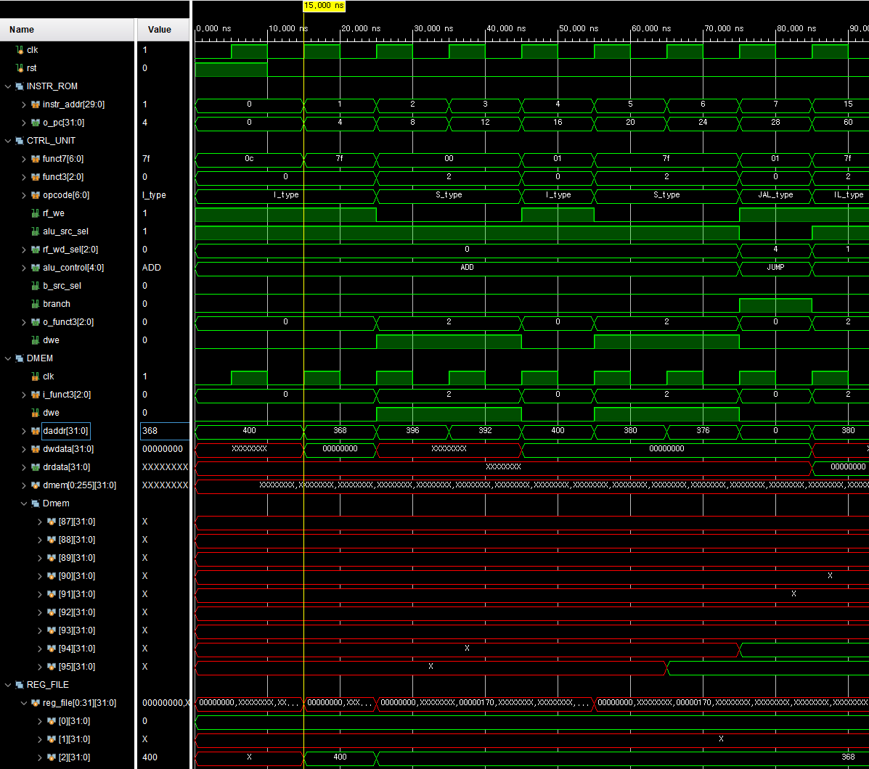
4. C to Assembler
• 누적 sum program
Li
addi
sw
sw
스택 포인터 Sp을 400주소로 지정
Sp을 -32까지 확보
함수가 끝난 뒤 return 주소 저장
현 함수를 호출하기 전 단계의 기준 S0주소 저장
8,C:
함수를 호출하지 않았기 때문에
SW 동작 의미 X
register file
addr | 목적 | value
x2 | SP | 400 -> 368
Data MEM
addr | value
X2 = 400
X2 = 400 - 32 = 368

Slide 65
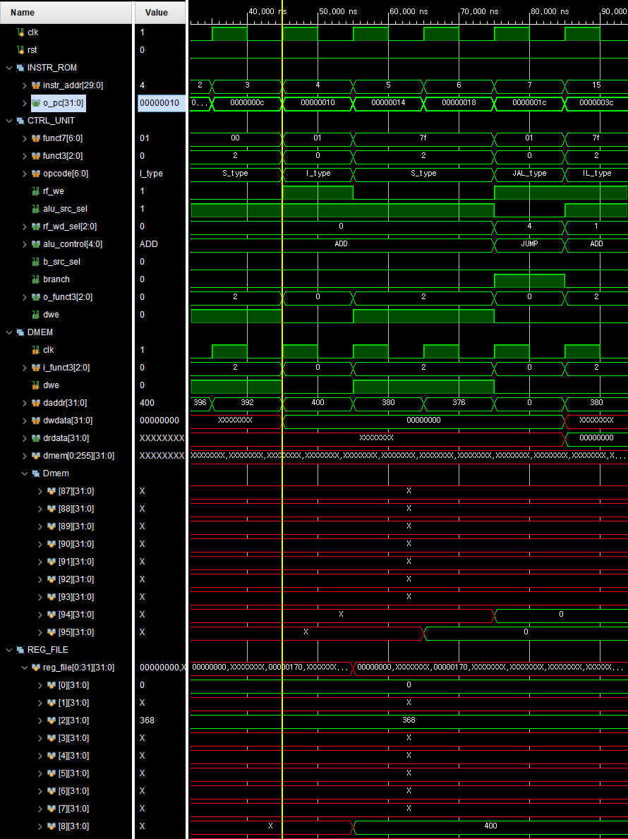
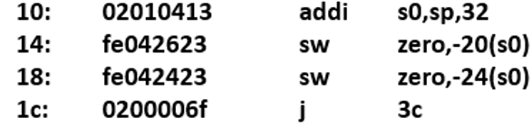
4. C to Assembler
S0을 400주소로 저장
addi
sw
sw
JAL
I = 0;
Sum = 0;
3C(while문)로 JUMP
[94] = I
[95] = SUM
register file
addr | 목적 | value
x8 | S0 | 400
x2 | SP | 368
Data MEM
addr | 목적 | value
95 | I | 0
94 | Sum | 0
X8 = S0

Slide 66
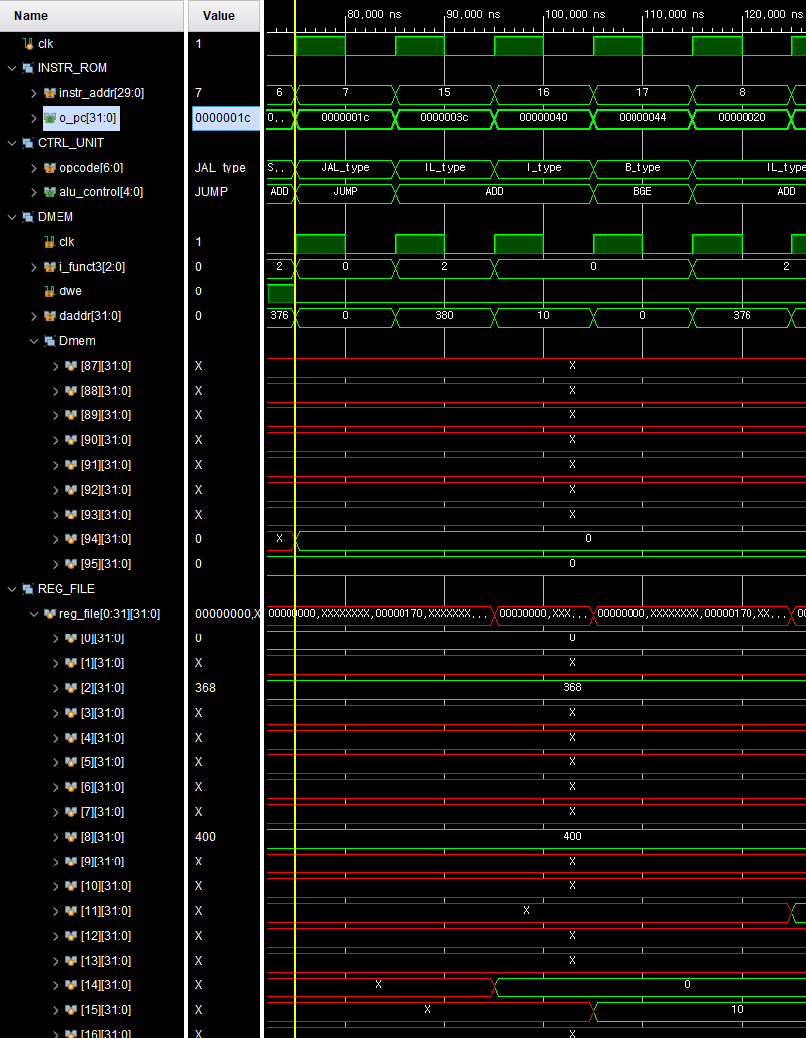
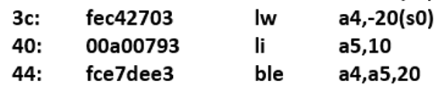
4. C to Assembler
Load I 값
LW
Li
BGE
비교값 10 저장
0<=10
If(i <= 10), JUMP 20
register file
addr | 목적 | value
x15 | 비교값 | 10
x14 | I | 0
x8 | S0 | 400
x2 | SP | 368
Data MEM
addr | 목적 | value
95 | I | 0
94 | Sum | 0
X14 = 0
X15 = 10

Slide 67
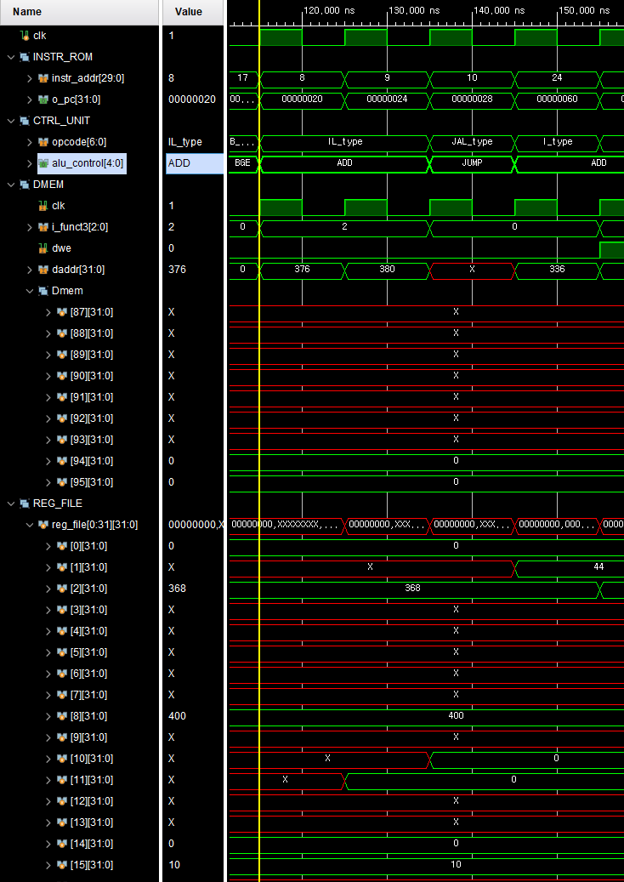
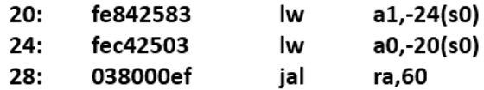

4. C to Assembler
Load SUM
LW
LW
JAL
Load I
JUMP 60
Adder 함수 호출 및
Retrun 주소 저장
44 = while 조건문
X1 = return 주소 저장
register file
addr | 목적 | value
x15 | 비교값 | 10
x14 | I | 0
X11 | SUM | 0
X10 | I | I
x8 | S0 | 400
x2 | SP | 368
X1 | While문주소 | 44
Data MEM
addr | 목적 | value
95 | I | 0
94 | Sum | 0
X11 = SUM
X10 = I

Slide 68
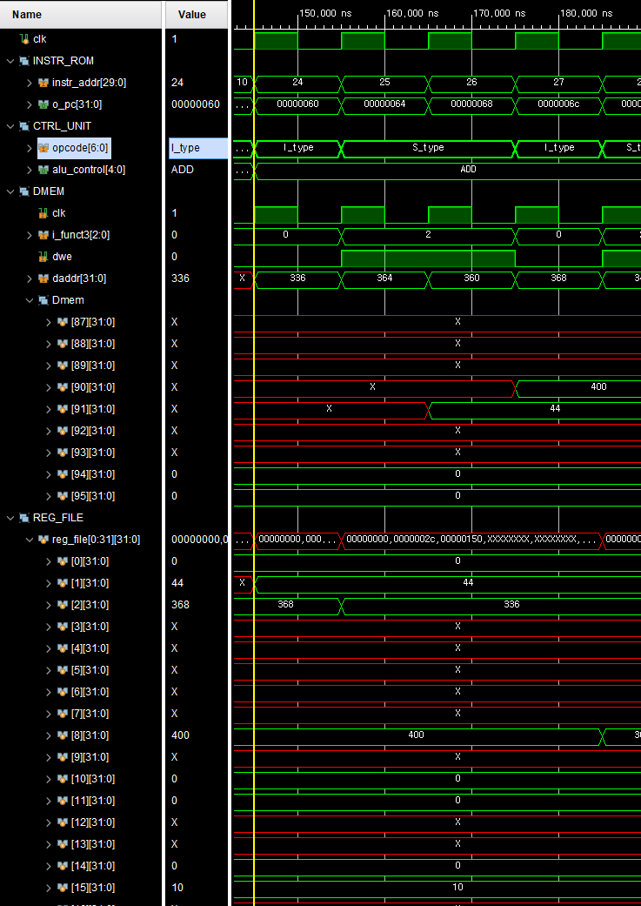
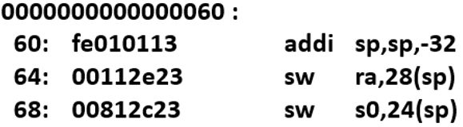
4. C to Assembler
스택 공간 추가 확보
addi
SW
SW
함수 끝나면 돌아갈 주소 저장
[91] = while 주소
[90]= MainS0
mine S0 값 저장
X2 = SP
register file
addr | 목적 | value
x15 | 비교값 | 10
x14 | I | 0
X11 | SUM | 0
X10 | I | I
x8 | S0 | 400
x2 | SP | 336
X1 | While문주소 | 44
Data MEM
addr | 목적 | value
95 | I | 0
94 | Sum | 0
91 | Return주소 | 44
90 | Main S0 | 400

Slide 69
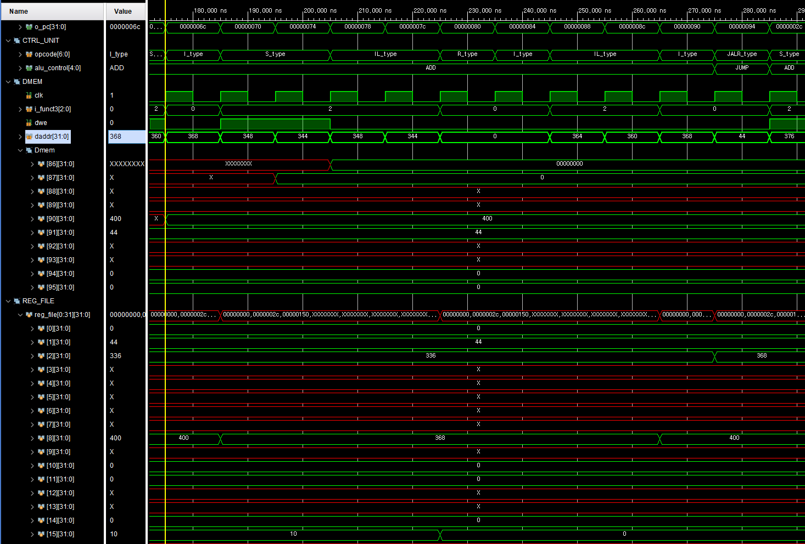

4. C to Assembler
S0 이동
addi
SW
SW
LW
LW
ADD
A 인자 저장
B 인자 저장
A 인자 Load
B 인자 Load
A + B
[87] = A
[86] = B
A + B
register file
addr | 목적 | value
x15 | A+B | 0
x14 | A인자 | 0
X11 | SUM | 0
X10 | I | I
x8 | S0 | 368
x2 | SP | 336
X1 | While문주소 | 44
Data MEM
addr | 목적 | value
95 | I | 0
94 | Sum | 0
91 | Return주소 | 44
90 | Main S0 | 400
87 | A인자 | 0
86 | B인자 | 0
x14 = A
x15 = B

Slide 70


4. C to Assembler
A + B을 x10으로이동
addi
LW
LW
addi
JALR
Return 주소 Load
함수 S0,SP
반납
SP 336➔ 368
Return
(adder 함수 끝)
X1 = return 주소
register file
addr | 목적 | value
x15 | A+B | 0
x14 | A인자 | 0
X11 | SUM | 0
X10 | A+B | 0
x8 | S0 | 400
x2 | SP | 368
X1 | While문주소 | 44
Data MEM
addr | 목적 | value
95 | I | 0
94 | Sum | 0
91 | Return주소 | 44
90 | Main S0 | 400
87 | A인자 | 0
86 | B인자 | 0
S0 368➔ 400
x10=A + B

Slide 71


4. C to Assembler
A +B 저장
i을 Load
SW
LW
ADDI
SW
LW
Li
BGE
i++
i을 저장
X10 =A + B
X15 = i
i을 Load
i을 Load
If(i<= 10), 20이동
(1 <= 10)
register file
addr | 목적 | value
x15 | i | 1
x14 | i | 1
X11 | SUM | 0
X10 | A+B | 0
x8 | S0 | 400
x2 | SP | 368
X1 | While문주소 | 44
Data MEM
addr | 목적 | value
95 | I | 0
94 | Sum | 0
91 | Return주소 | 44
90 | Main S0 | 400
87 | A인자 | 0
86 | B인자 | 0
[95] = i
x14 = i
x14 = i
i++

Slide 72


4. C to Assembler
SKIP
NOP
lw
lw
addi
end
복귀할 주소 Load
Main : 없음
S0 반납
Sp 반납
end
register file
addr | 목적 | value
x15 | i | 10
x14 | i | 11
X11 | SUM | 45
X10 | A+B | 55
x8 | S0 | xx
x2 | SP | Xx
X1 | While문주소 | xx
Data MEM
addr | 목적 | value
95 | I | 11
94 | Sum | 55
91 | Return주소 | 44
90 | Main S0 | 400
87 | A인자 | 10
86 | B인자 | 45

Slide 73

4. C to Assembler
SUM = 55
I = 11
register file
addr | 목적 | value
x15 | i | 10
x14 | i | 11
X11 | SUM | 45
X10 | A+B | 55
x8 | S0 | xx
x2 | SP | Xx
X1 | While문주소 | xx
Data MEM
addr | 목적 | value
95 | I | 11
94 | Sum | 55
91 | Return주소 | 44
90 | Main S0 | 400
87 | A인자 | 10
86 | B인자 | 45

Slide 74
5. Trouble shooting
• 힘든 점:
누적 sum program을 분석하는 과정에서 전체적인 Assembler Code구조에 이해가 힘듦을 느낌
(Register와 data memory을 쓰임새, 함수 호출 시 새로운 스택을 사용)
• 해결방안:
Data Flow을 분석을 여러 차례 분석을 진행한 결과 규칙적인 쓰임새가 보이기 시작함
규칙성을 바탕으로 위의 문제점을 해결함

