Slide 1



FIFO Simulate Scenario
01
02
03
randomize
Only Push/Only Pop
randomize
Push + Pop at the same time
randomize
Push/pop 1000 cycle

Slide 2
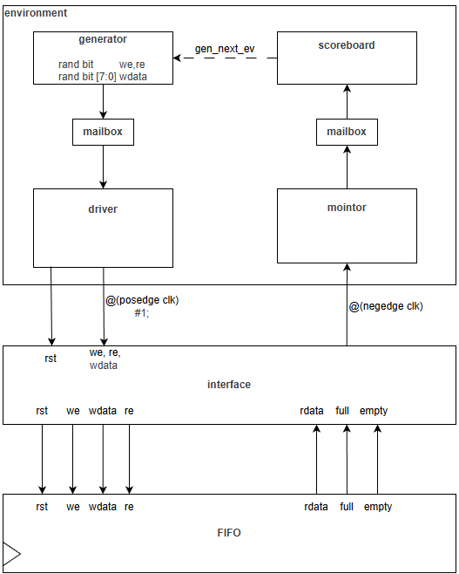
FIFO Verification
Type | name
Rand bit | we
Rand bit | re
Rand bit | wdata
Logic | rdata
bit | full
bit | empty

Slide 3
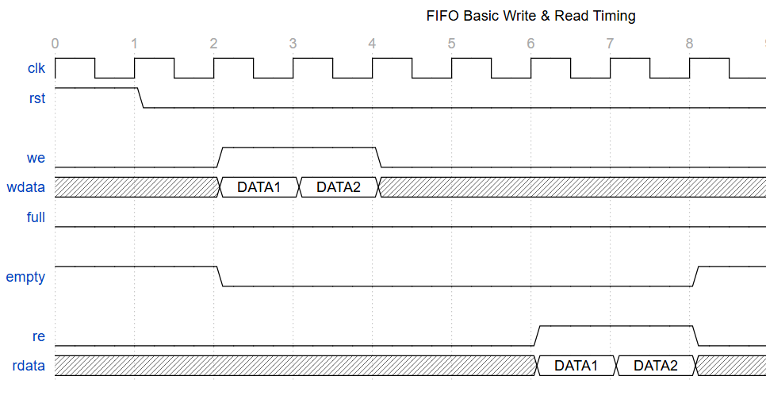
FIFO Verification
driver
monitor

Slide 4
FIFO Verification
wdata
rdata
We && !full
Q list
First input data
T/F
Re && !empty

Slide 5
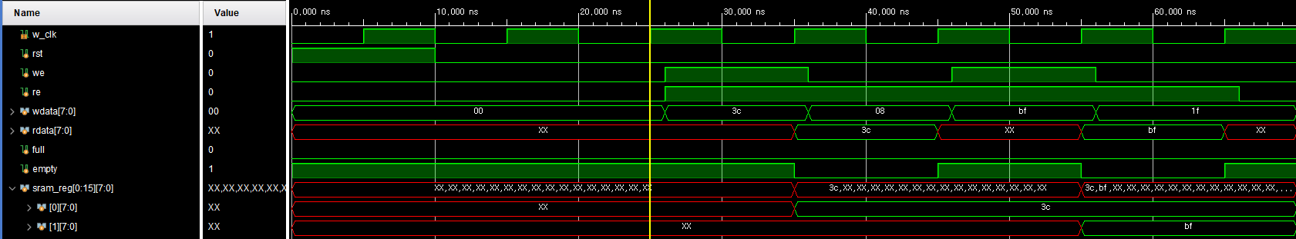
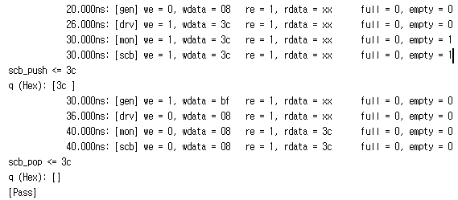
FIFO Verification
- Verification

Slide 6
FIFO Verification
- Verification

Slide 7
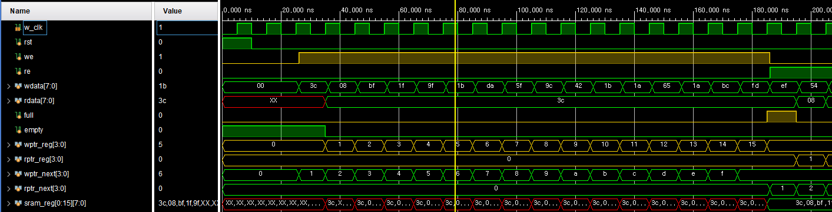
FIFO Verification
- Verification(16번 we)
we -> empty = 0
We -> (wptr_next == rptr_reg) -> full = 1
Re -> full = 0

Slide 8
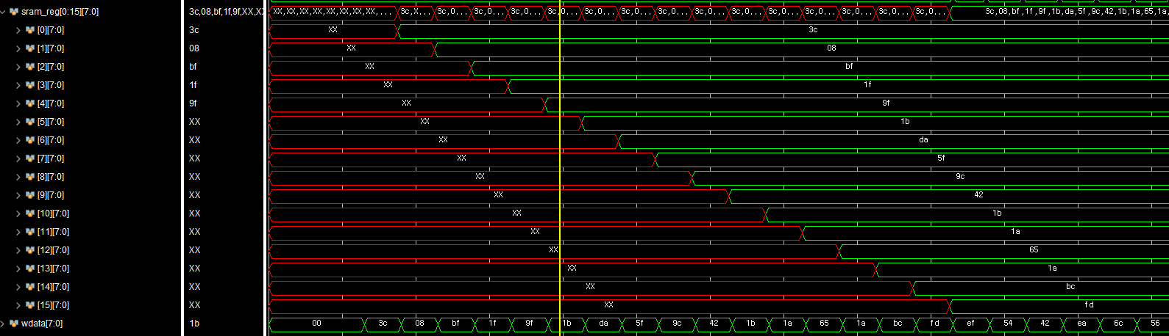
FIFO Verification
- Verification(16번 we)

Slide 9
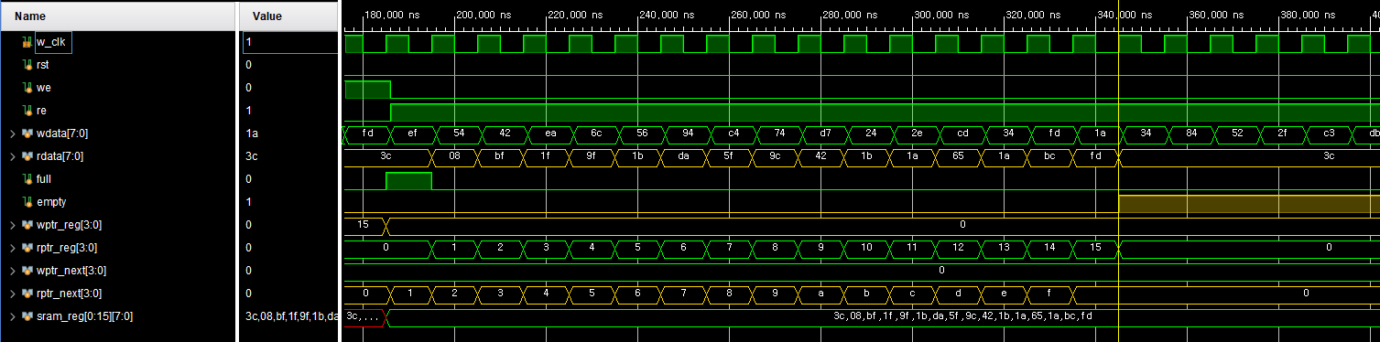
FIFO Verification
- Verification(16번 re)
Re -> (wptr_reg == rptr_next) -> empty = 1

Slide 10
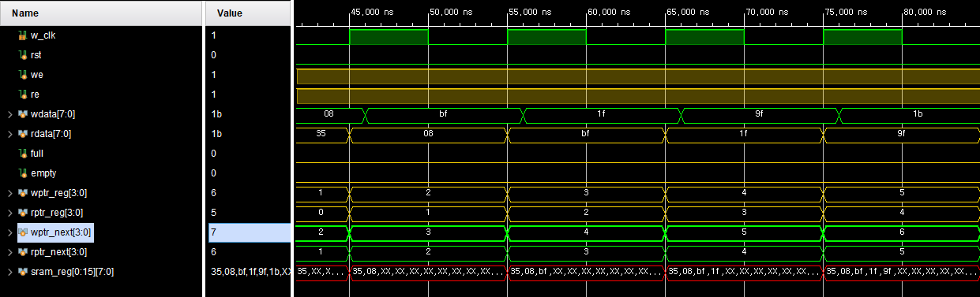
FIFO Verification
- Verification(동시 we= 1, re = 1)
we = 1, re = 1 -> wptr_reg++, rptr_reg++;

Slide 11
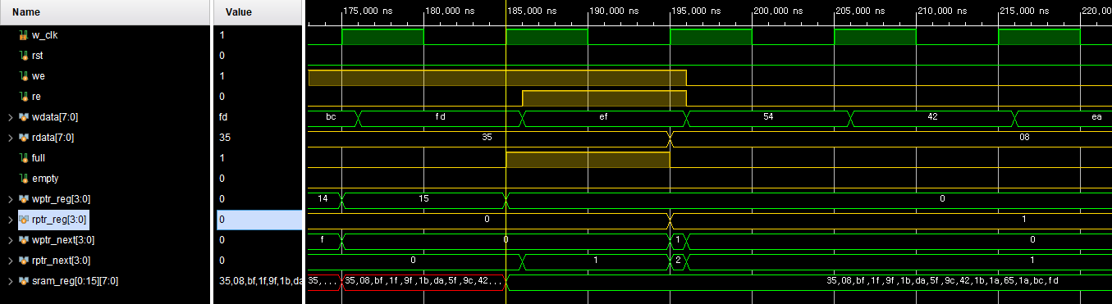
FIFO Verification
- Verification(동시 we= 1, re = 1)
full == 1 상황:
we = 1, re = 1 -> full = 0, rptr_reg++;

Slide 12
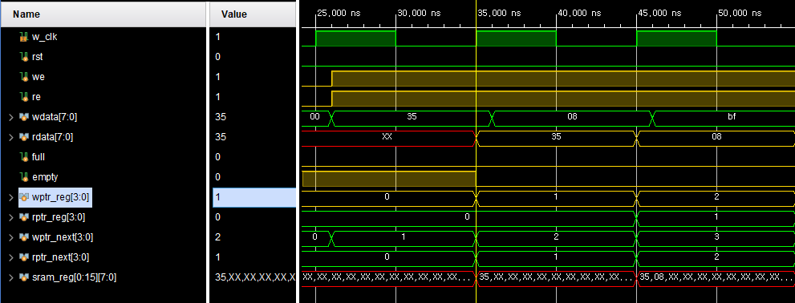
FIFO Verification
- Verification(동시 we= 1, re = 1)
empty == 1 상황:
we = 1, re = 1 -> empty = 0, wptr_reg++;

Slide 13
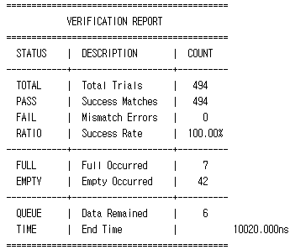
FIFO Verification
- Verification(random 1000 cycle)

Slide 14
RX + FIFO Simulate Scenario
01
02
03
randomize
Run 1 cycle
Check Rx + FIFO data Flow
randomize
Run 1000 cycle
randomize
Baud delay rate Allowable range

Slide 15
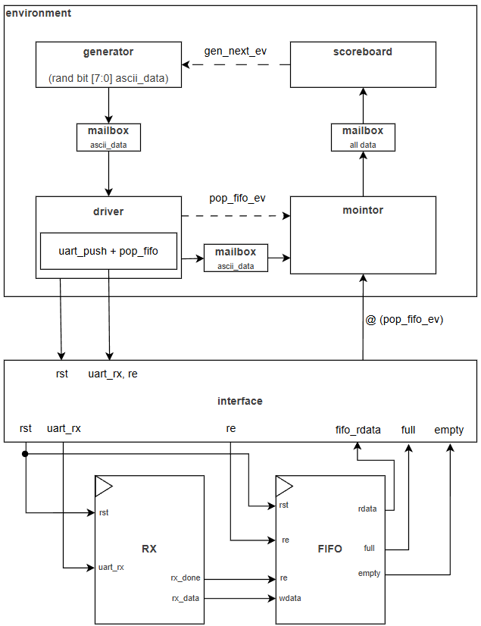
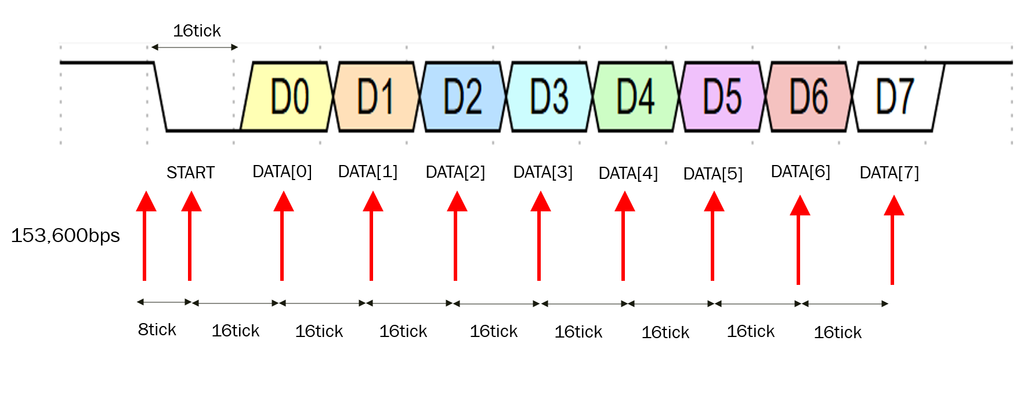
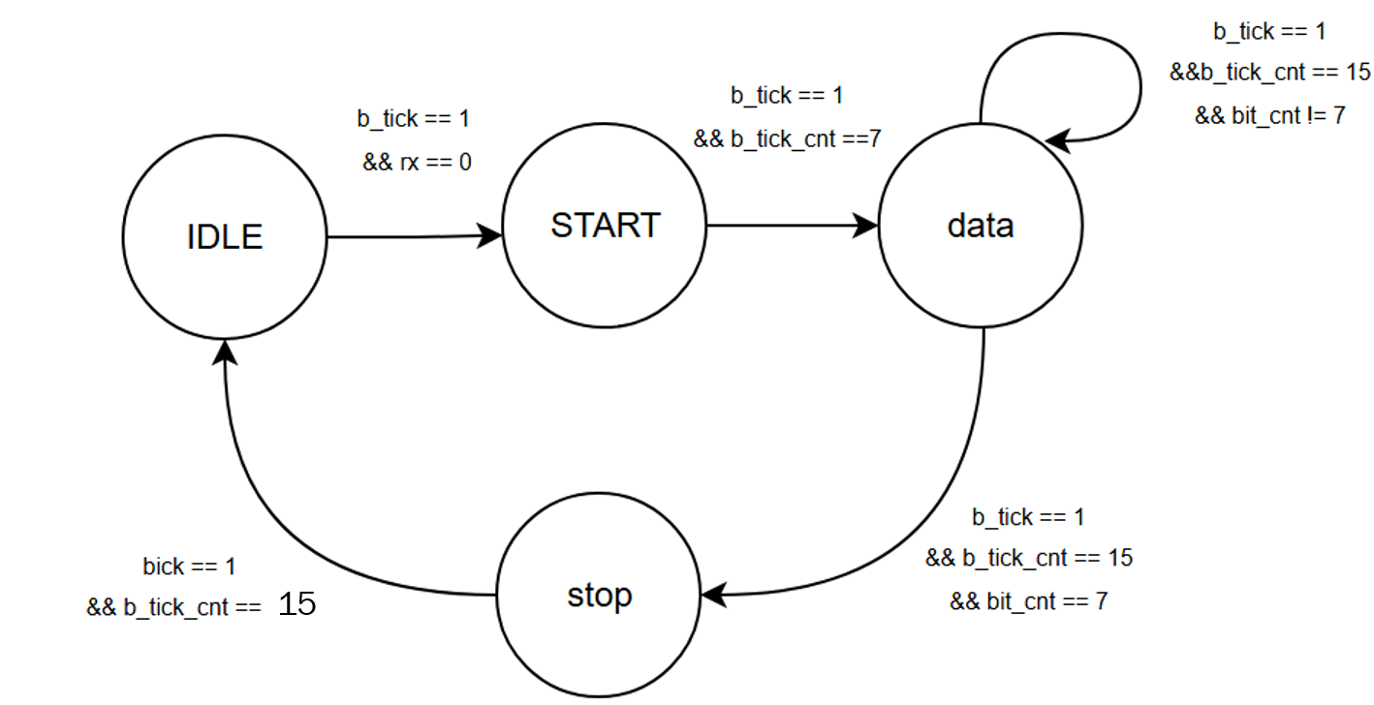
RX + FIFO Verification

Slide 16
RX + FIFO Verification
c
Type | name
Randc bit | ascii_data
bit | re
logic | Fifo_data
bit | full
Bit | empty

Slide 17
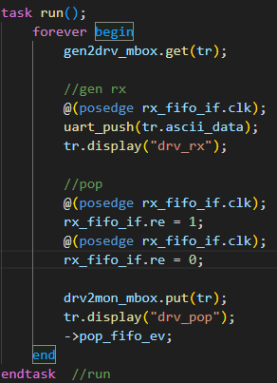
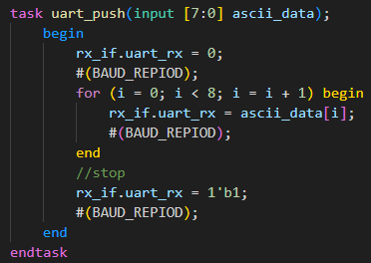
RX + FIFO Verification
BAUD_REPIOD = (100MHz / 9600bpm)*10

Slide 18
RX + FIFO Verification
c
Ascii data + Interface I/O
@(pop_fifo_ev)
mailbox
Scoreboard
ASCII DATA == tr.rx_data

Slide 19
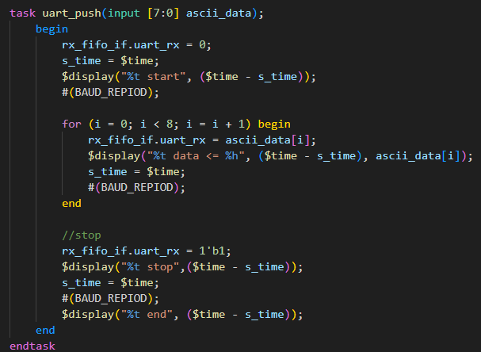
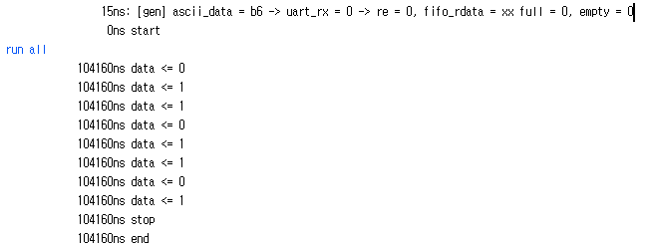
RX + FIFO Verification
- Verification(check gen RX)
BAUD_REPIOD = (100MHz / 9600bpm)*10 = 104160

Slide 20
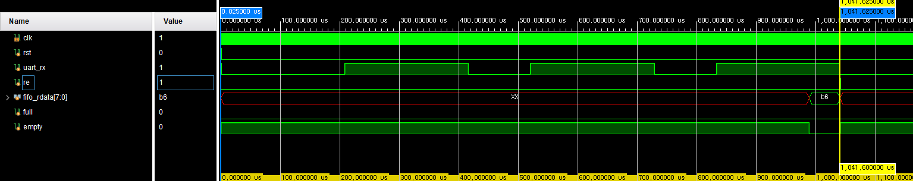
RX + FIFO Verification
- Verification(check gen RX)
Rx = 10bit * 104160 = 1041600ns = 1041.6us

Slide 21
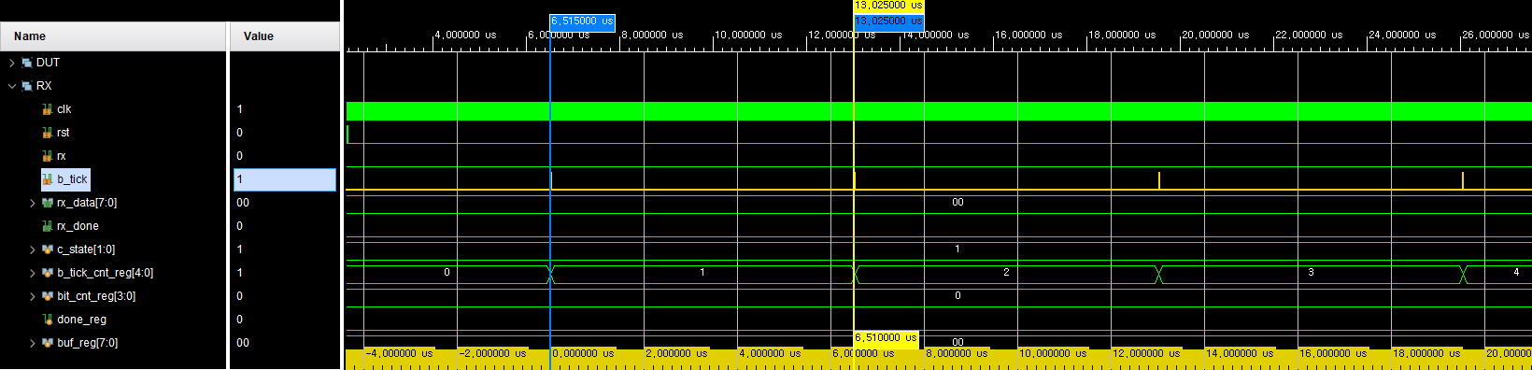
RX + FIFO Verification
- Verification(module RX)
B_tick = 100Mhz / (9600bps * 16배)= 6.51us

Slide 22
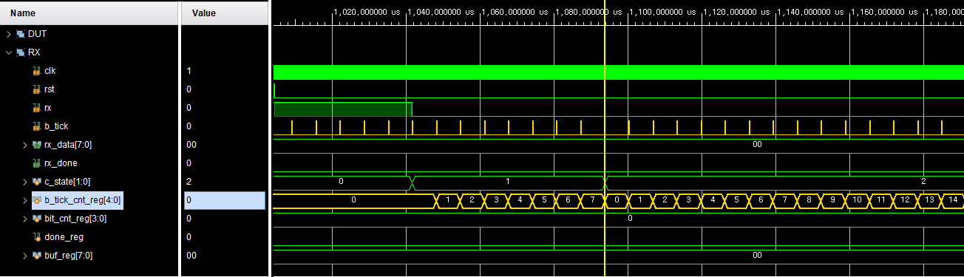
RX + FIFO Verification
- Verification(module RX) input(8’hB6)
START
DATA

Slide 23
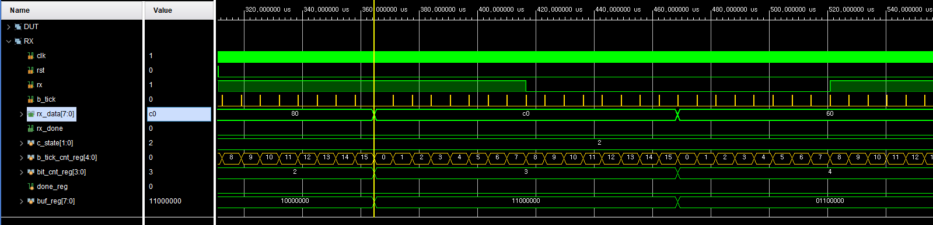
RX + FIFO Verification
- Verification(module RX) input(8’hB6)
B_tick_cnt 15마다 buf_reg의 MSB에 반영 및 shift 발생

Slide 24
RX + FIFO Verification
- Verification(module RX) input(8’hB6)
B_tick_cnt 15마다 buf_reg의 MSB에 반영 및 shift 발생

Slide 25
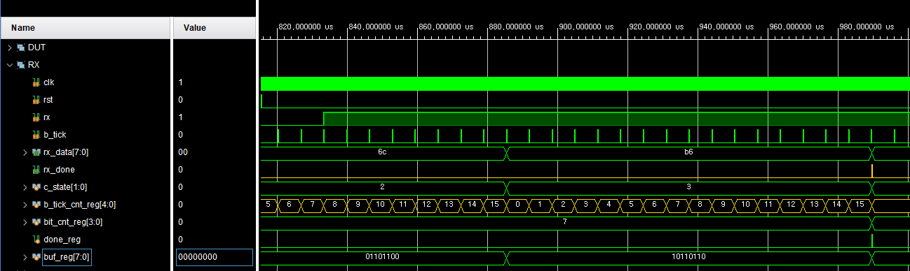
RX + FIFO Verification
- Verification(module RX) input(8’hB6)
(Rx_done == 1) ➔ Rx_data = 8’b6

Slide 26
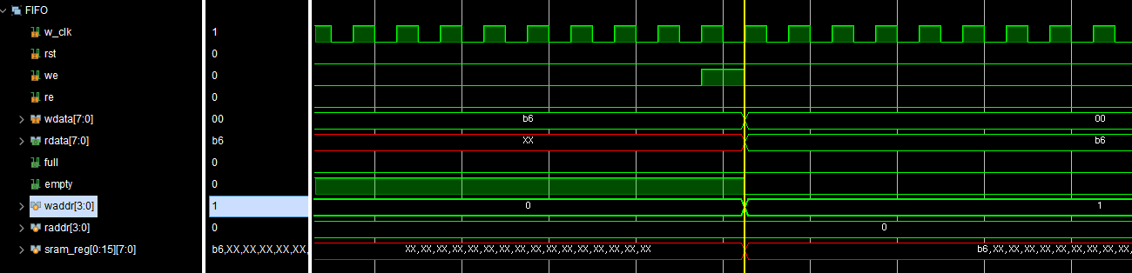
RX + FIFO Verification
- Verification(RX ➔ FIFO) input(8’hB6)

Slide 27
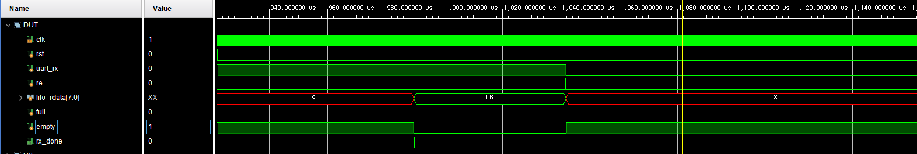
RX + FIFO Verification
- Verification(RX ➔ FIFO) input(8’hB6)
Rx_done은 uart_rx신호를 다 보내기 전에 발생

Slide 28
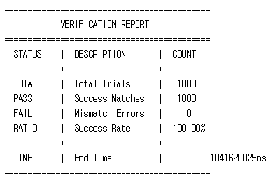
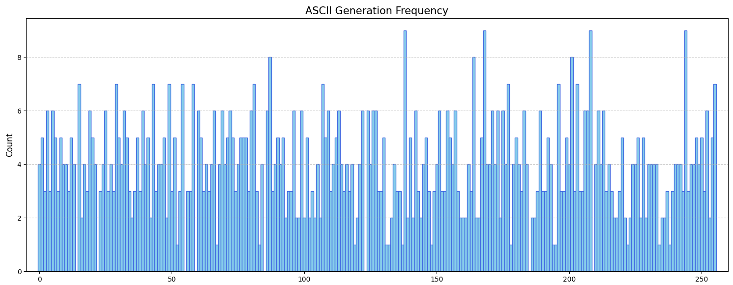
RX + FIFO Verification
- Verification(random 1000 clcye)
rx_data 검증 data : 14,22,55,59,85,123,185,209제외된 0~255 data

Slide 29
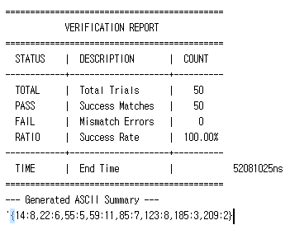

RX + FIFO Verification
- Verification(missing cases 50 clcye)
rx_data 추가 검증 data : 14,22,55,59,85,123,185,209

Slide 30
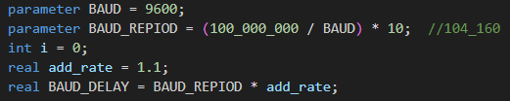
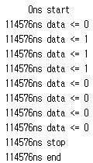
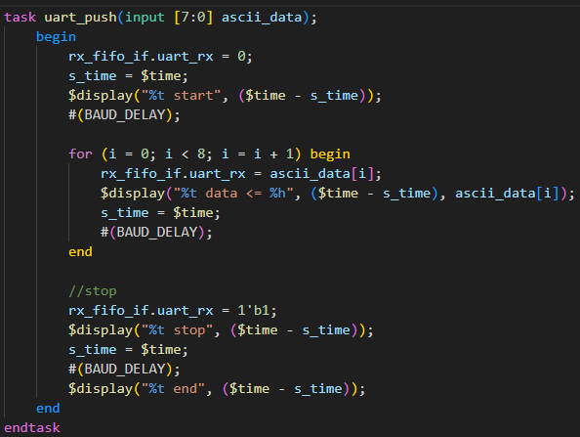
RX + FIFO Verification
- Verification(baud delay rate)

Slide 31
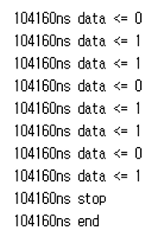
RX + FIFO Verification
- Verification(baud delay rate)
Add_rate = 1.0
Add_rate = 1.1

Slide 32
RX + FIFO Verification
- Verification(baud delay rate)
rate | 1.1 | 1.07 | 1.06 | 1.05 | 1.04 | 1.02 | 1.0 | 0.98 | 0.95 | 0.94 | 0.93
Total | 50 | 50 | 50 | 50 | 50 | 50 | 50 | 50 | 50 | 50 | 50
Pass | - | - | - | 50 | 50 | 50 | 50 | 50 | 50 | - | -
fail | 50 | 50 | 50 | - | - | - | - | - | - | 50 | 50
Use Rx_delay rate = 95% ~105%

Slide 33
TX + FIFO Simulate Scenario
01
02
randomize
Run 1 cycle
Check Tx + FIFO data Flow
randomize
Run 1000 cycle

Slide 34
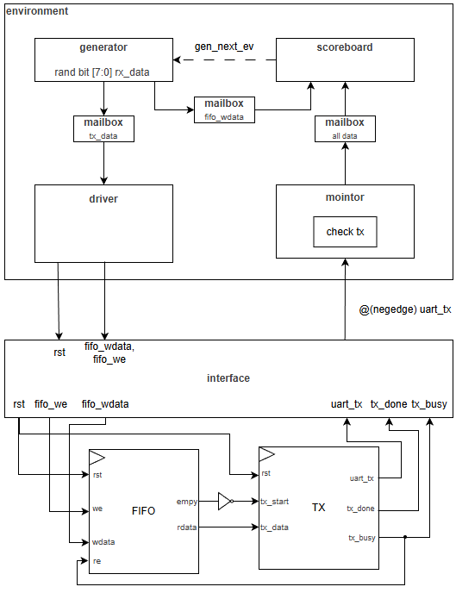
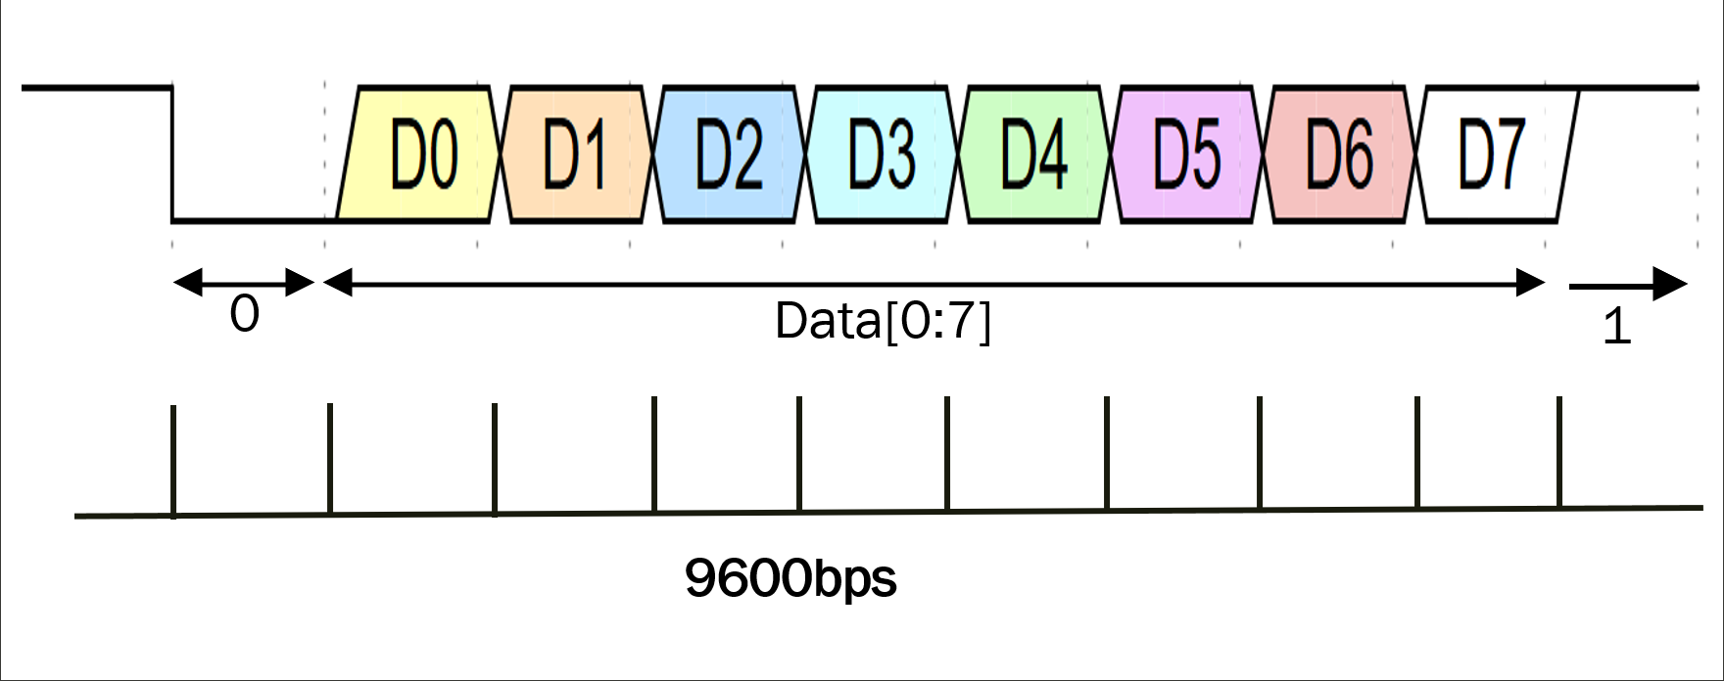
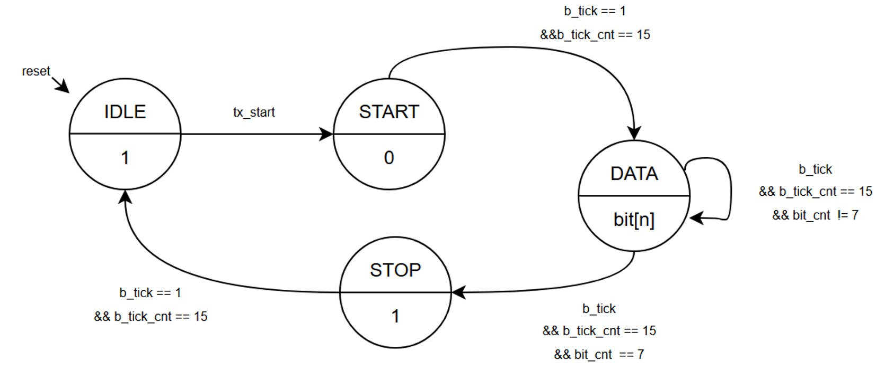
TX + FIFO Verification

Slide 35
TX + FIFO Verification
c
Type | name
bit | Fifo_we
Randc bit | Fifo_wdata
bit | Tx_busy
bit | Tx_done
bit | Uart_Tx
bit | PC_data

Slide 36
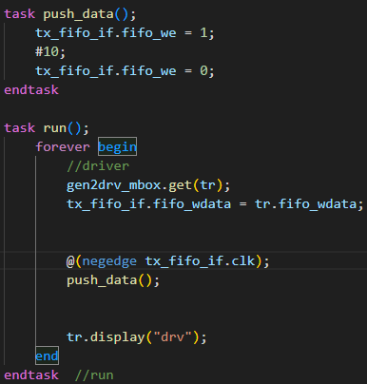
TX + FIFO Verification
c

Slide 37
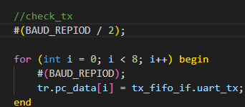
TX + FIFO Verification
c
BAUD/2 + BAUD
BAUD
BAUD
BAUD
BAUD
BAUD
BAUD
BAUD
BAUD * 8cycle

Slide 38
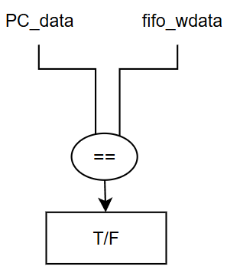
TX + FIFO Verification
c

Slide 39
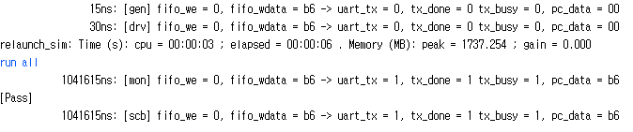
TX + FIFO Verification
- Verification(TX) input(8’hB6)
Generate wdata
Tx_read data

Slide 40
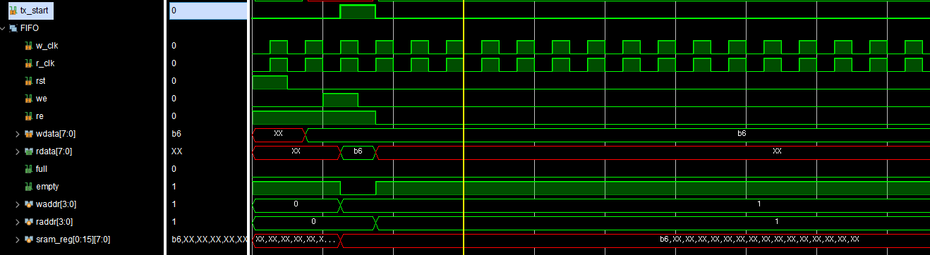
TX + FIFO Verification
- Verification(FIFO ➔ TX) input(8’hB6)
We==1 Re==1 ➔ rdata = b6,empty = 0 ➔ tx_start = 1

Slide 41
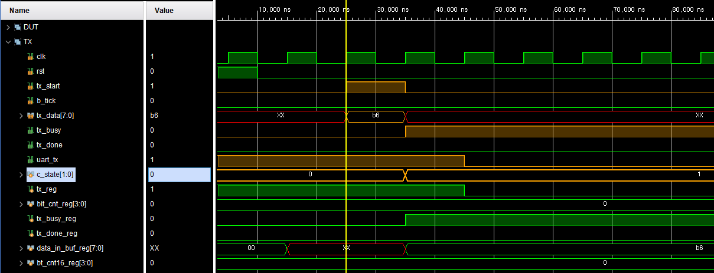
TX + FIFO Verification
- Verification(TX) input(8’hB6)
Uart_tx = 0
Save tx_data

Slide 42
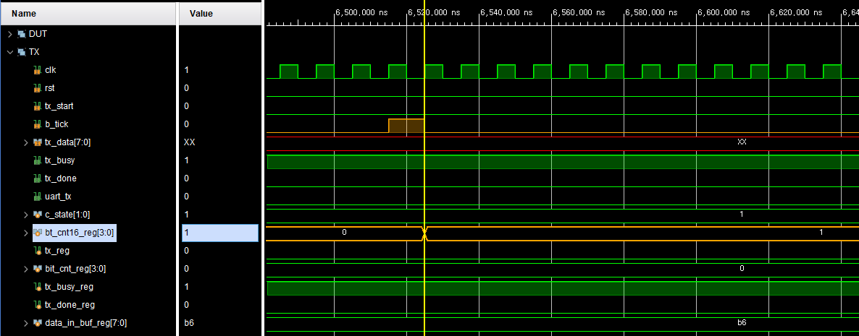
TX + FIFO Verification
- Verification(TX) input(8’hB6)
B_tick 발생 ➔ bt_cnt16_reg ++

Slide 43
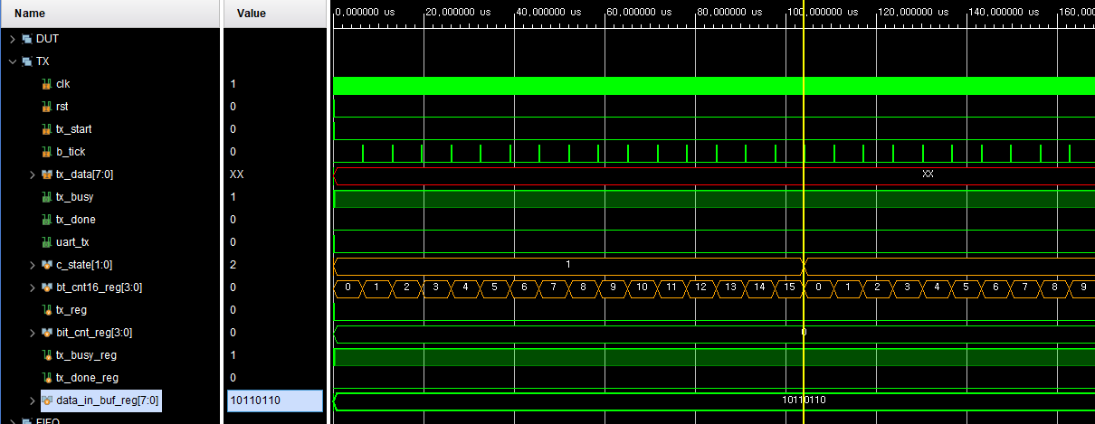
TX + FIFO Verification
- Verification(TX) input(8’hB6)
START
DATA

Slide 44
TX + FIFO Verification
- Verification(TX) input(8’hB6)
START
DATA

Slide 45
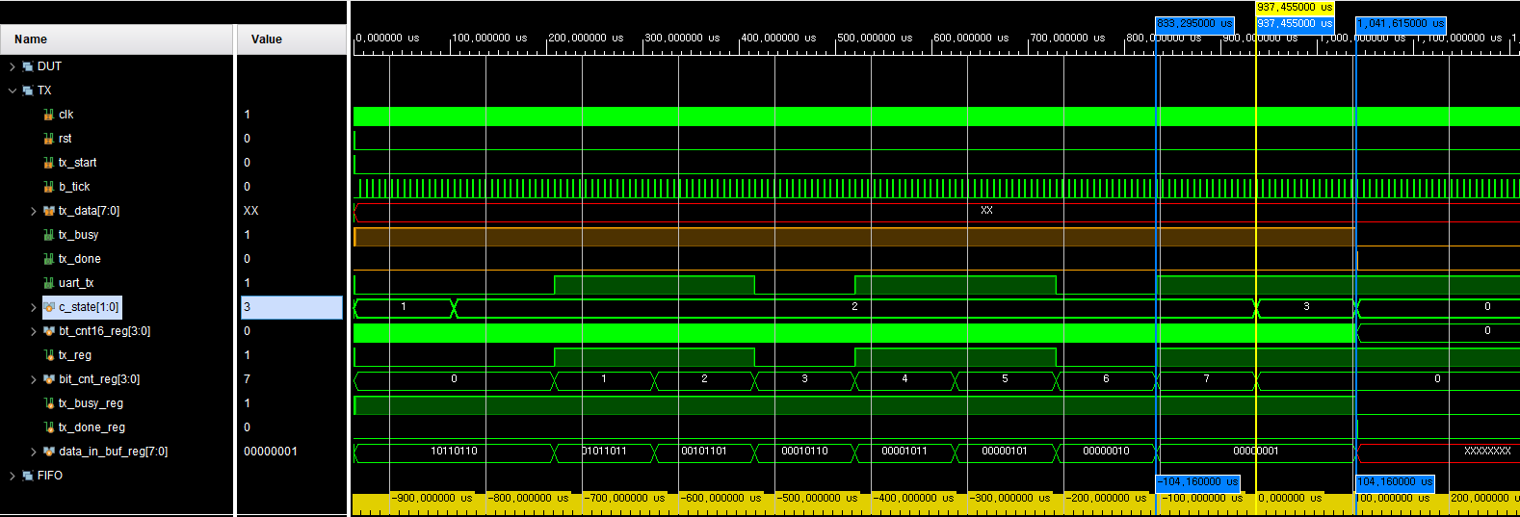
TX + FIFO Verification
- Verification(TX) input(8’hB6)
START
DATA
STOP
DATA bit별 send time = 104.16us
STOP bt send time = 104.16us

Slide 46
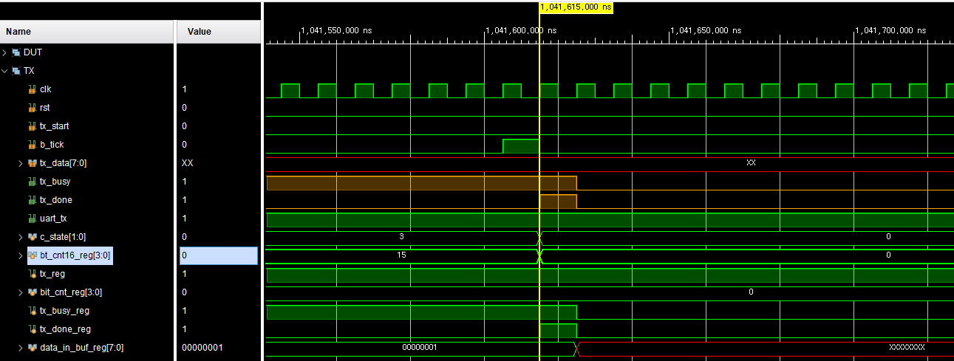
TX + FIFO Verification
- Verification(TX) input(8’hB6)
STOP
IDLE
(STOP -> IDLE) ➔ done 1 tick 발생 및 busy = 0

Slide 47
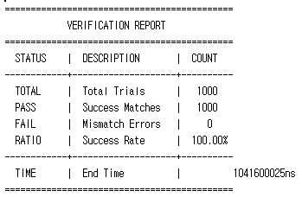
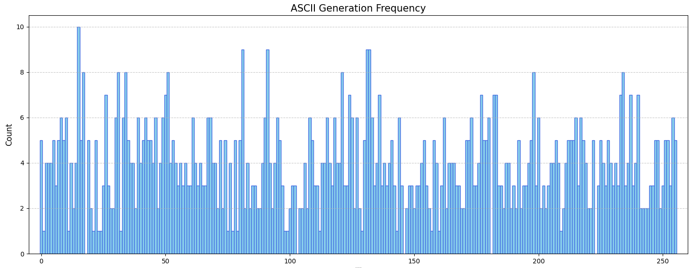
TX + FIFO Verification
- Verification(random 1000 cycle)

Slide 48
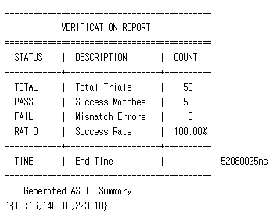
TX + FIFO Verification
- Verification(random 1000 cycle)
rx_data 검증 data : 18,246,223

Slide 49
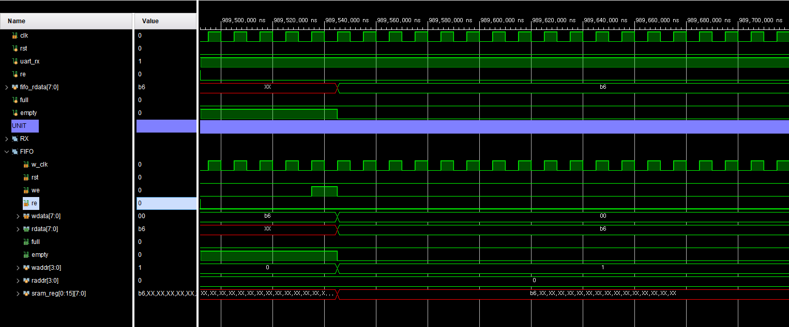
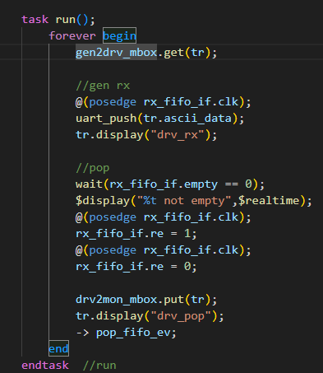
Troubleshooting
RX + FIFO (uart_push 후 FIFO rdata를 read 해야할 상황)
문제: Empty == 0 일때, pop 수행하려 시도 하였지만 re 발생 하지 않음
원인: uart_push와 wait 타이밍의 문제
해결: wait 동작을 거치지 않고 uart_push task가 끝나면 read 진행

