Slide 1
Team Bravo
Project 1
Junchi Tian
Bixuan Huang

Slide 2
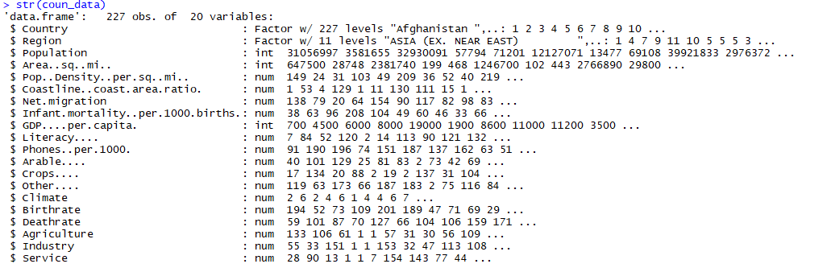
QUESTION： Will the net migration be influenced by GDP? Data resource: Kaggle/ Us government Data:227 countries’ names, population, Gdp and more.

Slide 3
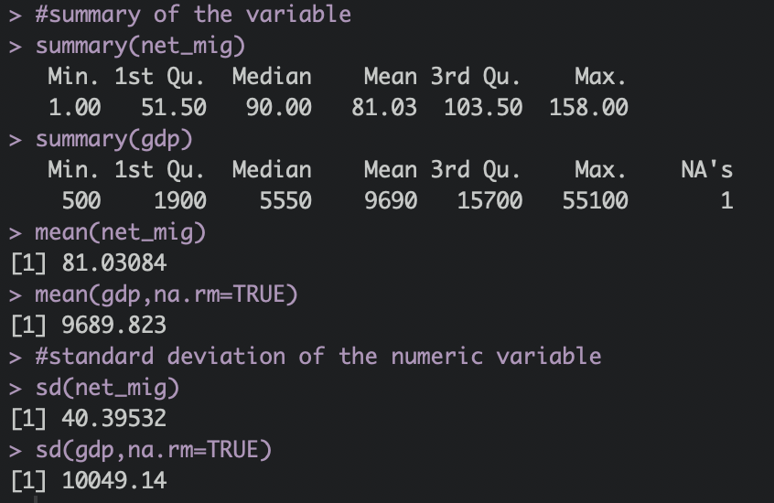
QUESTION： Will the net migration be influenced by GDP?
Null hypothesis: There is no statistical relationship between net migration and GDP.
Alternative hypothesis: There is statistical relationship between net migration and GDP.
Summary of the variables

Slide 4
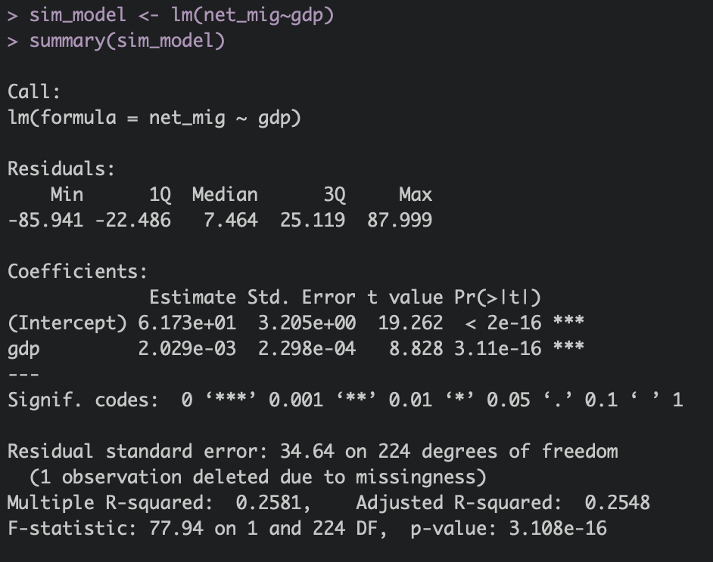
simple linear regression： Will the net migration be influenced by GDP PER capita?
Answer: we reject the null hypothesis and there is statistics relationship between net migration and GDP.
25.48% of the net migration can be explained by gdp per capita.
The percentage error is (any prediction would still be off by) 34.63/157*100% = 22.05%.
Notes:
25.48% of the net migration can be explained by gdp per capita.
The actual net migration can deviate from the regression line by approximately 34.64, on average. In other words, given that the range net migration is 157 and that the Residual Standard Error is 34.63, we can say that the percentage error is (any prediction would still be off by) 34.63/157*100% = 22.05%. It’s also worth noting that the Residual Standard Error was calculated with 224 degrees of freedom.

Slide 5
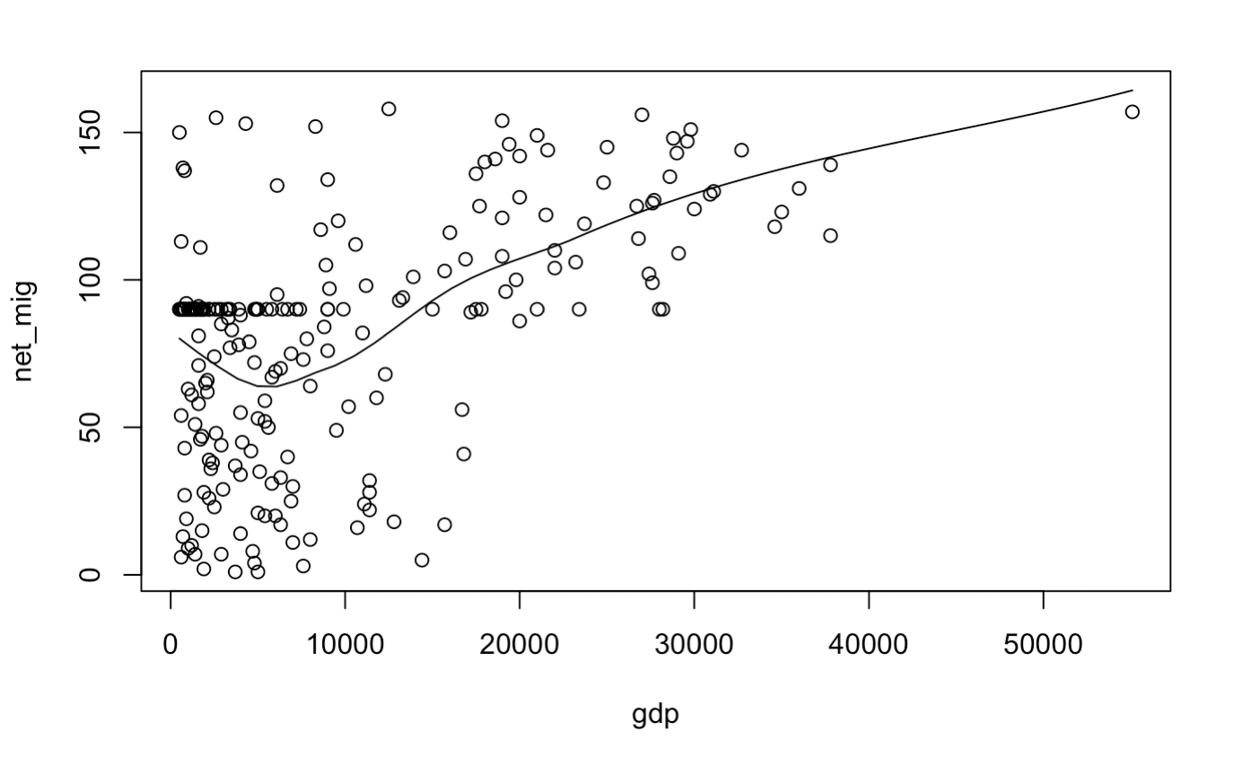

simple linear regression
Notes:
The skewness is less than zero, so the dispersion on the left side of the x-mean is stronger than the right side.

Slide 6

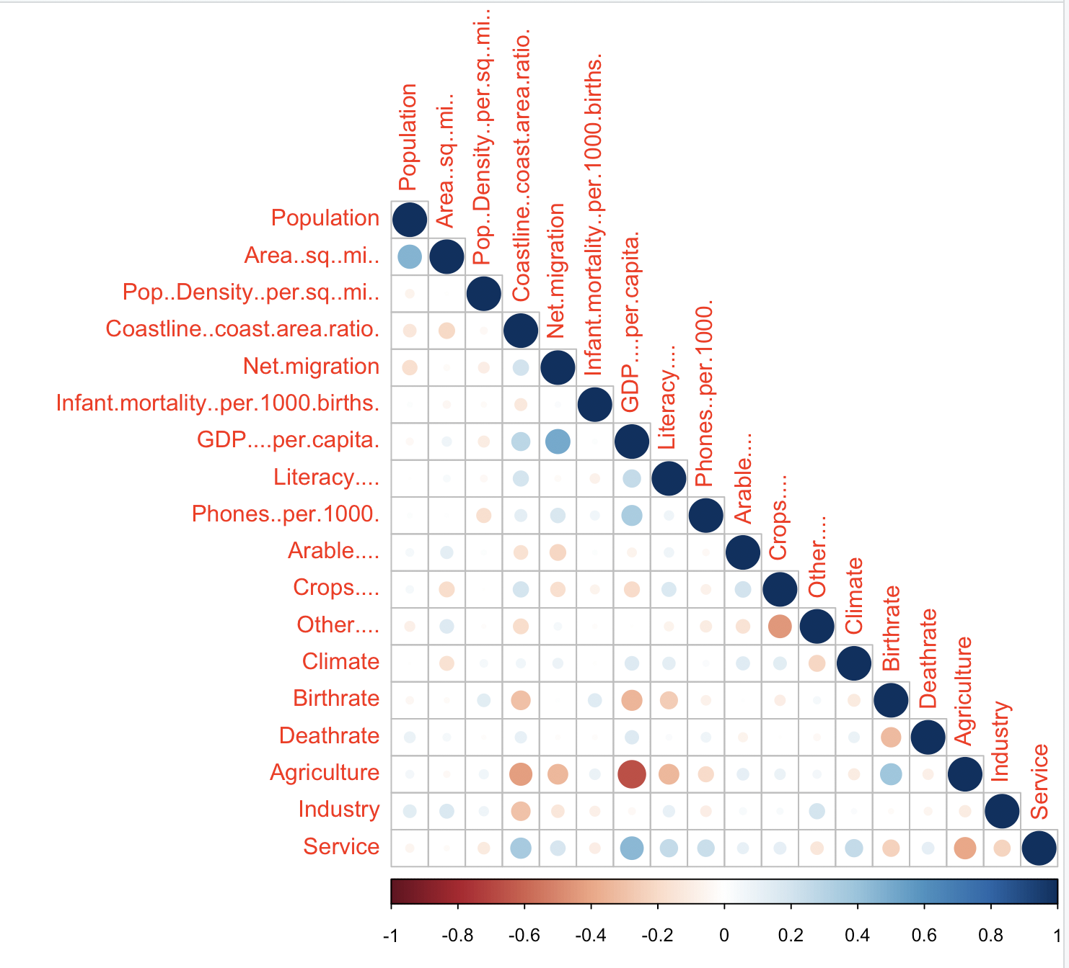
Correlation between the variables

Slide 7
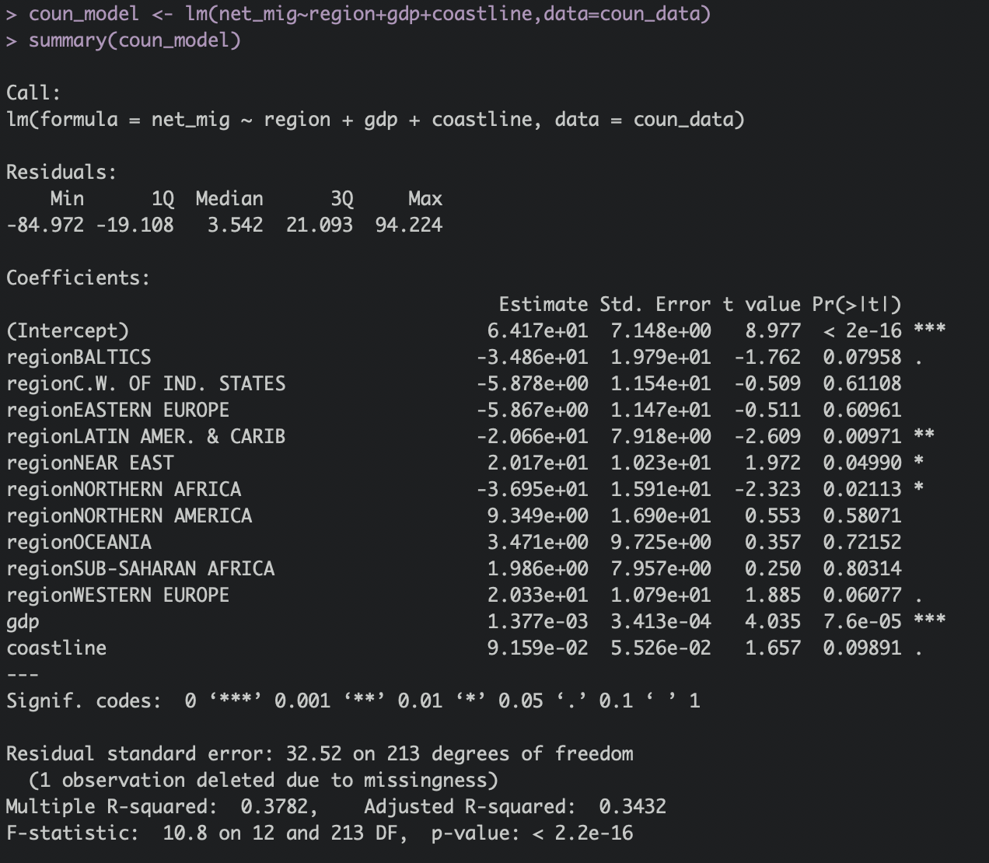
Multiple Linear Regression: Will the net migration be influenced by more factors?
34.32% of the net migration can be explained by the independent variables.
The percentage error is (any prediction would still be off by) 32.52/157*100% = 20.71%.
The LATIN AMER & CARIB, NEAR EAST, and NORTHERN AFRICA are more significant.

Slide 8

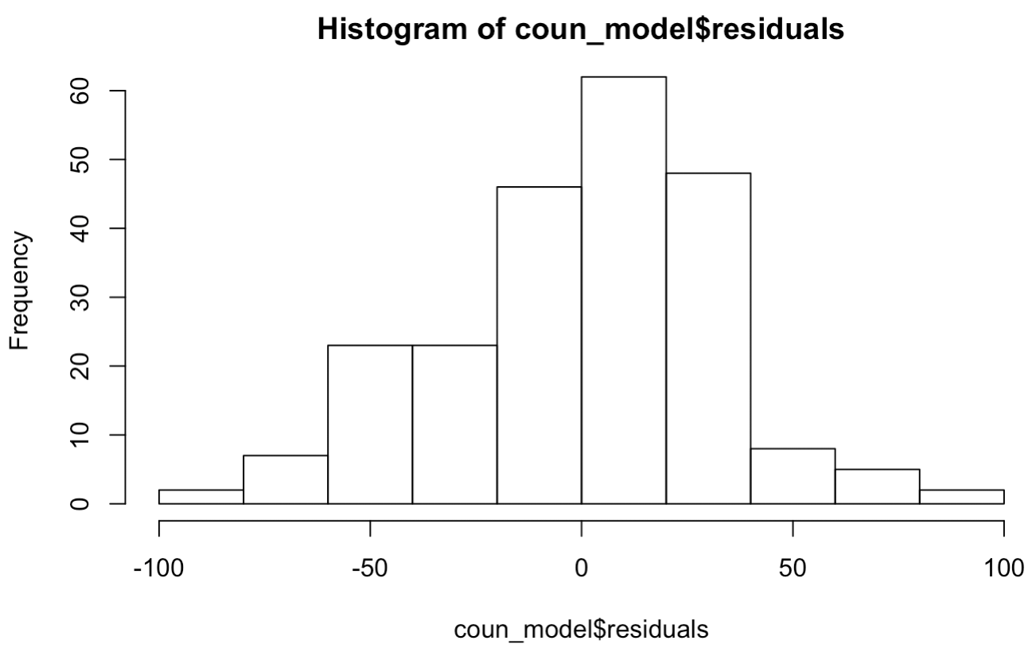
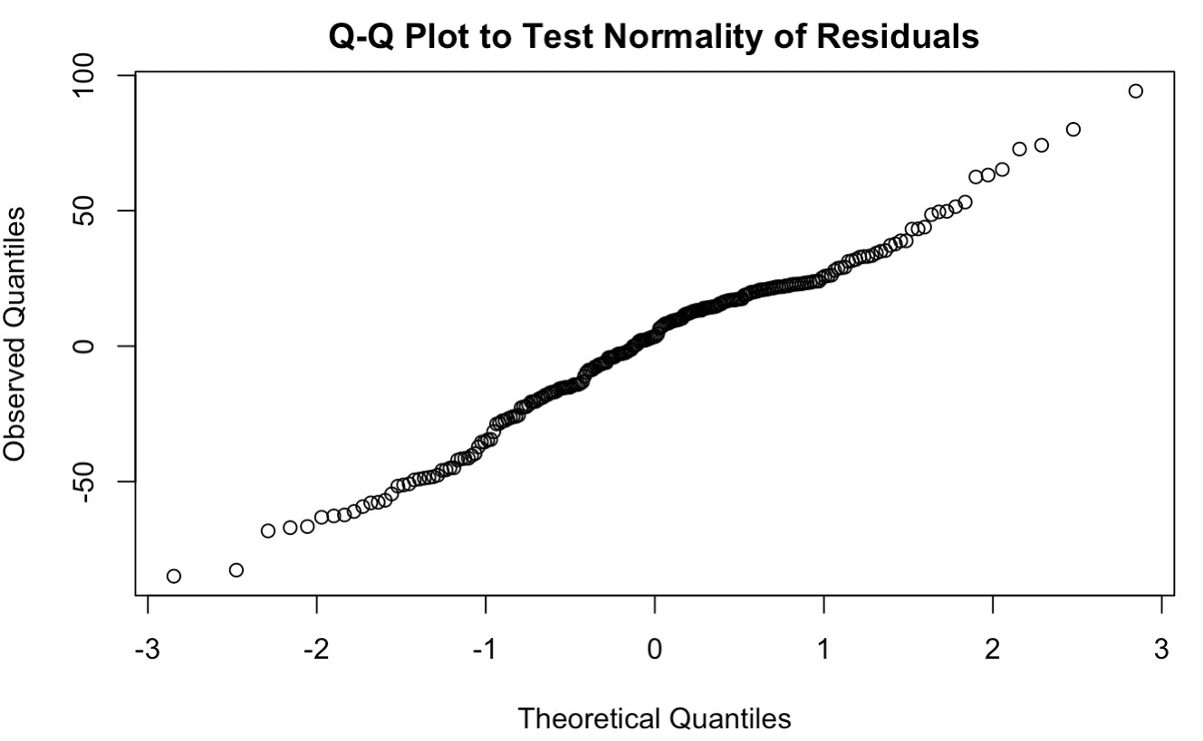
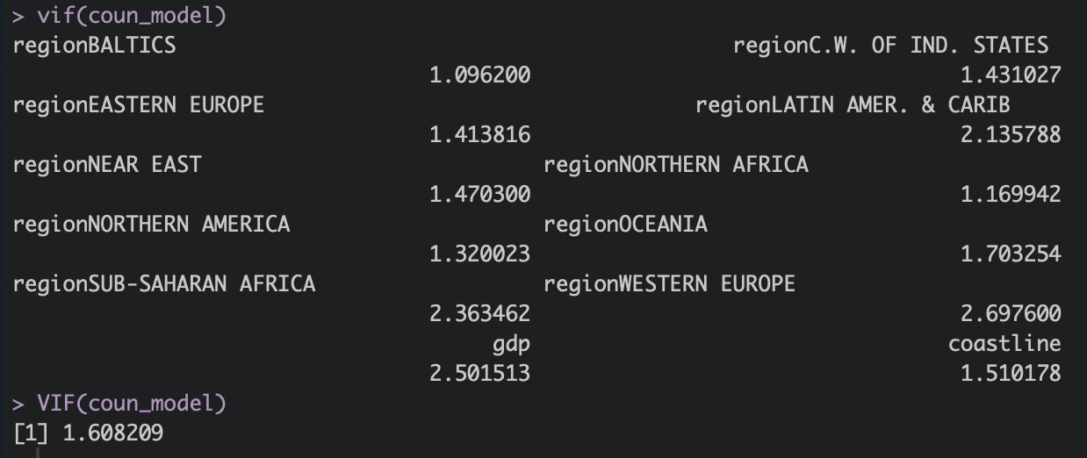
Multiple Linear Regression

Slide 9
Conclusion
1, Most of countries’ GDP are in the low level and a small number of rich developed countries raise the mean of GDP. But net migration is pretty normally shaped.
2, From the result of simple linear regression model, we can say that there is a significant linear relationship between net migration and GDP per capita. In other words, people are likely to move to the country with higher economic performance, which is more obvious when GDP per capita is larger than 6000 dollars.
3, From the result of multiple linear regression model, we can say that there is a significant linear relationship between net migration and composition of region, GDP per capita, coastline. In other words, people are likely to move to the country with higher economic performance, higher percent coastline area and specific regions. For regions, people prefer to move to West Europe and North America, and not Latin America and Caribbean, BAlTICS and Northern Africa.

Slide 10
Team Bravo
Thank you
Junchi Tian
Bixuan Huang

