Slide 1
Team 8
Final Project
Junchi Tian
Jingshu Song

Slide 2

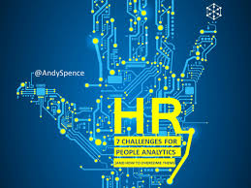
BAckground： People Analysis
People Analytics (PA) is a data-driven HR function recently emerged in world’s top high-tech companies. Starting from specific talent management questions, PA collects, integrates and analyzes data, and applies the result to human resource decision-making and practices.

Slide 3
motivation
As we all know, data science is powerful when it applies to different domains, such as Fintech, health analytics, NLP and so on. People analytics is a quite new domain and growing rapidly. It motivates me to learn more, find this dataset and try to figure out why employees want to leave a company.
We want to figure out why employee want to leave a company, then company can retain more talents and make better human resource management strategies. Therefore, it is valuable for company’s operation for a long term.

Slide 4
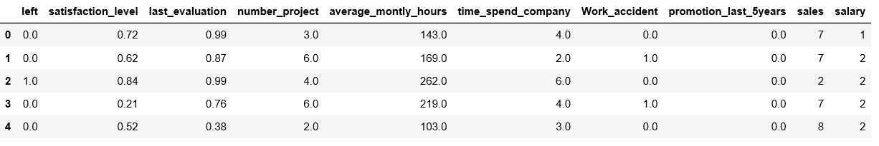
data： why people want to leave a company?
https://www.kaggle.com/lnvardanyan/hr-analytics
Data is from Kaggle with ten features. Target feature is ‘left’, whether people leave this company. 1 is left and 0 is stay. So this is a typical classification question.

Slide 5
Why is this meaningful?
After understanding why people want to leave a company, then we can develop our talent strategies to retain more talents on the company.
Let’s see our coding !

