Slide 1
Team Bravo
How to improve customer retention of bank
Junchi Tian
Bixuan Huang

Slide 2
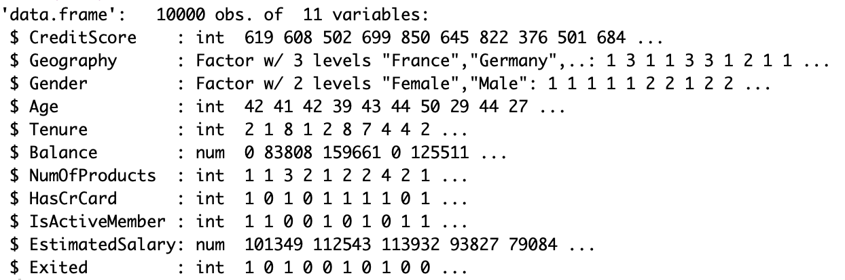
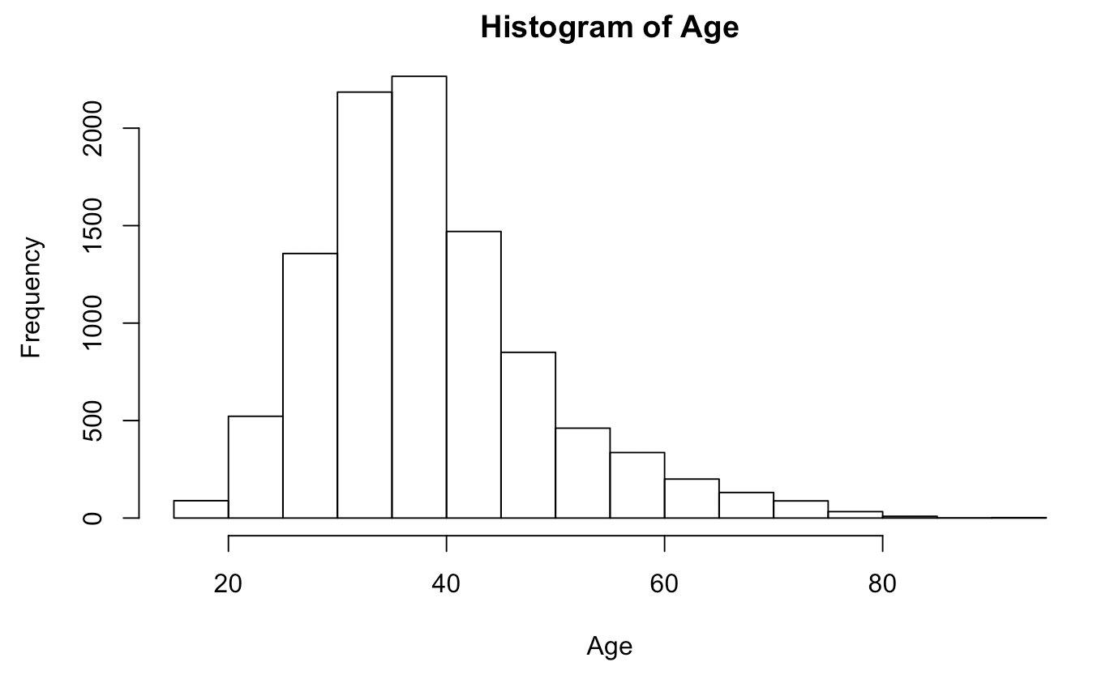
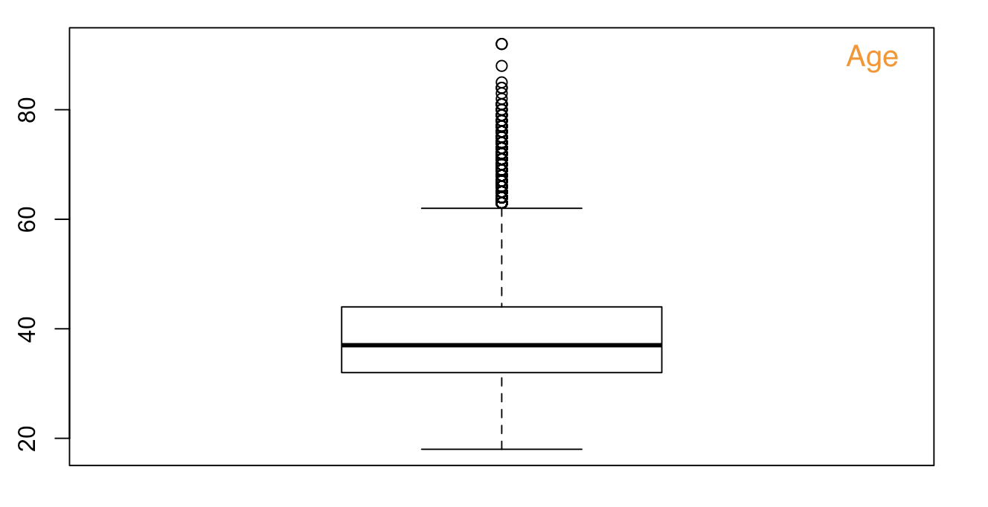
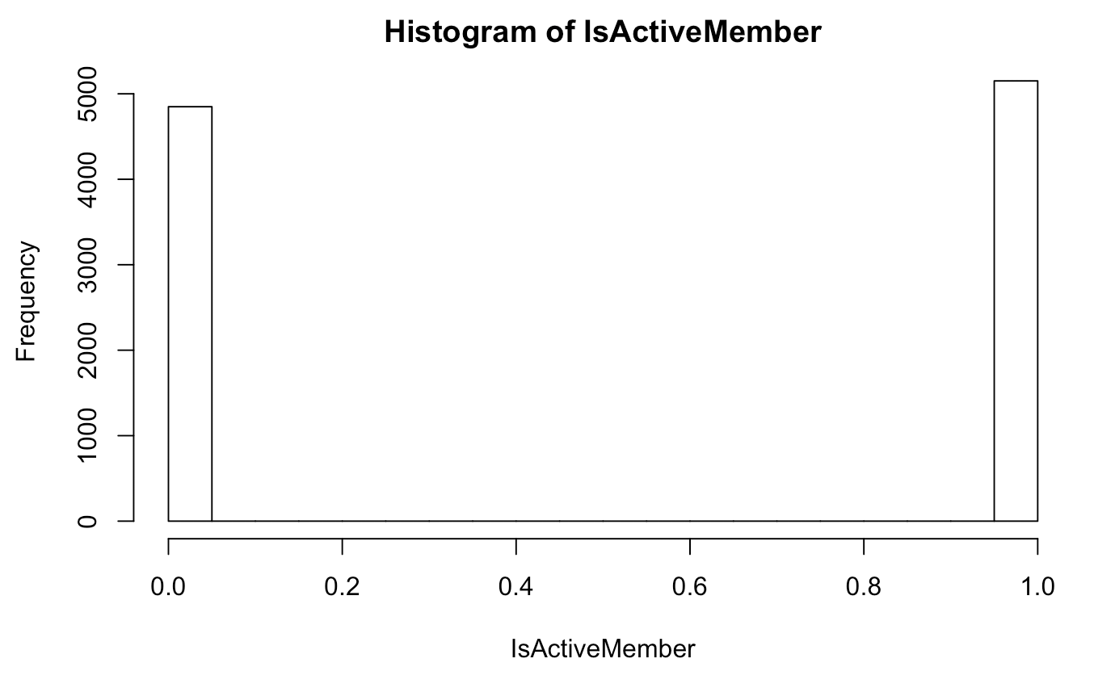
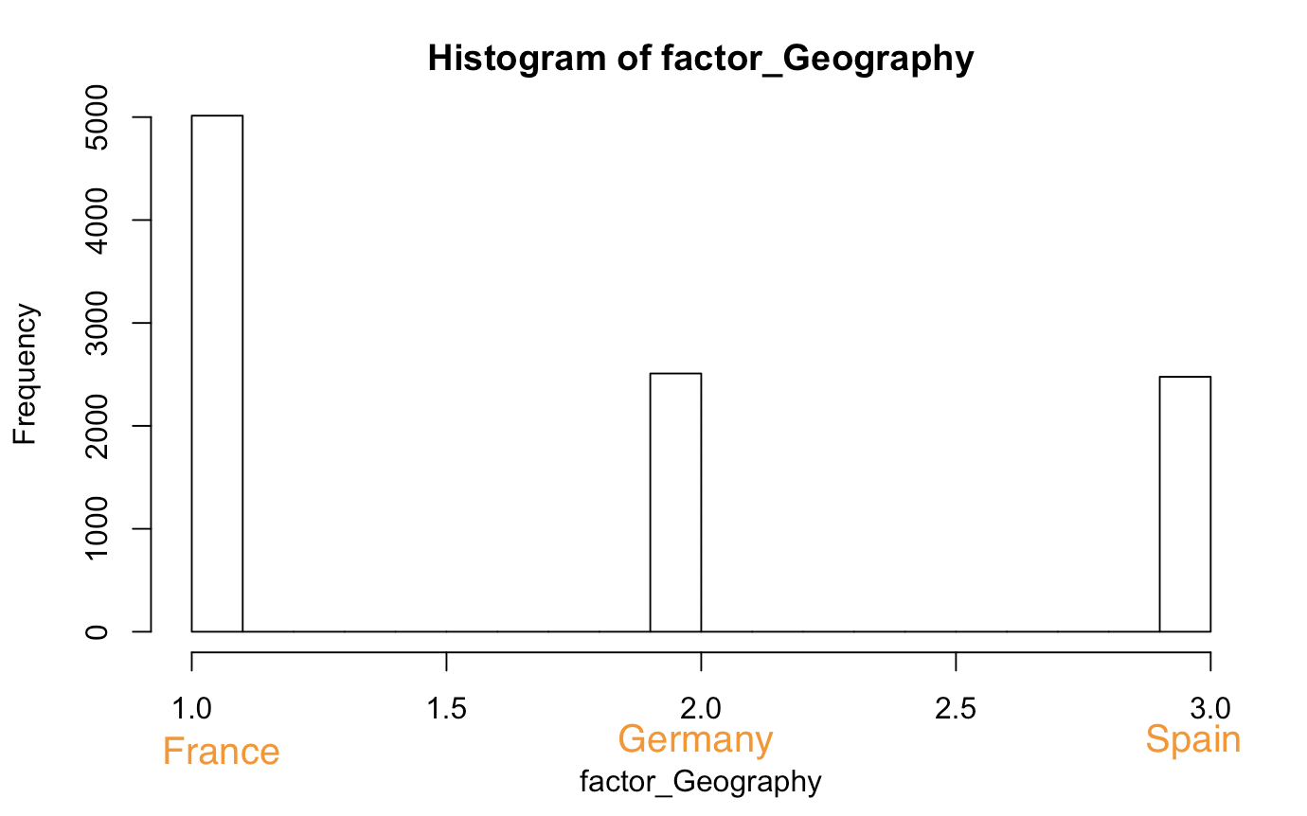
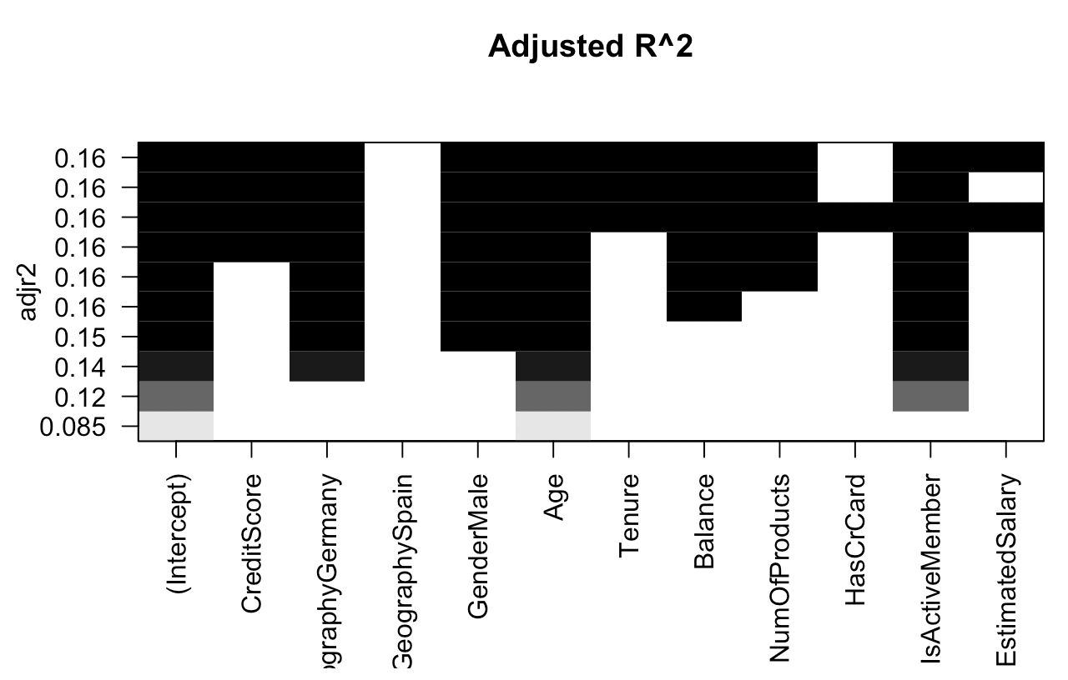
exploratory data analysis
Exited：
Retain: 7963
Leave: 2037

Slide 3
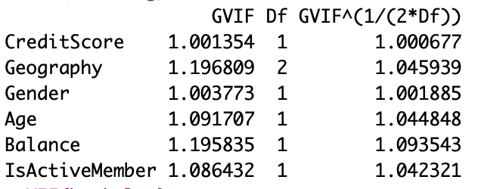
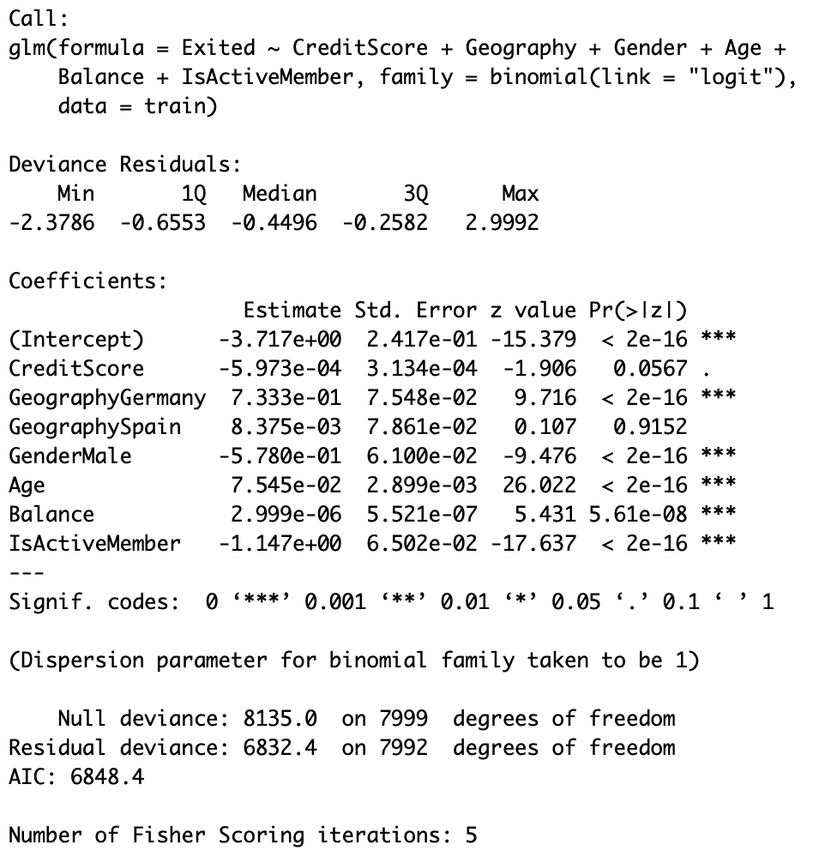
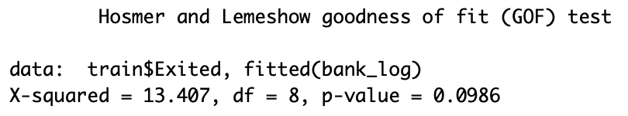
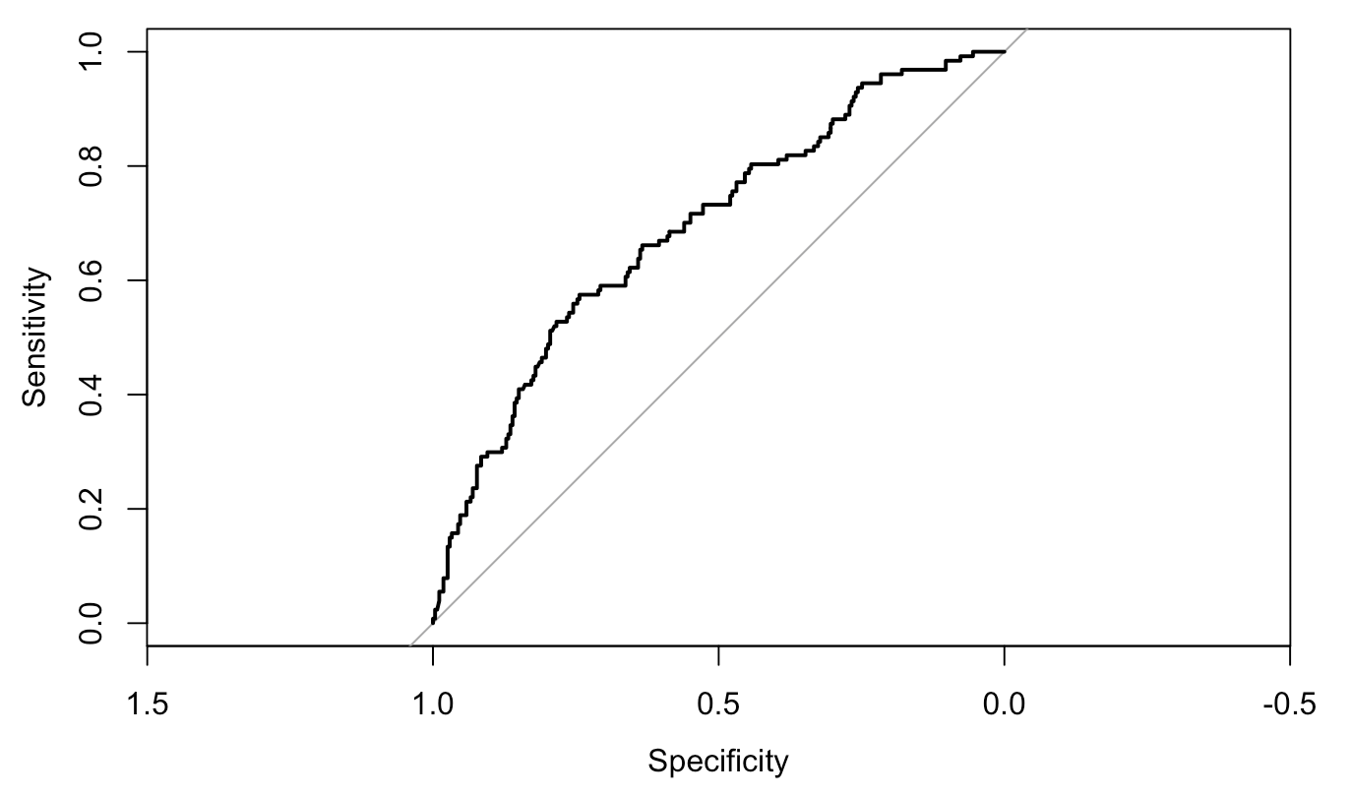
Model Diagnostics
Dependent: Exited
Independent: CreditScore, Geography, Gender, Age, Balance, IsActiveMember
Multicollinearity:
Hit rate : 0.809
AUC : 0.7418554

Slide 4
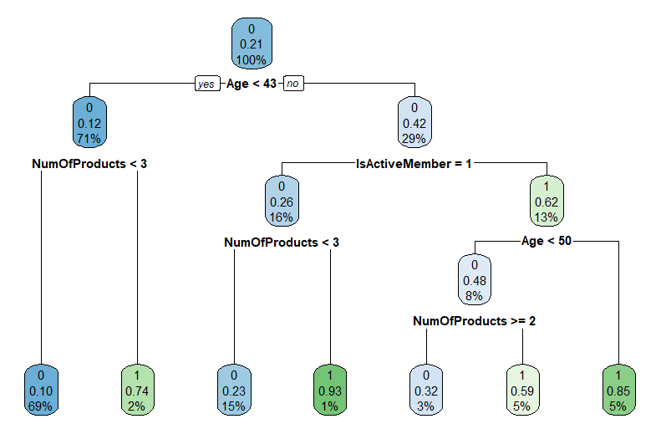
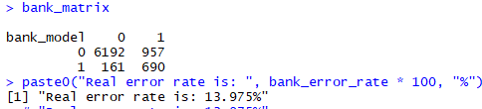
Decision tree
Hit rate : 0.805

Slide 5
Conclusion/solution
1, The bank should held promotional activities to the old, particularly age is older than 43.
2, Create more useful products and enable customers to have more accounts, better than 3.
3, Focus on German and Female, compared to France, Spain and Male.
4, Establish a good membership system to make more active members.

Slide 6
Team Bravo
Thank you
Junchi Tian
Bixuan Huang

