Slide 1
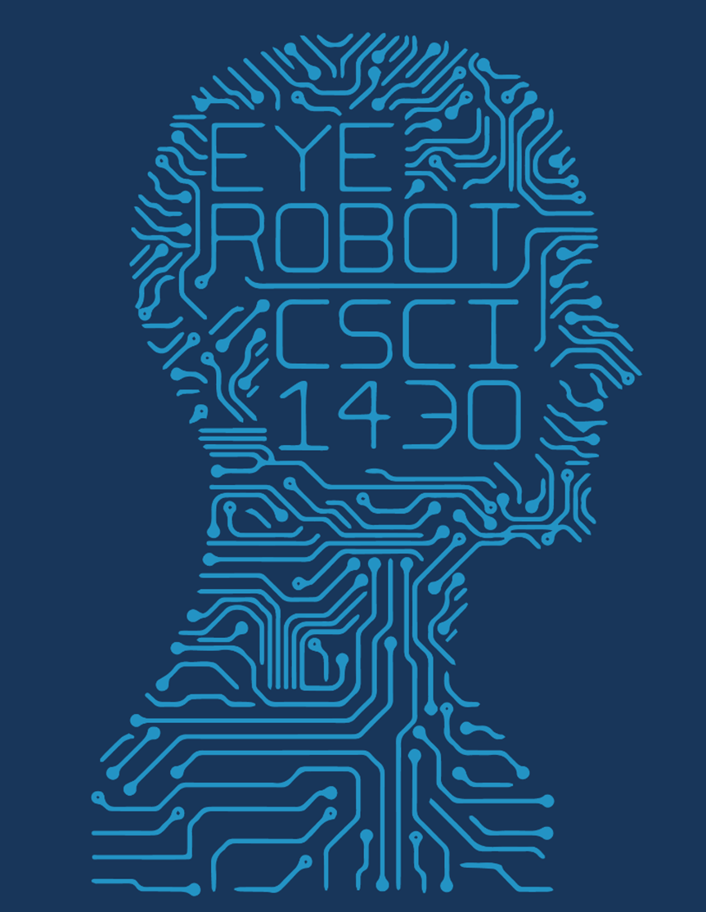
CS1430 Final Project Panorama
Team--- Procameramen
Members
Xiaoyu Lian
Kangping Hu
Yuchen Yang
Junchi Chu

Slide 2
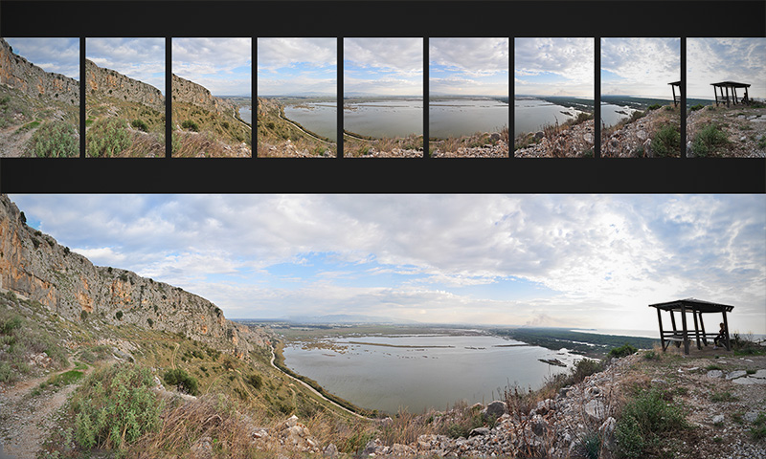
What is panorama? Definition: an unbroken view of the whole region surrounding an observer.
CSCI 1430
Notes:
Src: http://pkkindia.blogspot.com/2011/02/computer-vision-syndrome.html

Slide 3




Step 1—Junchi & Yuchen
Collect enough data
Take panorama input photos (Junchi & Yuchen)
OVERVIEW
Step 2--Kangping
Extract features Your choice:
SIFT/SURF/ORB

Slide 4
Step 3—Kangping & Junchi:
Brute Force Matching!
Use FLANN+RATIO TEST+RANSAC
Optimize method: PCA-SIFT
Step 4—
Xiaoyu & Yuchen:
Finding Homography Matrix
Source image transfermation
Image mapping and stitching
Blending

Slide 5
Get these photos

Slide 6
Features capturing & Matching

Slide 7
Combing images&output

Slide 8
Thank you so much!

