Slide 1
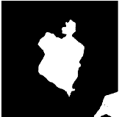
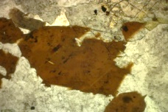
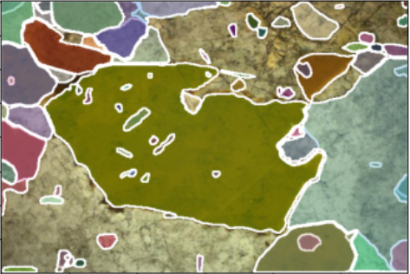
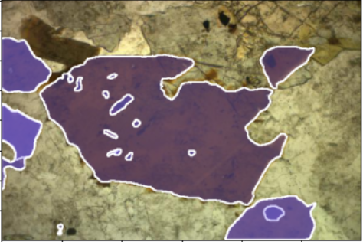
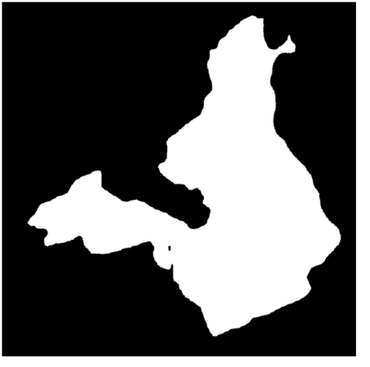
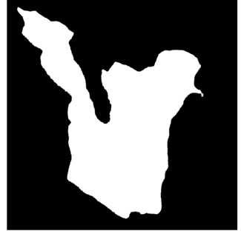
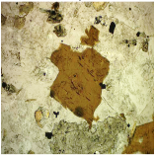
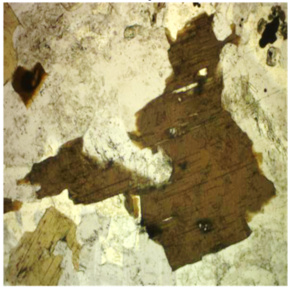
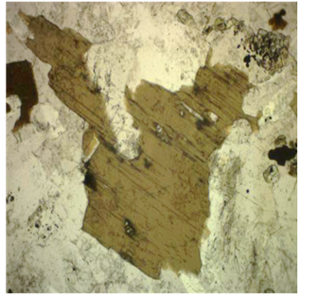
Point Prompt
SAM
Feature Matching
Auto Segmentation
Feature Matching
Feature
Collection
LoRA -SAM

Slide 2
LoRA
Layer
Linear
GELU
Linear
GELU
Decoder
Decoder
.
.
.
.
.
.
Transformer block
Transformer block
LoRA layer
Transformer block
Transformer block
LoRA layer
Transformer block
Patch Embedding
Image
Image

