Slide 1
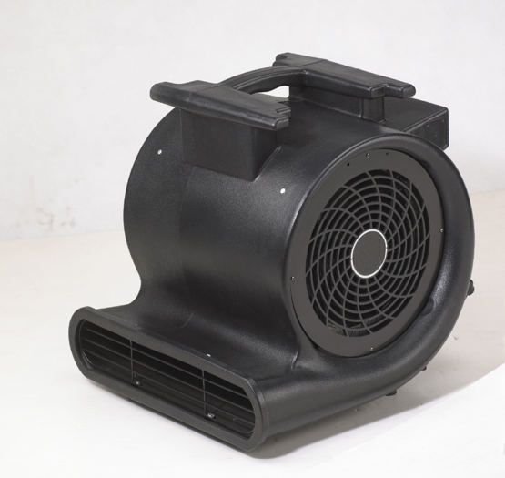
▣ Specification ▣
 | Parameter | Description | Remark
 | Product | Industrial Fan Blower
 | Model | PB-2500
 | Supplier | ORIENT
 | Safety Approval | ETL
 | Voltage | 230 | VAC
 | Frequency | 50Hz | Hz
 | Current | 3.5 | A
 | Power Consumption | 700 W | W
 | No. of speed | 3
 | Motor RPM | 1350
 | Air Volume | 2500 | CFM
 | Noise | 75 | dB
 | Product Weight |  | LBS
 | Power cord length |  | FT
 | Product size |  | IN (W x L x H)
 | Carton size |  | IN (W x L x H)
 | Container loading quantity |  | pcs
 | Quantity per carton | 1 | pcs
Remark

