Slide 1
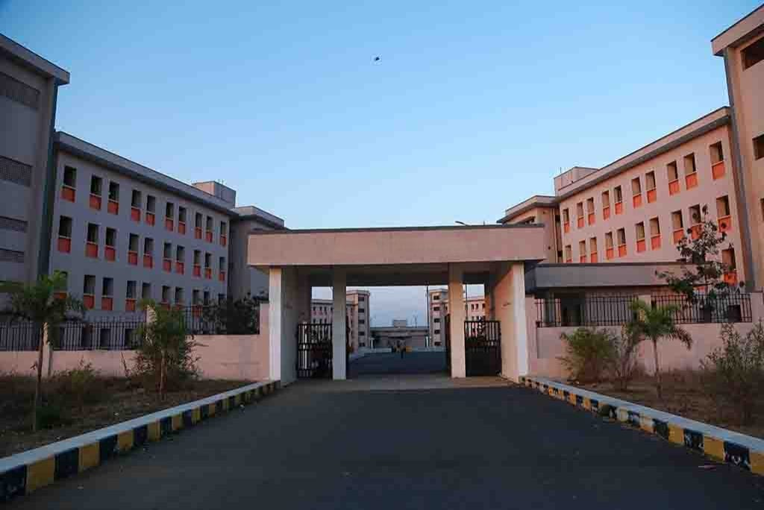
Hostel Room Allocation System
PRESENTED BY
CSE 2-2 BATCH 11
G. Dharani - 23SS1A0520
G. Anjali - 23SS1A0518
K. Poojitha - 23SS1A0531
P. Komali Kavya - 23SS1A0548
GUIDED BY
Mrs. B. Sangeetha
Assistant Professor
CSE Department

Slide 2
Table of Contents
Abstract
Introduction
Literature Survey
Problem Statement
Proposed System
System Architecture
Modules & Features
Algorithms Specialization
Conclusion

Slide 3
Abstract
The Hostel Room Allocation System is designed to streamline the process of assigning hostel rooms to students. In the current scenario, room allocation is often a tedious and error-prone process involving manual paperwork and delays.
Our proposed system automates this process, allowing students to apply for rooms online and receive real-time updates on their application status. The system intelligently matches students with available rooms based on their preferences, ensuring a fair and transparent allocation process.
Administrators benefit from a user-friendly dashboard that provides real-time insights into room occupancy and allocation status, enabling them to make informed decisions and manage the hostel more efficiently.

Slide 4
Literature Survey
1. "Hostel Management System" on GitHub
Summary : A standalone application designed to efficiently manage hostel-related operations, providing an intuitive interface and robust functionalities for administrators, staff, and students.
Identified Problems:
Being standalone, it might lack accessibility compared to web-based systems.​
May not support real-time updates or remote access.​
2."Online Hostel Management System" by Free Student Projects
Summary: An advanced web-based hostel management system developed specifically for hostel owners to manage different activities, including room availability and student accommodations.

Slide 5
.
Identified Problems:
Might not address specific institutional requirements or customization needs.​
Potential challenges in integrating with existing institutional systems
3. "Automated Scheduling of Hostel Room Allocation Using Genetic Algorithm"
Limitation:
Focuses only on a genetic algorithm, which requires complex computations and may not be suitable for all institutions.
If the system is built with fixed rules, it may not allow administrators to customize the process based on their institution’s policies

Slide 6
Problem Statement.
Hostel room allocation in academic institutions with multiple hostels is a challenging task. Traditional methods involve manual allocation, which can lead to inefficiencies, and dissatisfaction among students. Additionally, many existing systems:
Do not support student preferences effectively – Some solutions do not allow students to select preferred rooms
Security vulnerabilities – projects may not use secure authentication mechanisms, risking unauthorized access.
Are not accessible across multiple hostels – Some are standalone applications that do not support real-time updates
Lack proper feedback mechanisms – Students often face issues like maintenance problems, room conditions but lack a structured way to report.

Slide 7
Proposed System
1️⃣ Multiple Allocation Algorithms
First Come First Serve (FCFS)
2️⃣ Real-Time Room Availability & Management
The system displays available rooms dynamically as students apply.
3️⃣ Secure and Verified Student Authentication
Uses college admission numbers to verify student identities.
Priority-based allocation (Merit, Reservation, etc.)
Randomized allocation
Preference-based allocation
Admins can update room availability (e.g., marking rooms as under maintenance)
Email-based verification ensures only authorized students can register.
Secure password encryption.

Slide 8
.
4️⃣ Web-Based System for Accessibility
Unlike standalone applications, our system is accessible from any device with an internet connection.
5️⃣ Student Feedback System
Students can submit feedback on room conditions and facilities.
6️⃣ Simple and Focused Design
User-friendly UI
No need for manual installations
Supports multiple hostels under a single platform
Helps administration improve hostel services based on student reports.
Unlike some bulky systems, our system is focused only on room allocation and feedback.
Ensures easy navigation and smooth operation.

Slide 9
System Architecture
.
Student
Admin
Login
Forgot password
Check credentials
Apply for room
Recovery mail
Database

Slide 10
Class Diagram
.
Student
Name
Admission number
Roll No
Email
Branch & Year
Room
Room_id
Status
Capacity
Available
Admin
Admin_Id
Username
Password

Slide 11
Admin Flowchart
Start
Login
Data
base
No
Password Valid?
Yes
Add Student data
Accept Applications
View Student Detail
Add/
Remove Room
Generate report
Logout
End

Slide 12
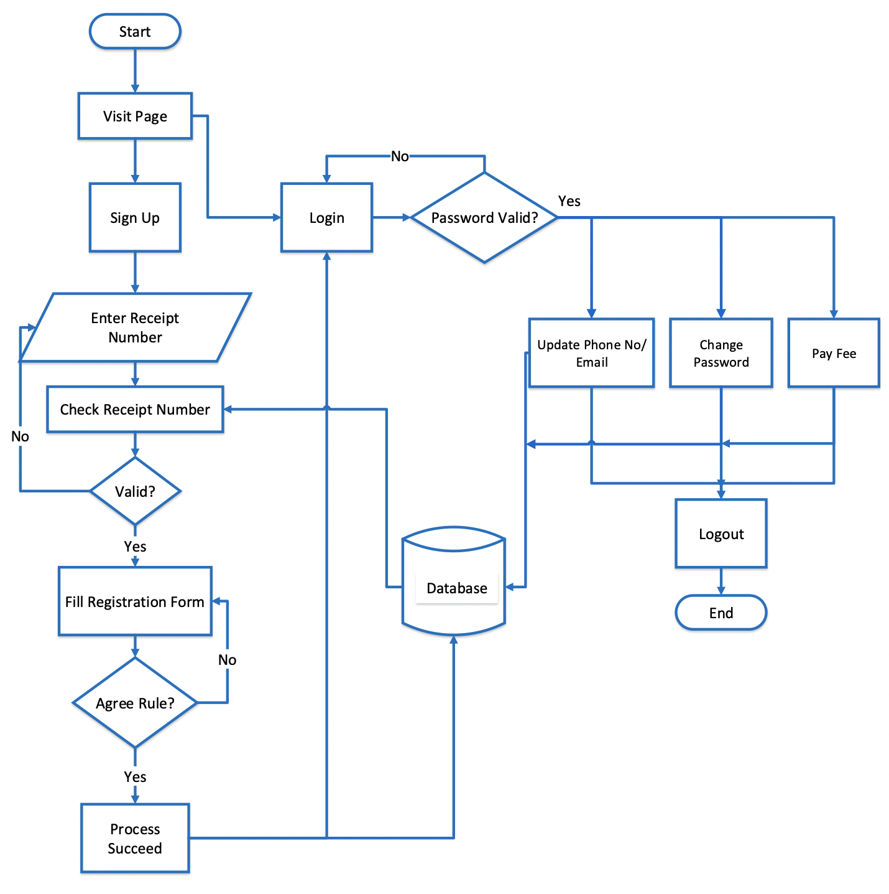

Student Flowchart
Enter admission number
Apply Rooms
Check

Slide 13
Algorithms Specialization
First-Come, First-Serve (FCFS):
First registered student gets a room.
Ensures that rooms are assigned in the order of application.
Best for handling general hostel applications fairly.
Useful when there is no need for prioritization or preference-based selection.
Priority-Based Allocation:
Based on seniority or special needs.
(Seniors with single rooms and freshers with shared rooms)
Ensures that deserving students get priority access to better or limited rooms.
Can be integrated with FCFS for lower-priority cases

Slide 14
.
Preference-Based Matching:
Uses Stable Matching Algorithm.
Allows students to select preferred room types, floors, or.
Ensures higher satisfaction by attempting to match students' choices.
If preferences conflict, priority-based rules or FCFS can act as a tie-breaker
Randomized Allocation:
Ensures fairness but may cause dissatisfaction.
Applied when there is an excess of demand for specific room types. Ensures unbiased selection, especially when multiple students request the same room.
Can be combined with priority or preference-based methods for fairness

Slide 15
Conclusion
In conclusion, our system efficiently combines four different room allocation methods to ensure fair, transparent and flexible process.
Overall, this system enhances the efficiency of hostel room allocation, providing real-time updates and user friendly interface for both students and administrators, ultimately leading to improved satisfaction and better resource management

Slide 16

.

