Slide 1
A Framework for Applying Neural Networks to Eddy Covariance Data
Dr. June Skeeter

Slide 2
Eddy Covariance

Slide 3
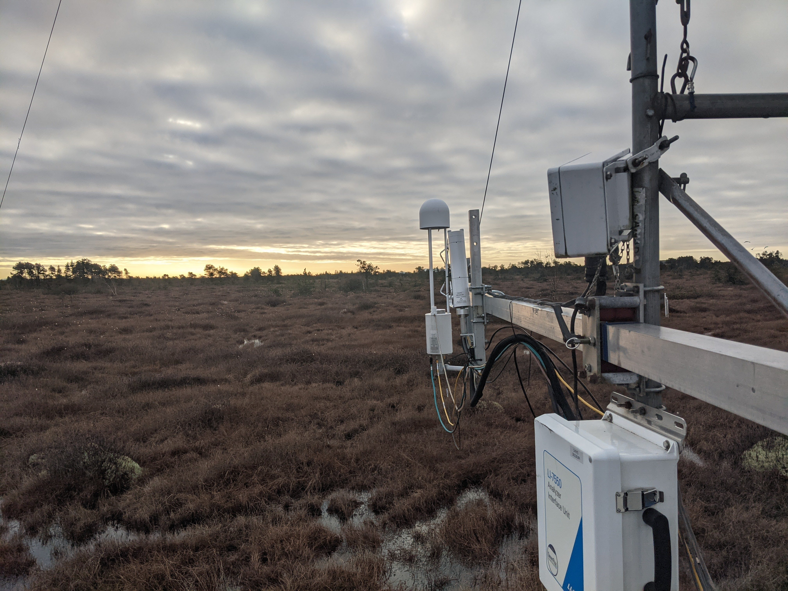
Semi-continuous, ecosystem-scale measurements of energy, water, and trace gas fluxes.
Noisy, voluminous data sets
Frequent gaps
Observational bias
Well suited for machine learning!
Burns Bog EC Station, Delta BC

Slide 4
Issue | Solutions
Over-fitting | - Model ensembles- 3-way cross validation - Pruning inputs
Black boxes models | - Plot partial derivatives - Feature importance
Computationally expensive | - Tensorflow - GPU processing
Neural Networks
Universal approximators: can map any continuous function to an arbitrary degree accuracy.
With enough hidden nodes, will fit any pattern in a dataset
Care must be taken to ensure the patterns are real
Early stopping allows
Well suited for non-linear, multi-variate response functions
Capable interpolation and extrapolation
Commonly Cited Limitations

Slide 5
Objective
Provide a framework for applying NN models to EC data for descriptive analysis and inferential modelling.
The github repository linked to this presentation has functional examples that can be used to apply NN models.
Runs in Python and Tensorflow
GPU support not required
Example Data

Slide 6
Burns Bog EC station
Harvested peatland undergoing active restoration
8+ years of meteorological & flux (CO2 and CH4) data

Slide 7
Training Procedures

Slide 8
Larger ensemble = more robust model
N <= 10 for data exploration/pruning
Three way cross-validation
Train/validate/test
Early Stopping: after e epochs
e = 2 for pruning stage

Slide 9
Pruning Inputs
Calculate partial first derivative of the output with respect to each input over test data domain.
Relative Influence (RI) of inputs
Normalized sum of squared derivatives (SSD)
Iteratively remove inputs with RI below a threshold
Use set of random scalars inputs to determine threshold
e.g., a float [0-1], a skewed float [0-1].25, and a binary integer (0/1)
Before and After Pruning FCO2

Slide 10
The Final Model
Once pruning is complete, re-train the final production level model, excluding the random scalars
Increase the ensemble size (e.g., N =30)
Could increase early stopping criteria (e.g., e = 10)
Larger e drastically increases training
Plot the model derivatives as a final check
If derivatives look implausible
Adjust inputs/parameters and try again
Plotting Derivatives
Helps ensure model responses are physically plausible
An essential step and key advantage of NN models
Raw derivatives show true feature responses
Normalized derivatives scaled by input variance
Relative input effects on common scale
What the model “sees”
95% confidence intervals around derivatives indicate modeled confidence in relationships
Partial Derivatives of FCO2

Slide 11
Normalized Derivatives of FCO2

Slide 12
Model Performance FCO2

Slide 13
Plot the model outputs and validation metrics calculated with the test data.

Slide 14
Before and After Pruning FCH4

Slide 15
Normalized Derivatives of FCH4

Slide 16
Model Performance FCH4

Slide 17
Plot the model outputs and validation metrics calculated with the test data.

Slide 18
Next Steps
Custom NN architecture: Separating input layers may allow us partition fluxes.
e.g., FCO2 into GPP and ER
Flux footprints: map response to spatial heterogenity
Upscaling: in space and time
u* filtering: partial derivatives could identify u* thresholds
Compare to process based models (e.g., CLASSIC)

Slide 19
Thank You
Questions?

