Slide 1

CeylonMate - Smart Tourism Companion for
Foreign Travelers in Sri Lanka
J.C.D.Soysa¹, K.K.T.Thathsarani², J.W.P.D Pathiraja³ M.R.K.A Moragaspitiya⁴, Buddika Harshanath⁵, N.C.P.Kumarapperuma⁶
^{1,2,3,4,5,6}Department of Information Technology Sri Lanka Institute of Information Technology, Sri Lanka
Presenting Author : J C D Soysa

Slide 2
Introduction
Current State: Travelers demand personalized, safe, and efficient journeys.
The Gap: Existing solutions are "siloed"—static apps that lack end-to-end integration
Sri Lanka's Challenge: Rich cultural heritage vs. Information Asymmetry & Safety concerns.
The Need: A proactive, context-aware ecosystem, not just a digital catalog.

Slide 3
Research Problem
• Static itinerary planning
• Reactive safety systems
• Limited cultural integration
• Poor historical interpretation

Slide 4
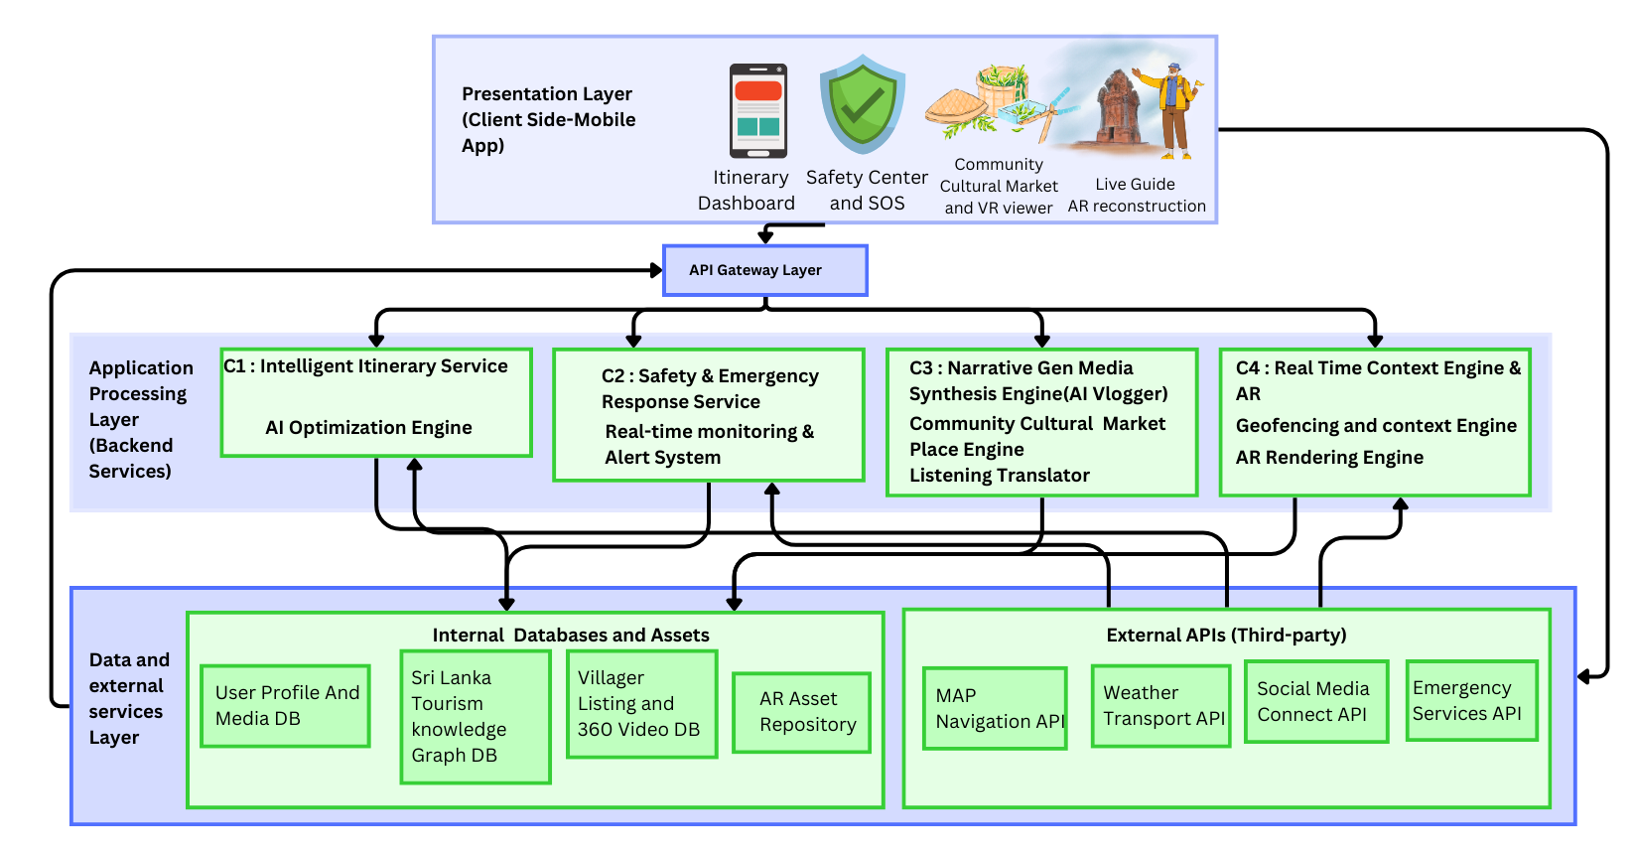
Proposed Solution

Slide 5
Module 1 - Dynamic Itinerary Planning
Objective: Solve Tourist Trip Design Problem (TTDP) in real-time.
Algorithm: Multi-Objective Genetic Algorithm (MOGA).
Key Inputs: User preferences + Real-time Weather + Traffic.
Unique Feature: Optimizes for Fatigue Management and re-routes during rain.

Slide 6
Module 2 - Intelligent Safety
Preventive: Spatio-Temporal Risk Analysis (predicts protests, floods from news feeds).
Reactive (Offline-First): Kinematic Anomaly Detector.
Detects falls using accelerometer/gyroscope.
Offline Protocol: SMS fallback with GPS coordinates.

Slide 7
Module 3 - Cultural Marketplace
Pre-Trip Trust: "Virtual Experience Viewer" (360° VR) to reduce uncertainty.
Post-Trip Engagement: "Moments Social Engine".
AI curates photos for aesthetics.
Generates captions/hashtags using LLMs.
Creates verified "Moments Cards" for sharing.

Slide 8
Module 4 - AR Discovery
Tech Stack: Neo4j Knowledge Graph + Google Geospatial Creator (VPS).
Feature: Markerless In-Situ AR Reconstruction.
Innovation: Semantic Knowledge Graph connects sites (e.g., "Built By") for storytelling.
Realism: Occlusion handling for realistic blending.

Slide 9
Results & Evaluation
Planner: 95% success in proactive rerouting (4.2s execution time).
Safety: 93.3% accuracy in Fall Detection; 90% reliability in offline SMS (Knuckles Range test).
User Satisfaction: 92% satisfaction with itinerary planning.
Cultural: 4.8/5 score for perceived authenticity.
AR Discovery:
Stable VPS tracking at heritage sites.
4.8/5 educational value from knowledge graph.

Slide 10
Comparison with Existing Solutions
Itinerary: Static Routing → Dynamic MOGA Optimization
Safety: Reactive Calls → Predictive Risk & Offline Fallback
History: Audio Guides → Markerless AR + Knowledge Graph

Slide 11
Conclusion and future work
Conclusion
Proposed an AI-powered smart tourism ecosystem.
Integrates itinerary planning, safety, culture, and AR.
Improves personalization, safety, and engagement.
Future Work
Large-scale real-world testing.
Improve AR precision.
Expand tourism knowledge graph.

Slide 12
Thank You

