Slide 1
CeylonMate - Smart Tourism Companion for Foreign Travelers in Sri Lanka (PP2)
Group: 238

Slide 2
Problem Statement & Stakeholders
Context: Tourism and cultural heritage exploration in Sri Lanka
Stakeholders: Foreign tourists visiting Sri Lankan ,tourism service providers, SLTDA
Observed issue: plan optimized travel routes
Why it matters: This leads to reduced tourist engagement
Notes:
State the problem precisely and measurably. Avoid long background. One slide only.

Slide 3
Research Gap & Objectives
Gap:
• Static itinerary planning
• Reactive safety systems
• Limited cultural integration
• Poor historical interpretation
Main objective: AI-powered smart tourism companion
Notes:
Restate objectives exactly as in proposal unless formally revised. PP2 evaluates alignment.

Slide 4
Solution Overview (What You Built)
Solution summary: AI-powered mobile tourism companion
Key features delivered:
FR1 – Dynamic itinerary planning FR2 – Safety FR3 – Cultural experience discovery
FR4 – AR heritage visualization
Non-functional focus: Performance, usability, reliability
Current completion status: ~90%
Notes:
This is the product view: what exists now as an integrated solution.

Slide 5
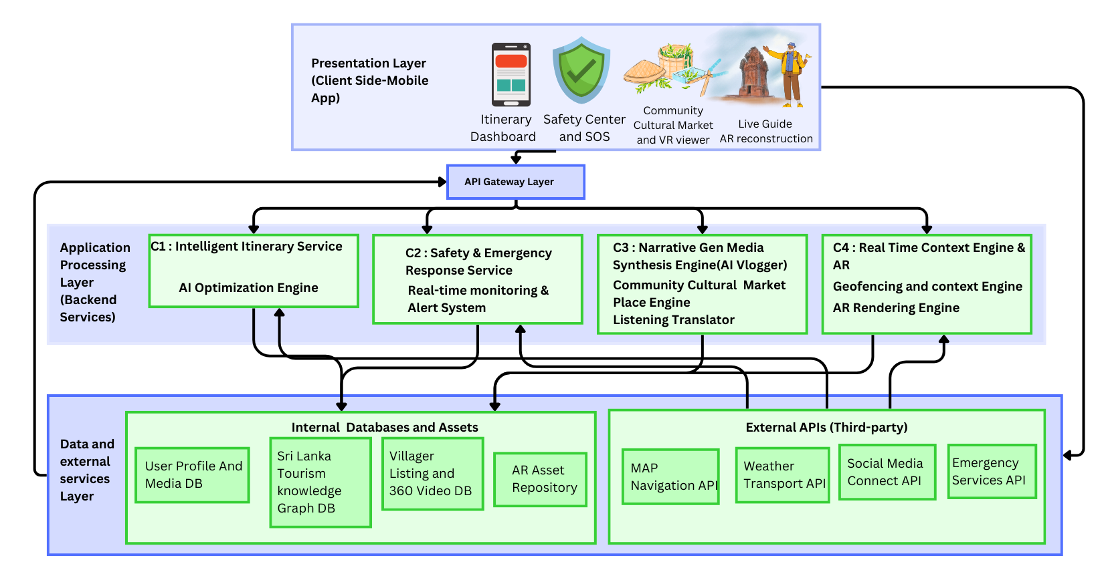
System Architecture & Integration (Show Diagram)
Notes:
Show one clear diagram. Explain data flow end-to-end. Mention interfaces and consistency.

Slide 6
Commercialization / Impact (Short)
Target users/market: Foreign tourists visiting Sri Lankan
Value proposition: An AI-powered tourism companion
Cost and feasibility: Low-cost mobile application
Adoption plan / next steps: Pilot testing at major heritage sites
Notes:
Keep this concise, but concrete. Link impact to measured results where possible.

