Slide 1
Semantic Changes in Canadian Parliamentary Debates Diachronic word replacement and changes in difference between political parties
Jungeun “June” Lim
CSC2611 Final Presentation
March 31, 2020

Slide 2
Data: Canadian Parliamentary Debates Model: Word2vecs
119 years worth of data (1901-2019)
Contains what have been said in Canadian Parliament
Word2vec trained with a window size of 20 and 300 dimensions
For Question 1, 6 models were built based on 6 time slices (each time slice = 20 years & last time slice = 19 years)
For Question 2, 21 models were built based on 7 most recent time slices (each time slice = 5 years & last time slice = 4 years) and 3 political parties (7*3 = 21)
Notes:
The dataset I used is the transcript of Parliamentary Debates of the past 119 years. I trained word2vec models to answer the two main questions. Next please.

Slide 3
Question 1: Diachronic word replacement
“Men” (as human beings) has been increasingly replaced by “people.”
“Miles” has been replaced by “kilometres” in Canada since the 1970s.
How can we detect such replacements?
Notes:
The first question is about diachronic word replacement. Diachronic word replacement can happen in many ways, but here I’ll introduce the most straightforward examples. Traditionally, English speakers used the word men to refer to all human beings, but such a usage is decreasing because people are recognizing that it’s sexist language, and the word “people” is used in place for “men” more often nowadays. Another example is metric units and imperial units. Canada was traditionally using imperial units but since the 1970s, the country has converted to the metric units. So for instance, “miles” has been replaced by “kilometres.” And I wanted to see how I can detect such replacement with word embedding in a simple way. Next please.

Slide 4
Method: Relationships with the other words
Pick shared words between two models you want to compare
Pick n most frequent words from the shared words (due to the limit of computational resource)
Construct an n*n matrix for each model (“neighborhood relationship matrix”) in which each row represents cosine similarity between a word and all the other words in the model (“neighborhood relationship vector”)
Take the neighborhood relationship vector corresponding to the word of interest from model 1’s neighborhood relationship matrix
In model 2’s neighborhood relationship matrix, look for the row that is most similar to the neighborhood relationship vector taken above
Notes:
Let’s say I have two word embedding models. One for the past and one for the present. I considered only the common words between them and among them I used 8000 most frequent words in my experiment. And for each model, I construct an 8000 by 8000 matrix, in which each row represents cosine similarity between a word and all the other words in the model. I will call this matrix “neighborhood relationship matrix”, and I will call each row in this matrix “neighborhood relationship vector”.
And let’s say I’m interested in how the word “miles” in the past is being replaced. I take the neighborhood relationship vector corresponding to “miles” from the neighborhood relationship matrix for the past time slice, and then I look for the most similar vector to it in the neighborhood relationship matrix for the present time slice. If no diachronic replacement has been occurred, I’m likely to get the same word, “miles”. But ideally, I am looking to get “kilometers” because it replaced “miles.”
And in some cases, I can actually do the same but in the opposite direction. I take the neighborhood relationship vector corresponding to “kilometers” from the neighborhood relationship matrix for the present time slice, and then I look for the most similar vector to it in the neighborhood relationship matrix for the past time slice. If I’m successful, I will get “miles”. I need to emphasize that going in both directions makes sense only for some cases in which the two words are almost completely interchangeable. For instance, men and people aren’t completely interchangeable, obviously, because the word “men” also means adult human males, not human beings in general. Next please.

Slide 5
100 years ago vs. Now in Canadian Parliamentary Debates: X is “the new Y”
100 years ago (1901-1920): “Y” | Now (2001-2019): “X” | Cosine Similarity
men | people | 0.6188
chairman | chair | 0.5009
mile | kilometres | 0.5310
canada | world | 0.5918
train | plane | 0.6045
gas | electrical | 0.6222
ought | should | 0.6649
pleased | happy | 0.6742
The number of common words between the two time slices: 48385
8,000 most frequent words were used
Notes:
This table shows some examples I acquired with this method. The yellow colored rows reflect social changes and the green colored rows mean changes in linguistic styles. For instance, the second yellow row tells us that, in the context in which the word “chairman” was used in the past, now the word “chair” is used. And the second green row tells us that, in the context in which the word “ought” was used in the past, now the word “should” is used. I will skip the other examples to save time. Next please.

Slide 6
100 years ago vs. Now in Canadian Parliamentary Debates: Y was “X in old days”
Now (2001-2019): “X” | 100 years ago (1901-1920): “Y” | Cosine Similarity
refugees | immigrants | 0.5668
chair | chairman | 0.5009
kilometres | mile | 0.6537
gay | jews | 0.5491
plane | train | 0.6545
great | splendid | 0.5171
ought | should | 0.6550
pleased | happy | 0.6650
The number of common words between the two time slices: 48385
8,000 most frequent words were used
Notes:
This table also shows some examples that flow in the opposite direction. For instance, the second last yellow row tells us that, in the context in which the word “gay” is used now, the word “jews” was used 100 years ago. I guess it reflects the changes in minority issues discussed in parliament. The blue-colored word pairs mean the same result as the previous table, which show that the two words are interchangeable. Next please.

Slide 7
How to detect words that experienced such changes automatically?
Look for cases in which 1) the word in model 2 that is most similar to the word of interest in model 1 != the word of interest in model 1 and 2) the cosine similarity between two neighborhood relationship vectors most similar to each other is larger than some threshold (0.5 was used)
The previous examples were found by this approach
Notes:
To find these examples, I iterated over all the words, looking for the cases in which, first, the word in the second model that is most similar to the word of interest in the first model is not equal to the word of interest and second, the cosine similarity between two neighborhood relationship vectors that are most similar to each other is larger than some threshold. I used 0.5 in my experiment. Next please.

Slide 8
Question 2: Differences between political parties and how have they changed over time
Intuition: Word embedding models represent the mental models of the authors or speakers
-> What could we find when we compare word embedding models based on what politicians from Party A said and those based on what politicians from Party B said?
Notes:
My second question is more specific to the parliament debates. Under the assumption that word embedding models represent the mental models of the authors or speakers, I wanted to see what I can find when I compare models based on what politicians from Party A said and those based on what politicians from Party B said. Next please.

Slide 9
Method: Relationships with the other words (again)
Pick shared words between two models you want to compare
Pick n most frequent words from the shared words (due to the limit of computational resource)
Construct an n*n matrix for each model (“neighborhood relationship matrix”) in which each row represents cosine similarity between a word and all the other words in the model (“neighborhood relationship vector”)
Iterate over n words to compute the similarity between each word’s neighborhood relationship vector from model 1 and that from model 2
-> n cosine similarity values
5) Compute the average of the n cosine similarity values acquired
Notes:
To do this, I first built the neighborhood relationship matrices again, but per each time slice, I built three word2vec models, one for the conservative party, one for the liberal party, and one for new democratic party. And I iterated over all the words to compute the similarity between each word’s neighborhood relationship vector from two models I was comparing. If I consider 3,000 most frequent words, I’ve got 3,000 cosine similarity values. Finally, I computed the mean of these values and considered it as difference between two word embedding models. Next please.

Slide 10
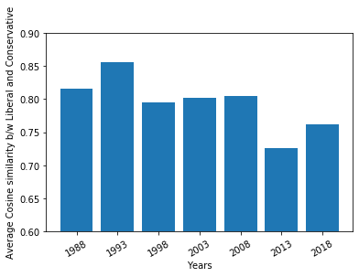
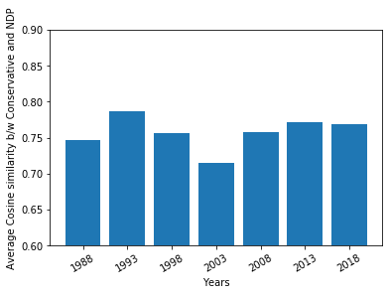
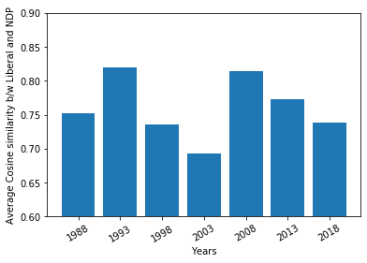
Changes in similarity between the word2vec models of different political parties over the past 30 years
Liberal vs. Conservative
Liberal vs. NDP
Conservative vs. NDP
Liberal Party and Conservative party are becoming less similar to each other.
NDP and Conservative Party are least similar to each other on average.
Notes:
The left chart shows the change in difference between the model based on what the liberal party members said and the model based on what the conservative party members said. In this chart, we can see that the two major parties are becoming less similar to each other which may suggest the tendency of political polarization. And when looking at the right chart, we can see that new democratic party and the conservative party are relatively less similar to each other compared to two other charts.

Slide 11
Changes in similarity between the word2vec models of different political parties over the past 30 years
Liberal vs. Conservative
Liberal vs. NDP
Conservative vs. NDP
When NDP becomes more similar to Liberal Party, it tends to get more seats in Parliament in the election after a few years (1993 -> 1997: 133% increased, 2008->2011: 178% increased)
Notes:
Let’s see the center chart. Interestingly, When the new democratic party becomes more similar to the Liberal Party, the new democratic party tends to get more seats in Parliament in the election after a few years. This may suggest that being less extreme or being closer to mainstream affects the election result positively. Next please.

Slide 12
Changes in similarity between the word2vec models of different political parties over the past 30 years
Liberal vs. Conservative
Liberal vs. NDP
Conservative vs. NDP
Need further rigorous validation 1) against political history in Canada 2) with models based on speeches about specific issues on which parties have different positions 3) with different time periods 4) with different datasets (e.g., US congressional records)
Notes:
All of these are just an observation without statistical evidences, and it needs further rigorous validation. But I think that this suggests some potentials to use word vector models in interesting ways. Next please.

Slide 13
Case study of policy-related words: 10 most similar words to “abortion”
Conservative Party (2016-2019) | Liberal Party (2016-2019) | NDP (2016-2019)
punishment | abortions | contraception
termination | reproductive | clinic
bestiality | counselling | reproductive
inhumane | shelter | sex
animal | adolescents | medical
fraudulent | vocational | remuneration
arson | mutilation | dual
bodily | genital | insurmountable
blasphemy | psychosocial | surgery
euthanasia | contraception | specialized
Notes:
Finally, let me briefly show how policy-related words can be used in different contexts by different party members. We can see that in the conservative party members’ speeches, the word abortion is closer to negative words related to cruelty, death, crime and violence, while in the two other parties’ members speeches, abortion is closer to neutral words mostly related to pregnancy itself and medical procedure.
That’s it, thank you for listening!

