Slide 1
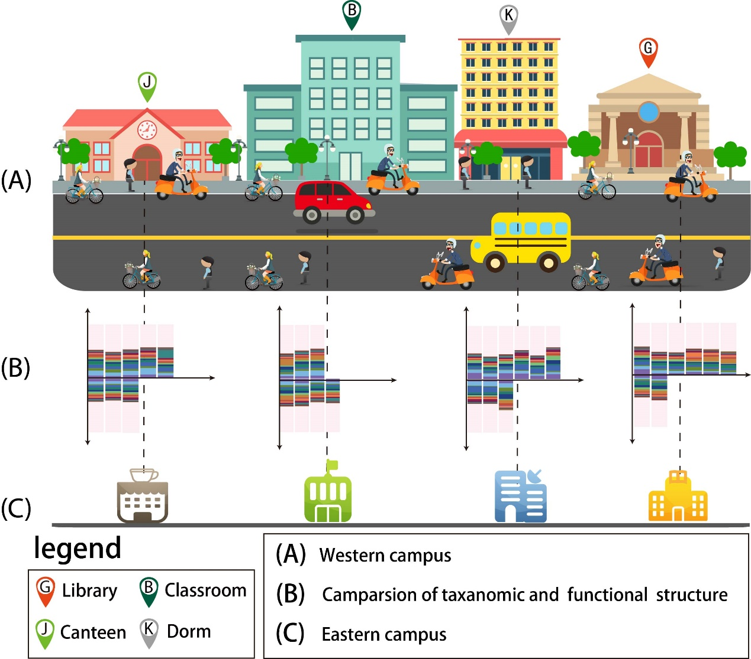

Campus Microbiome Home Project Outreach About
To know your campus and what microbiome you are living with.
Brief Introduction
…
Our values
Results
…
Our Service
…

Slide 2
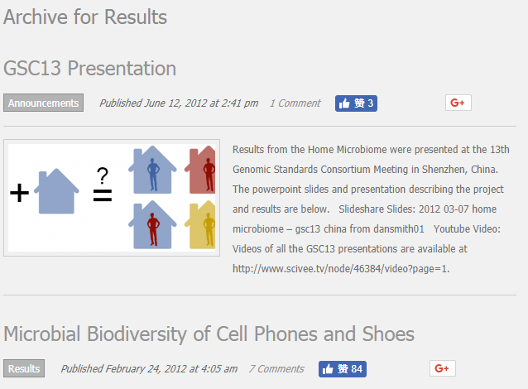
Campus Microbiome Home Project Outreach About
Introduction Results Methods …

Slide 3
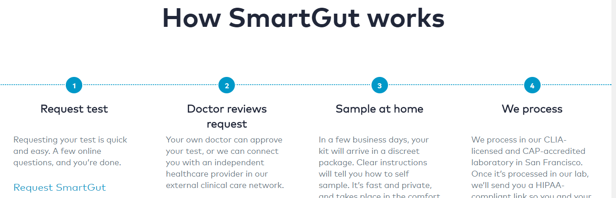

Campus Microbiome Home Project Outreach About
这里是 crowd courcing 的内容，有一些数据搜索和查询，提交的窗口，但是具体实施的方案还没有讨论出来啊。
Submit
data
….
Check
Status
(数据处理情况)
….
Search
Others sharing
Open
sources
….
Released News
********************
….

Slide 4
Campus Microbiome Home Project Outreach About
Contributions
XXX XXX
Acknowledgments

