Slide 1


Shear Flow Modeling
08/19/2025
Ethan Cao

Slide 2

Agenda
Motivating Example
Modeling Objectives
Data Overview
Model Architecture & Output
Future Steps

Slide 3
Motivating Example
The concept of shear flow and how it motivates the use of deep learning simulation

Slide 4

What is a Shear Flow?
Definition: adjacent fluid layers moving parallel to each other with different speeds.
Scenario on the right:
Flow carrying tracer downstream through advection
Tracer spreads and blurs through diffusion
The two fluid layers at the side of the 'white stream' moves at different velocity, hence stretches the tracer

Slide 5
What is a Shear Flow?
Viscosity: measure of a fluid's internal resistance to a flow, can be thought of as thickness
µ
Shear Rate: The rate at which the fluid is deformed (or difference in velocity) due to shear stress
du/dy
Shear Stress: force per unit area exerted (parallel) to a surface by a fluid, causing layers to slide past each other.
𝞽 = µ x du/dy
(Shear Stress for fluids)

Slide 6
Couette Flow – Ideal Example
Upper plate moves at velocity U
V max
Faster layers pulls slower layers forward:
viscosity creates resistance
Shear Stress applied to cause deformation of fluid layers
V = 0
Bottom plate at fixed Motion

Slide 7

Real-World Shear Flow Fluid Dynamics
Crude oil pipeline:
Scenario: As a fluid moves through a pipe, friction at the pipeline’s walls slows the flow and pressure steadily drops. Especially often with cold, high-viscosity fluids or rough pipes.
Application: Predicting velocity and pressure for different pipeline scenarios, evaluating effectiveness of Drag-Reducing Agents (DRAs)
Advantages: fast and data-driven forecasts
High shear stress required due to friction -> more pump power needed to maintain flow
Pressure falls along the pipeline with accumulating friction -> less throughput

Slide 8
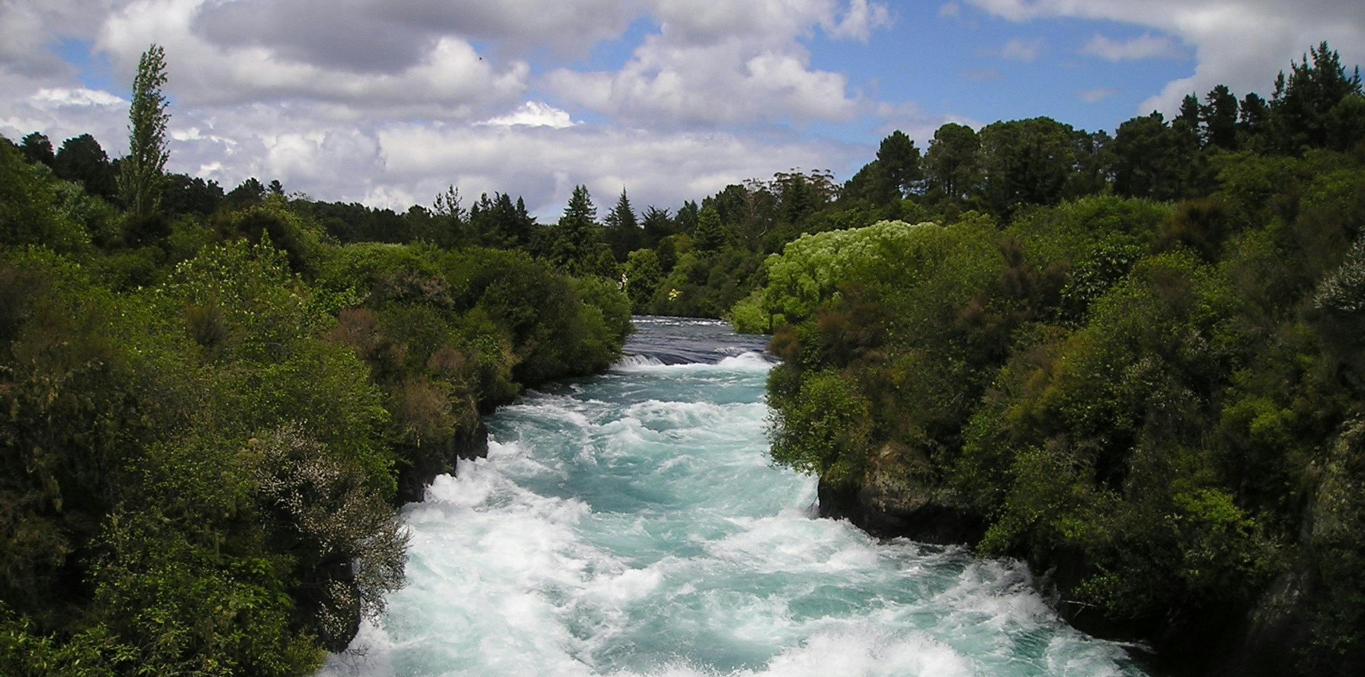
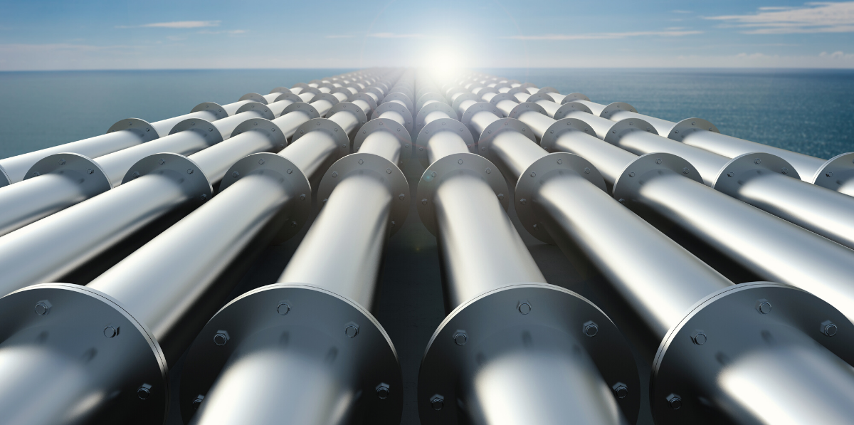

Real-World Shear Flow Fluid Dynamics (in General)
Scenarios of where Shear Flow occurs:
Industrial pipelines: Oil, gas, and water transportation through pipes
Boundary Layers: Air flowing over airplane wings or car bodies
Natural Environments: ocean currents, river shear zones
Lubrication: Thin oil films in engines and machinery

Slide 9
Modeling Objectives
To predict tracer, pressure, and velocity fields in the shear flow system

Slide 10
How it motivates the project?
Shear flows driven by pressure exhibit tightly linked advection, viscous diffusion, and pressure effects across fluid layers.
This project aims to utilize deep learning to:
  Predict complex fluid dynamics in a more time-efficient, data-driven way
  Anticipate transport and flow patterns in biological, environmental, and industrial shear flow systems
  Design better pipelines or industrial fluid systems with the knowledge of shear flow behavior

Slide 11
What are we predicting with PARC?
Velocity fields:
u(x, y, t) and v(x, y, t) – a vector field consisting of horizontal velocity (carries shear layers), and vertical velocity (carries blob perturbations)
Tracer:
s(x, y, t) – a scalar field carried by the flow, indicating the location and the speed of particle diffusion
Pressure Field:
p(x, y, t) – a scalar field that enforces incompressibility and governs the shear flow system

Slide 12
Data Overview
Overview of the fields and conditions in the dataset provided for shear flow

Slide 13
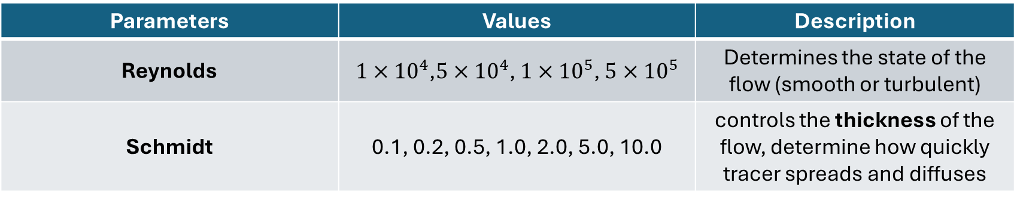
Constants in the dataset
Parameters | Values | Description
Reynolds | ${1×10}^{4}$,$5×{10}^{4}$, $1×{10}^{5}$, $5×{10}^{5}$ | Determines the state of the flow (smooth or turbulent)
Schmidt | 0.1, 0.2, 0.5, 1.0, 2.0, 5.0, 10.0 | controls the thickness of the flow, determine how quickly tracer spreads and diffuses
Viscosity µ = 1/Reynolds
Diffusivity D = µ / Schmidt
"How does the combination of edge cases of Re & Sc affect shear flow?"

Slide 14
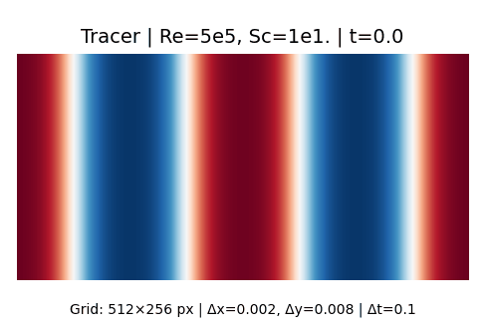
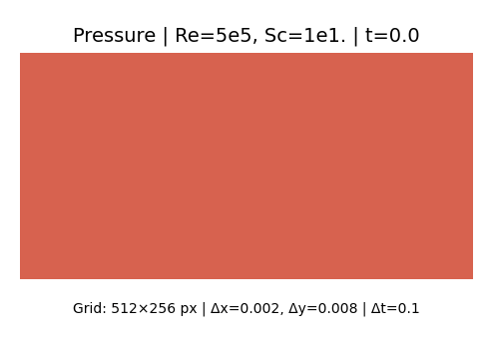
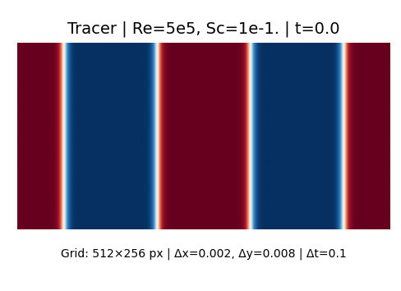
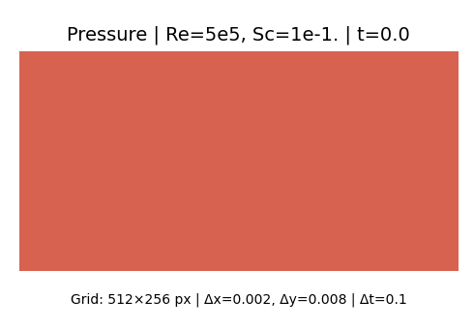
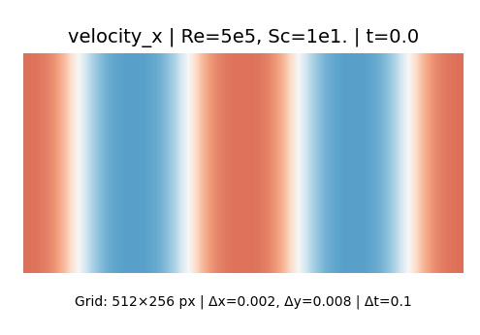
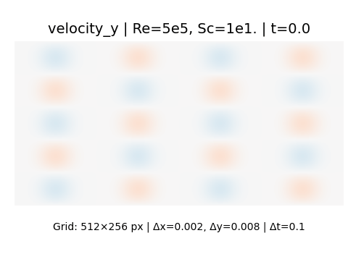
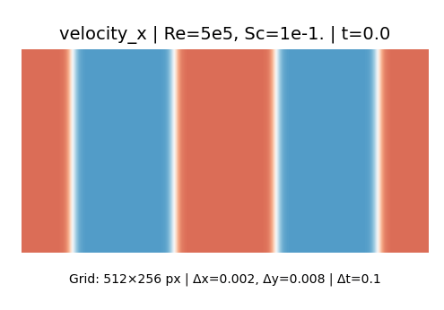
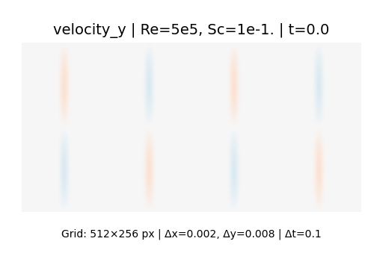
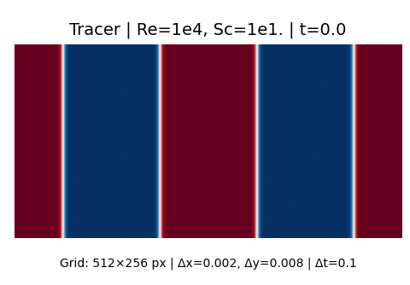

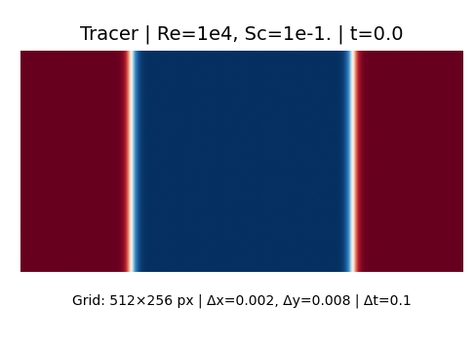

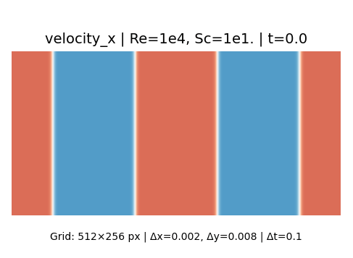
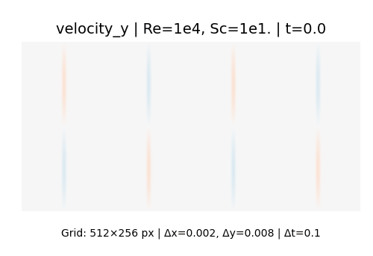
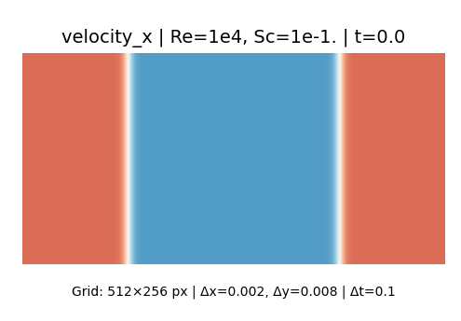
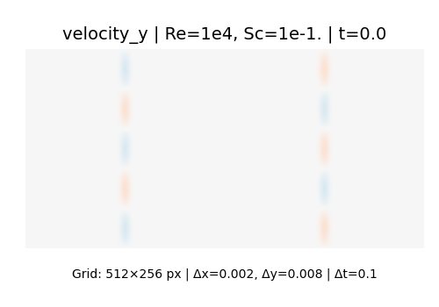
Edge Cases of Reynolds and Schmidt
High Reynolds &
High Schmidt:
Strong Advection, Weak diffusion
High Reynolds &
Low Schmidt:
Strong Advection, Strong diffusion
Low Reynolds & High Schmidt:
Weak Advection, Weak diffusion
Low Reynolds &
Low Schmidt:
Weak Advection, Strong diffusion

Slide 15
Initial Conditions
Parameter | Values | Description
N_shear | 2, 4 | Number of parallel shear layers
N_blobs | 2, 3, 4, 5 | Number of sinusoidal perturbations per layer, controls how many wave-like 'blobs' appear.
W | 0.25, 0.5, 1.0, 2.0, 4.0 | Width of the 'blobs'
Boundary Condition
Frame structure of the simulation – boundaries with periodic flows moving to all sides of the frame

Slide 16
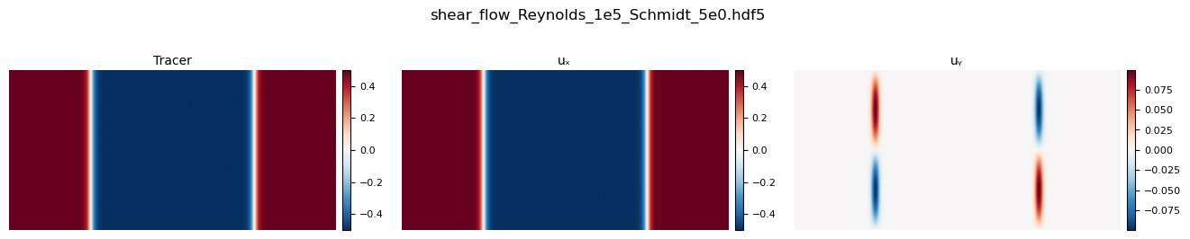
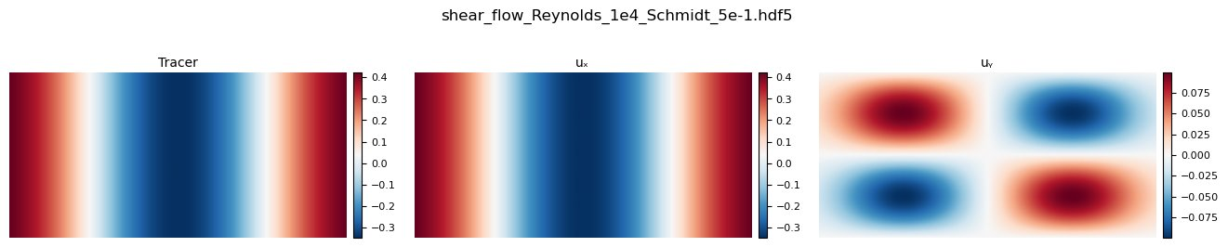
Initial Conditions
Num of Blobs (n_blob)
(n_shear=2, n_blob=2, w=0.25)
Blob width (W)
Num of shears (n_shear)
(n_shear=2, n_blob=2, w=4)

Slide 17
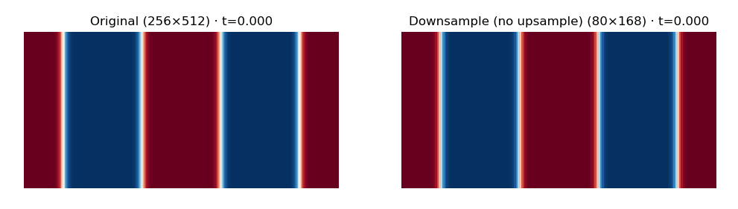
Spatial Down Sampling
Reynolds = 2e-1, Schmidt = 1e4
Notes:
Aspect ratio changed in downsampling
Velocity field may be impacted by the downsampling

Slide 18
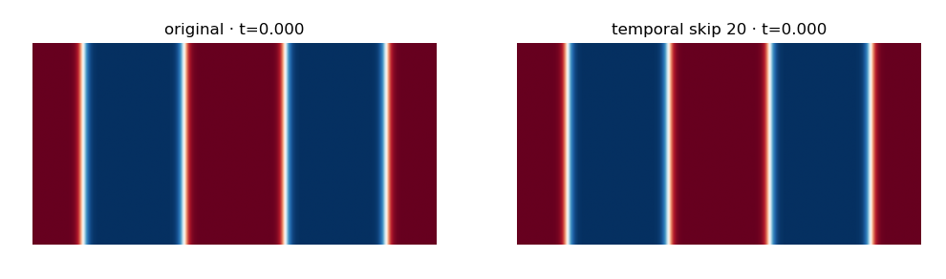
Temporal Down Sampling
Reynolds = 2e-1, Schmidt = 1e4
Notes:
Ideally lower temporal skips
Reduce batch rize of factor of 4 or 8
Increase temporal resolution
Similar computation
But better outcomes

Slide 19
Trajectory Overview
33 data files in total
10 files with 4 trajectories per file -> Original Test Samples
23 files with 32 trajectories per file -> Original Train Samples
The 10 files are duplicates of the same initial/boundary conditions and constants but with different trajectories

Slide 20
Train-Test Split Strategy
Re-split dataset based off Schmidt numbers for better optimization

Slide 21
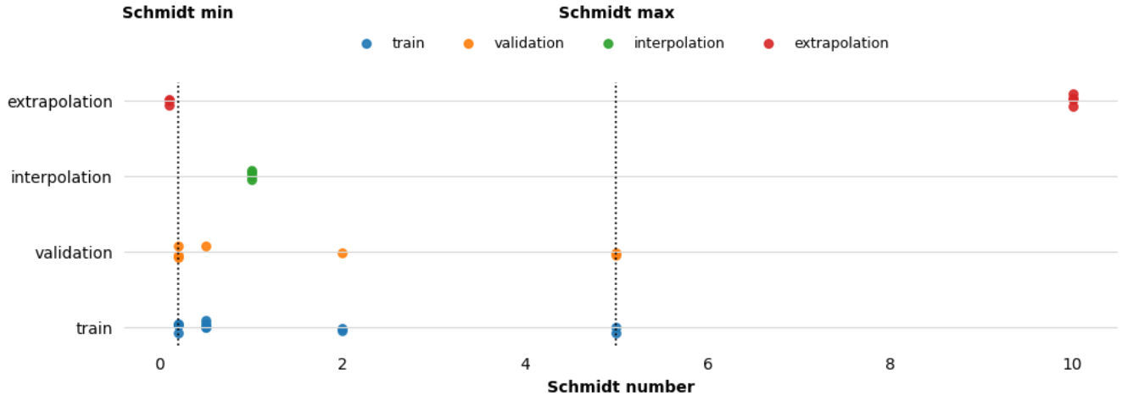
Re-splitting the dataset
Re-splitting the dataset based off Schmidt constant for interpolation and extrapolation
With the same number of trajectories + unique constant and initial conditions

Slide 22
Training Process
Re-designing differentiator and the data loader for better training

Slide 23
Model Building Changes
Adjusted Differentiator to take in Reynolds and Schmidt constants fields and consider their time-derivatives as zeroes
  Ensure model learns the real physical dynamics of shear flow
Extracted Single Trajectories for faster training/validation purposes
Adjusted Integrator to take in velocity fields as state variables to ensure model learns velocity evolving in time

Slide 24
Model Building Changes
Computed spatial reductions & temporal skips for faster and more time-efficient trainings
  Reduced spatial size of data to 1/3
  Skips 10 – 20 temporal steps
  Does not undermine the training output

Slide 25
Training Strategies #1
Train on full trajectories and validate on single trajectory samples
Extract two files {Sc=0.5 & 2.0} for both training and validation
Compute validation loss at each epoch, select the model with the lowest loss for final inference
Train two models with different integrators at the same time to evaluate performance

Slide 26
Training Strategies #2 (Current)
Train and validate on single trajectory samples
Extract two files {Sc=0.5 & 2.0} for validation and all files for training
Compute validation loss at each epoch, select the model with the lowest loss for final inference
Train two models with different integrators at the same time to evaluate performance

Slide 27
Model Output
Outputs of the model from initial rounds of training

Slide 28
Euler Model Inference
Evaluating model outputs on Train, Test, and Validation Samples

Slide 29
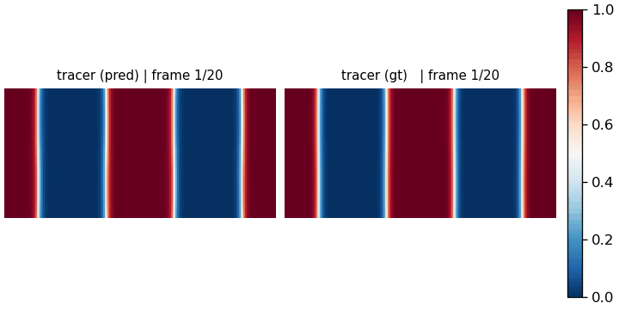
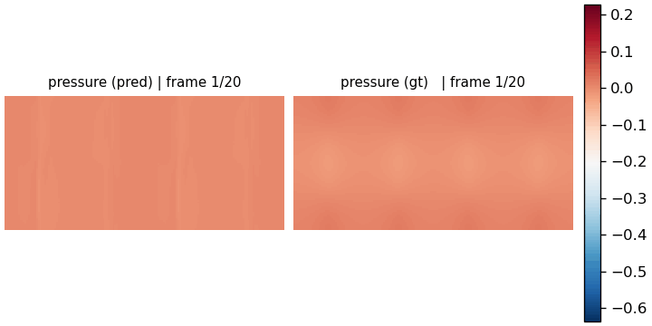
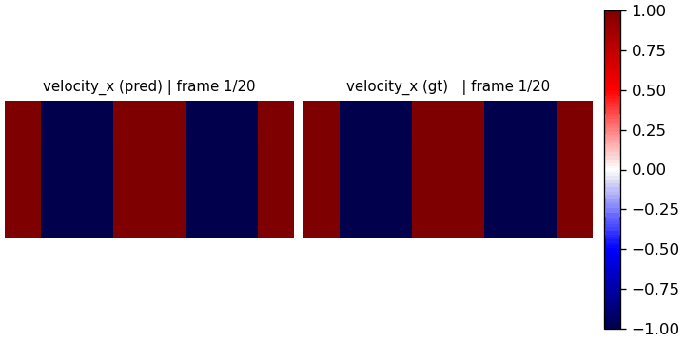
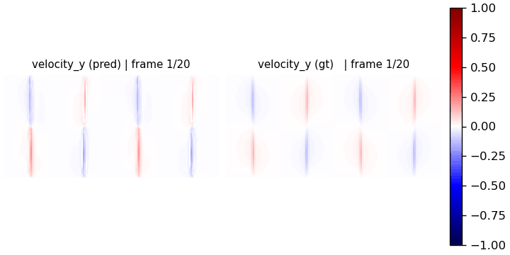
Snapshot Inference Output – Euler
Integrator: Euler, inference: train samples
Epochs: 1000, Batch Size: 60, Temporal Skip: 50, Training: 11 files + single trajectories, Validation: 2 files + single trajectories , learning rate: 1e-4

Slide 30


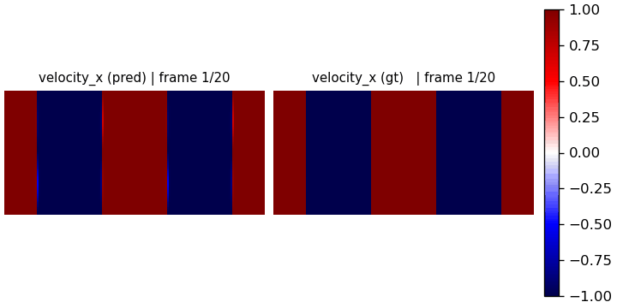
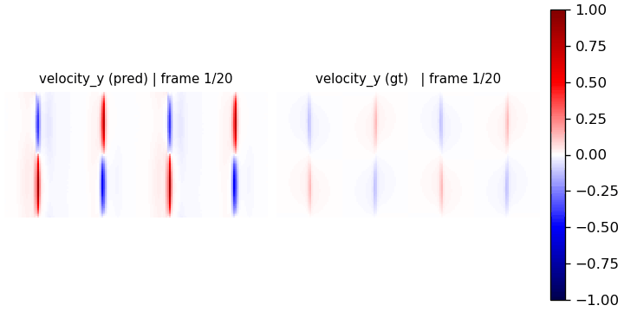
Rollout Inference Output – Euler
Integrator: Euler, inference: train samples
Epochs: 1000, Batch Size: 60, Temporal Skip: 50, Training: 11 files + single trajectories, Validation: 2 files + single trajectories , learning rate: 1e-4

Slide 31
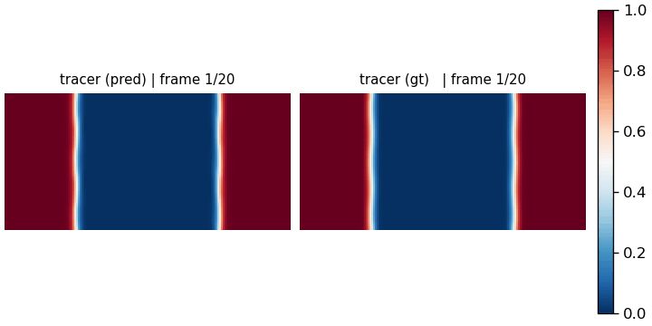
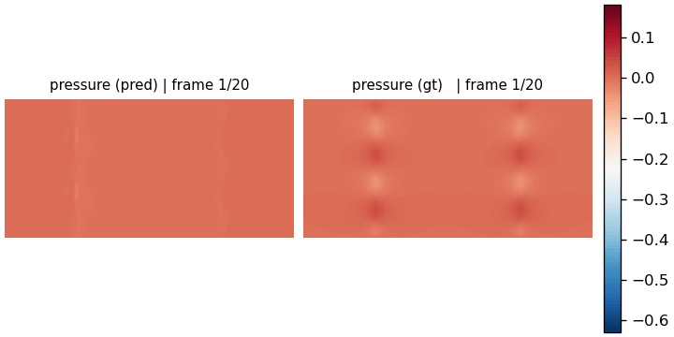
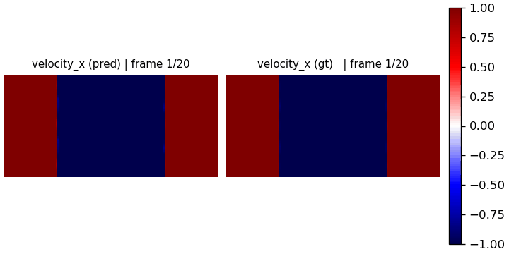
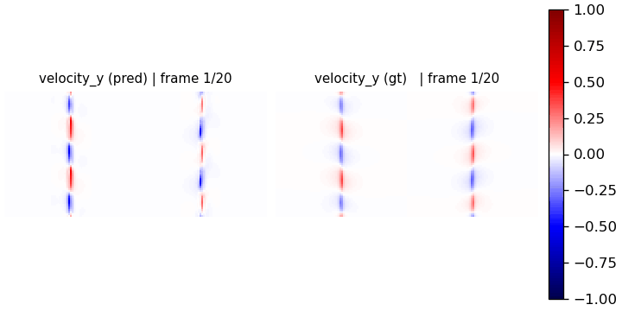
Snap Inference Output – Euler
Integrator: Euler, inference: test samples
Epochs: 1000, Batch Size: 60, Temporal Skip: 50, Training: 11 files + single trajectories, Validation: 2 files + single trajectories , learning rate: 1e-4

Slide 32



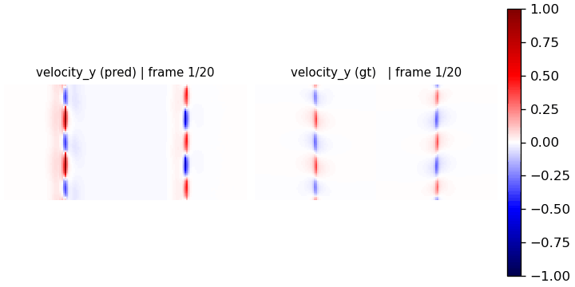
Rollout Inference Output – Euler
Integrator: Euler, inference: test samples
Epochs: 1000, Batch Size: 60, Temporal Skip: 50, Training: 11 files + single trajectories, Validation: 2 files + single trajectories , learning rate: 1e-4

Slide 33
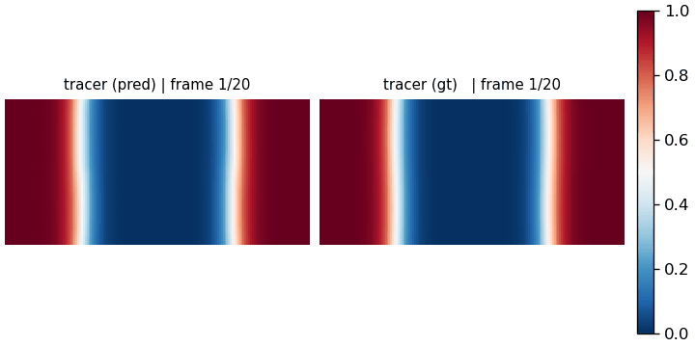
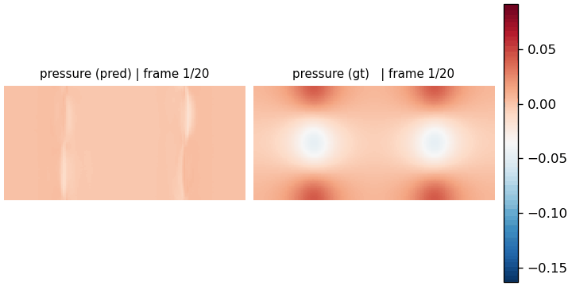
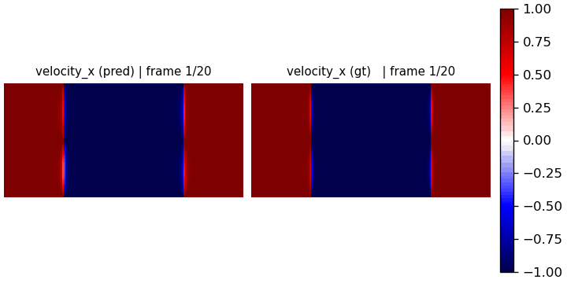
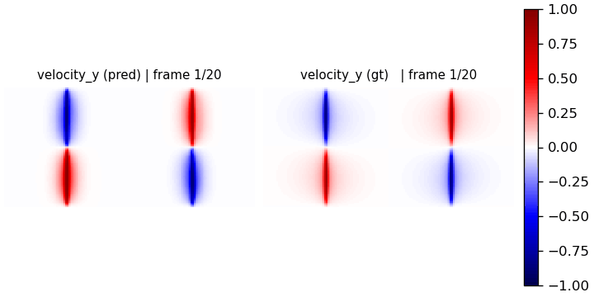
Snapshot Inference Output – Euler
Integrator: Euler, inference: validation samples
Epochs: 1000, Batch Size: 60, Temporal Skip: 50, Training: 11 files + single trajectories, Validation: 2 files + single trajectories , learning rate: 1e-4

Slide 34
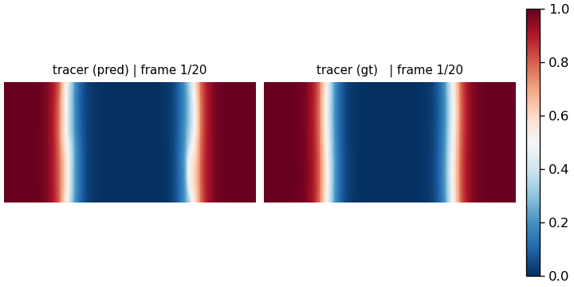
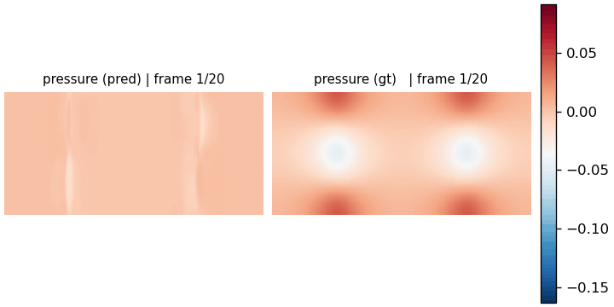

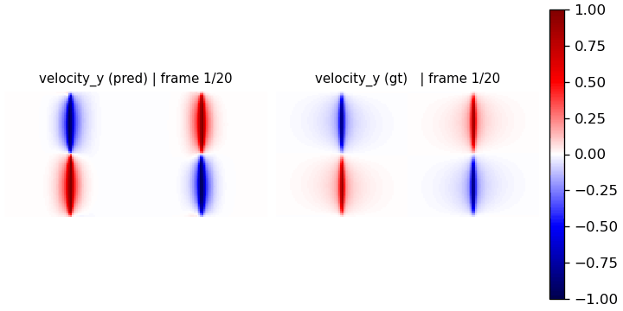
Rollout Inference Output – Euler
Integrator: Euler, inference: validation samples
Epochs: 1000, Batch Size: 60, Temporal Skip: 50, Training: 11 files + single trajectories, Validation: 2 files + single trajectories , learning rate: 1e-4

Slide 35
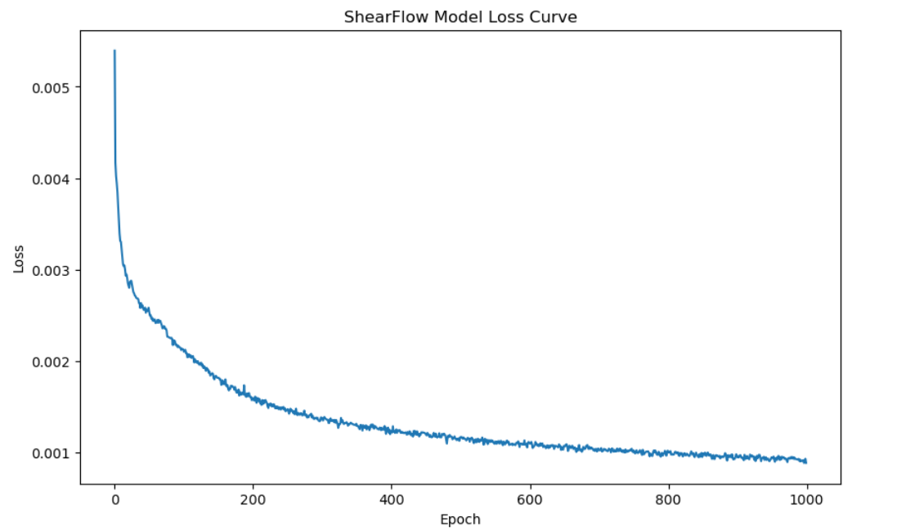
Euler Loss Curve

Slide 36
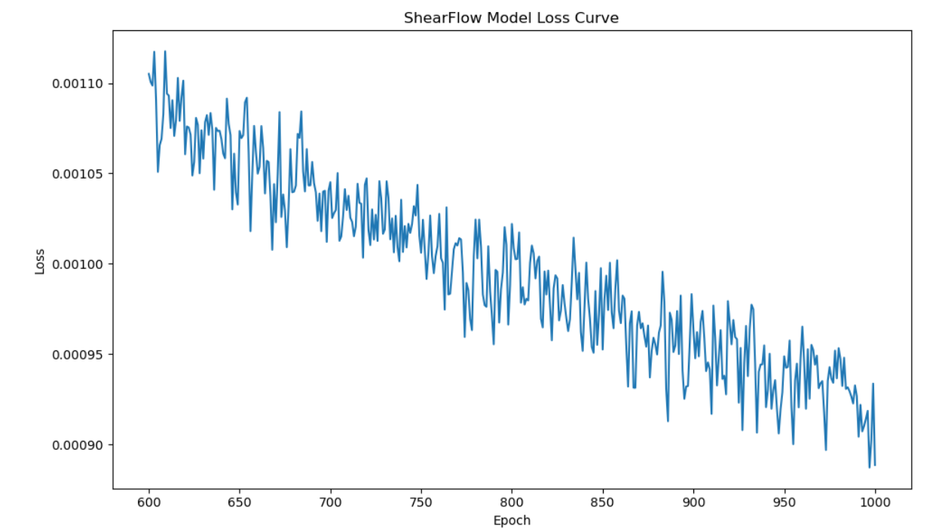
Euler Loss Curve

Slide 37
RK4 Model Inference
Evaluating the model outputs on Train, Test, and Validation Samples

Slide 38

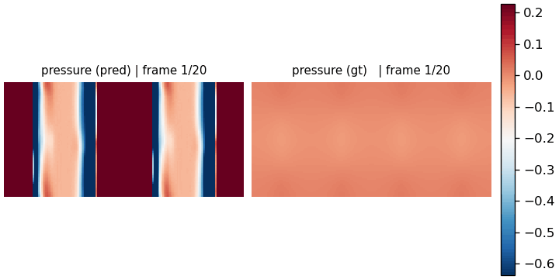

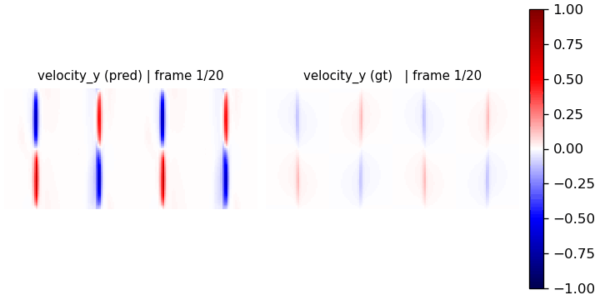
Snapshot Inference Output – RK4
Integrator: RK4, inference: train samples
Epochs: 1000, Batch Size: 40, Temporal Skip: 50, Training: 11 files + single trajectories, Validation: 2 files + single trajectories , learning rate: 1e-4

Slide 39

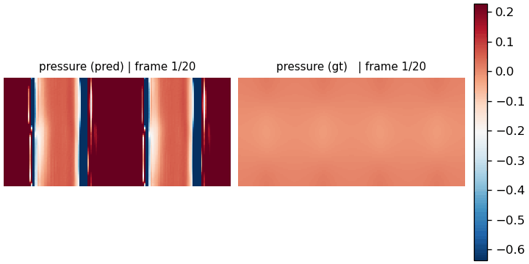

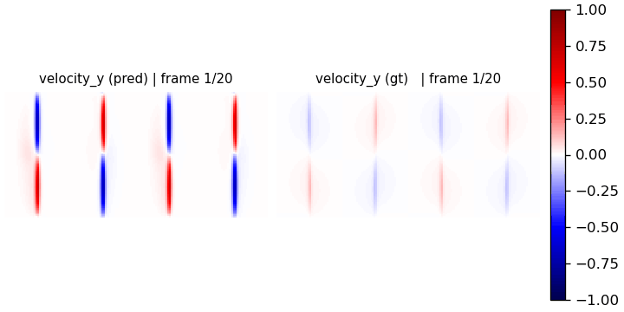
Rollout Inference Output – RK4
Integrator: RK4, inference: train samples
Epochs: 1000, Batch Size: 40, Temporal Skip: 50, Training: 11 files + single trajectories, Validation: 2 files + single trajectories , learning rate: 1e-4

Slide 40

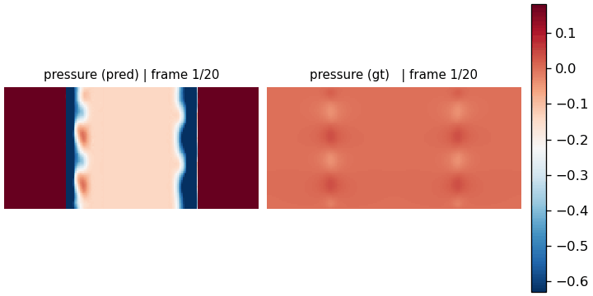

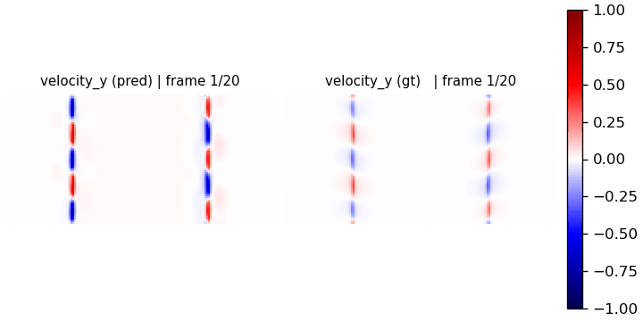
Snapshot Inference Output – RK4
Integrator: RK4, inference: test samples
Epochs: 1000, Batch Size: 40, Temporal Skip: 50, Training: 11 files + single trajectories, Validation: 2 files + single trajectories , learning rate: 1e-4

Slide 41

Rollout Inference Output – RK4
Integrator: RK4, inference: test samples
Epochs: 1000, Batch Size: 40, Temporal Skip: 50, Training: 11 files + single trajectories, Validation: 2 files + single trajectories , learning rate: 1e-4

Slide 42

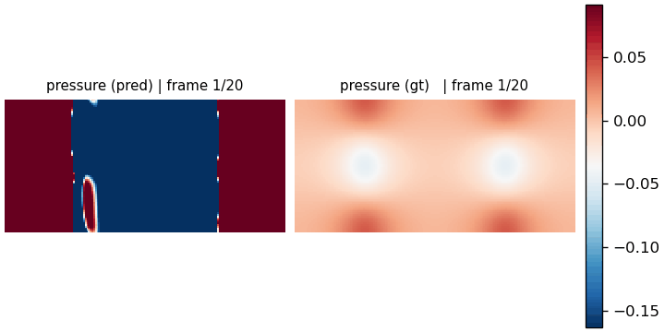

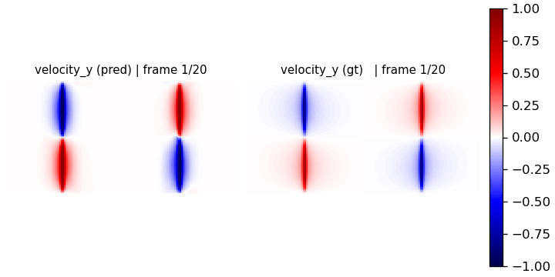
Snapshot Inference Output – RK4
Integrator: RK4, inference: validation samples
Epochs: 1000, Batch Size: 40, Temporal Skip: 50, Training: 11 files + single trajectories, Validation: 2 files + single trajectories , learning rate: 1e-4

Slide 43




Rollout Inference Output – RK4
Integrator: RK4, inference: validation samples
Epochs: 1000, Batch Size: 40, Temporal Skip: 50, Training: 11 files + single trajectories, Validation: 2 files + single trajectories , learning rate: 1e-4

Slide 44

RK4 Loss Curve

Slide 45

RK4 Loss Curve

Slide 46
Observations
Euler: Quicker training iterations, accurate snapshot predictions, loss is unstable and with mediocre rollout predictions
  Appears to rollout better at 100-200 epochs
RK4: slower training iterations, stabler loss, theoretically less error on rollout prediction, but performs poorly due to compounding errors -> different configuration needed
Both models generally predict well on snapshots + very first timestamp of rollout

Slide 47
Euler Inference at 100 epochs
Interesting Observation of better performance at earlier stages

Slide 48




Rollout Inference Output – Euler
Integrator: Euler, inference: train samples
Epochs: 100, Batch Size: 60, Temporal Skip: 50, Training: 11 files + single trajectories, Validation: 2 files + single trajectories , learning rate: 1e-4

Slide 49




Rollout Inference Output – Euler
Integrator: Euler, inference: test samples
Epochs: 100, Batch Size: 60, Temporal Skip: 50, Training: 11 files + single trajectories, Validation: 2 files + single trajectories , learning rate: 1e-4

Slide 50




Rollout Inference Output – Euler
Integrator: Euler, inference: validation samples
Epochs: 100, Batch Size: 60, Temporal Skip: 50, Training: 11 files + single trajectories, Validation: 2 files + single trajectories , learning rate: 1e-4

Slide 51
Future Steps
Further steps to take to optimize the model and evaluate its outputs

Slide 52
Optimization Results so far
Training time accelerated from 8+ hours per training sample w/ full trajectory -> 6.75 minutes per training sample w/ full trajectory.
Reduced rollout inference MSE on training sample from ~0.12 to ~0.0228 (by ~81%)

Slide 53
Optimizing Inference Quality
Experiment with a range of parameters & configurations
  Learning rates, temporal skips, number of trajectories, number of training samples, integrators
Once optimized fully, check if test and validation results perform equally as good as training samples.
Evaluate the inference quality with physics-based quantitative physics metrics in the ShearFlow equation.

Slide 54
Thank You
Notes:
Lower batch size – lower than 60 to 5 to 2
- Could explain why loss

Slide 55
Older Documentation Pages
Previous explorations or slides that reflected poor outputs

Slide 56
Trajectory Analysis
Based on the information from the header file, we know that there are 4 trajectories for each file – we want to compare these to each other across 3 files (at random)
Min/Max Absolute Difference: For each field, we take the trajectories and compute the min & max absolute difference – smallest and largest of those values are the min & max absolute differences
  Why does this good? – Catches any change, anywhere, tells us how similar or not (min & max) the runs are to each other
    At least 1 identical: min = 0
    Every Pair Diff: min > 0 or max >0
    All the Same: max = 0
Conclusion:
  Within files: we have four independent starting points randomized by tracer blobs – same scenario slightly tweaked
  Amongst files: the files differ in terms of flow regime (different Re & Sc), but the way randomization of the blobs occur does not change

Slide 57
More recent trainings (broken model)

Slide 58




Snapshot Inference Output – Euler
Integrator: Euler, inference: train samples
Epochs: 100, Batch Size: 70, Temporal Skip: 20, Training: 2 files + full trajectories, Validation: 2 files + single trajectories , learning rate: 1e-5
Notes:
Euler

Slide 59




Rollout Inference Output – Euler
Integrator: Euler, inference: train samples
Epochs: 100, Batch Size: 70, Temporal Skip: 20, Training: 2 files + full trajectories, Validation: 2 files + single trajectories , learning rate: 1e-5
Notes:
Euler

Slide 60




Snapshot Inference Output – Euler
Integrator: Euler, inference: test samples
Epochs: 100, Batch Size: 70, Temporal Skip: 20, Training: 2 files + full trajectories, Validation: 2 files + single trajectories , learning rate: 1e-5
Notes:
Euler

Slide 61




Rollout Inference Output – Euler
Integrator: Euler, inference: test samples
Epochs: 100, Batch Size: 70, Temporal Skip: 20, Training: 2 files + full trajectories, Validation: 2 files + single trajectories , learning rate: 1e-5
Notes:
Euler

Slide 62

Loss Curve – Euler (recent)

Slide 63

Loss Curve – Euler (recent)

Slide 64
Longer training outputs

Slide 65




Snapshot Inference Output – Euler
Integrator: Euler, inference: val samples
Epochs: 1000, Batch Size: 70, Temporal Skip: 20, Training: 2 files + full trajectories, Validation: 2 files + single trajectories , learning rate: 1e-5
Notes:
Euler

Slide 66




Rollout Inference Output – Euler
Integrator: Euler, inference: val samples
Epochs: 1000, Batch Size: 70, Temporal Skip: 20, Training: 2 files + full trajectories, Validation: 2 files + single trajectories , learning rate: 1e-5
Notes:
Euler
Learning rate – experiment for shearflow
Don’t use the word ‘model’ is wrong, but rather wrong configuration
Pressure – normalize to 0 to 1
Make experiments less than 30 min for 500 epochs – aim for rollout not breaking (tracer)

Slide 67

Loss Curve – Euler (longer)

Slide 68

Loss Curve – Euler (longer)

Slide 69




Snap Inference Output – RK4
Integrator: RK4, inference: train samples
Epochs: 100, Batch Size: 40, Temporal Skip: 20, Training: 2 files + full trajectories, Validation: 2 files + single trajectories , learning rate: 1e-5
Notes:
RK4

Slide 70




Rollout Inference Output – RK4
Integrator: RK4, inference: train samples
Epochs: 100, Batch Size: 40, Temporal Skip: 20, Training: 2 files + full trajectories, Validation: 2 files + single trajectories , learning rate: 1e-5
Notes:
RK4

Slide 71




Snap Inference Output – RK4
Integrator: RK4, inference: test samples
Epochs: 100, Batch Size: 40, Temporal Skip: 20, Training: 2 files + full trajectories, Validation: 2 files + single trajectories , learning rate: 1e-5
Notes:
RK4

Slide 72




Rollout Inference Output – RK4
Integrator: RK4, inference: test samples
Epochs: 100, Batch Size: 40, Temporal Skip: 20, Training: 2 files + full trajectories, Validation: 2 files + single trajectories , learning rate: 1e-5
Notes:
RK4

Slide 73

Loss Curve – RK4 (recent)

Slide 74

Loss Curve – RK4 (recent)

Slide 75
Older trainings (broken model)

Slide 76




Snapshot Inference Output
Integrator: Euler, Epochs: 1000, Batch Size: 70, Temporal Skip: 20, Training: 2 files + full trajectories, Validation: 2 files + single trajectories , inference: test samples, learning rate: 1e-5
Notes:
Normalization for tracer and pressure – range: 0 to 1 or -1 to 1
Highlight the sample that is used for inference

Slide 77




Rollout Inference Output
Integrator: Euler, Epochs: 1000, Batch Size: 70, Temporal Skip: 20, Training: 2 files + full trajectories, Validation: 2 files + single trajectories , inference: test samples, learning rate: 1e-5

Slide 78




Snapshot Inference Output
Integrator: RK4, Epochs: 1000, Batch Size: 20, Temporal Skip: 20, Training: 2 files + full trajectories, Validation: 2 files + single trajectories , inference: test samples, learning rate: 1e-5
Notes:
The min max for pressure doesn’t look right, there could be another file that dominates the larger range of the pressure field, the range should be ranging from 0 to 1 or -1 to 1. Pressure scale out of scale needs to be address.

Slide 79




Rollout Inference Output
Integrator: RK4, Epochs: 1000, Batch Size: 20, Temporal Skip: 20, Training: 2 files + full trajectories, Validation: 2 files + single trajectories , inference: test samples, learning rate: 1e-5

Slide 80

Loss Curve – Euler

Slide 81

Loss Curve – Euler

Slide 82

Loss Curve – RK4

Slide 83

Loss Curve – RK4

