Slide 1

Popular baby names in era of 1800-1900
Michelle Houston

Slide 2
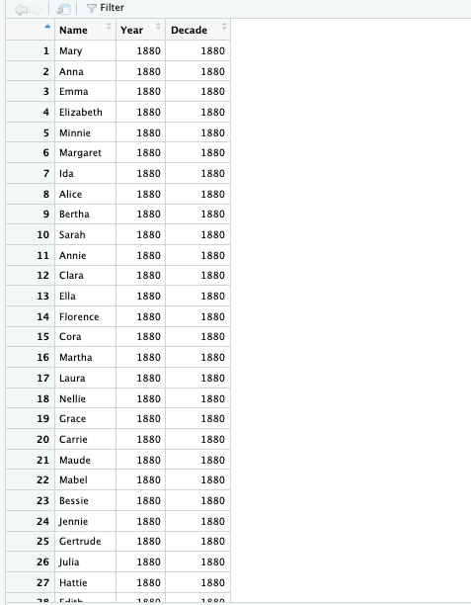
DATA DECADE

Slide 3
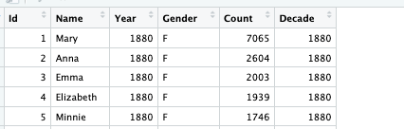
5 MOST POPULAR FEMALE NAMES

Slide 4
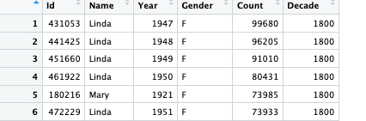
5 MORE MOST POPULAR FEMALE NAMES

Slide 5
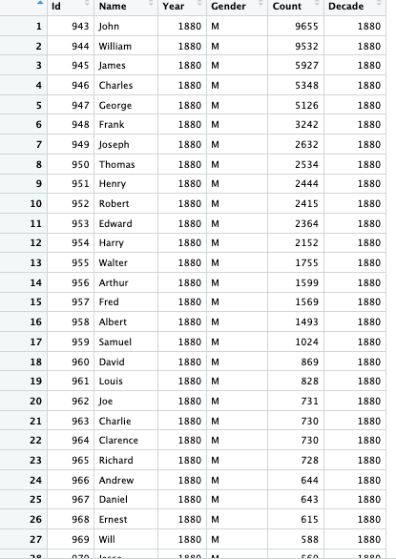
MOST POPULAR MALE NAMES

Slide 6
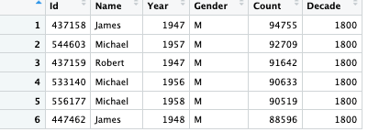
5 TOP POPULAR MALE NAMES

Slide 7
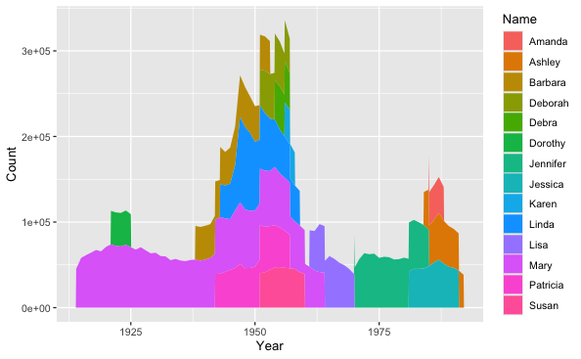
FEMALE PLOT FOR MOST POPULAR NAMES

Slide 8
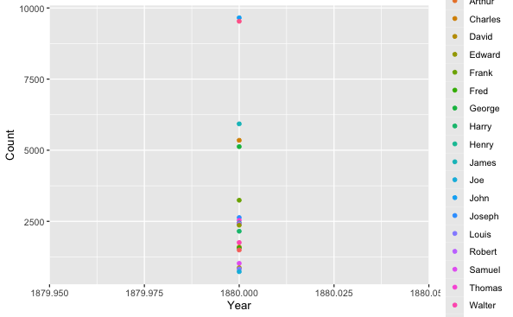
MALE PLOT FOR MOST POPULAR NAMES

Slide 9
Conclusion
The Observation that was shown from era 1800-1900’s:
For Females names:
Mary, Anna, Emma Elizabeth, Minnie, Margaret. Then there is the Ashely’s, Amanda’s
For Males:
Michael, John, William, Frank.

Slide 10
Thank you so much
.

