Slide 1

SPACESHIP TITANTIC
R PROJECT
Michelle Houston

Slide 2
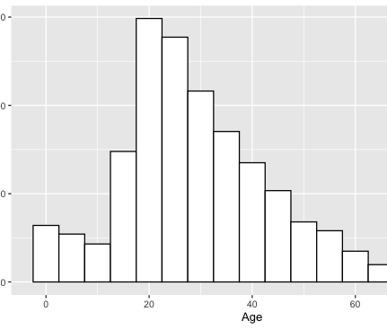
AGE GROUP FOR TITANIC
The age group passengers were 29, youngest passengers were 0, and the oldest passengers were 79. 53% were adult ages from 20-39. Minors ages from 0-12 (9%) and senior 60+ (3%). Among the transported passengers, children 0-12 shows the highest likelihood of being transported (70%) than the older age groups.

Slide 3
Passengers per Destination Total
53% of the passengers from Earth, 23% of the passengers from Europa, 24% from Mars.
For Destination: 69% will be debarking at TRAPPIST-1e, 20% will debark at 55 Cancri e, and 11% will be debarking at PSO J318.5-22.

Slide 4
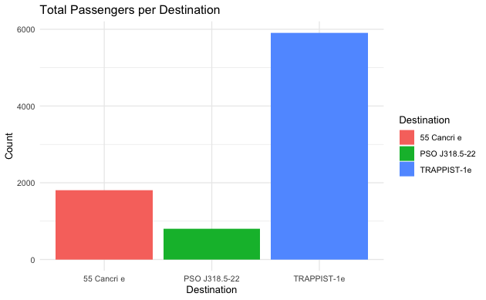
Where most of the passengers going?!

Slide 5
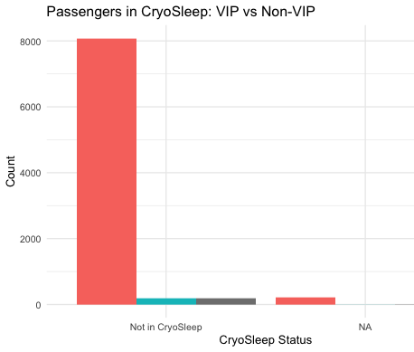
CryoSleep VIP vs Non-VIP
There were no VIP’s in CryoSleep.
There were about 1544 passengers in CryoSleep.

Slide 6
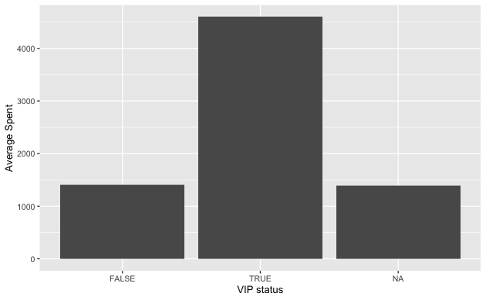
Average Spent by VIP’s and Non VIP’S
On average VIP’s Passengers spent over $5,000
On average the non VIP’s spent a little over, close to $1800.00

