Slide 1
World Happiness Analysis and Prediction
Group 2:
Keqi Zhang, Zhichun Xiao, Cheritha Kondru, Junemo Moon
2025FA - REGRES TIME SER 16:954:596:02

Slide 2
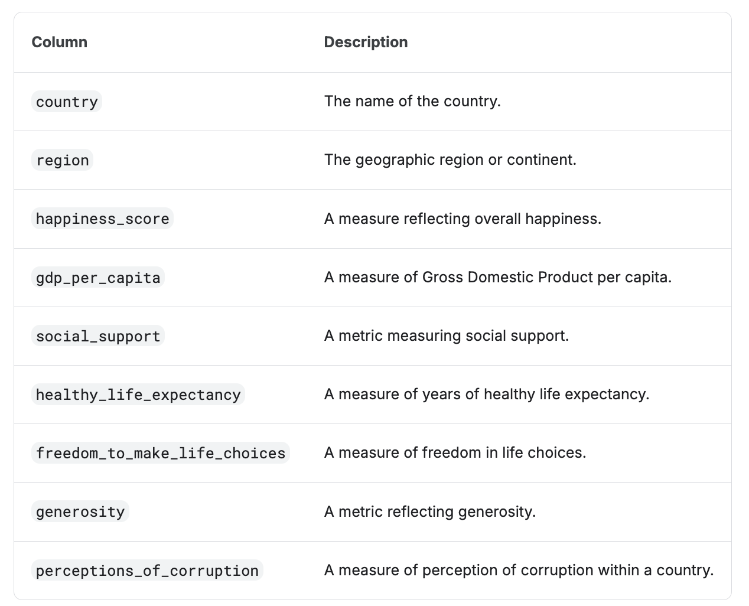
Dataset
2015 up to 2023
1367 observations
10 Region: Western Europe/North America and ANZ/Latin America and Caribbean/Middle East and North Africa/Southeast Asia/East Asia/Central and Eastern Europe/Africa/Sub-Saharan Africa/Commonwealth of Independent States
Kaggle – Global Happiness Scores and Factors (2015–2023)
https://www.kaggle.com/datasets/sazidthe1/global-happiness-scores-and-factors

Slide 3
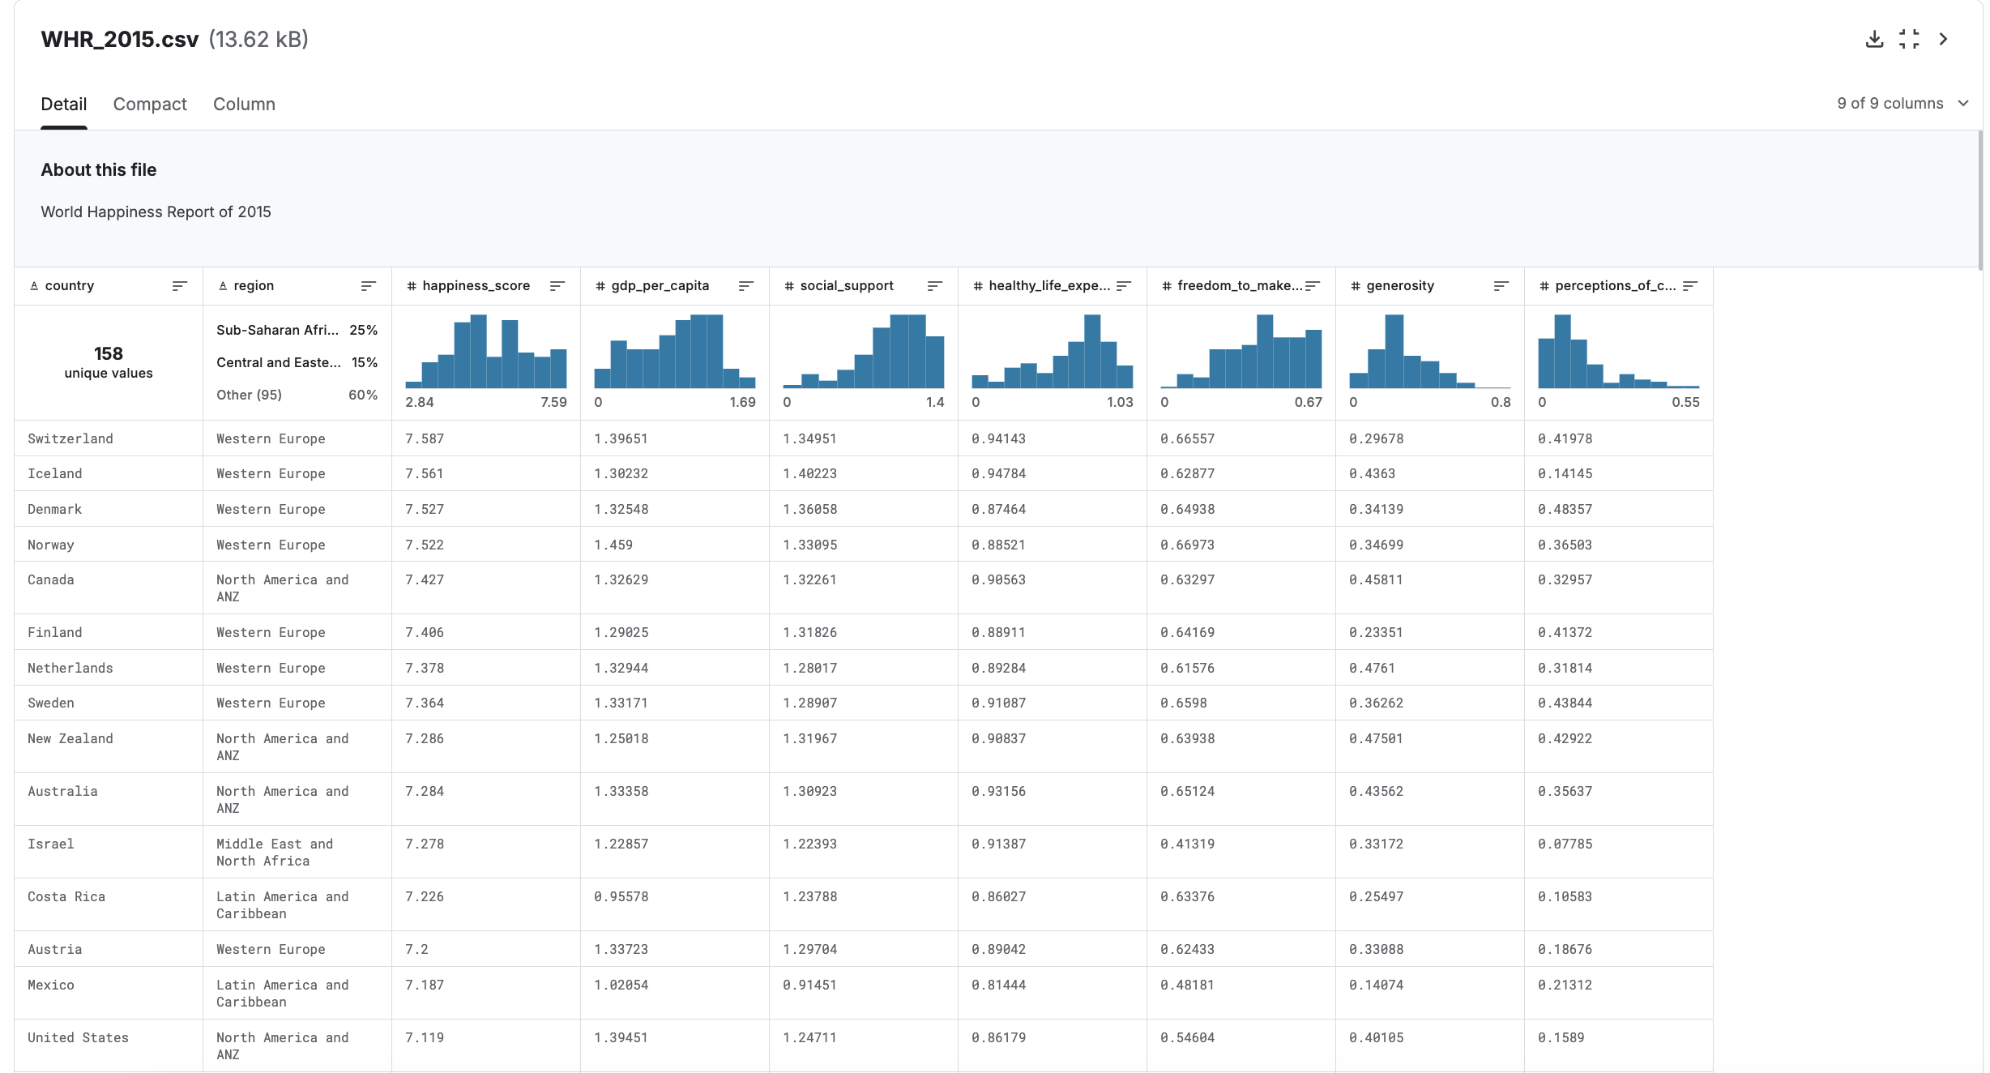

Slide 4
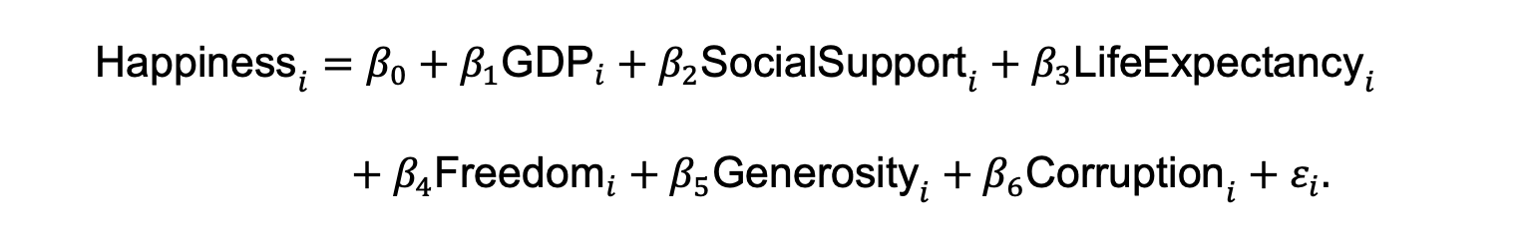
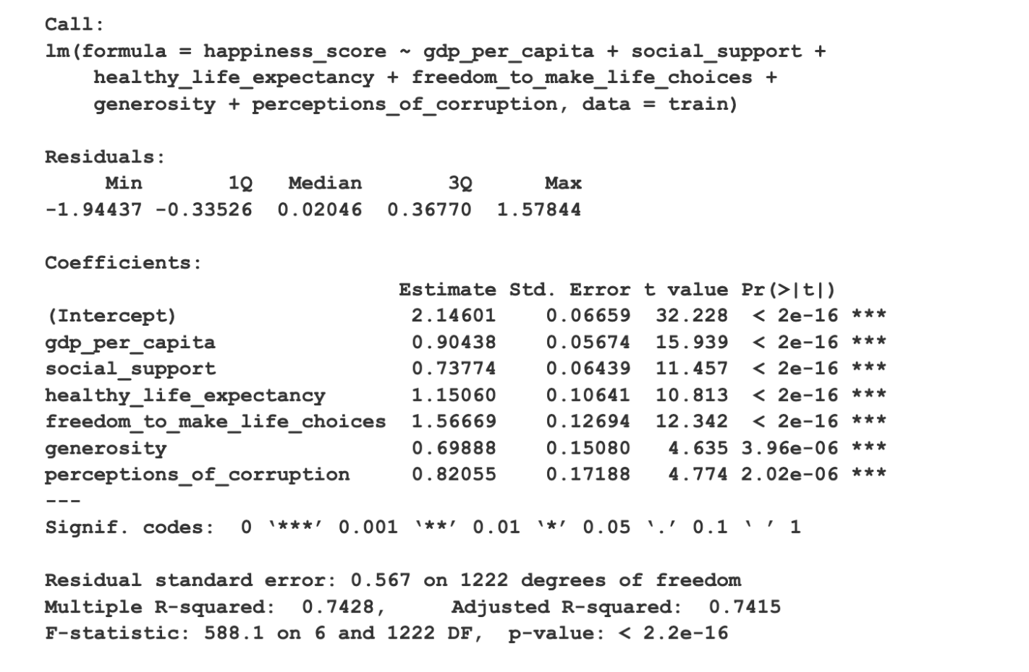
Regression model

Slide 5
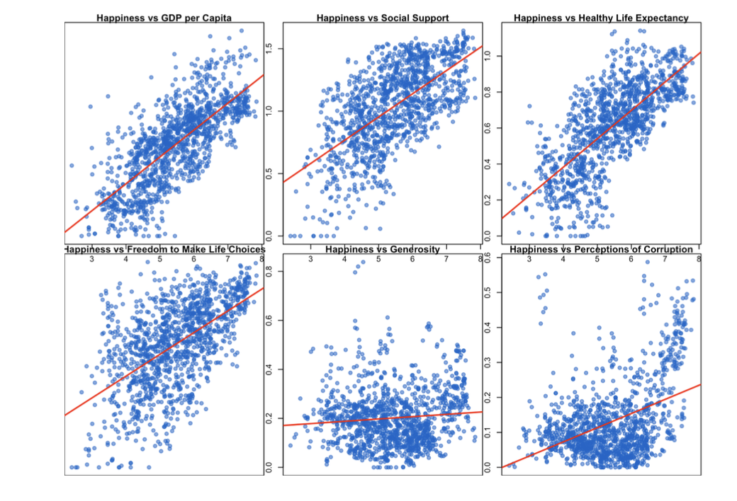

Relationship between dependent variable & six explanatory variables
The Happiness Score tends to increase, which is consistent with the positive coefficients ($β value$s)reported in the regression results.

Slide 6
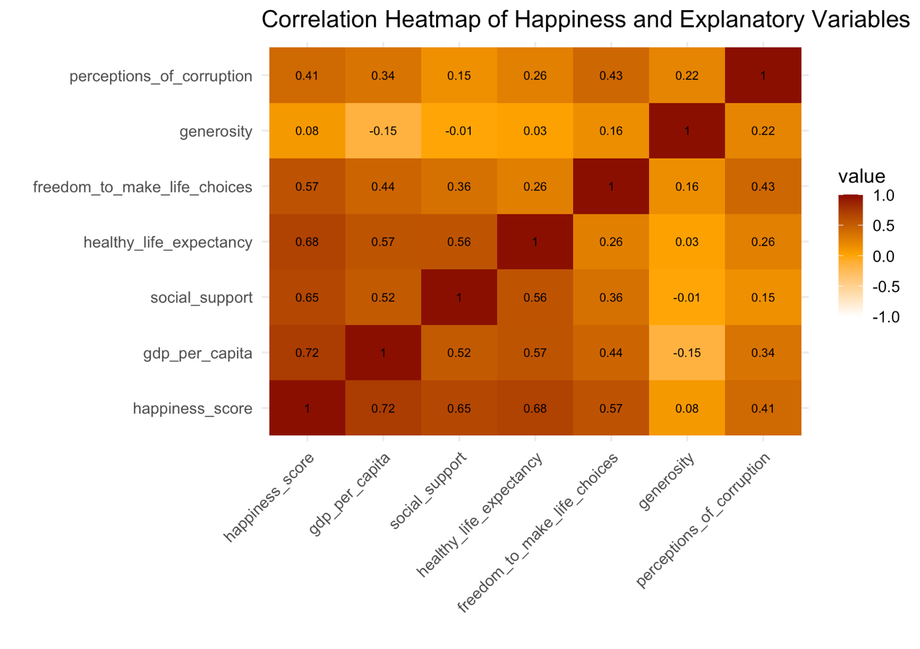
Heat map
Red/Dark Orange (Closer to 1.0): Indicates a strong positive correlation.
GDP_per_capita=0.72 is strongest positive correlation; higher GDP is associated with higher happiness.
Comparing the correlation from the heatmap to the regression coefficients
bivariate relationship and a multivariate relation

Slide 7
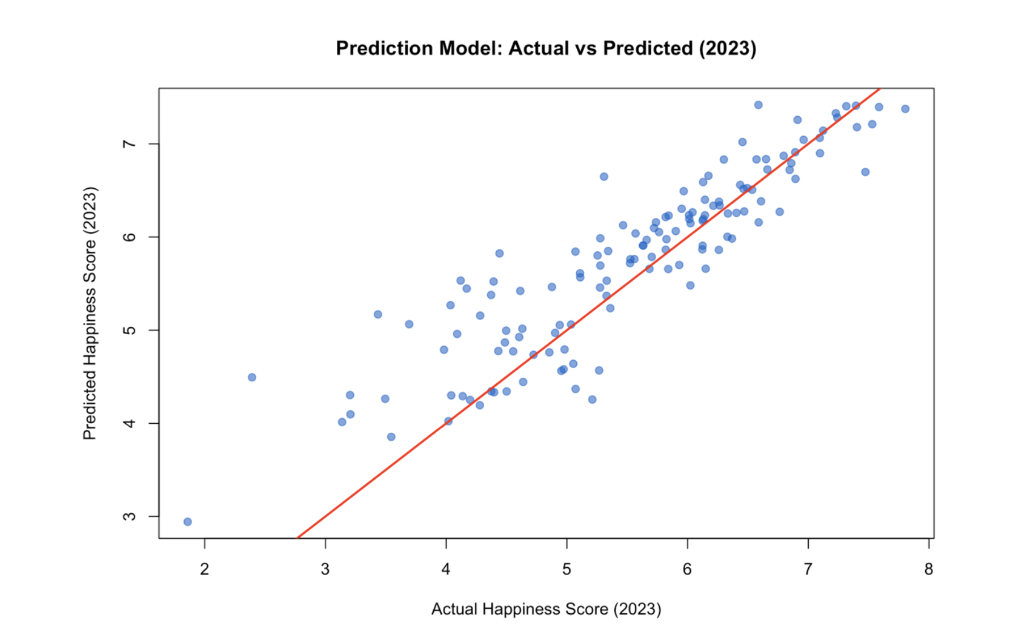
Prediction performance
2015-2022 data as the training set and the 2023 data as the testing set
Overall Fit: The majority of the blue data points cluster tightly around the red line, indicating that the model's predictions are highly accurate for most countries in 2023. (perfect prediction line.)

Slide 8
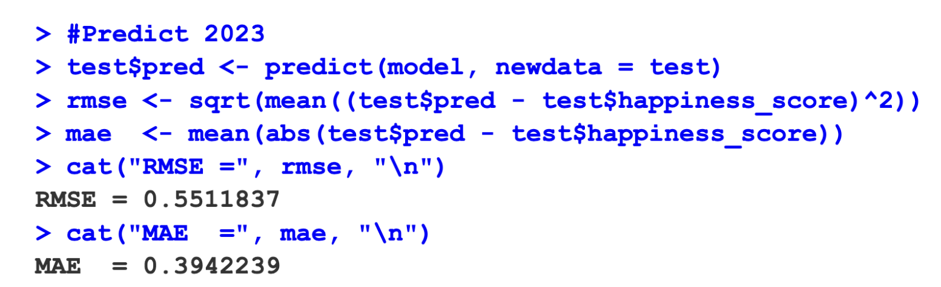
Prediction performance
RMSE (Root Mean Square Error) quantifies the average magnitude of errors between predicted values from a model and actual observed values.
MAE(mean absolute error) is a measure of the average magnitude of errors between paired observations.
It is calculated by summing the absolute differences between predictions and actual values, then dividing by the number of observations.
Notes:
On average, our model’s predictions are off by about 0.551 points from the actual happiness score.
On average, our model’s predictions are off by about 0.394 points in absolute terms.

Slide 9
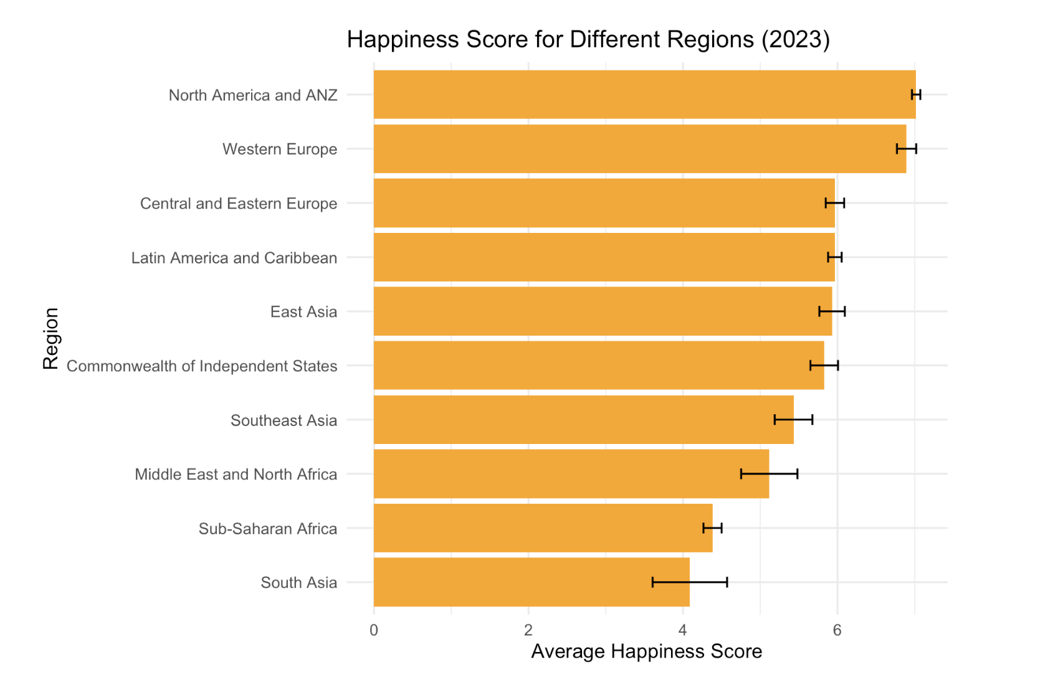
Predicted average happiness scores across major world regions in 2023 (including error)
The black “H” bars represent the prediction error or margin of error associated with that regional average.
The fact that these error bars are relatively small indicates that the model's predictions are precise.
This is consistent with the low overall error metrics found in the model's performance analysis.

Slide 10
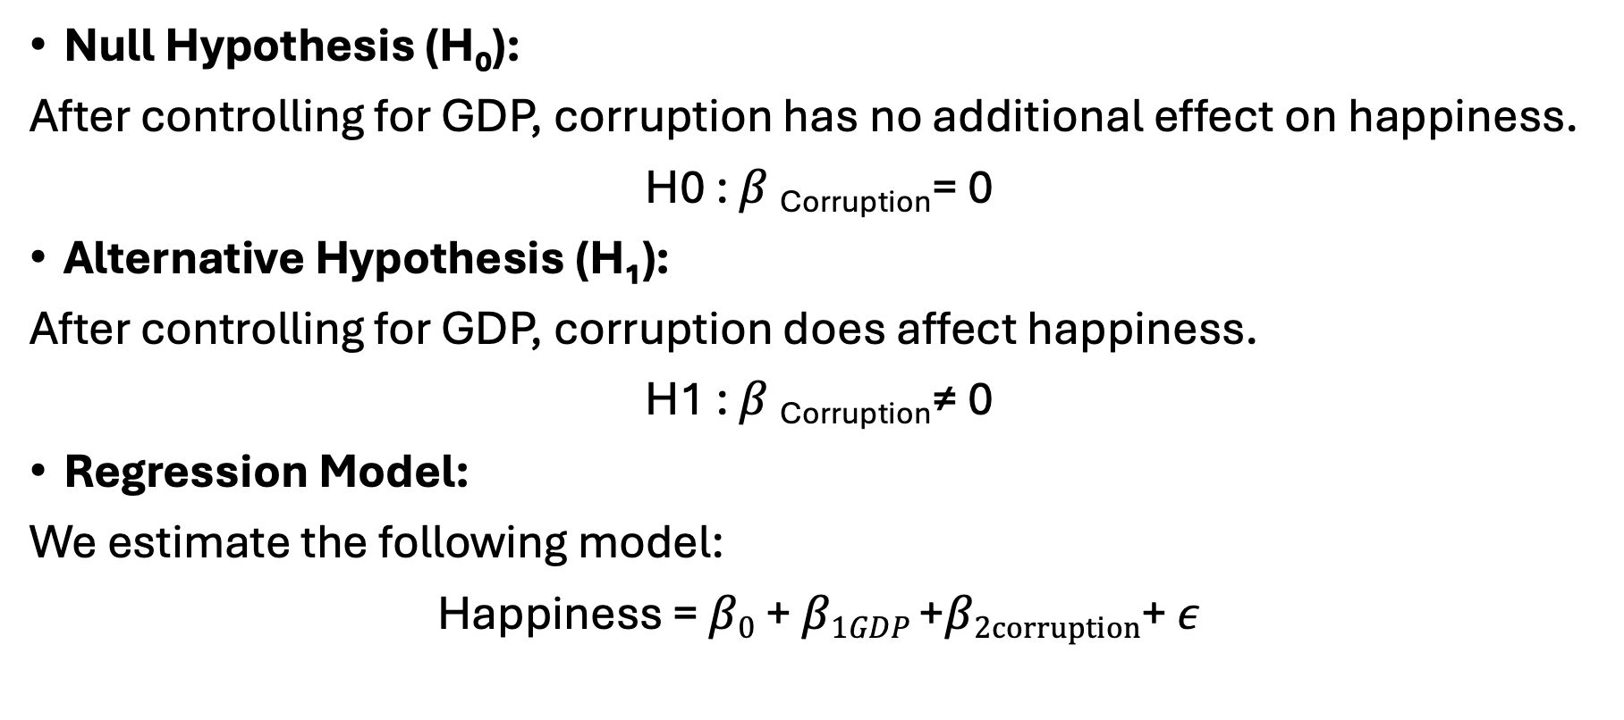
Hypothesis 1: Does Corruption Affect Happiness After Controlling for GDP?
Null Hypothesis (H₀):
After controlling for GDP, corruption has no additional effect on happiness.
H0 : $β \text{Corrupti}\text{on}$= 0
Alternative Hypothesis (H₁):
After controlling for GDP, corruption does affect happiness.
H1 : $β \text{Corruptio}\text{n}$≠ 0
Regression Model:
We estimate the following model:
Happiness = $β0$ + $β1GDP$ +$β2corruption$+ $ε$

Slide 11
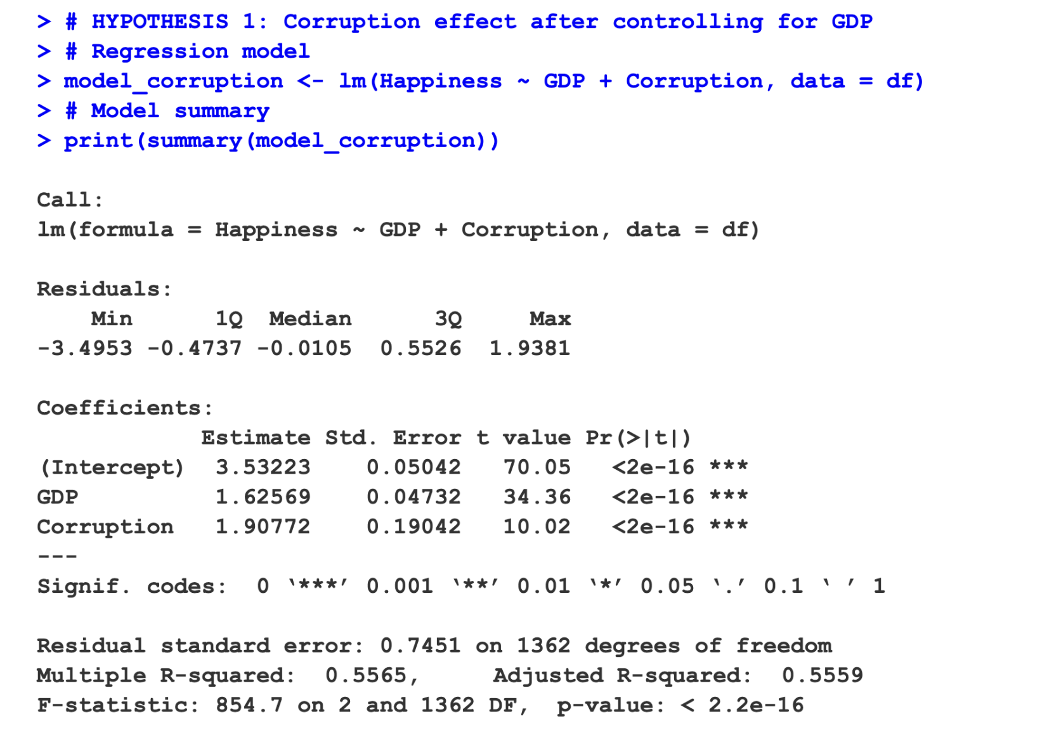

Slide 12
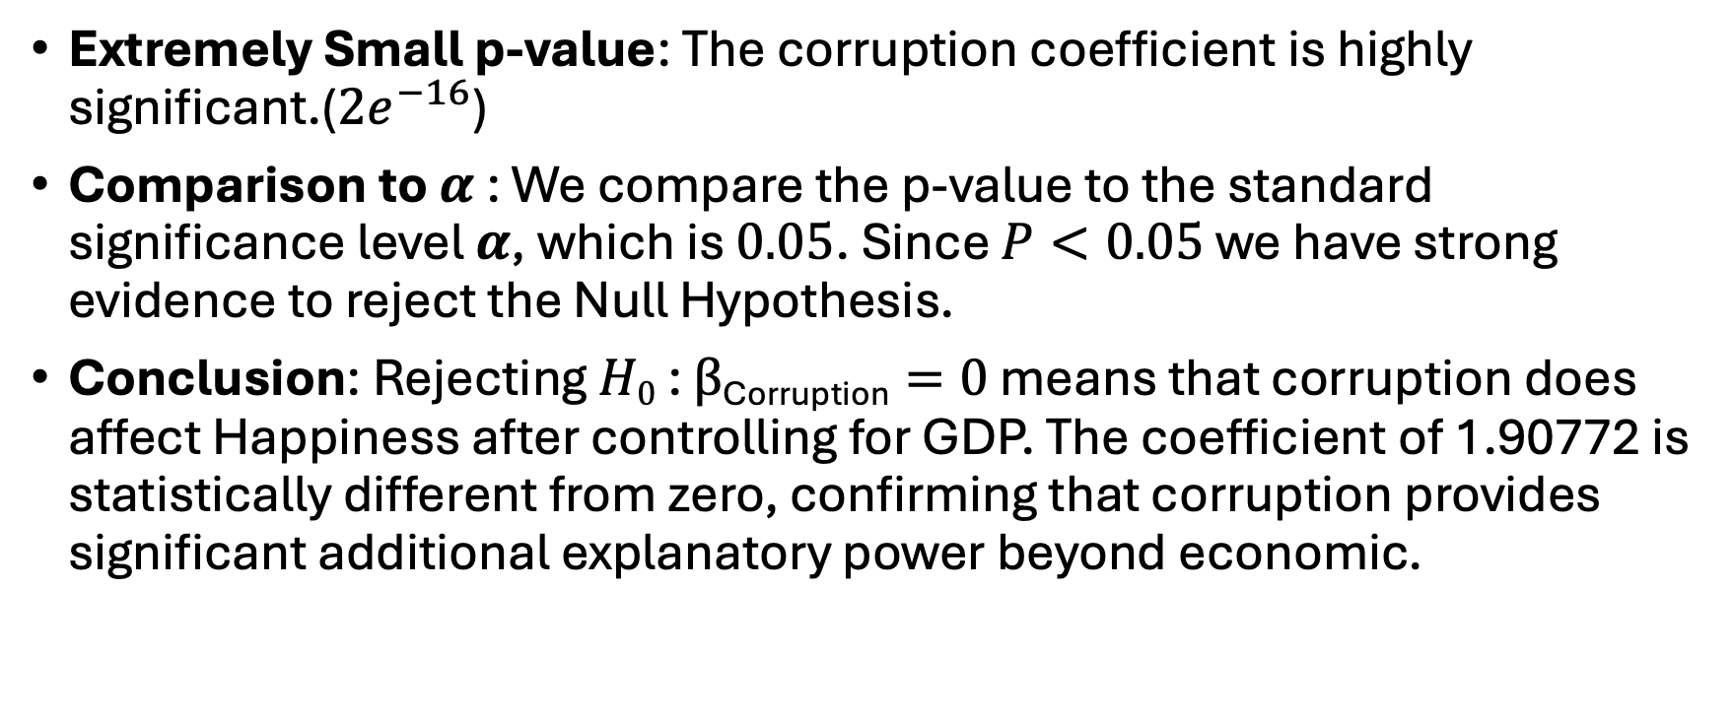
Model Output
Extremely Small p-value: The corruption coefficient is highly significant.(${2e}^{−16}$)
Comparison to$α$ : We compare the p-value to the standard significance level $α$, which is $0.05$. Since $P<0.05$ we have strong evidence to reject the Null Hypothesis.
Conclusion: Rejecting $H0$ : $β\text{Corruption}=0$ means that corruption does affect Happiness after controlling for GDP. The coefficient of 1.90772 is statistically different from zero, confirming that corruption provides significant additional explanatory power beyond economic.

Slide 13
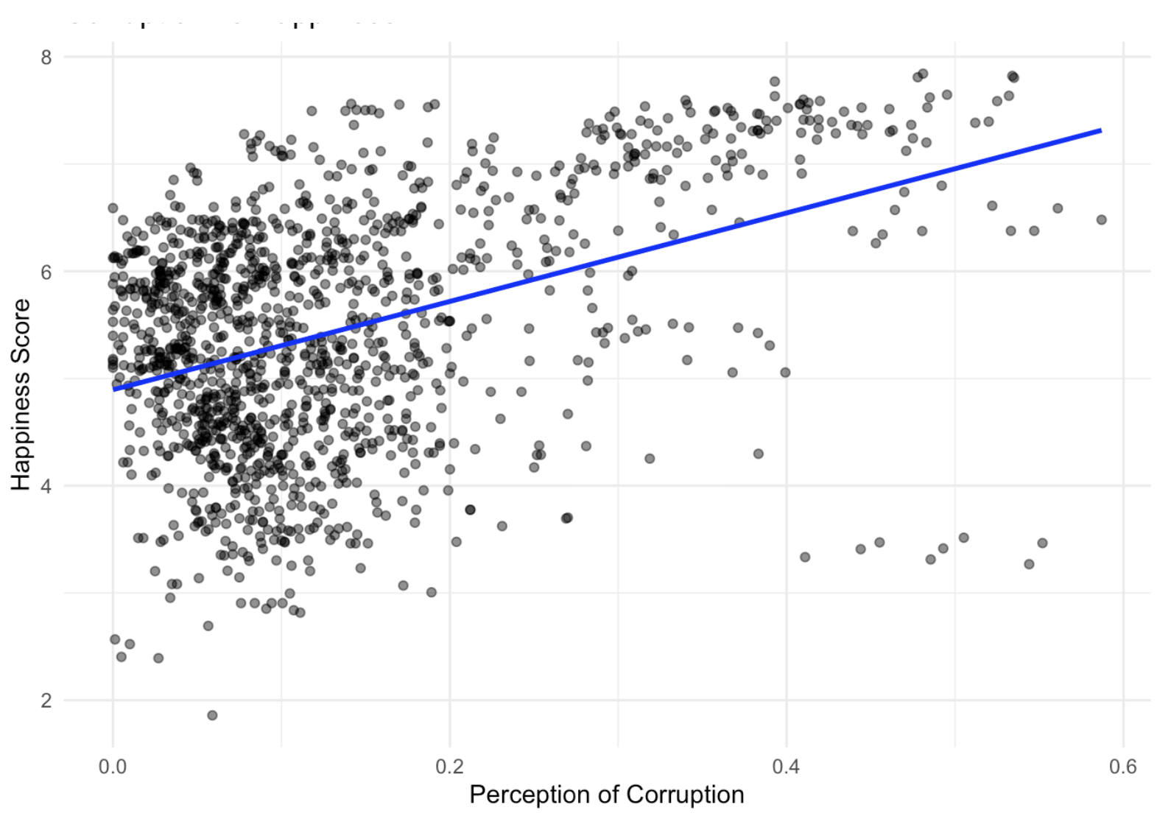
Model Output
X-axis: "Perception of Corruption"
Y-axis: "Happiness Score"
Points: Colored by GDP (black = lower GDP, darker black = higher GDP)
The Counterintuitive result: as Corruption Perception increases Happiness increases.
Higher X-values = LESS corruption perceived in the dataset.

Slide 14

Random Forest
It works by building multiple decision trees during training and outputting the average prediction (for regression) or the majority vote (for classification) of the in dividual trees.
model’s robustness and checked for overfitting

Slide 15
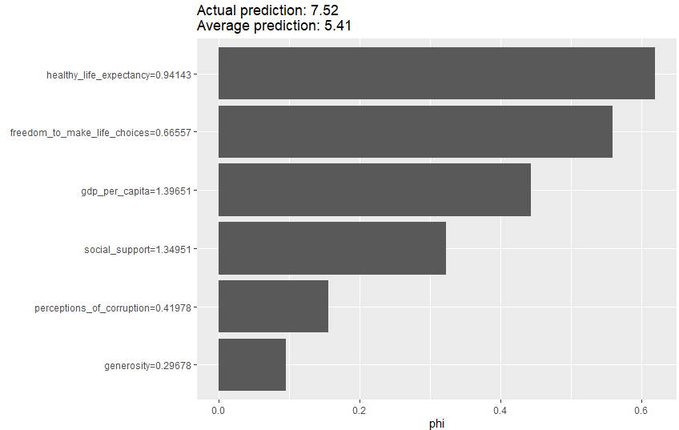
SHAP
The SHAP plot explains how each feature contributes to predictions, enhancing model interpretability.
gdp_per_capital (+1.396) :largest positive contributor
social_support (+1.350): second largest contributor

Slide 16
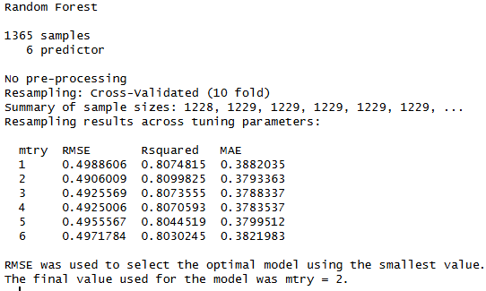
Random Forest
Cross-validation scores are consistent: Low variance between folds
Random Forest model explains 81% of the variance in happiness scores across countries, which is very strong performance.

Slide 17

XGBOOST(eXtreme Gradient Boosting)
is an implementation of gradient boosted decision trees designed for speed and performance.
Happiness scores are inherently noisy, subjective measures
They range from ~2.5 to ~7.5 (5-point range)
An RMSE of 0.05 means average prediction error is only 1% of the total range. This suggests the model is predicting with near-perfect accuracy

Slide 18
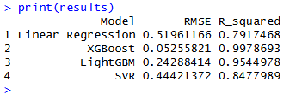
Comparing Models
RMSE lower is better, R_squared is higher is better
XGBoost dominates Performance
Tree-based boosting algorithms (XGBoost, LightGBM) clearly outperform traditional methods for this happiness prediction task

Slide 19
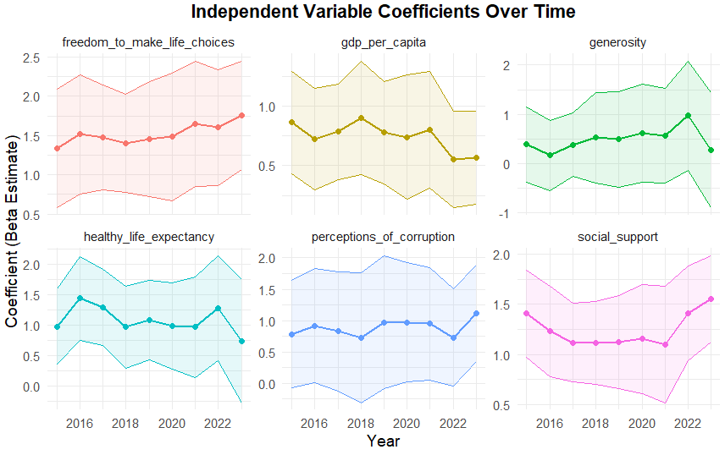
plm - Timeregression (Panel Data Regression )
The plot shows how each variable's coefficient (impact on happiness) evolves from 2016 to 2022
Social support might have spiked in importance during 2020-2021 (pandemic years)
Notes:
Line shows if impact is increasing, decreasing, or stable over time

Slide 20
World Happiness Analysis and Prediction
Q&A
Thank you for listening

