Slide 1
혼자 공부하는 머신러닝 +딥러닝
DNN
심층 신경망
2401023 김상준

Slide 2
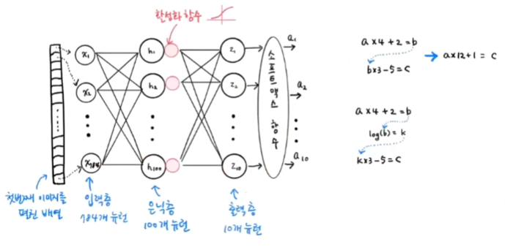
2-layer
Hidden / Output layer

Slide 3
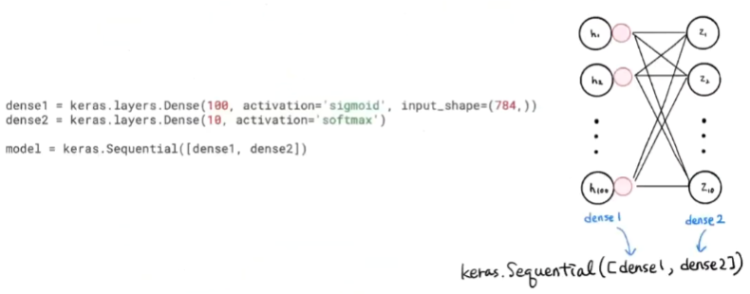
심층신경망
Deep Neural Network, DNN

Slide 4
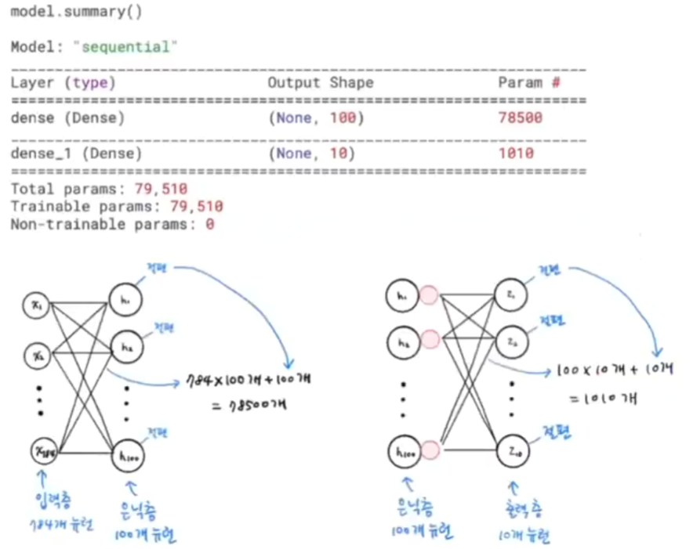
summary() method

Slide 5
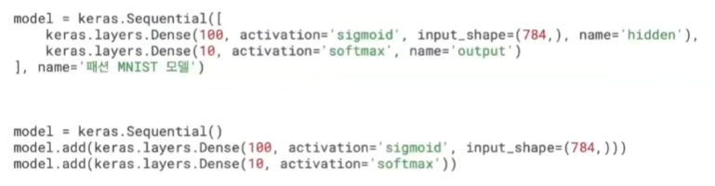
Adding layers

Slide 6
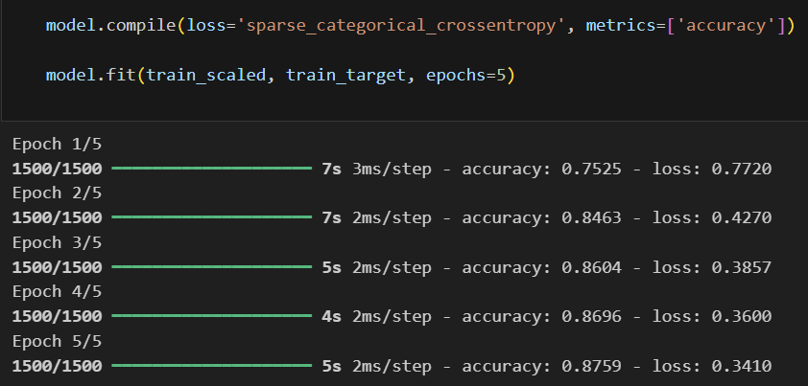
Model training

Slide 7
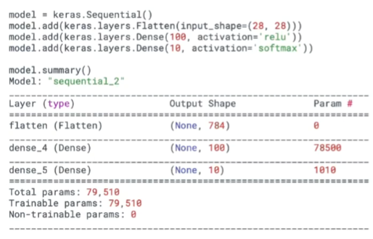
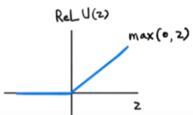
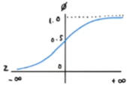
ReLu / Flatten
Rectified Linear Unit / Layer

Slide 8
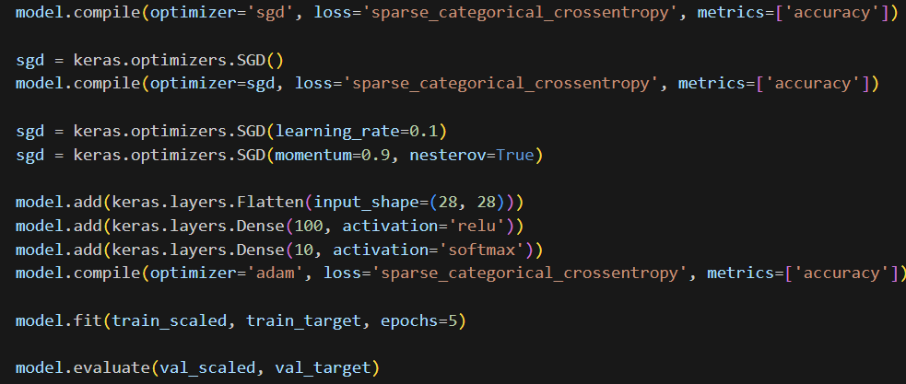
Optimizer
Rectified Linear Unit / Layer

Slide 9
