Slide 1

MARKET BRIEF · 2026
AI Agent market crosses USD 100B by 2028
Agents evolve from chat wrappers to autonomous workflow orchestration across the enterprise stack.

Slide 2
PART 01
Enterprises still run 70% of workflows without agents
Manual handoffs, brittle RPA, and siloed copilots leave most knowledge work unautomated.

Slide 3
TAM reaches USD 47B in 2026 with 42% CAGR
$47B
42%
3.2×
Total addressable market · 2026
Compound annual growth · 2024–2028
Enterprise vs consumer spend by 2028
Source: illustrative estimates for sample deck · verify before external use

Slide 4
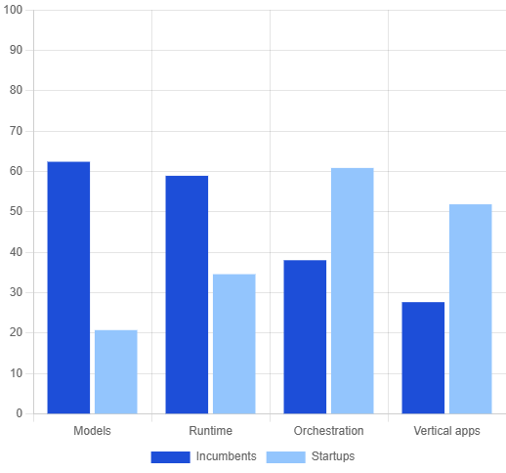
Incumbents vs startups split the stack differently
COMPETITIVE MAP
Hyperscalers
— models, cloud runtime, agent marketplaces
Stack strength by player type
Startups
— vertical agents, orchestration, eval & guardrails
Gap
— cross-tool memory and enterprise policy layers

Slide 5
Three forces reshape agent architecture in 2026
TREND 01
TREND 02
Multi-agent orchestration
Tool-use standards
Specialist agents coordinate via shared memory and handoff protocols. Single monolithic copilots lose to composable swarms in complex workflows — especially in ops, support, and research pipelines.
MCP and OpenAPI bridges normalize how agents call enterprise systems.
TREND 03
Eval & guardrails
Offline eval suites and runtime policy engines become purchase criteria.

Slide 6
Product roadmap aligns to three adoption waves
Q1 · Assist
Q2 · Automate
Q3 · Orchestrate
Q4 · Scale
Copilot overlays on existing tools
Semi-autonomous multi-step workflows
Agent fleets with shared memory
Enterprise policy + eval at gate

Slide 7
Capture the orchestration layer before Q4
→
Seed round to ship orchestration MVP by Q2
→
Design-partner pipeline across 3 verticals
→
90-day eval benchmark vs incumbent copilots
Schedule deep dive →

