Slide 1
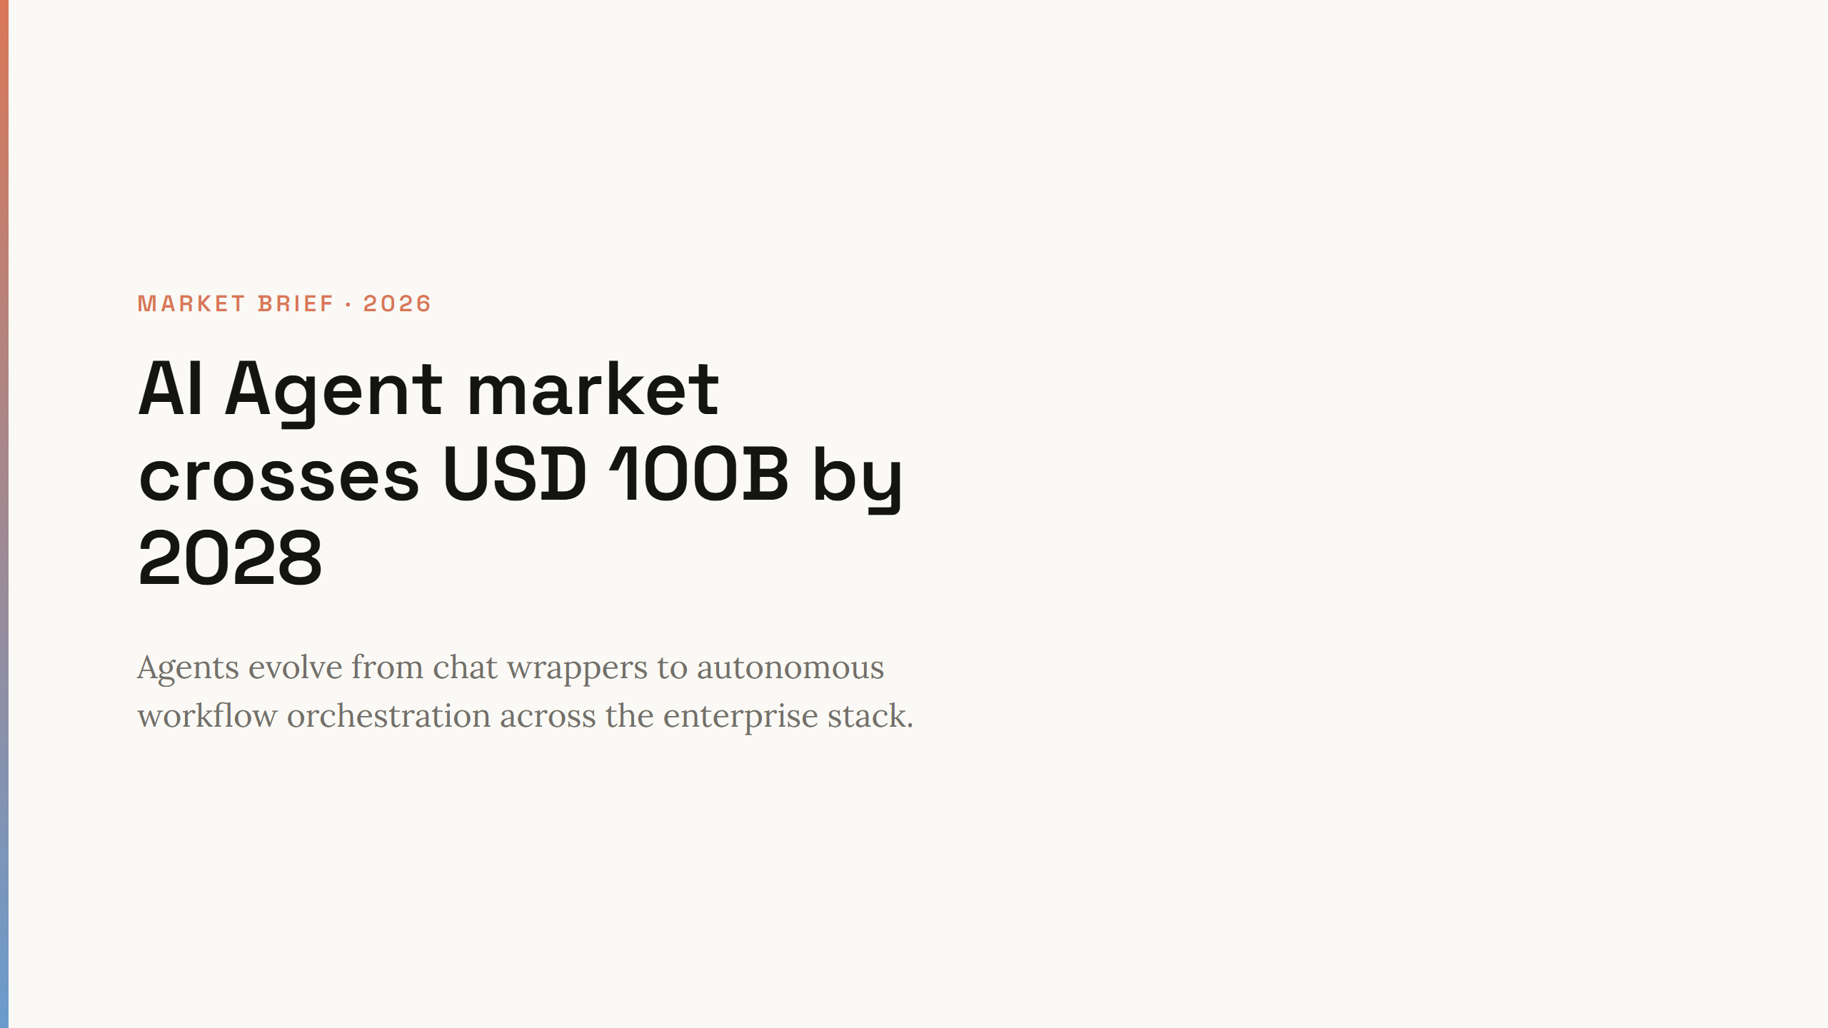
Notes:
Open with TAM headline. This is a platform shift, not a feature add-on.

Slide 2
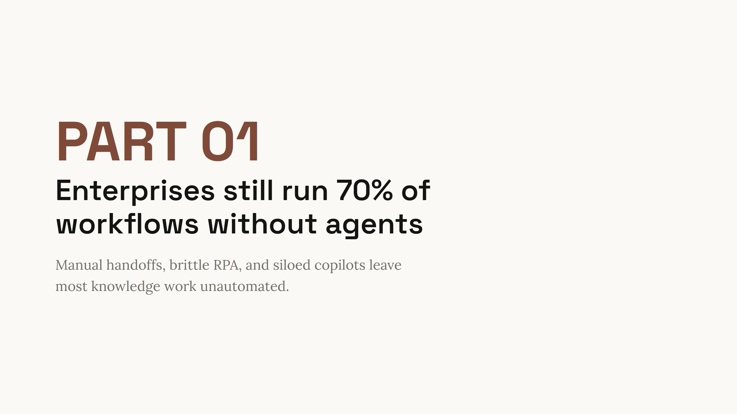
Notes:
Section break. 70% is illustrative for this sample deck — replace with verified research for production use.

Slide 3
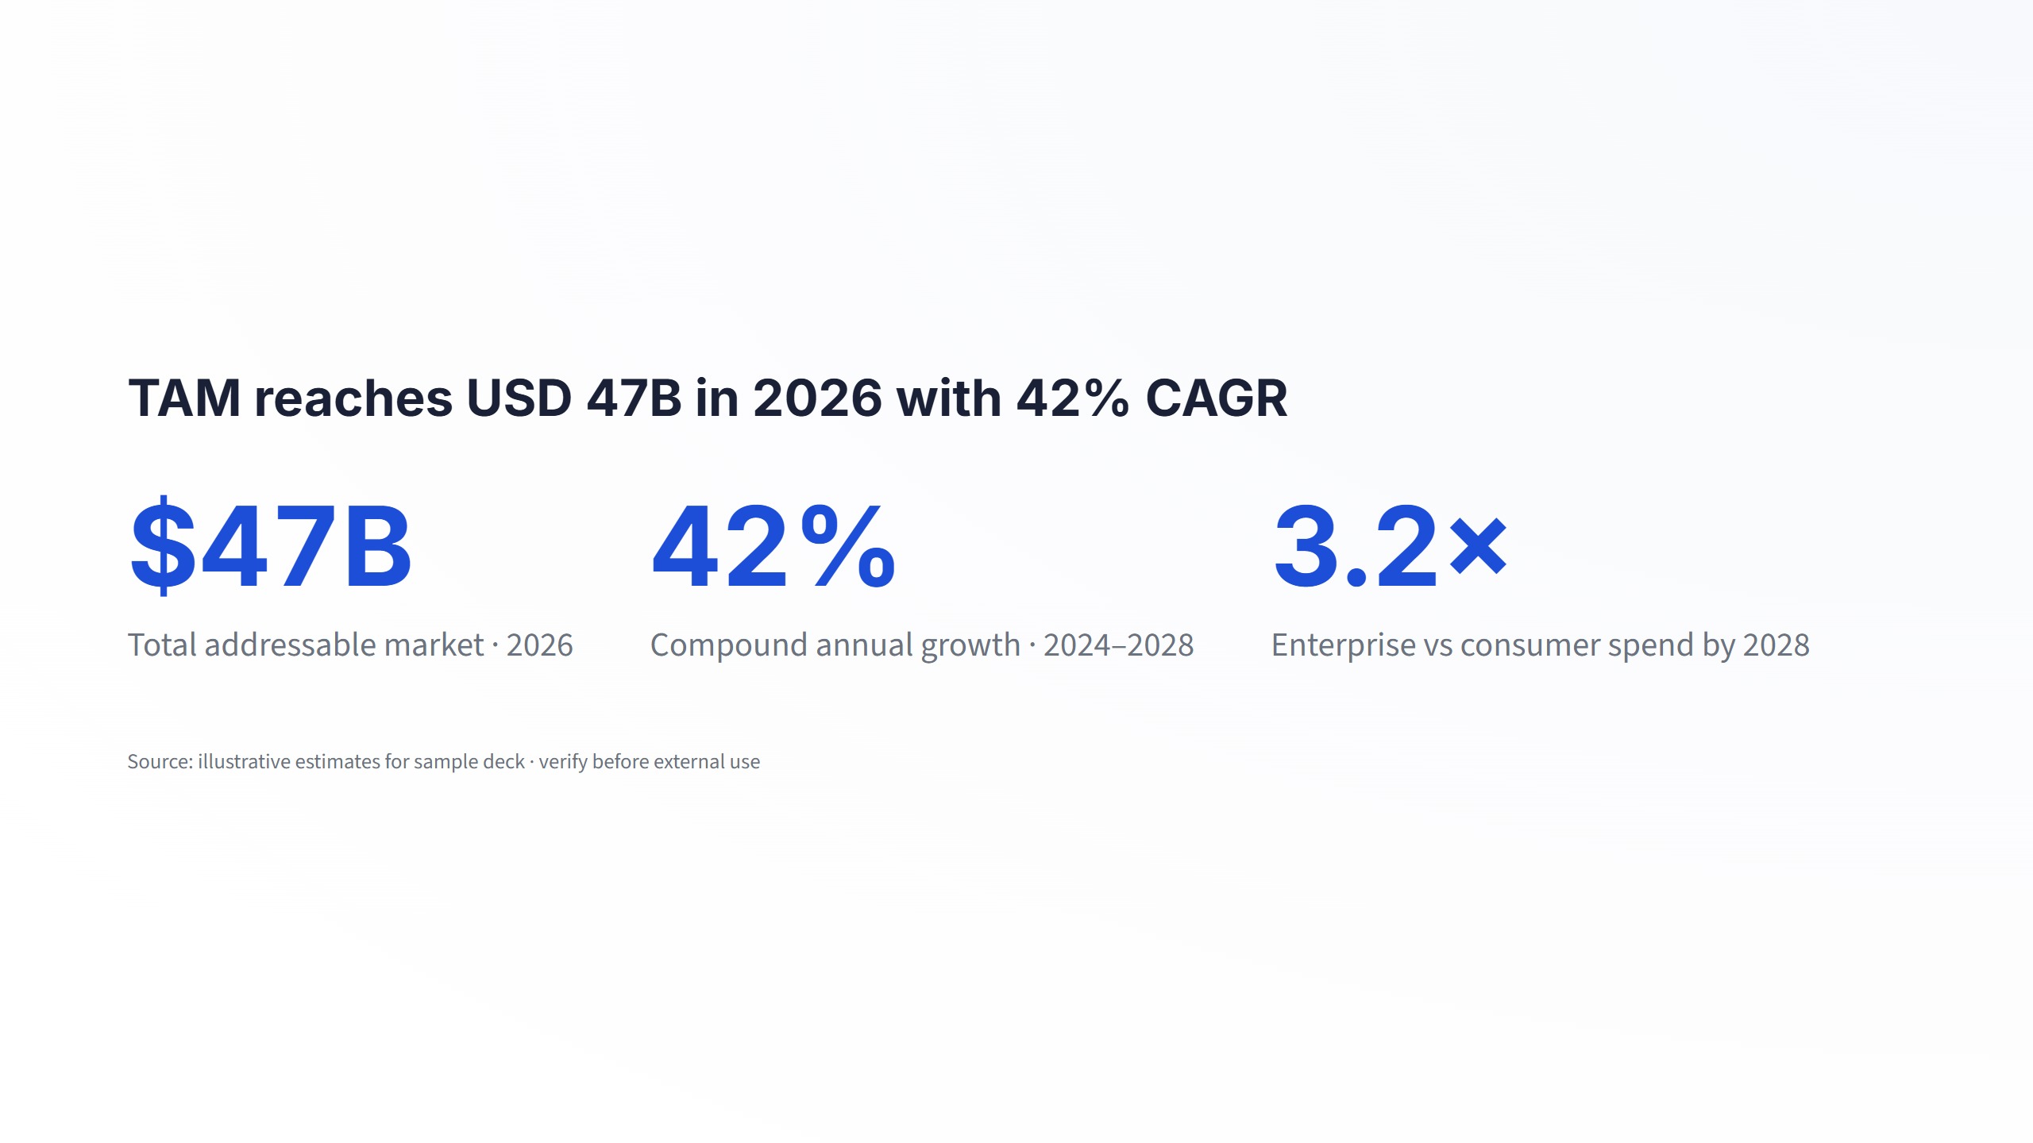
Notes:
Three market KPIs. Numbers are illustrative — run research phase for production decks.

Slide 4
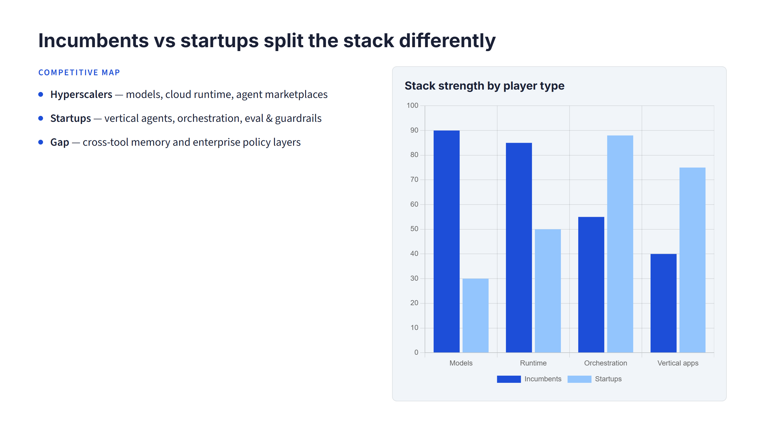
Notes:
Landscape slide: incumbents own infra, startups wedge on orchestration and verticals. Chart data is illustrative.

Slide 5
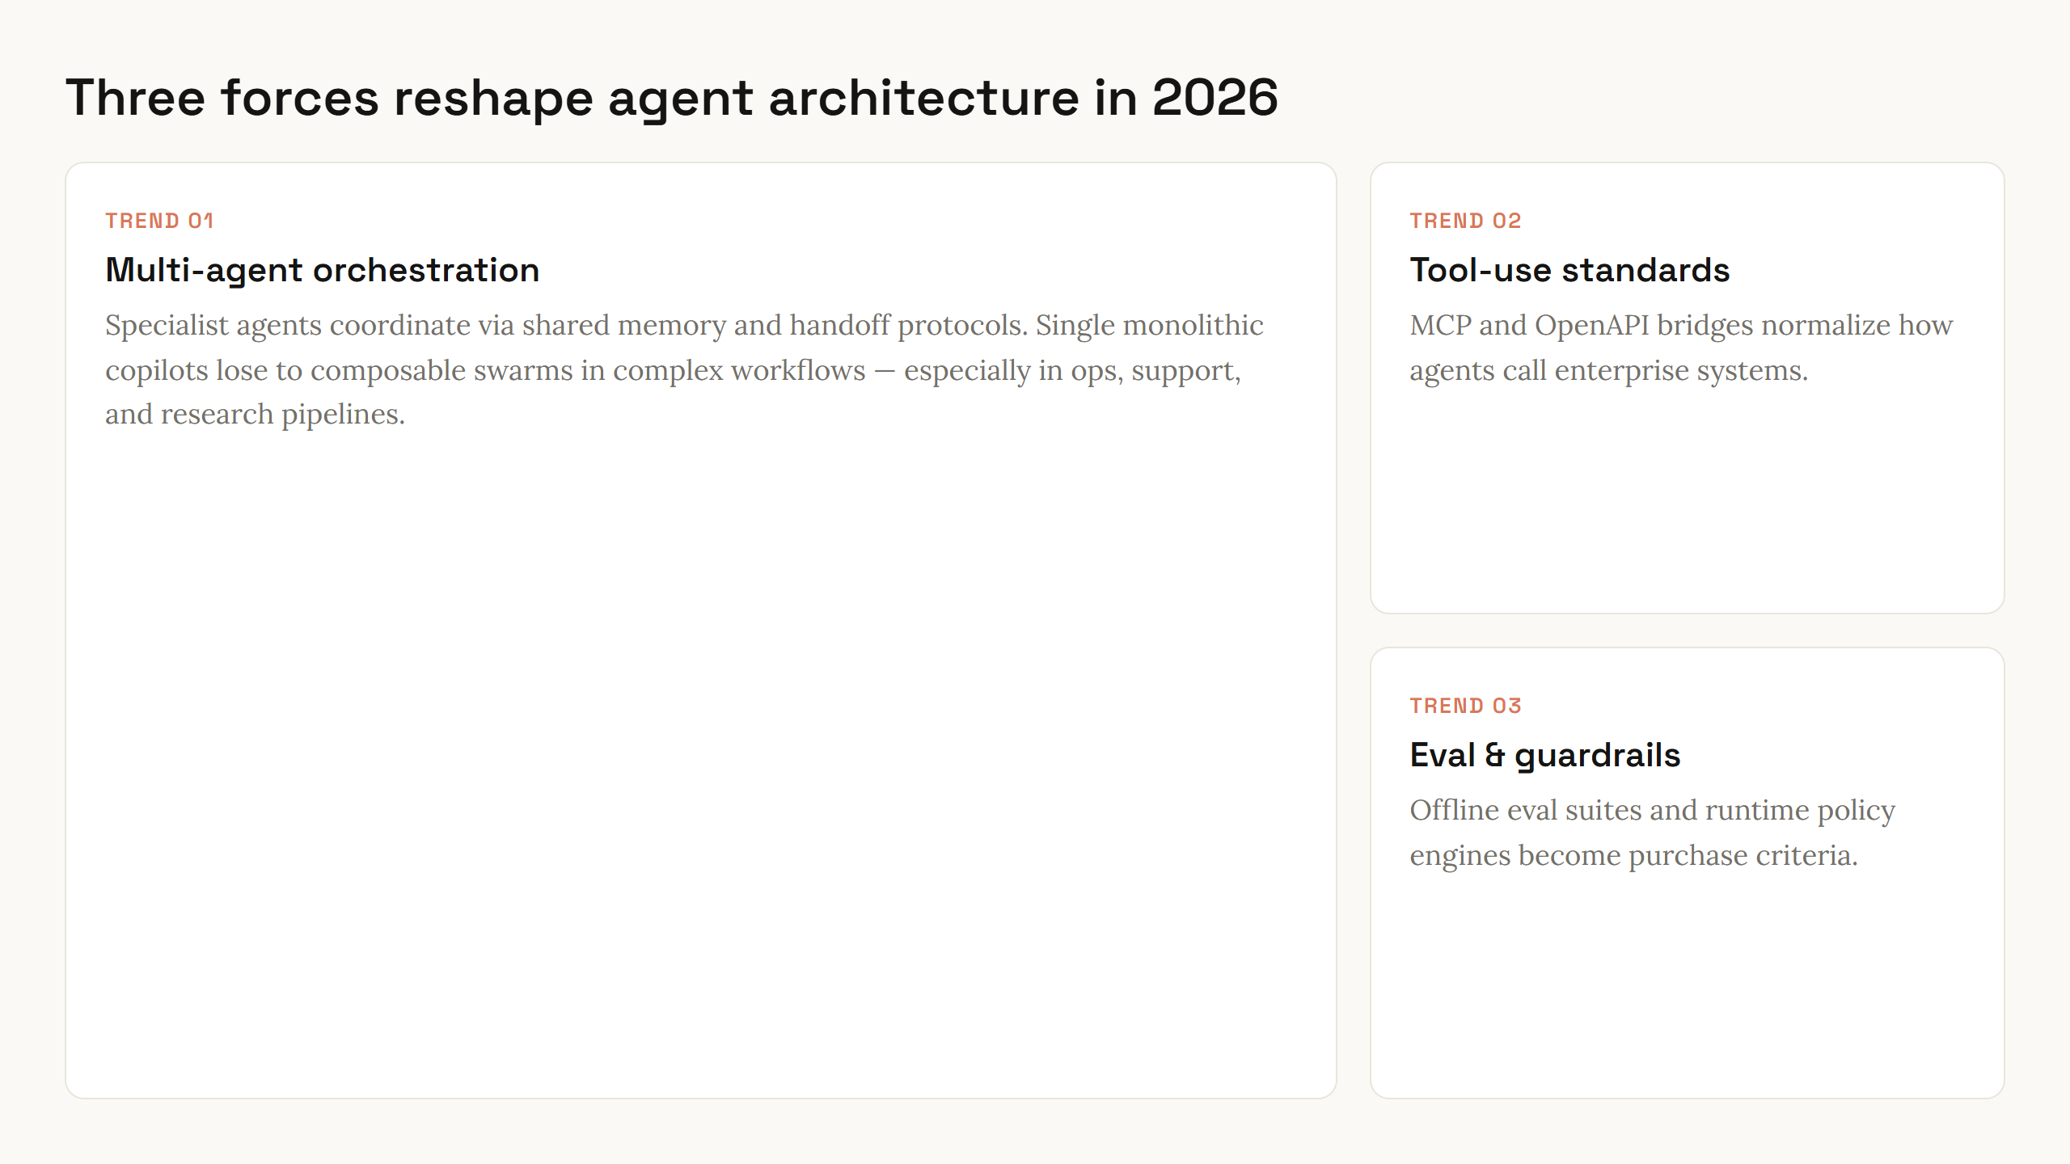
Notes:
Three tech trends in bento layout. Main card is orchestration — the thesis of the deck.

Slide 6
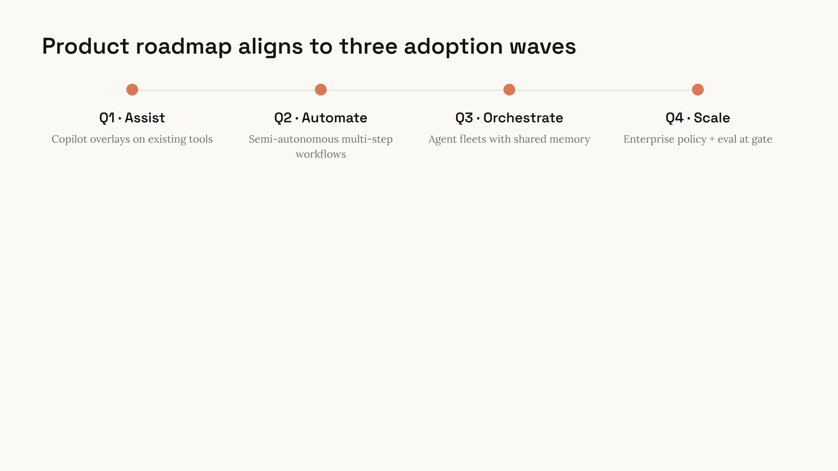
Notes:
Roadmap waves left to right. Bridge to closing investment ask.

Slide 7
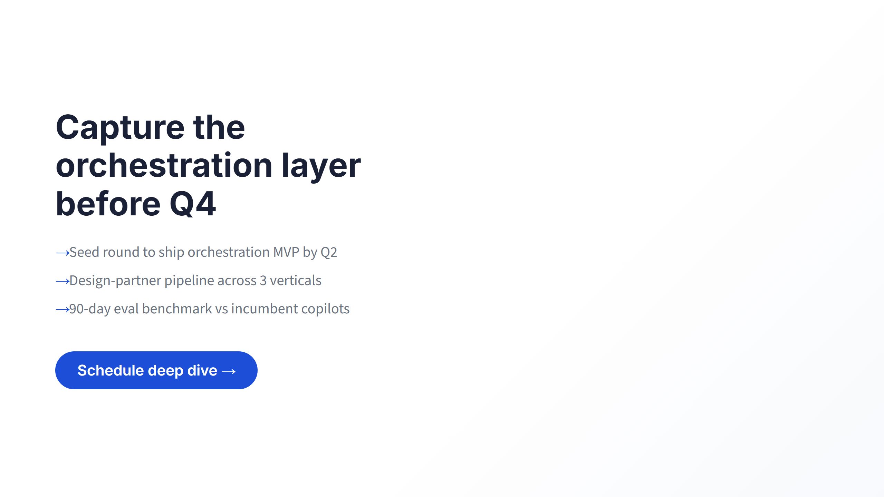
Notes:
Investment close. Three asks, then pause on CTA.

