Slide 1

PPTWORK · AGENT SKILLS
Portable agent skills turn any host into a deck pipeline
Two composable skills for Cursor, Claude Code, OpenCode, or Codex — HTML in, PowerPoint out.

Slide 2
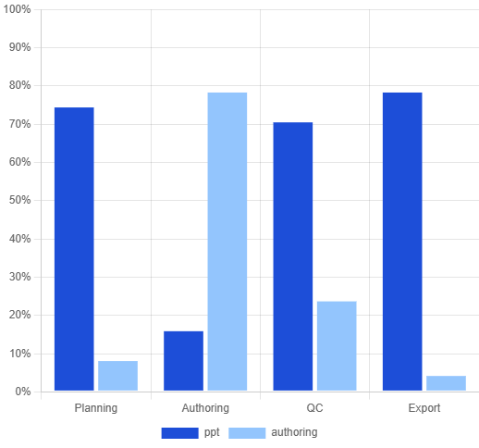
Deck orchestration and single-page authoring compose cleanly
TWO-SKILL SPLIT
ppt skill
— clarify, plan, init deck, visual QC, export
Responsibility coverage
ppt-html-authoring
— design.md + slide.html per page
Node scripts replace MCP: deck, screenshot, export

Slide 3
Two skills and template buckets form one pipeline
ORCHESTRATION
AUTHORING
ppt skill
ppt-html-authoring
Clarifies intent, reads template index.json for story planning, initializes deck.json, delegates each page to authoring, runs screenshot visual QC, exports raster or editable PPTX via html2pptx-pro or pptxgenjs.
Produces design.md + 1280×720 slide.html per outline entry.
TEMPLATES
ppt/assets/ buckets
corporate-light + claude-warm: 10 layouts with data-role slots.

Slide 4
The toolchain covers the full render-export loop
2
10
3
1280
Composable agent skills (deck + authoring)
Built-in layout templates across 2 themes
Node scripts: deck, screenshot, export
×720 px canvas — PowerPoint 16:9 wide
Source: PPTWork repository · ppt/ + ppt-html-authoring/

Slide 5
Four phases from intent to shipped deck
Clarify
Plan
Author
Ship
Audience, length, style, export mode
outline.md + template assetId picks
design.md + slide.html per page
screenshot QC → export .pptx

Slide 6
Quick start in four commands
01
02
Init deck
Add slide
deck.mjs init mydeck --mode raster
deck.mjs init-slide mydeck cover
03
04
Screenshot QC
Export PPTX
screenshot.mjs mydeck cover
export.mjs mydeck --mode raster

Slide 7
Edit the HTML, verify the pixels, then ship the deck
— PPTWork design philosophy

Slide 8
Clone the repo and run your first deck today
→
Browse examples/ for two sample decks with thumbnails
→
Install ppt/ deps and copy skills to your agent host
→
Run node ppt/test/smoke.mjs to verify end-to-end
Get started →

