Slide 1
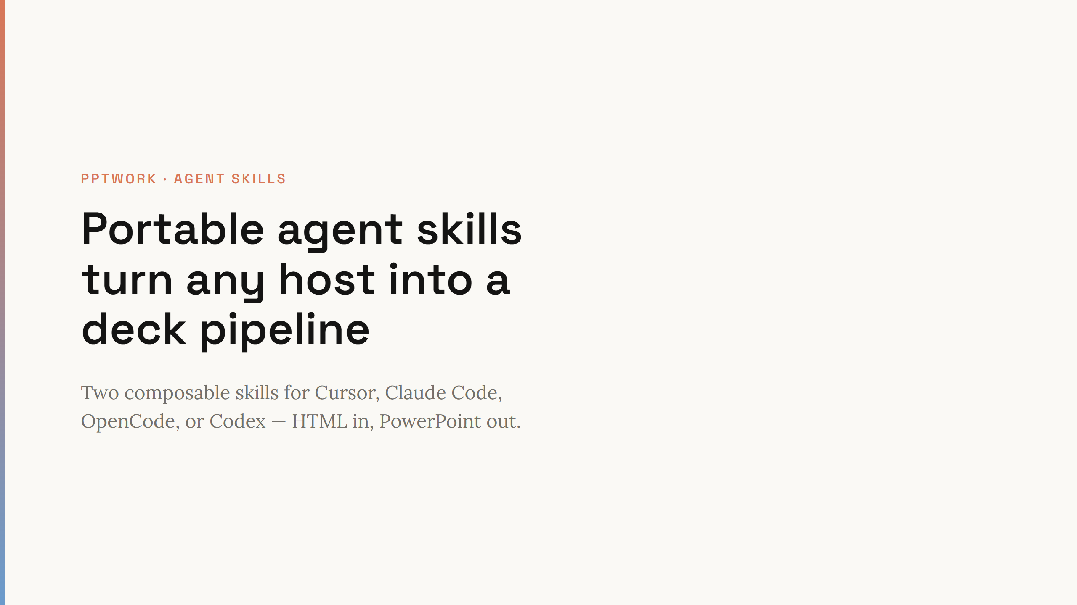
Notes:
Open with the headline. Emphasize portability — no custom MCP required, just Node scripts and SKILL.md files.

Slide 2
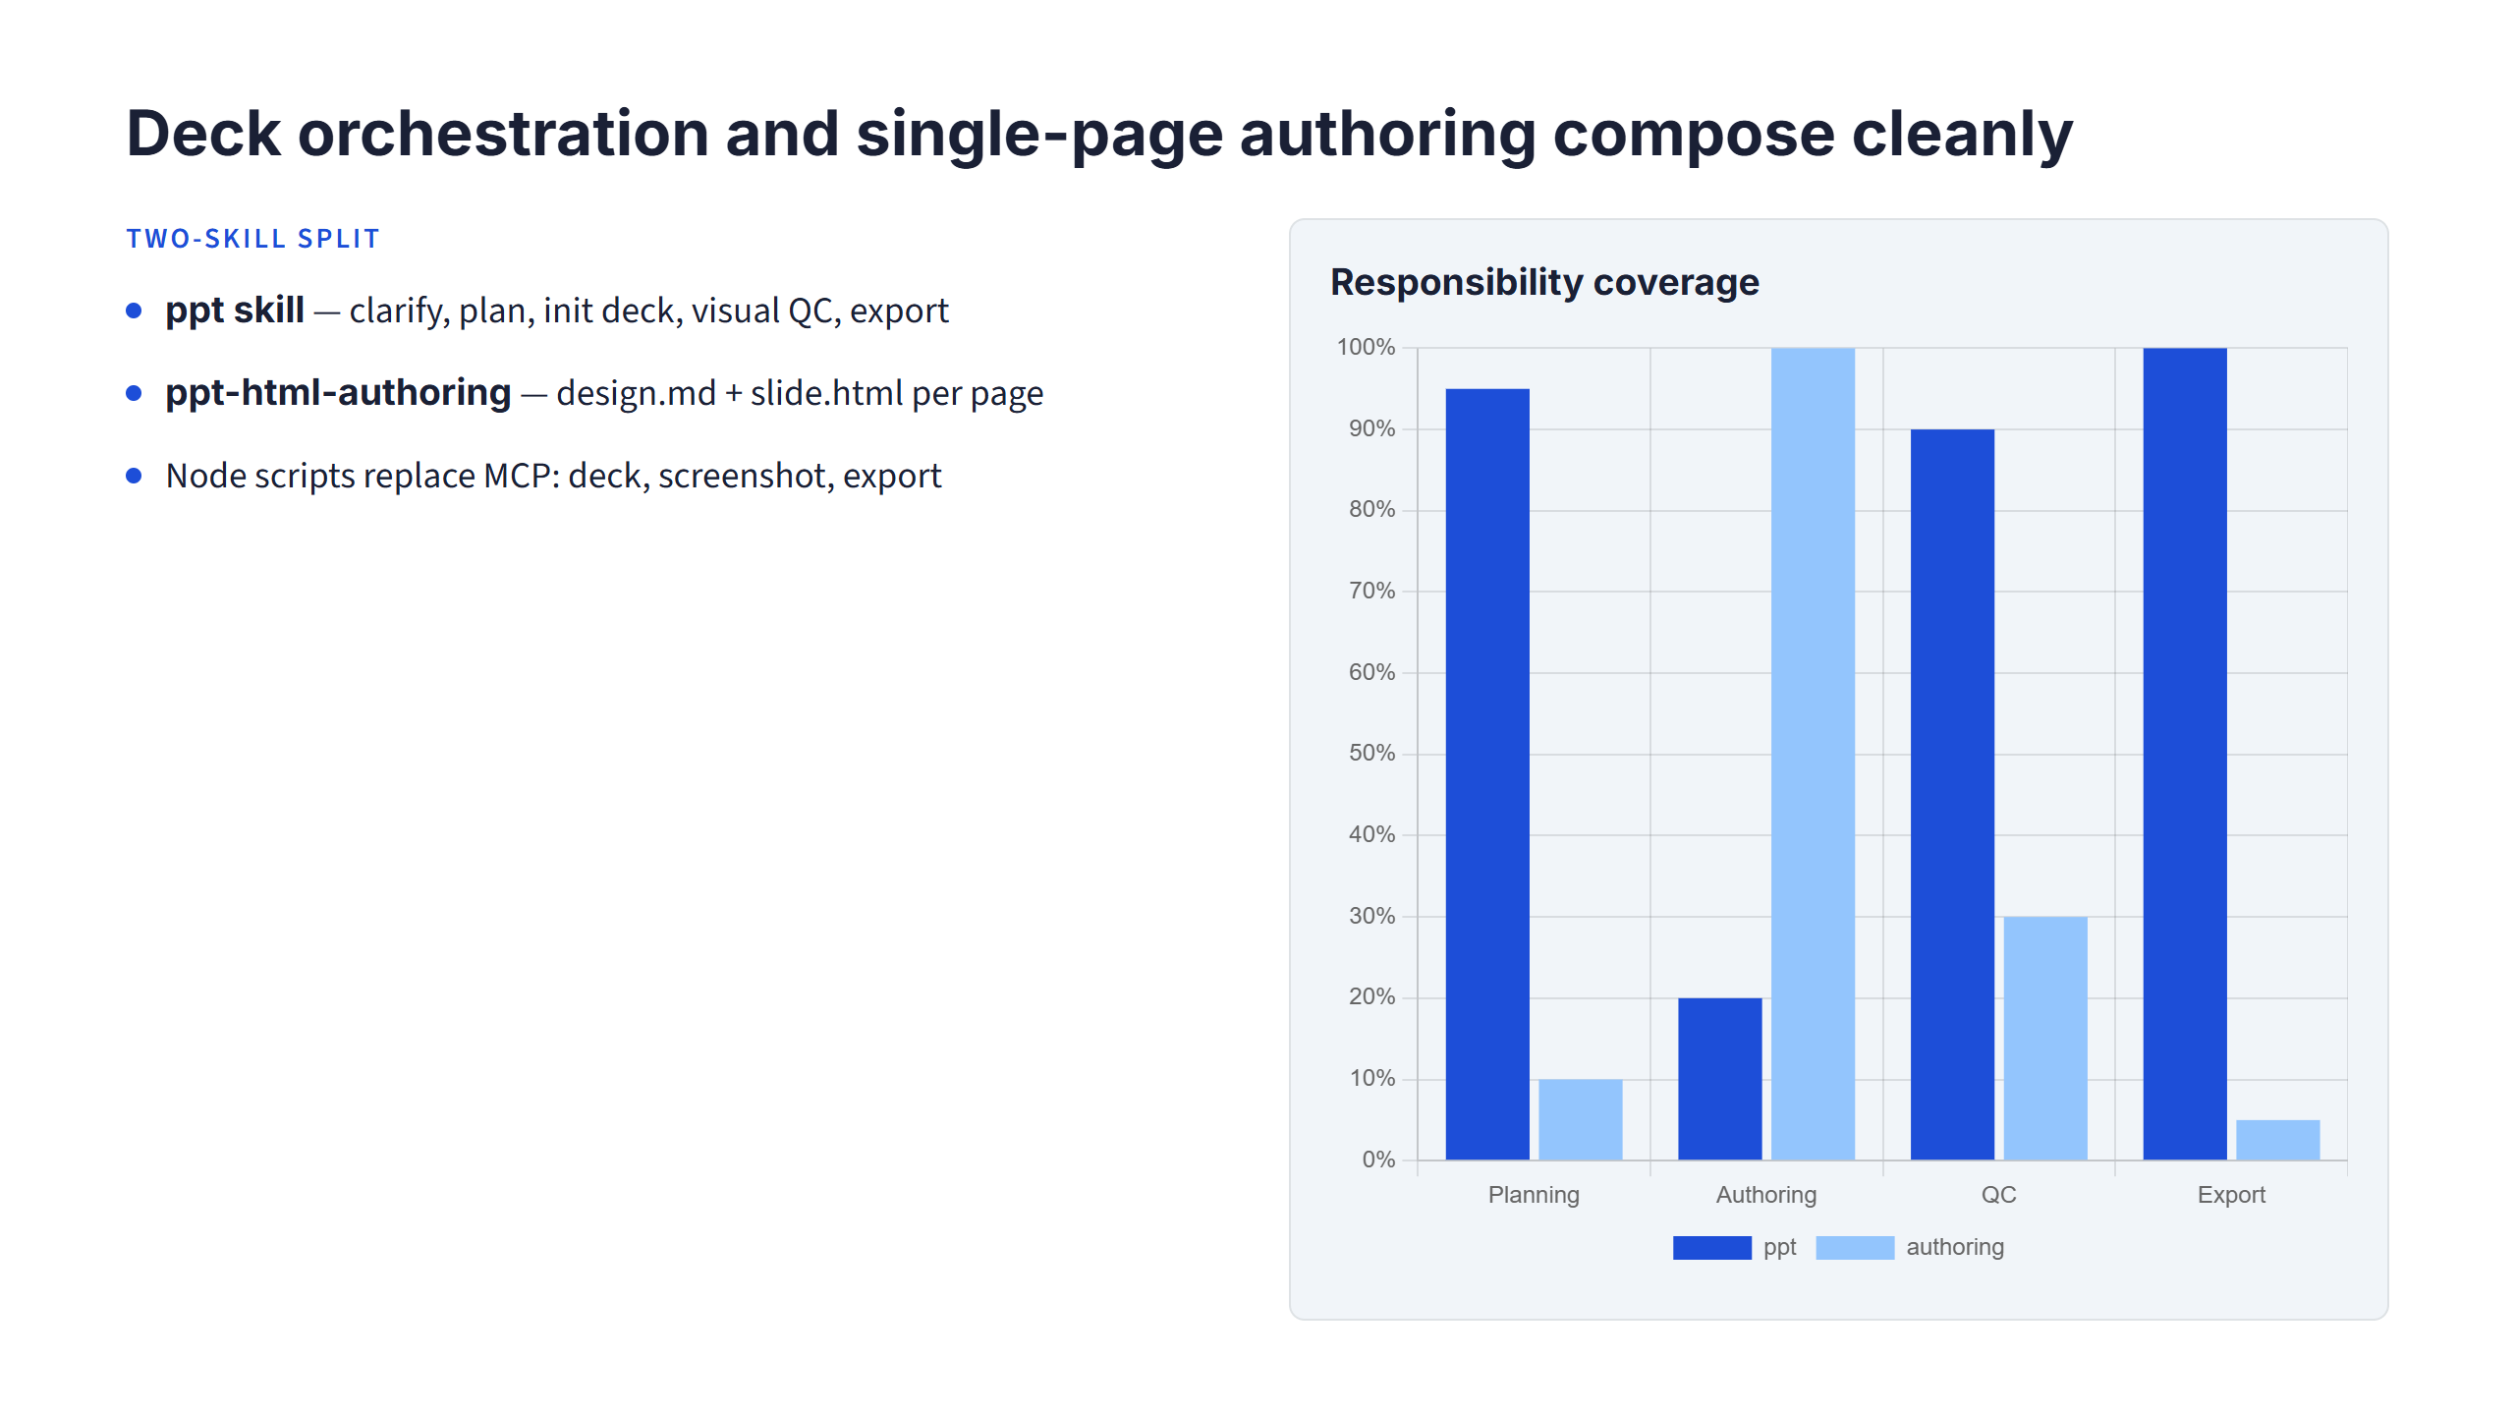
Notes:
Left column is the narrative split. Right chart shows relative scope — orchestration touches every page, authoring is per-slide.

Slide 3
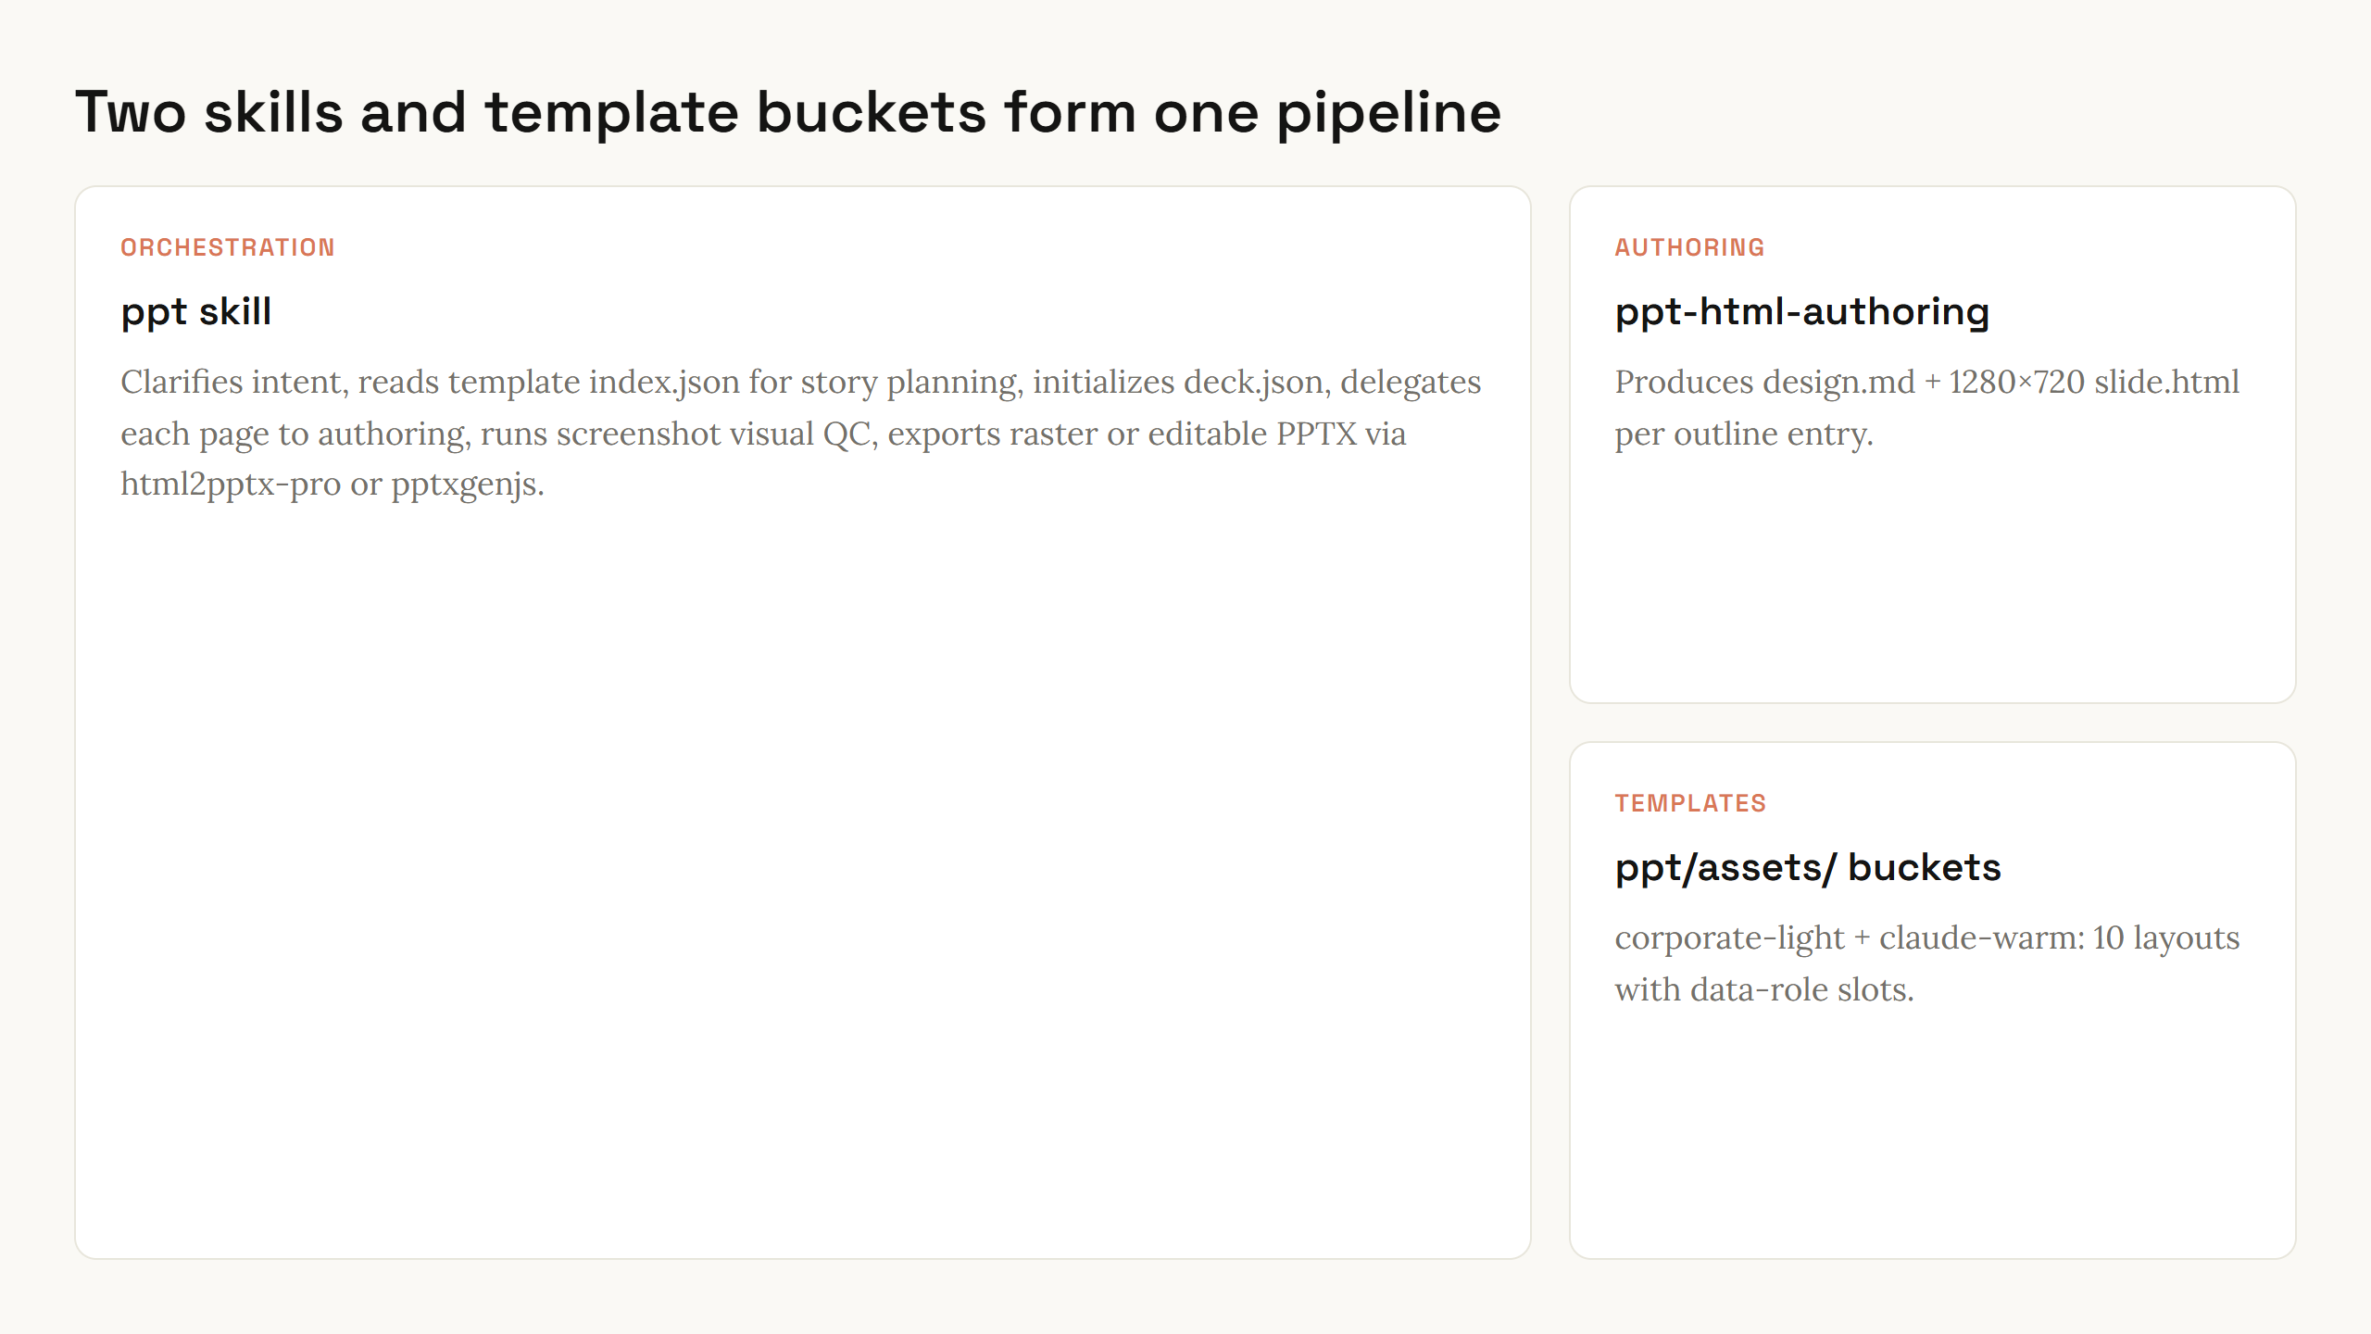
Notes:
Bento layout shows three modules. Main card is orchestrator; side cards are per-page author and layout library.

Slide 4
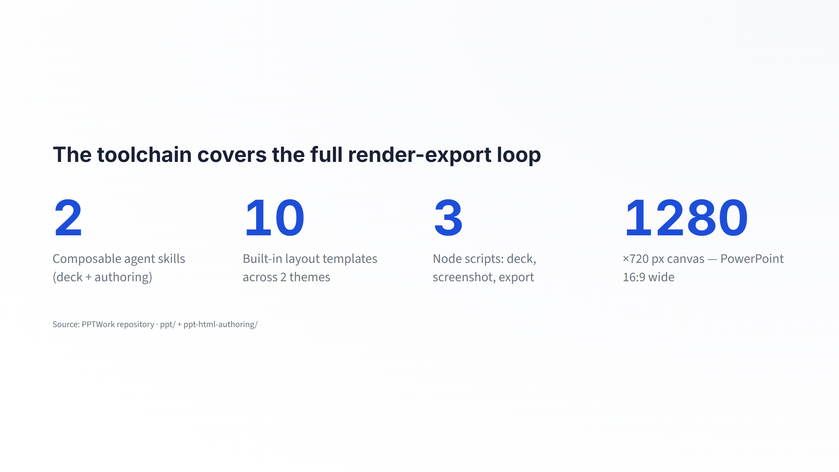
Notes:
Four KPIs map to concrete repo facts. Templates now ship in-repo — no more blank-slate authoring.

Slide 5
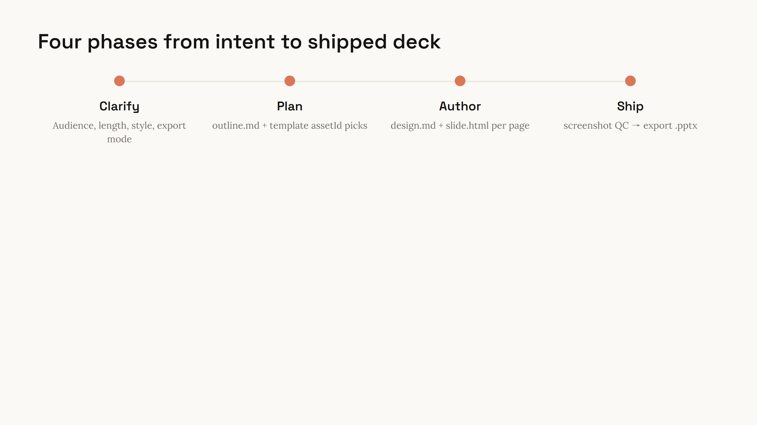
Notes:
Walk left to right. Screenshot QC is the quality gate — pixels are the contract before export.

Slide 6
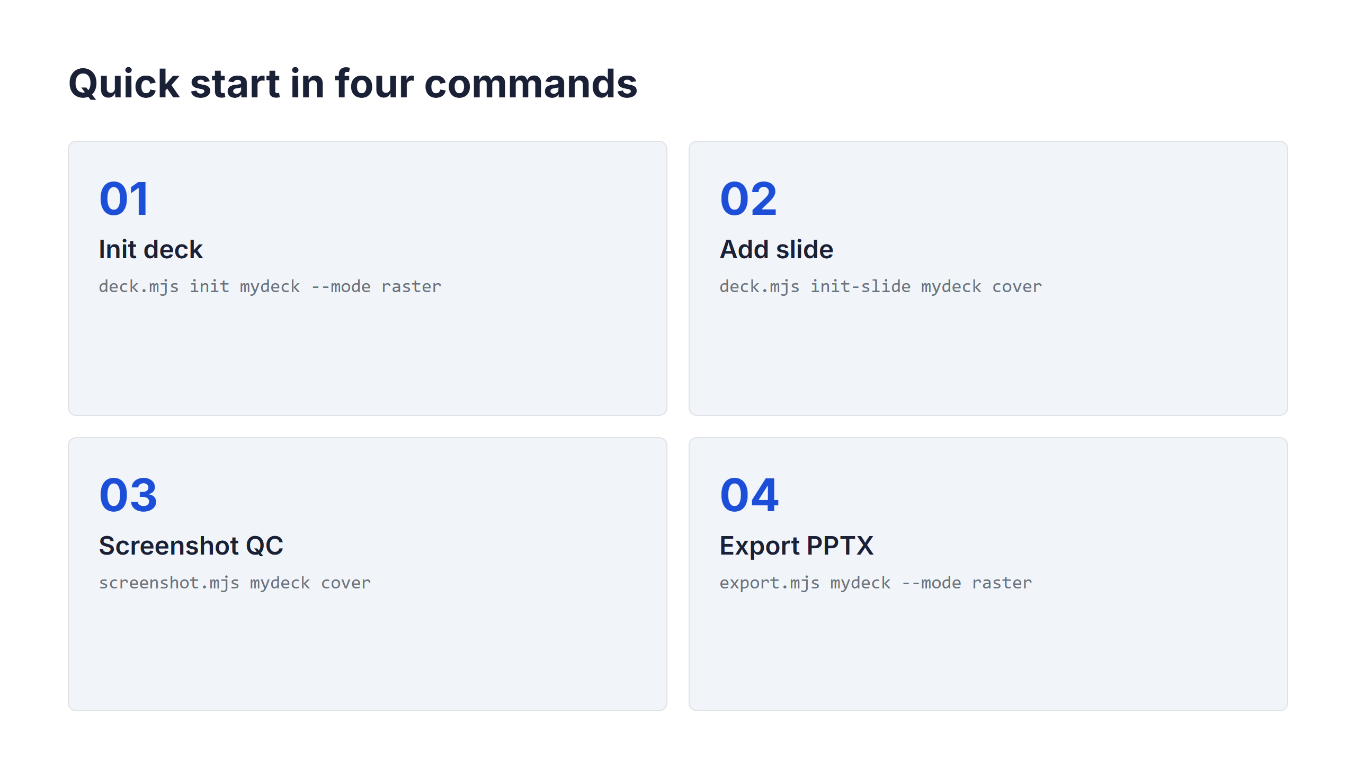
Notes:
Each card is one CLI step. Offer to demo live if presenting to developers.

Slide 7
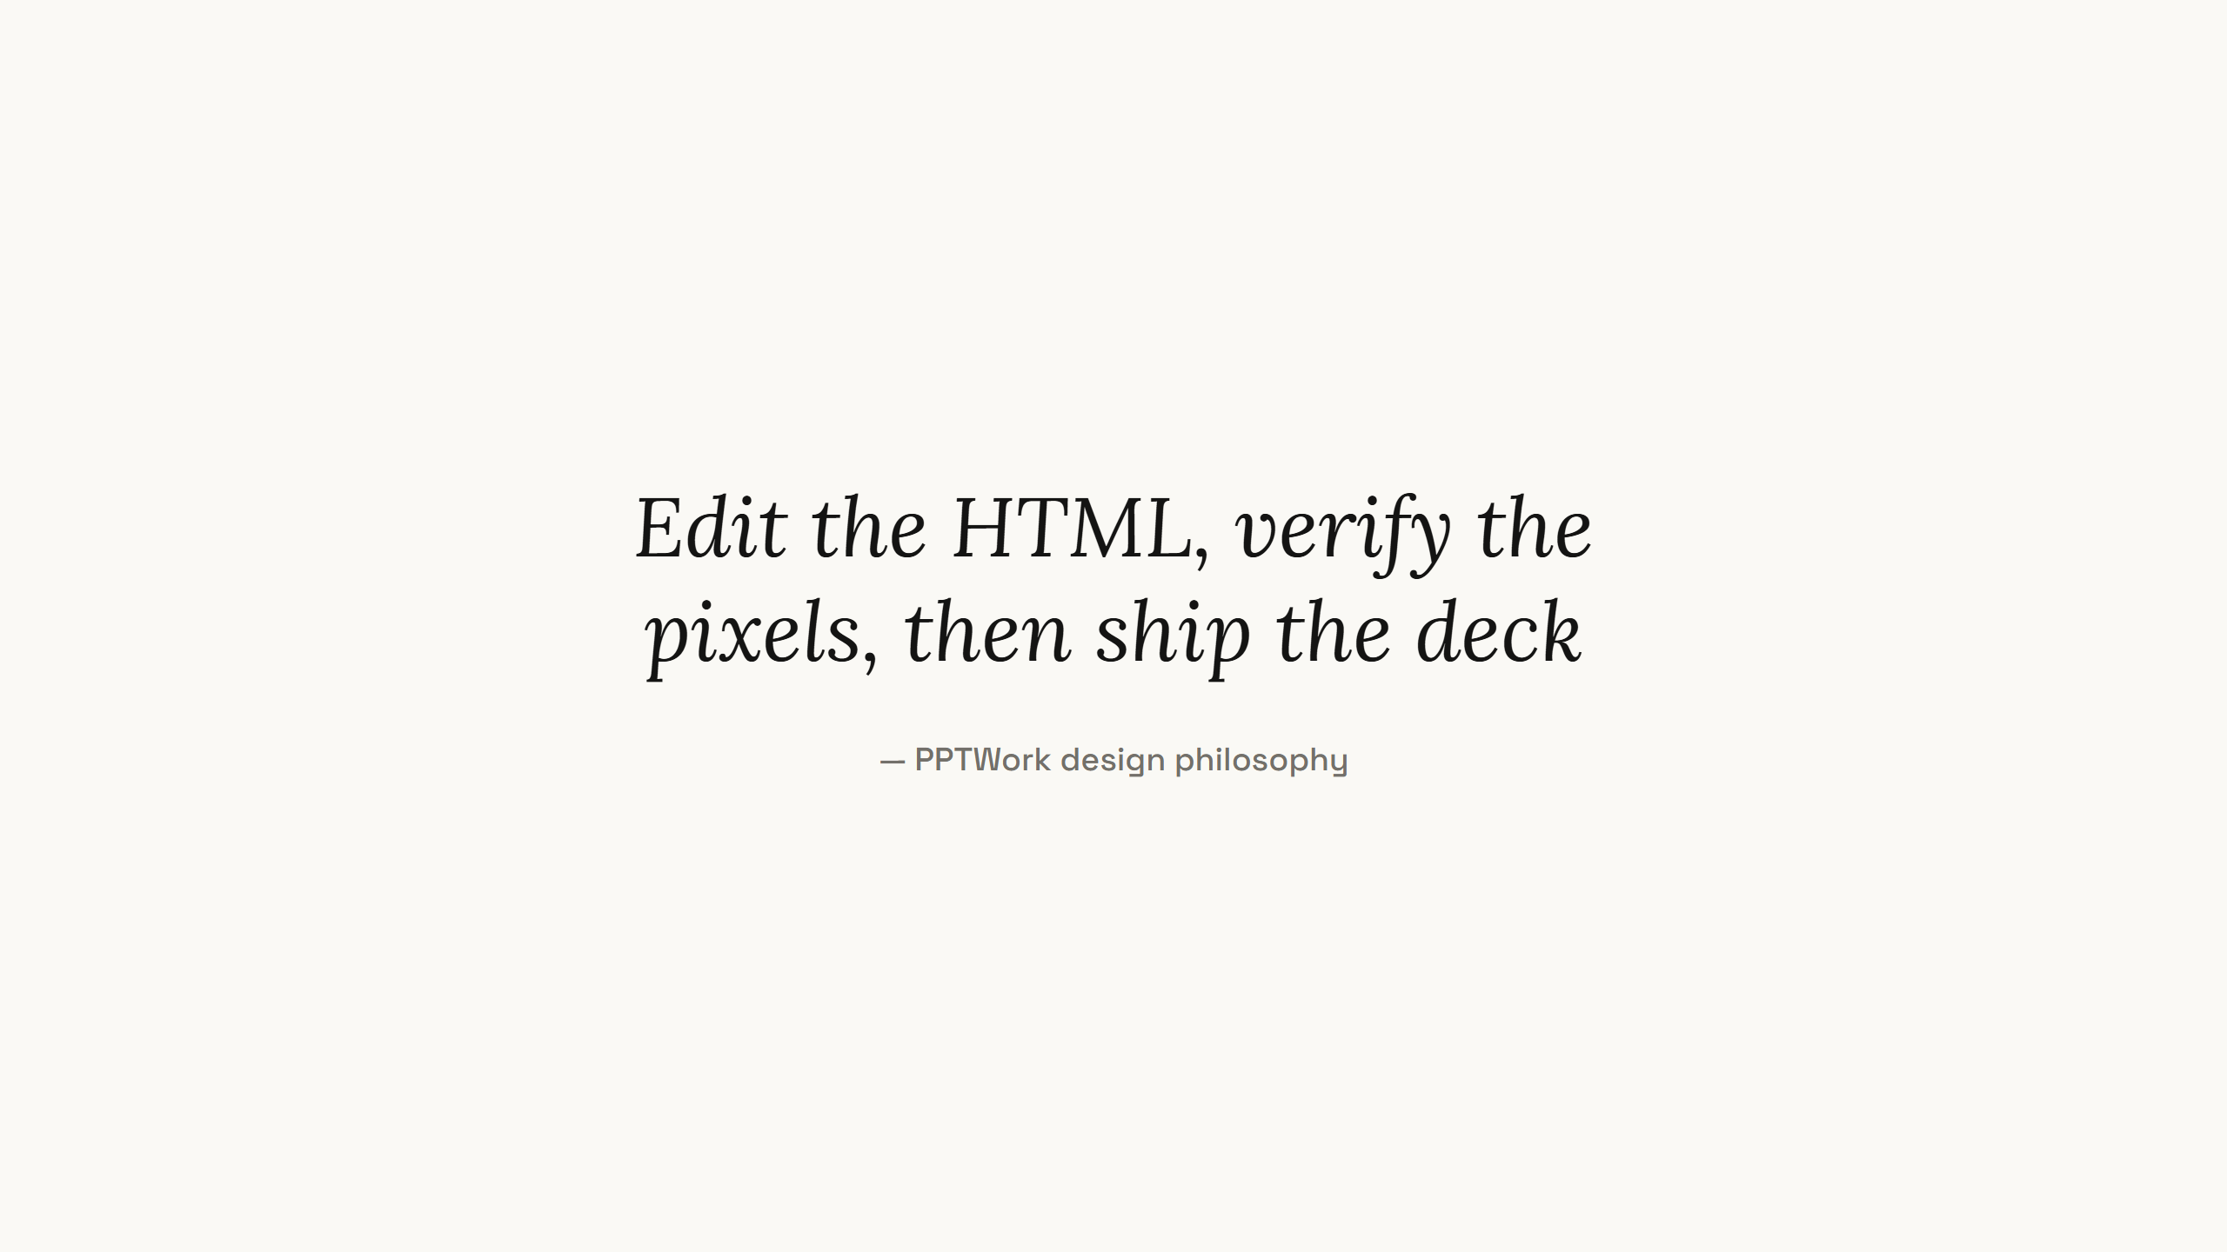
Notes:
One quote slide. Let it land, then move to the closing ask.

Slide 8
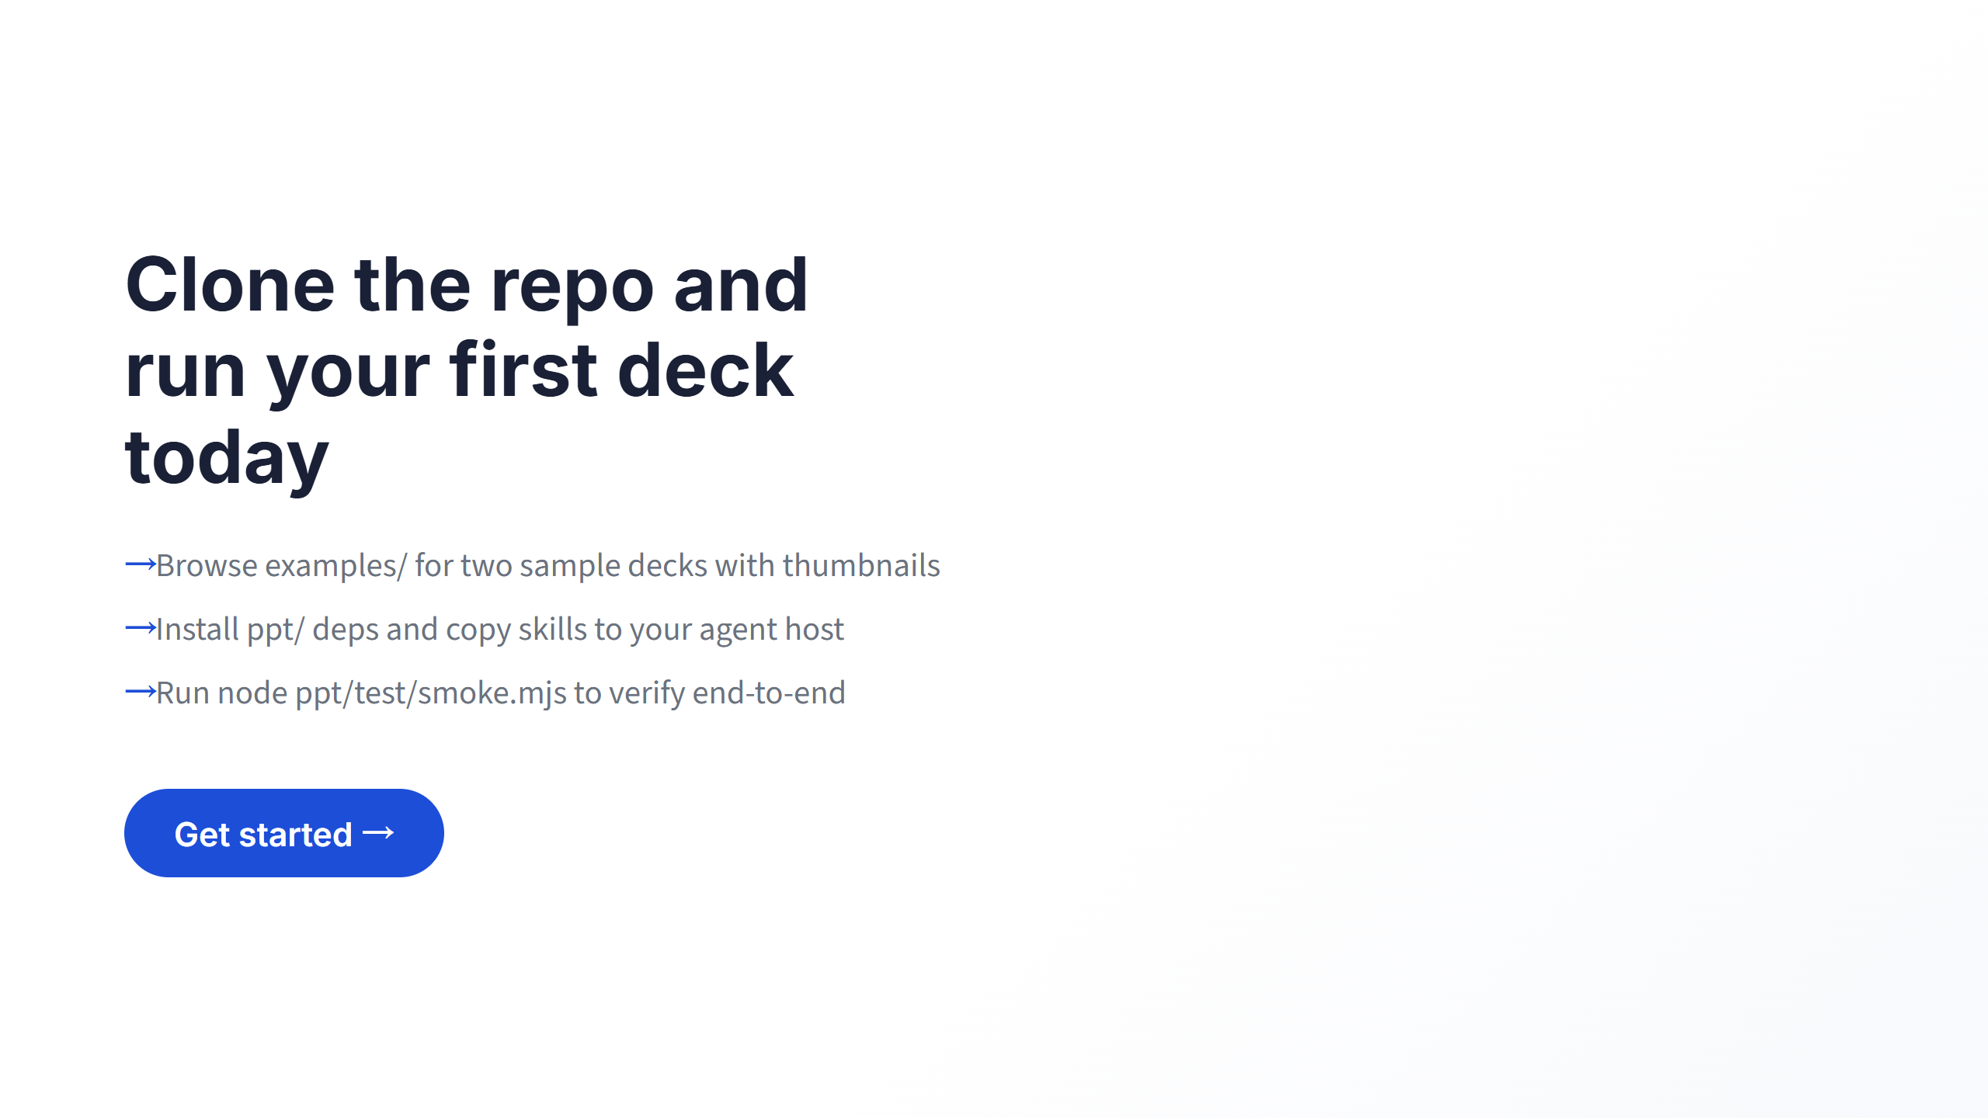
Notes:
Close with three concrete next steps. Pause on the CTA.

