Slide 1
PRO
0 1 2 3 4 5 6 7 8 9
SCORE PLAY AGAIN! START! COIN
COIN
GAME OVER

Slide 2
PRO
LOL
UNRANKED
LOG

Slide 3
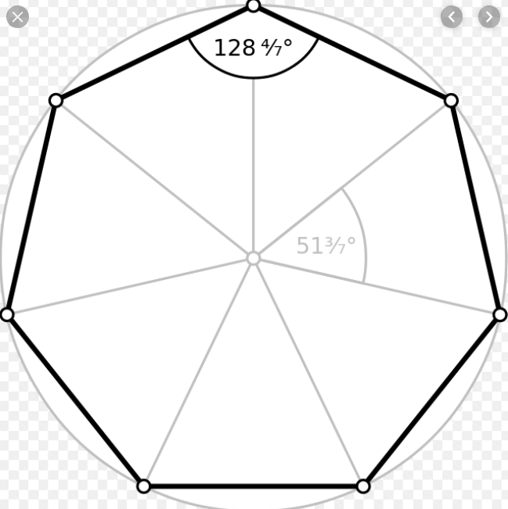
PRO
LOL
LOG

Slide 4
WIN
LOSE
PRO
PRO
낮음
매우
높음
보통
높음
장인

