Slide 1
Overview – Data Science at IMD
Jung PARK, PhD
Research Fellow in Data Science
First uploaded 2019 July 29
Last modified 2019 Aug 23

Slide 2
What is Data Science
Data Science is a multidisciplinary field that combines information technology (IT), statistics and management study.
Due to the rapid advancement of IT, much more data and new analytic techniques became available.
We need to balance it with sound statistical knowledge and business expertise to create useful insights.

Slide 3
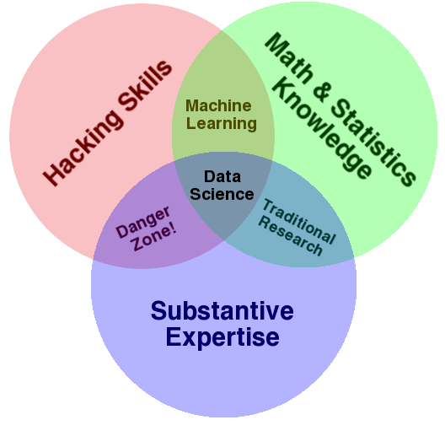
Multidisciplinary field
This diagram is often refered to show which knowledge is needed for data science
“Hacking skills” is eye-catching but too narrow
Data science venn diagram
Source: http://drewconway.com/zia/2013/3/26/the-data-science-venn-diagram

Slide 4
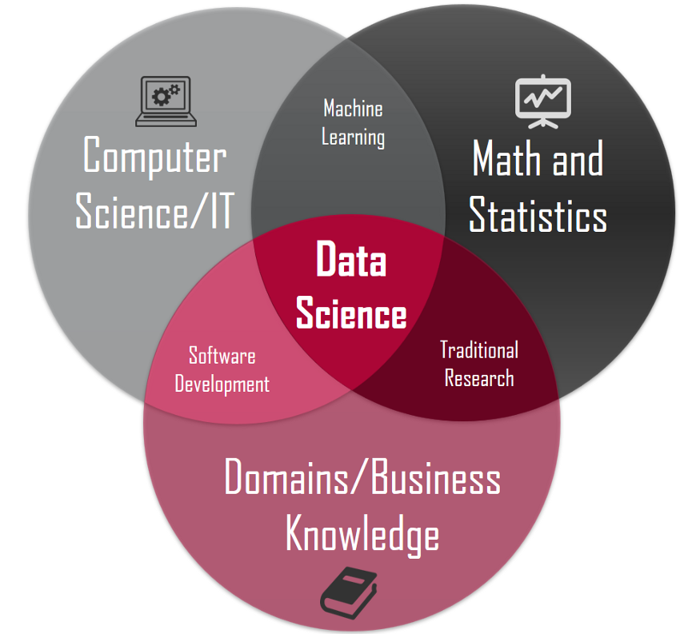
Multidisciplinary field – alternative description
This alternative diagram is less popular but shows more acceptable description
https://towardsdatascience.com/introduction-to-statistics-e9d72d818745

Slide 5
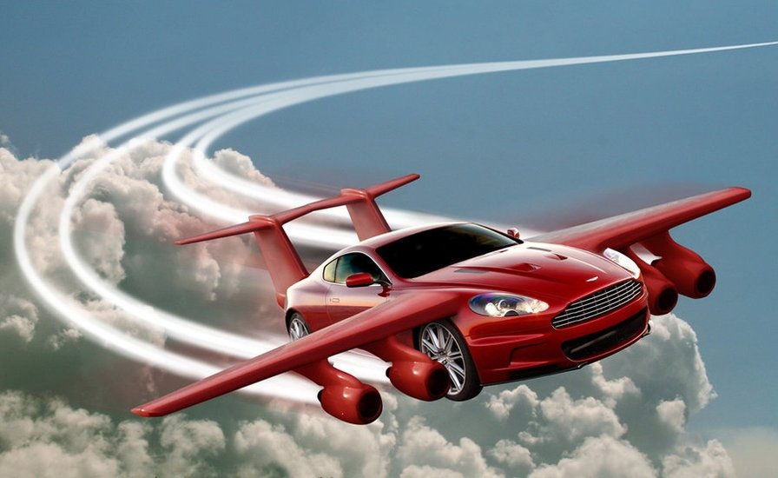
Data Science: analogy to a flying vehicle
The rapid advancement of IT forces us to adjust other areas accordingly
Thrusting: IT
Balancing: Statistics
Directing: Business
Source: https://sourceable.net/degree-in-flying-cars-coming-soon/

Slide 6
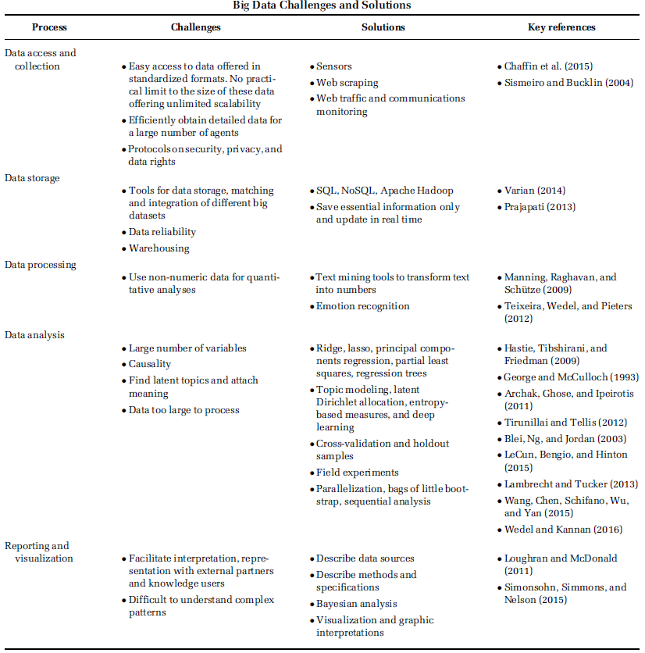
Five processes in Data Science
We will document knowledge using these five processes as a category

Slide 7
Data Collecting
Web scraping from public websites
How to collect information from websites
10K reports from SEC.gov
EU Open Data
Open data Swiss
Collecting data using API
Tweeter
Facebook
Database in IMD library
Bloomberg
Thomson One
Datastream
Factiva: news media
IoT (Internet of Things)
Smart building
Wearable devices
Web traffic

Slide 8
Data Storing
Distributed computing
Do I need it?
What is Apache Hadoop
What is Apache Spark
Other relevant information
SQL and NoSQL
Cloud technolgy

Slide 9
Data Processing
Data wrangling
Merging the unstructured data
Text data
Images
Audios
Contents analysis
NPL (Natural Language Processing)

Slide 10
Data Analysing
Big data specific (list from McKinsey Global Institute 2011)
A/B testing
Cluster analysis
Data fusion and integration
Data mining, genetic algorithms, machine learning
Natural language processing
Neural networks
Network analysis
Signal processing and spatial analysis, simulation
Time series analysis
Visualisation
Econometrics
Time series analysis
Score matching techniques
Two-stage models for endogeneity problems
Artificial Intelligence and Machine Learning
History of Artificial Intelligence
Supervised Machine Learning
Unsupervised Machine Learning/ Deep learning/ Neural networks

Slide 11
Data Reporting
Data Reporting
Robustness check
Information for reproducibility
Related information
Open science
Ethics and privacy
GDPR (General Data Protection Regulation)

Slide 12
Distinct Research Fields in Data Science
Attitude to AI | AI as a goal | AI as a tool | AI as a phenomenon
Expertise | Computer science | Statistics | Social science
Roles | Develop AI and machine learning algorithms Advance IT technologies for higher computing power and connectivity | Use big data and machine learning techniques to solve research questions Add values/ create insights using data | Discuss the impact of AI on the society and organizations Understand the potential changes in ethics and policies

Slide 13
References
George, G., Haas, M. R., & Pentland, A. (2014). FROM THE EDITORS BIG DATA AND MANAGEMENT. Academy of Management Journal, 57(2), 321-326.
Drew Conway’s data science venn diagram, accessed 5 Aug 2019 at http://drewconway.com/zia/2013/3/26/the-data-science-venn-diagram
Michael Barber, accessed 5 Aug 2019 at https://towardsdatascience.com/introduction-to-statistics-e9d72d818745

