Slide 1
ROS2 자율주행자동차

Slide 2
ROS 2 Humble 환경 조회
$ printenv | grep -i ROS
ROS_VERSION=2
ROS_PYTHON_VERSION=3
ROS_DISTRO=humble
…

Slide 3
ROS 2 Humble 빌드 테스트 및 환경 설정 (필수)
$ mkdir -p ~/robot_ws/src
$ cd ~/robot_ws/
$ colcon build --symlink-install
Summary: 0 packages finished [0.41s]
$ ls
build install log src
$ nano ~/.bashrc
source /opt/ros/humble/setup.bash
source ~/robot_ws/install/local_setup.bash
$ source ~/.bashrc
~/.bashrc 파일 하단에 추가

Slide 4
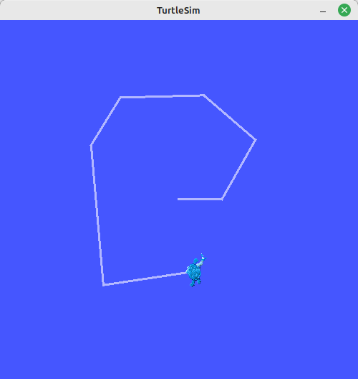
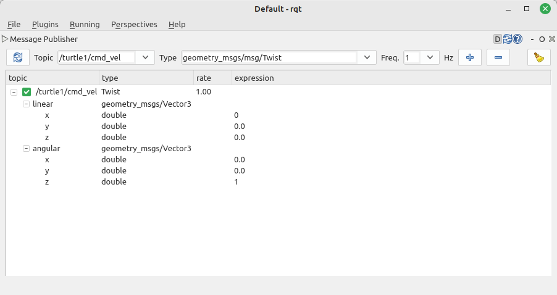
Turtlesim
$ ros2 run turtlesim turtlesim_node
$ ros2 run turtlesim turtle_teleop_key
$ ros2 topic echo /turtle1/cmd_vel
$ rqt

Slide 5
TurtleBot3 패키지 사용을 위한 준비 과정
$ nano ~/.bashrc
source /opt/ros/humble/setup.bash
source ~/robot_ws/install/local_setup.bash
source ~/turtlebot3_ws/install/local_setup.bash
source /usr/share/gazebo/setup.sh
source /usr/share/colcon_argcomplete/hook/colcon-argcomplete.bash
source /usr/share/vcstool-completion/vcs.bash
source /usr/share/colcon_cd/function/colcon_cd.sh
export _colcon_cd_root=~/robot_ws
export ROS_DOMAIN_ID=1
export ROS_LOCALHOST_ONLY=1
export RMW_IMPLEMENTATION=rmw_fastrtps_cpp
# export RCUTILS_CONSOLE_OUTPUT_FORMAT='[{severity} {time}] [{name}]: {message} ({function_name}() at {file_name}:{line_number})'
export RCUTILS_CONSOLE_OUTPUT_FORMAT='[{name}] [{severity}] [{time}]: {message}'
export RCUTILS_COLORIZED_OUTPUT=1
export RCUTILS_LOGGING_USE_STDOUT=0
export RCUTILS_LOGGING_BUFFERED_STREAM=1
export TURTLEBOT3_MODEL=waffle_pi
alias nr='nano ~/.bashrc'
alias sr='source ~/.bashrc'
alias cw='cd ~/robot_ws'
alias cs='cd ~/robot_ws/src'
alias dw='cd ~/robot_ws && rm -rf build/ install/ log/'
alias cb='cd ~/robot_ws && colcon build --symlink-install --continue-on-error'
alias cbs='colcon build --symlink-install'
alias cbp='colcon build --symlink-install --packages-select'
alias cbu='colcon build --symlink-install --packages-up-to'
alias ct='cd ~/robot_ws && mkdir test_result && colcon test --test-result-base ./test_result/ '
alias ctp='colcon test --packages-select'
alias ctr='colcon test-result'
alias rt='ros2 topic list'
alias re='ros2 topic echo'
alias rn='ros2 node list'
alias killgazebo='killall -9 gazebo & killall -9 gzserver & killall -9 gzclient'
alias roslint='ament_uncrustify && \ ament_cpplint && \ ament_cppcheck && \ ament_flake8 && \ ament_pep257 && \ ament_lint_cmake && \ ament_xmllint && \ ament_copyright'
$ source ~/.bashrc

Slide 6
TurtleBot3 패키지 사용을 위한 준비 과정
$ sudo apt update && sudo apt upgrade
$ sudo apt install ros-humble-gazebo-*
$ sudo apt install ros-humble-cartographer
$ sudo apt install ros-humble-cartographer-ros
$ sudo apt install ros-humble-navigation2
$ sudo apt install ros-humble-nav2-bringup
$ sudo apt install ros-humble-dynamixel-sdk
$ sudo apt remove ros-humble-turtlebot3*
$ mkdir -p ~/turtlebot3_ws/src/
$ cd ~/turtlebot3_ws/src/
$ git clone -b humble-devel https://github.com/ROBOTIS-GIT/turtlebot3.git
$ git clone -b humble-devel https://github.com/ROBOTIS-GIT/turtlebot3_msgs.git
$ git clone -b humble-devel https://github.com/ROBOTIS-GIT/turtlebot3_simulations.git
$ cd ~/turtlebot3_ws && colcon build --symlink-install
$ source ~/.bashrc

Slide 7
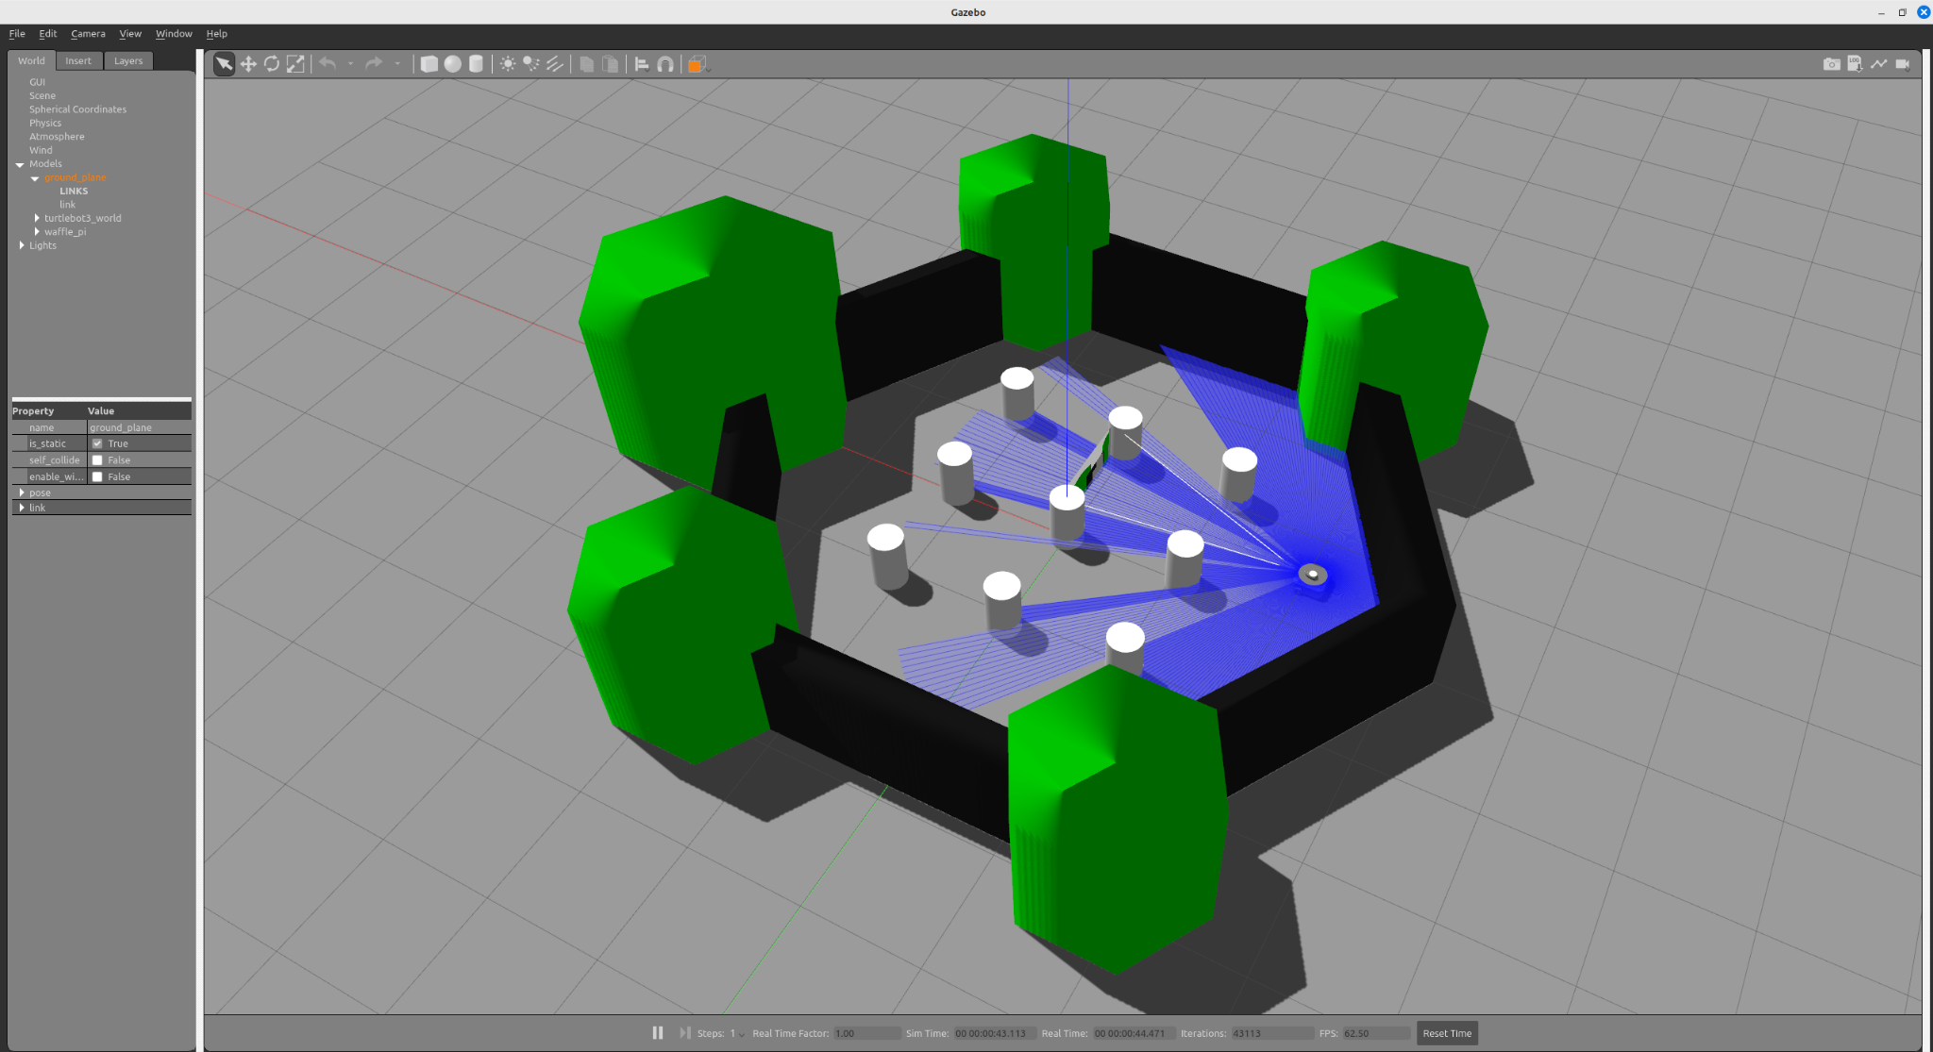
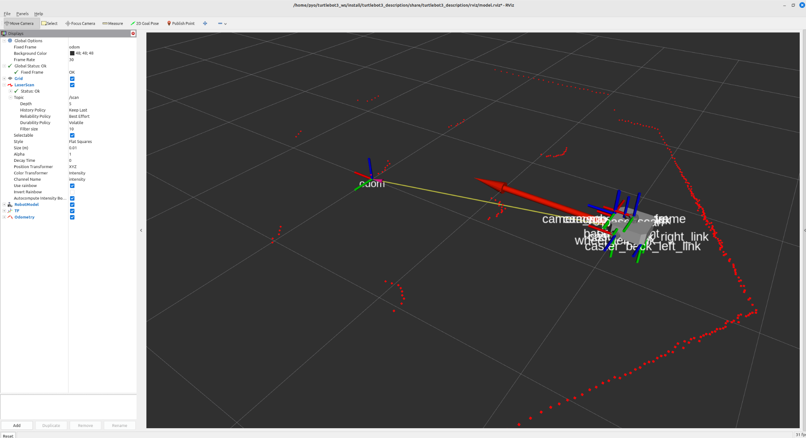
TurtleBot3 Simulation (Gazebo + Teleoperation)
$ ros2 launch turtlebot3_gazebo turtlebot3_world.launch.py
$ ros2 launch turtlebot3_bringup rviz2.launch.py
$ ros2 run turtlebot3_teleop teleop_keyboard
(아래와 같이 키보드로 터틀봇3를 제어해 보세요.)
---------------------------
Moving around:
w
a s d
x
w/x : increase/decrease linear velocity (Burger : ~ 0.22, Waffle and Waffle Pi : ~ 0.26)
a/d : increase/decrease angular velocity (Burger : ~ 2.84, Waffle and Waffle Pi : ~ 1.82)
space key, s : force stop
CTRL-C to quit

Slide 8
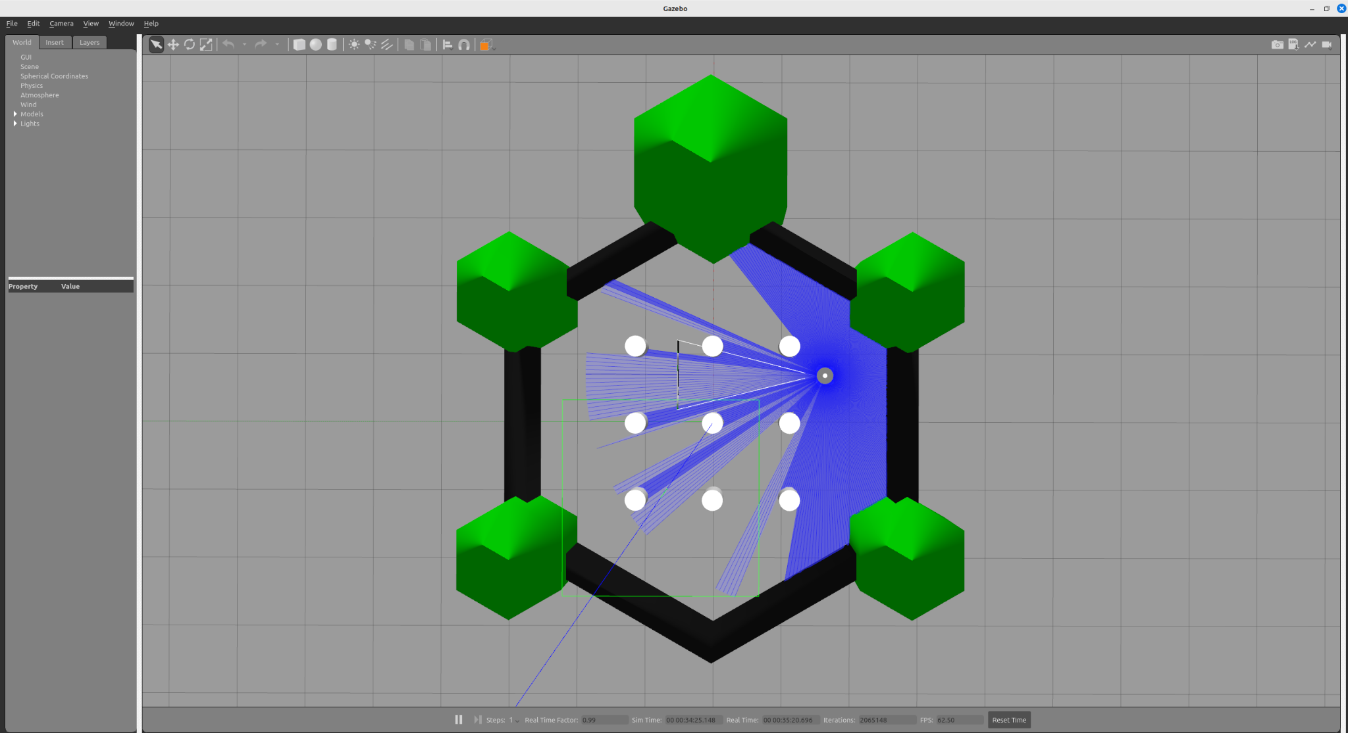
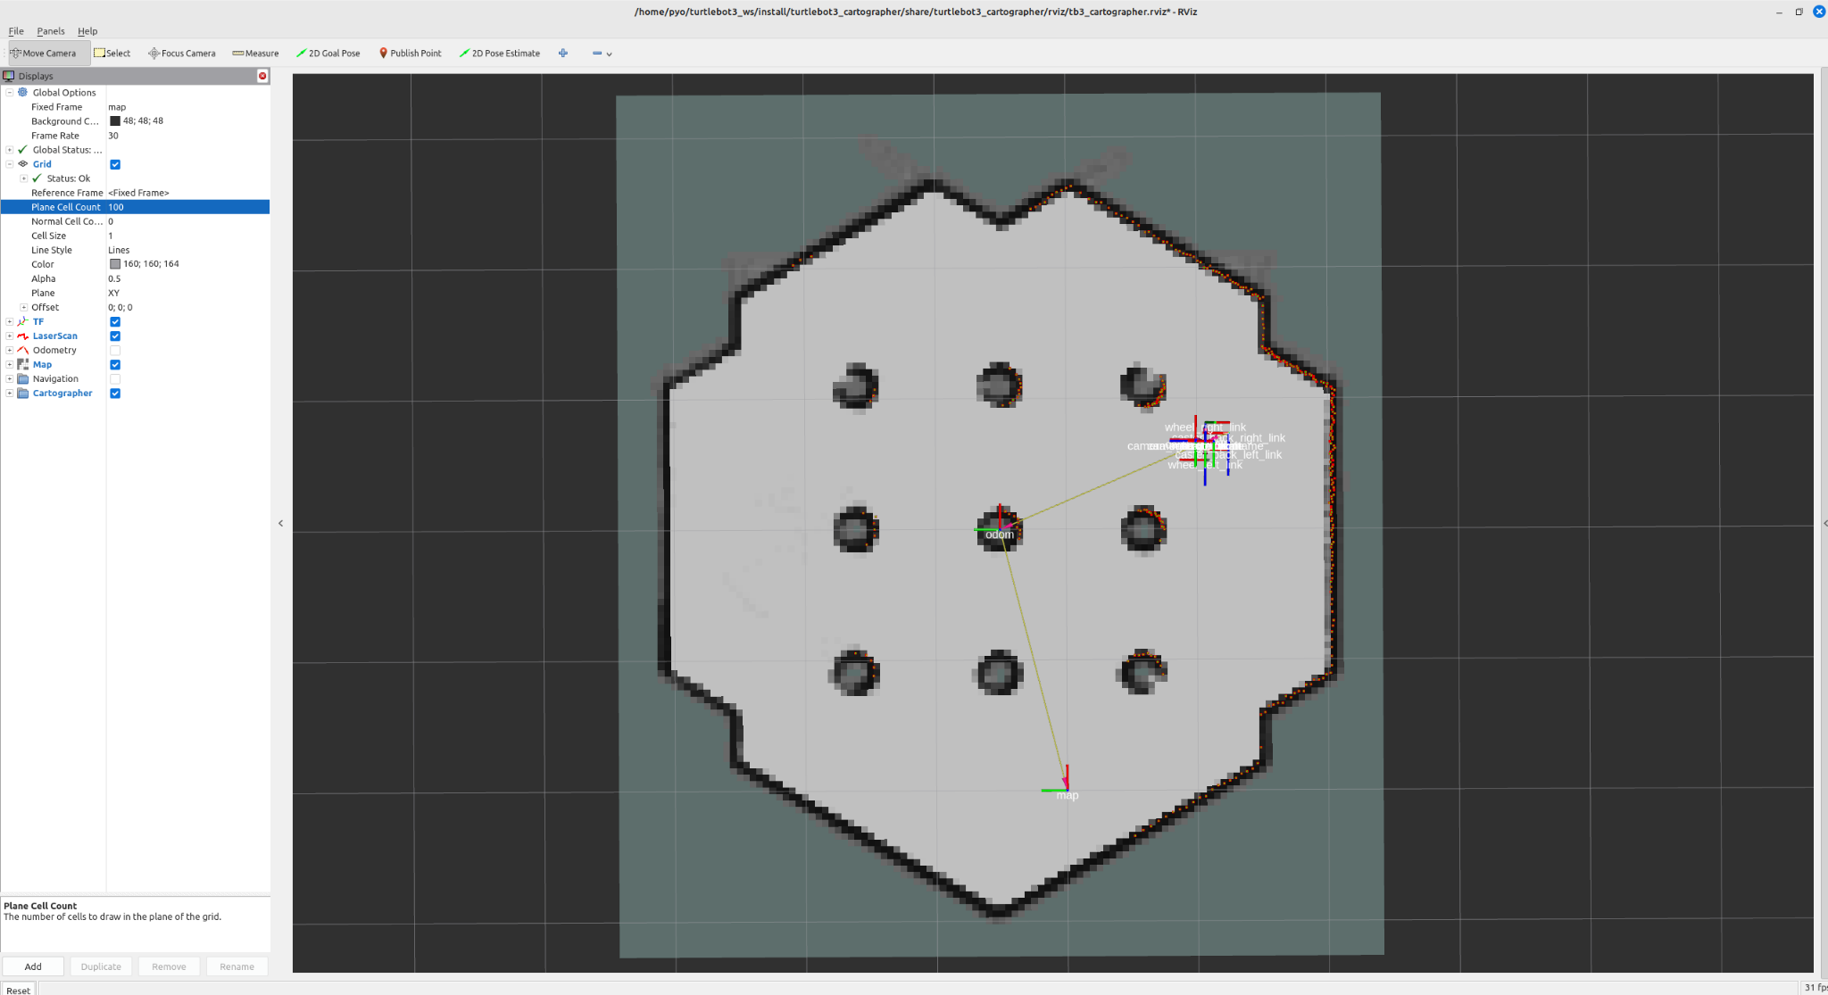
TurtleBot3 Simulation (Gazebo + SLAM)
$ ros2 launch turtlebot3_gazebo turtlebot3_world.launch.py
$ ros2 launch turtlebot3_cartographer cartographer.launch.py use_sim_time:=True
$ ros2 run turtlebot3_teleop teleop_keyboard
(키보드 w, a, s, d, x 버튼으로 로봇을 움직이며 지도를 작성하세요.)
$ ros2 run nav2_map_server map_saver_cli -f ~/map
(작성한 지도를 파일 형태로 저장하세요.)

Slide 9
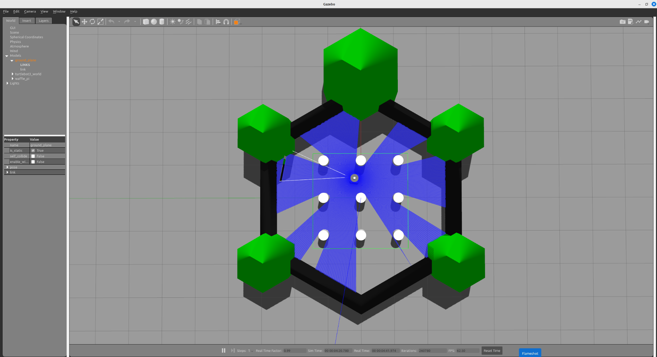
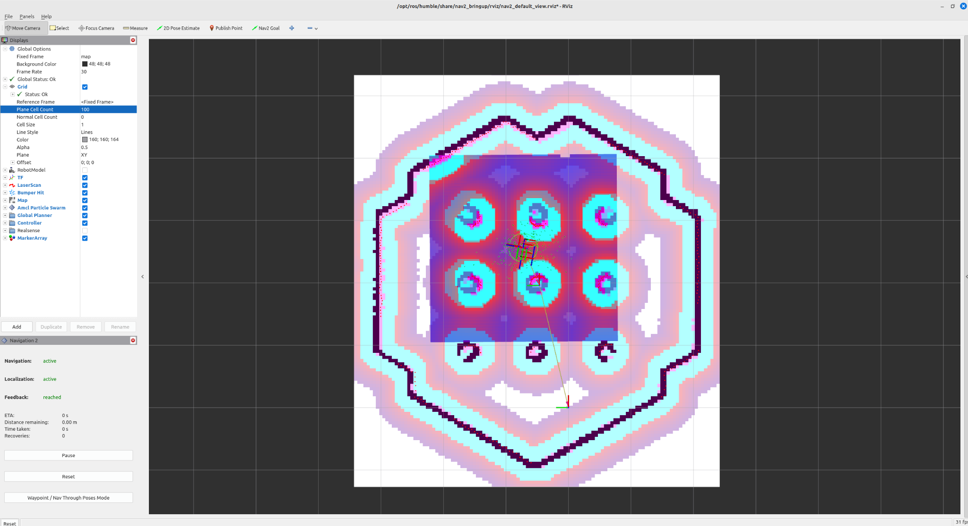
TurtleBot3 Simulation (Gazebo + Navigation)
$ ros2 launch turtlebot3_gazebo turtlebot3_world.launch.py
$ ros2 launch turtlebot3_navigation2 navigation2.launch.py use_sim_time:=True map:=$HOME/map.yaml
(RViz 화면 상단의 2D Pose Estimate 버튼을 눌러 초기 위치를 지정하세요.)
(RViz 화면 상단의 Nav2 Goal 버튼을 눌러 목적지를 지정하세요.)

Slide 10
Monica24
$ cd {$workspace_path}/src/
$ git clone https://github.com/orocapangyo/monicar2.git
$ git clone -b $ROS_DISTRO https://github.com/micro-ROS/micro_ros_setup.git
$ git clone -b ros2 https://github.com/Slamtec/rplidar_ros.git
$ sudo apt install -y ros-humble-cartographer-ros ros-humble-nav2-map-server \
ros-humble-rqt-robot-steering ros-humble-imu-tools \
ros-humble-tf2-py ros-humble-tf2-tools ros-humble-nav2-bringup ros-humble-navigation2
cd {$workspace_path}/src/monicar2/monicar2_arduino
./create_udev_rules_esp32snode.sh
./create_udev_rules_rplidar.sh
cd {$workspace_path}
# jetson , terminal 1
$ ros2 launch monicar2_bringup mcu.launch.py
#jetson or pc terminal 2
$ ros2 launch monicar2_teleop teleop_joy.launch.py
#jetson or pc terminal 2
$ ros2 run monicar2_teleop teleop_keyboard
cd {$workspace_path}
$ ros2 launch monicar2_localization ekfPose.launch.py
# or using another options
# example) teleop_joy, not using description
$ ros2 launch monicar2_localization ekfPose.launch.py use_joy:='true' use_des:='false'
#terminal #2, recommand PC than Jetson
$ ros2 launch monicar2_cartographer cartographer.launch.py
#terminal #3, recommand PC than Jetson
$ ros2 launch monicar2_cartographer cartographer_rviz.launch.py

