Slide 1
AI for Network Anomaly Detection

Slide 2
Outline
Introduction
Popular Dataset
KDD99 Intrusion Detection Dataset
Download and Prepare Environment
Explanation about “preprocess_data.py”
Explanation about “Lab.ipynb”

Slide 3
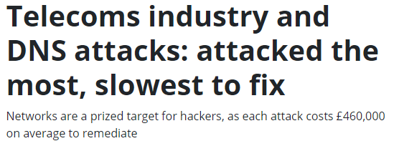
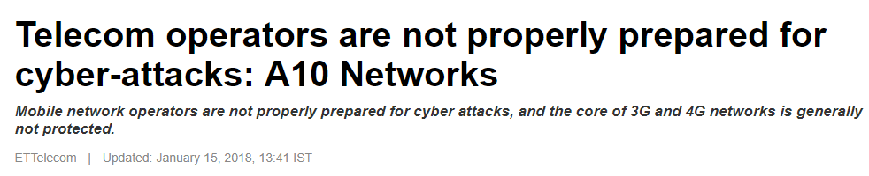
Introduction
Definition of Anomaly
An observation that is likely generated by a different mechanism
Anomaly is “NOT BAD” behavior, it is out of norm behavior
Why is it important?
In the field of network, data size and types are growing along with the rapid development of technologies, which risks are becoming indistinguishable and complex as well
Relevant news:
https://www.information-age.com/telecoms-industry-dns-attacks-attacked-slowest-fix-123469037/ https://telecom.economictimes.indiatimes.com/news/telecom-operators-are-not-properly-prepared-for-cyber-attacks-a10-networks/62504221

Slide 4

Introduction
Spot the anomaly

Slide 5
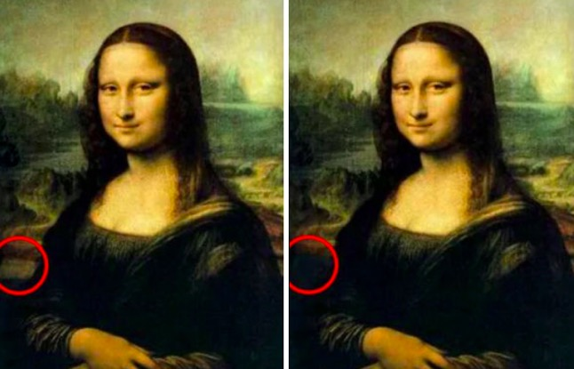
Introduction
Answer

Slide 6
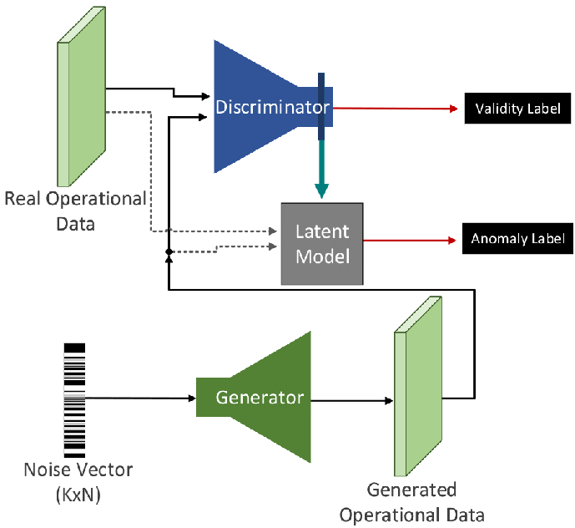
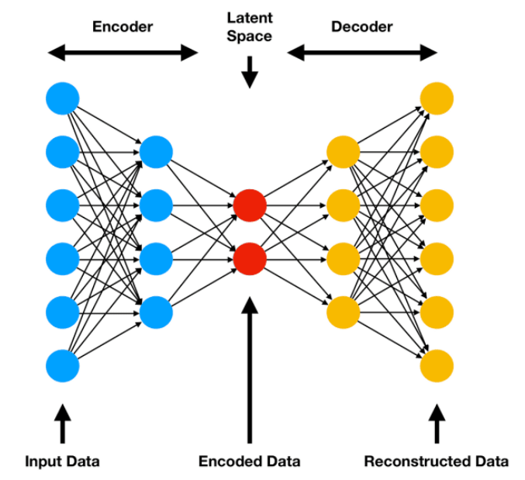
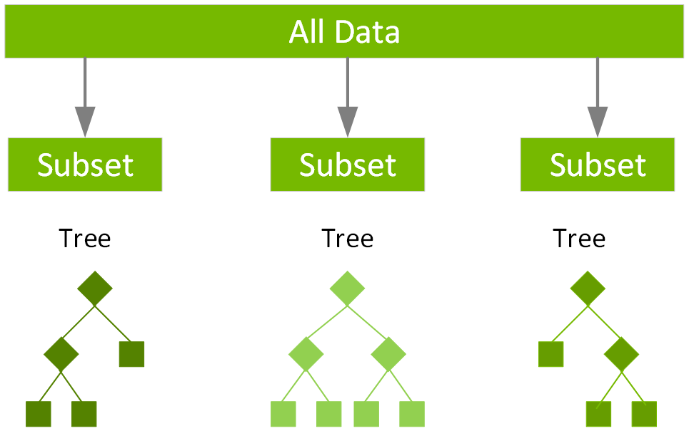
Introduction
How to detect anomaly
Anomaly Detection
Supervised
(When you have Labels)
Unsupervised
(When you don’t have labels for your data)
XGBoost
Autoencoders
Generative Adversarial Networks
Main Focus

Slide 7
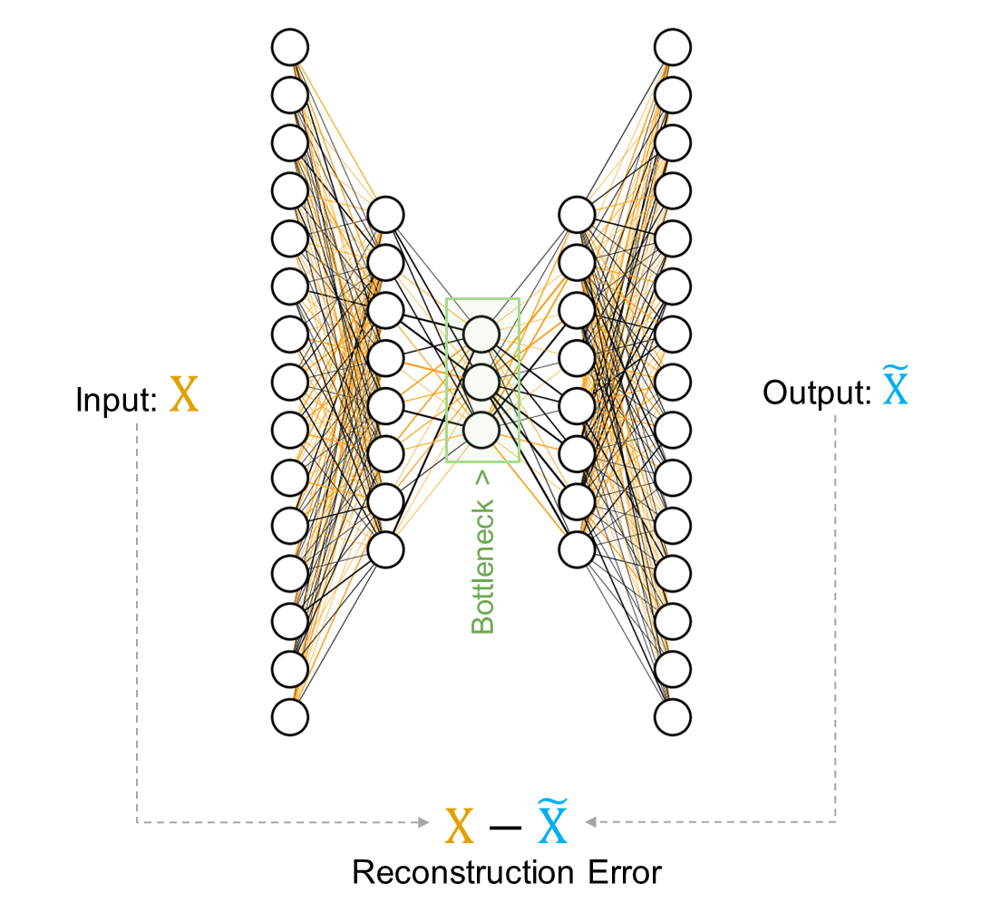
Introduction
Autoencoder Method
A form of unsupervised learning and have applications outside of anomaly detection
Consists of two parts the encoder and decoder
Encoder: a neural network that maps the input to a lower-dimensional space
Decoder: a neural network that maps the encoded data back to the input
Anomalies have high reconstruction error
Higher the error is the more input is not following the trend of previous dataset

Slide 8
Popular Dataset
KDD99 Intrusion Detection Dataset
Purpose: Detect anomalies by observing network packet logs
http://kdd.ics.uci.edu/databases/kddcup99/kddcup99.html
Numerical
Categorical
Basic Features | Content Features | Traffic Features
duration | hot | count
protocol_type | num_failed_logins | serror_rate
service | logged_in | rerror_rate
src_bytes | num_compromised | same_srv_rate
dst_bytes | root_shell | diff_srv_rate
flag | su_attempted | srv_count
land | num_root | srv_serror_rate
wrong_fragment | num_file_creations | srv_rerror_rate
urgent | num_shells | srv_diff_host_rate
 | num_access_files
 | num_outbound_cm
 | is_hot_login
 | is_guest_login
Size | 743 Mb
No. of Features | Numeric = 22 ; Categorical = 9
No. of Rows | 18 Million
No. of Classes | 23 (Including the Normal category)

Slide 9
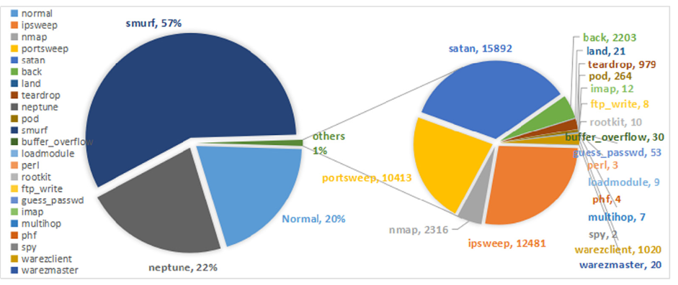
KDD99 Intrusion Detection Dataset
Distribution of classes in the dataset

Slide 10
Download and Prepare Environment
Download dataset: https://www.kaggle.com/api/v1/datasets/download/galaxyh/kdd-cup-1999-data
Unzip dataset and place “kddcup.data.corrected” file with the code in the same directory(folder)
https://github.com/Junghs21/AI-Networking.git
Install necessary libraries(packages)
Create python virtual environment if needed
Run “pip install -r requirements.txt”

Slide 11
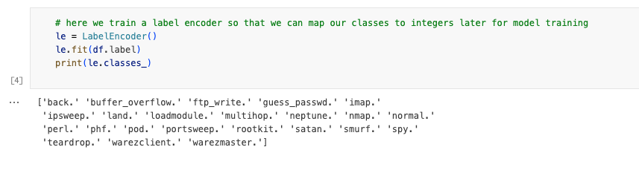
Data Preprocessing (Lab1.ipynb)
Categorical features cannot be used in DNN
LabelEncoder maps categorical data into specific integers
Label
normal
back
Land
phf
pod
Label
0
1
2
3
4

Slide 12
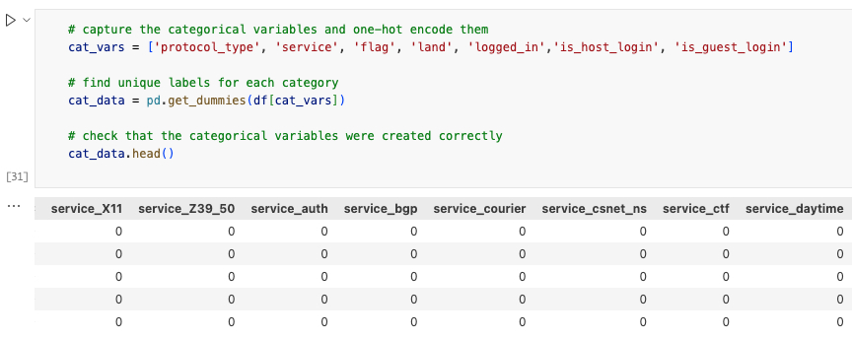
Data Preprocessing (Lab1.ipynb)
One hot encoding creates a categorical feature into separate columns of each category and indicates with binary
service
X11
Z39_50
auth
bgp
courier
service_X11 | service_Z39_50 | service_auth | service_bgp | service_courier
1 | 0 | 0 | 0 | 0
0 | 1 | 0 | 0 | 0
0 | 0 | 1 | 0 | 0
0 | 0 | 0 | 1 | 0
0 | 0 | 0 | 0 | 1

Slide 13
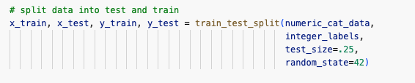
Data Preprocessing (Lab1.ipynb)
Train Test Split
Randomly split train and test dataset
Can select the ratio of test size (25% in the code)

Slide 14
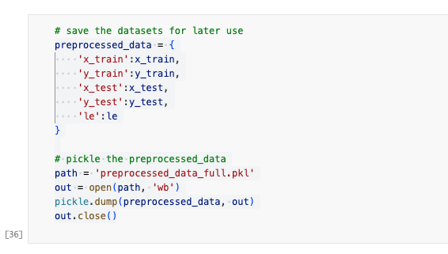
Data Preprocessing (Lab1.ipynb)
Save the processed data for future experiments

Slide 15
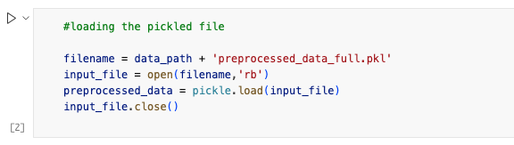
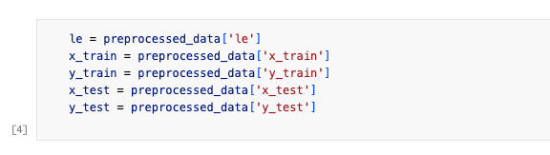
Load Dataset (Lab2.ipynb)
Load the saved dataset
Declare each dataset as a variables
Notes:
Lab2.ipyng

Slide 16
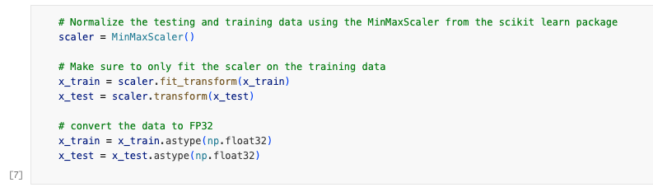
Load Dataset (Lab3.ipynb)
Normalize the dataset for stable training of autoencoder
Scaling all data points into 0~1
Sometimes anomaly data is too far from the norm which interrupts the representation of the data
Notes:
Lab3.ipynb

Slide 17
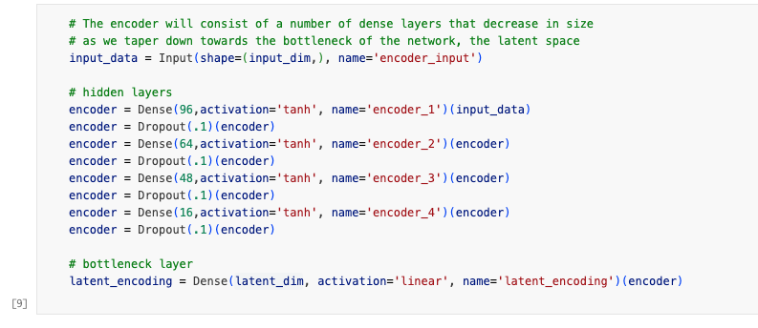
Autoencoder (Lab3.ipynb)
Creating a model(Autoencoder) using Tensorflow (Keras)

Slide 18
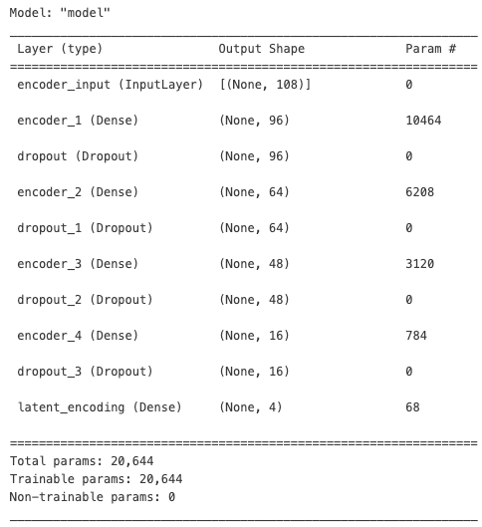

Autoencoder (Lab3.ipynb)
Log the model summary to check whether the model has been defined as intended

Slide 19
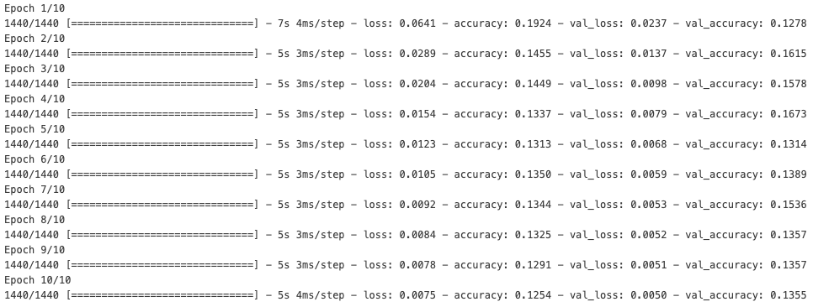
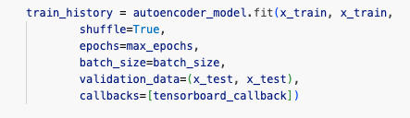
Training (Lab3.ipynb)
Train the model

Slide 20
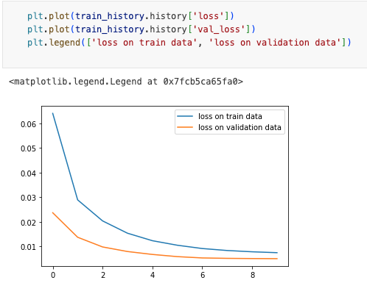
Training (Lab3.ipynb)
Plot the training history(Loss) to validate the training process
If the graph converges, then it has been training
Reconstruction loss is gradually decreasing → Model is able to construct the representation of the data

Slide 21
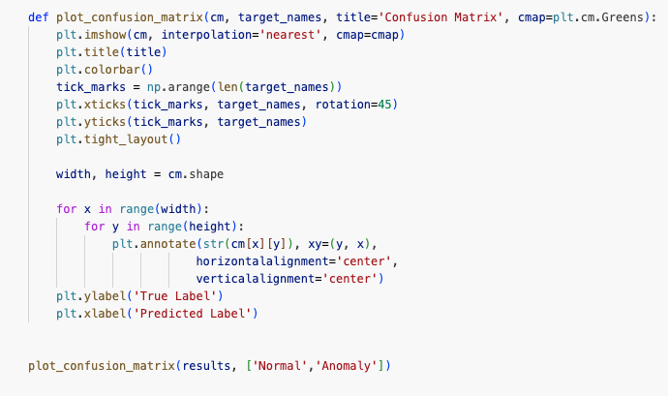
Validation (Lab3.ipynb)
Validate the model with confusion matrix

Slide 22
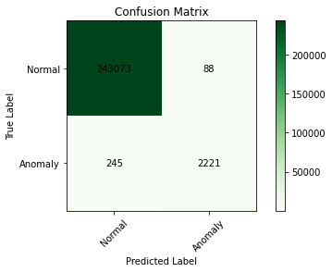
Validation (Lab3.ipynb)
Validate the model with confusion matrix
“True Label” and “Predicted Label” should match to evaluate the model’s performance
Correct
Wrong

Slide 23
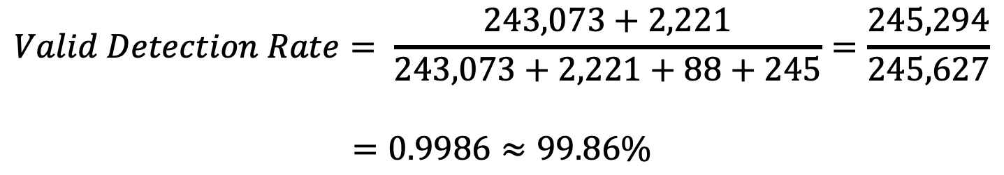
Validation (Lab3.ipynb)
Correct
Wrong
$$Valid Detection Rate= \frac{243,073+2,221}{243,073+2,221+88+245}=\frac{245,294}{245,627}$$ $$=0.9986≈99.86\%$$

Slide 24
Thank You!

