Slide 1

Effective Project Management: JIRA for Issue and Bug Tracking
Group Members
Hirdesh Timilsena
Gaurab Rijal
Janak Bhandari
Date: 12 Oct, 2024

Slide 2
Agenda
Issue and Bug Tracking Tools Used
Workflow
Integrations with Other Tools
Resource Allocation and Workload Balancing
Summary
Questions

Slide 3
Issue and Bug Tracking Tools
JIRA as the Primary Issue and Bug Tracking Tool
For the daily management of our project, we have selected JIRA as our primary tool for issue and bug tracking. JIRA is widely regarded as one of the most robust and feature-rich platforms for managing agile projects, offering flexibility in tracking issues, bugs, tasks, and overall project progress.
Why JIRA?
JIRA was chosen for our project because of its comprehensive features that cater specifically to software development and project management teams. It allows us to streamline the entire process of tracking, managing, and resolving issues, ensuring that all stakeholders remain aligned throughout the project lifecycle.

Slide 4
Key Features of JIRA for Issue and Bug Tracking:
Issue and Bug Tracking:
JIRA allows the team to efficiently log, track, and manage issues and bugs throughout the project lifecycle.
Customizable workflows ensure that each issue follows a defined path (e.g., To Do, In Progress, Done), providing clarity on the current status and what requires attention.
Task Management:
JIRA breaks down the project into tasks and epics, assigned to specific team members for clear deliverables and transparent resource allocation.
The Kanban board in JIRA visually tracks task progress, highlighting bottlenecks and allowing real-time adjustments to maintain smooth workflow.
Customization and Flexibility:
JIRA allows teams to customize workflows by adding stages that fit the project’s needs, like review or testing.
Custom fields and reports can be created to track project-specific data and improve task monitoring and insights.

Slide 5
Key Features of JIRA for Issue and Bug Tracking:
4. Integration with GitHub:
JIRA integrates with GitHub, allowing the team to connect repositories and sync pull requests, commits, and branches with JIRA issues.
This integration ensures real-time updates and alignment between development and project management tasks.
5. Real-Time Collaboration:
JIRA enables real-time collaboration with comments, attachments, and progress updates directly on tasks.
Notifications and mentions keep team members informed and ensure efficient communication about project updates.
6. Tracking Progress:
JIRA's tracking tools identify delays, monitor productivity, and enable data-driven decisions to optimize resources and keep the project on track.

Slide 6
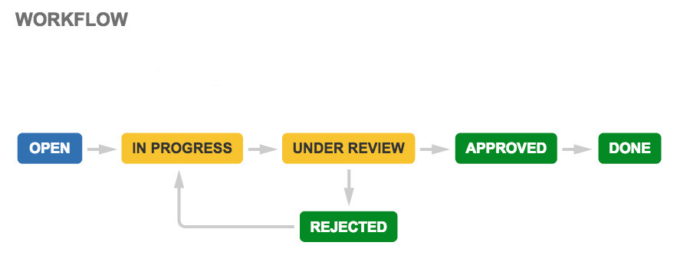
Workflow
Workflow for Online Travel Booking Platform
In the development and management of the Online Travel Booking Platform, we use a well-defined workflow within JIRA to manage issues and tasks related to both functional and non-functional requirements. Each issue progresses through specific stages to ensure the smooth completion of tasks and timely resolution of bugs. Here’s the workflow we’ve established for this project:

Slide 7
Workflow Example for Online Travel Booking Platform:
To Do: The task "Implement User Authentication Feature" is created in JIRA and prioritized in the backlog, indicating it needs to be worked on to allow users to securely sign up and log in.
In Progress: A developer selects the task and changes its status to "In Progress." They begin coding the user authentication process, including registration, login, password recovery, and session management.
Under Review: After completing the coding, the developer submits the feature for review. Team members test the user authentication functionality to ensure it works as expected, checking for security vulnerabilities and usability.
Rejected: If the review team finds issues (e.g., vulnerabilities in password storage or incorrect error messages), the task is marked as "Rejected." The developer receives specific feedback to fix the identified issues.
Approved: Once the developer addresses the feedback and resubmits the feature, the review team tests it again. If it meets all requirements and passes security checks, the task is marked as "Approved."
Done: Finally, after successfully deploying the "User Authentication Feature" to the production environment and confirming it operates correctly, it is marked as "Done." This feature is now live, allowing users to register and log in securely to the online travel booking platform.

Slide 8

Integrations with Other Tools:
GitHub Integration in JIRA
In our project, we are using GitHub as the primary tool for version control and code management, while JIRA handles issue tracking and project management. Integrating GitHub with JIRA ensures smooth collaboration between development and project management teams, making the entire workflow more efficient.
Jira
GitHub

Slide 9

Using GitHub with JIRA: Implementation and Considerations
How GitHub is used:
GitHub is used to manage our project’s codebase by allowing team members to collaborate, commit changes, and create pull requests. Each commit or pull request in GitHub is linked to a specific issue or task in JIRA.
This linkage ensures that any code changes are directly tied to the project’s progress, helping to track the completion of features or bug fixes.
GitHub’s version control capabilities also allow us to track changes over time, review past commits, and easily revert to previous versions if needed.

Slide 10
Using GitHub with JIRA: Implementation and Considerations
Considerations for integration with JIRA:
Ensuring that every issue or task in JIRA is linked with the corresponding branch or commit in GitHub so that the work is tracked properly.
Regular syncing between GitHub and JIRA to ensure that all updates in the codebase reflect the latest progress in JIRA.
Proper use of branch naming conventions and pull requests to ensure that each JIRA issue has an associated GitHub branch, making it easier to track the work done on each task.
Monitoring pull requests and commits to ensure they align with the project’s goals and timelines outlined in JIRA.
By integrating GitHub and JIRA, we ensure that our development efforts are well-aligned with project management, providing real-time updates and a clear overview of the project's progress.

Slide 11
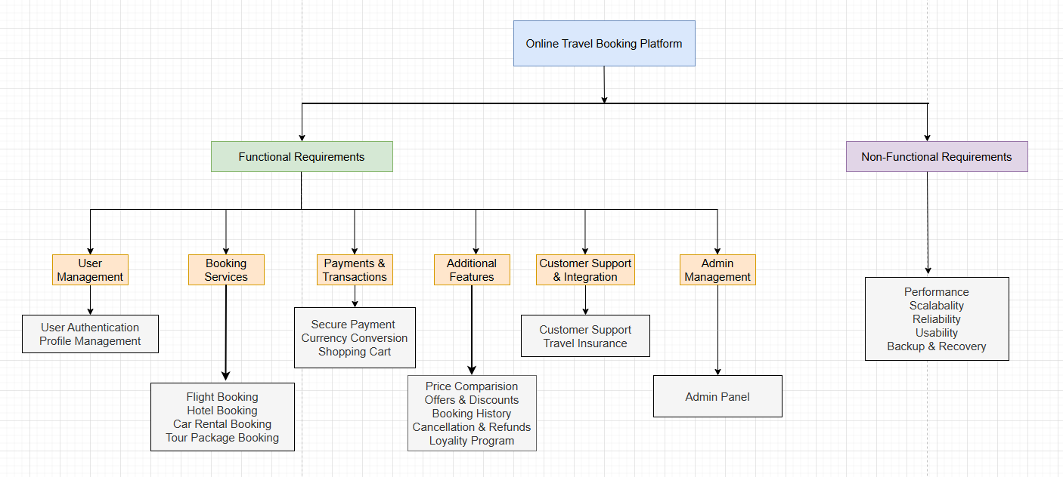
Resource Allocation and Work Balancing
In this project, the deliverables have been divided into different epics, and each epic contains multiple tasks. Each task has been assigned to specific team members, ensuring a balanced distribution of responsibilities and avoiding overlap. This approach provides transparency in the workflow, making it easier to monitor the progress of each deliverable.
Fig 2: Hierarchical Representation based on Requirements

Slide 12
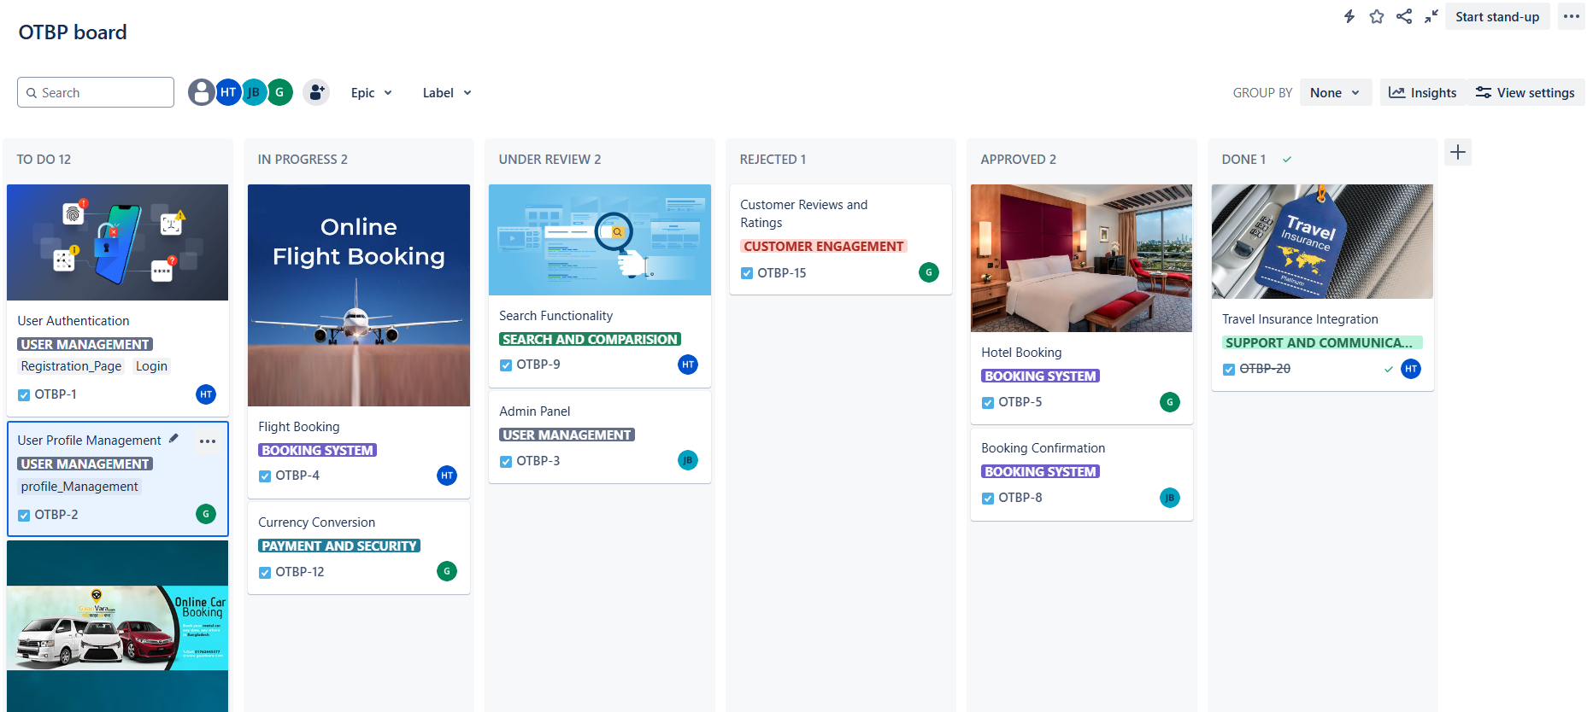
Task Assignment Management in JIRA
Team members will work on their assigned tasks, and we will utilize JIRA for tracking the progress of each task within the epics. The breakdown of tasks and team member assignments will be reflected in the attached JIRA screenshots.
Kanban Board

Slide 13
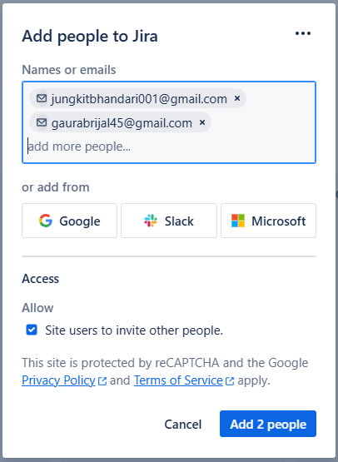
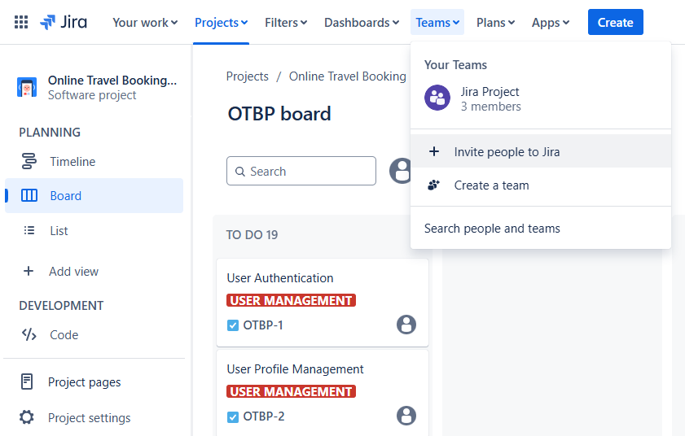
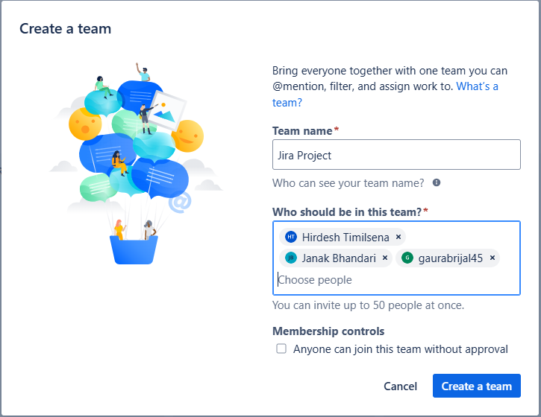
Task Assignment Management in JIRA
Adding people to Jira and Creating Team

Slide 14
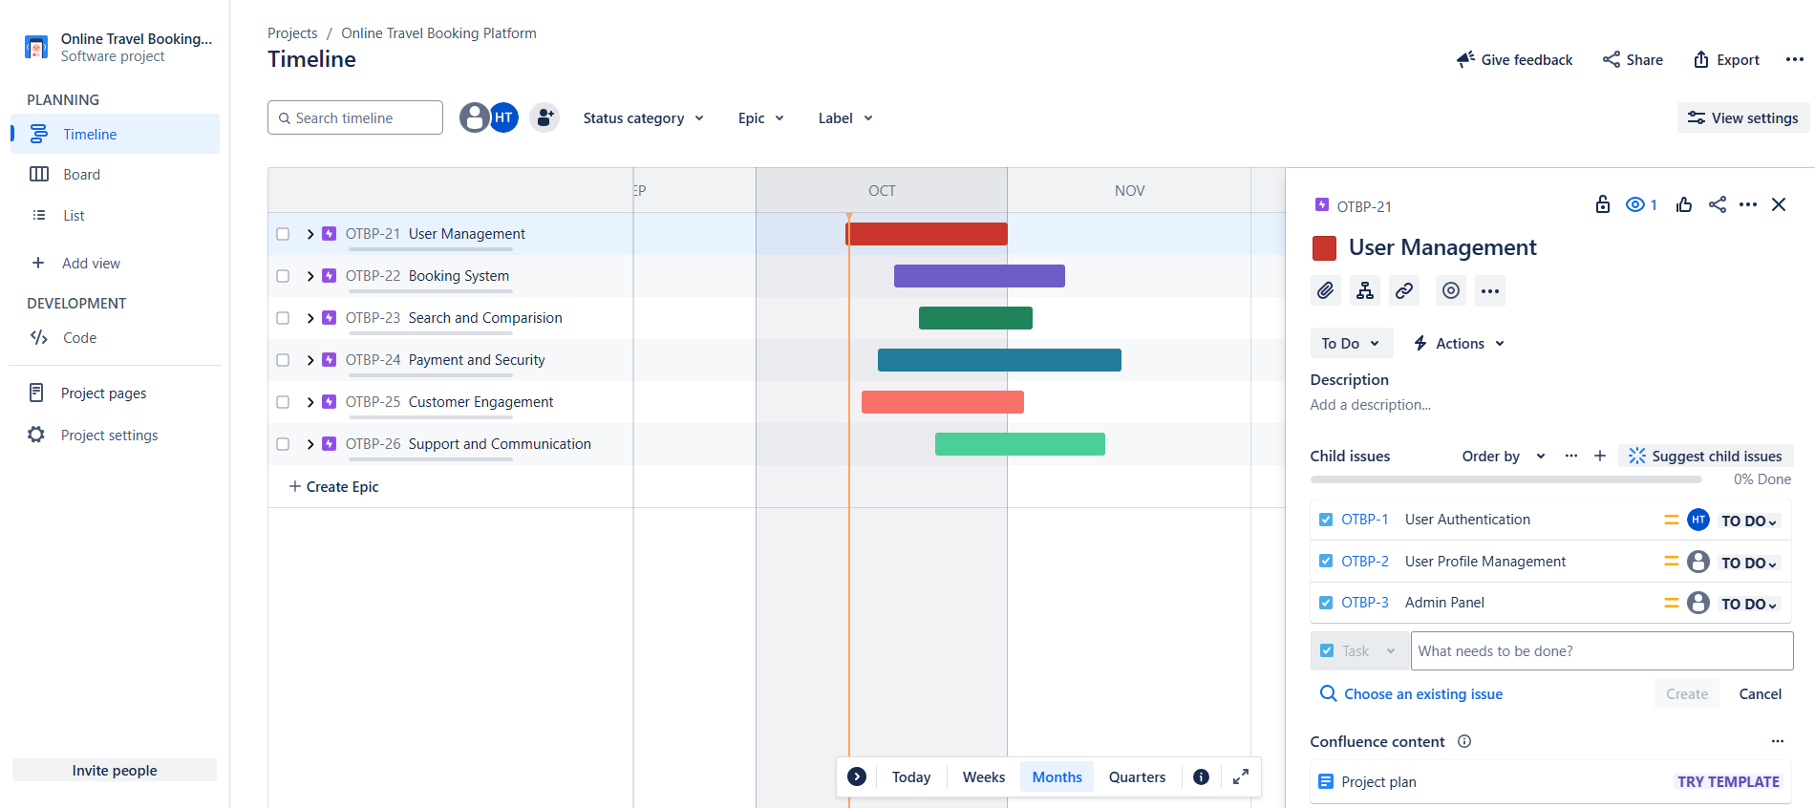

Task Assignment Management in JIRA
Assign Task
Create Epic
Creating Epic and Assigning Task to each Epic

Slide 15
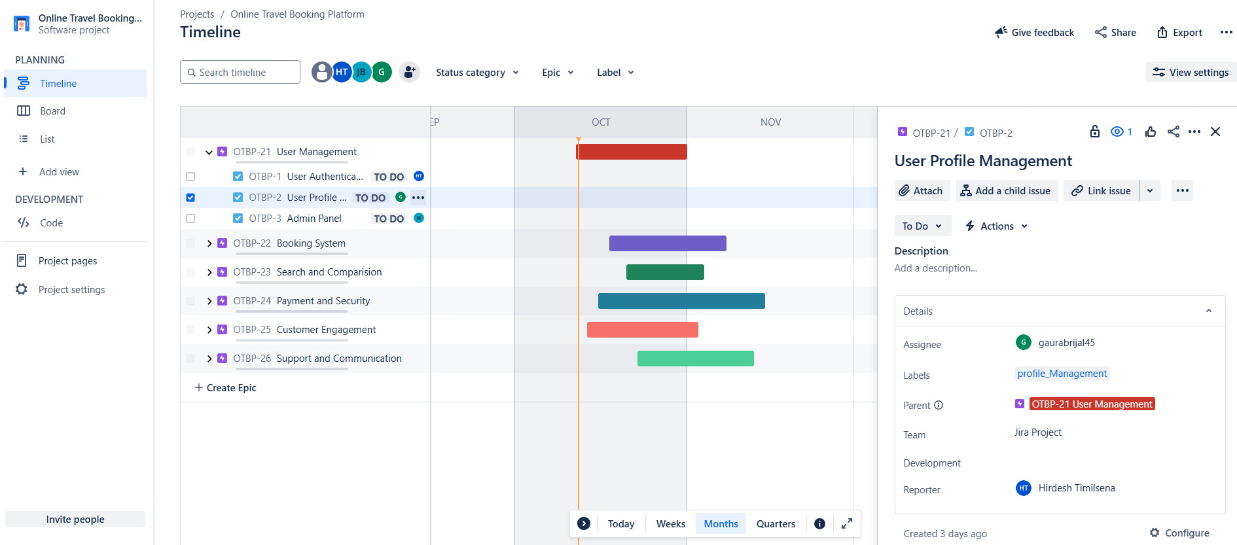
Task Assignment Management in JIRA
Assigning Task to Team Members

Slide 16
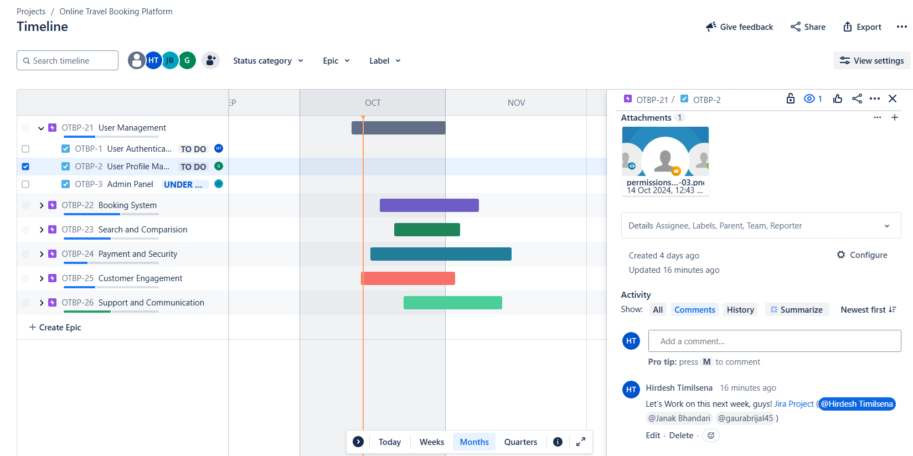
Task Assignment Management in JIRA
Adding Comment under Task

Slide 17
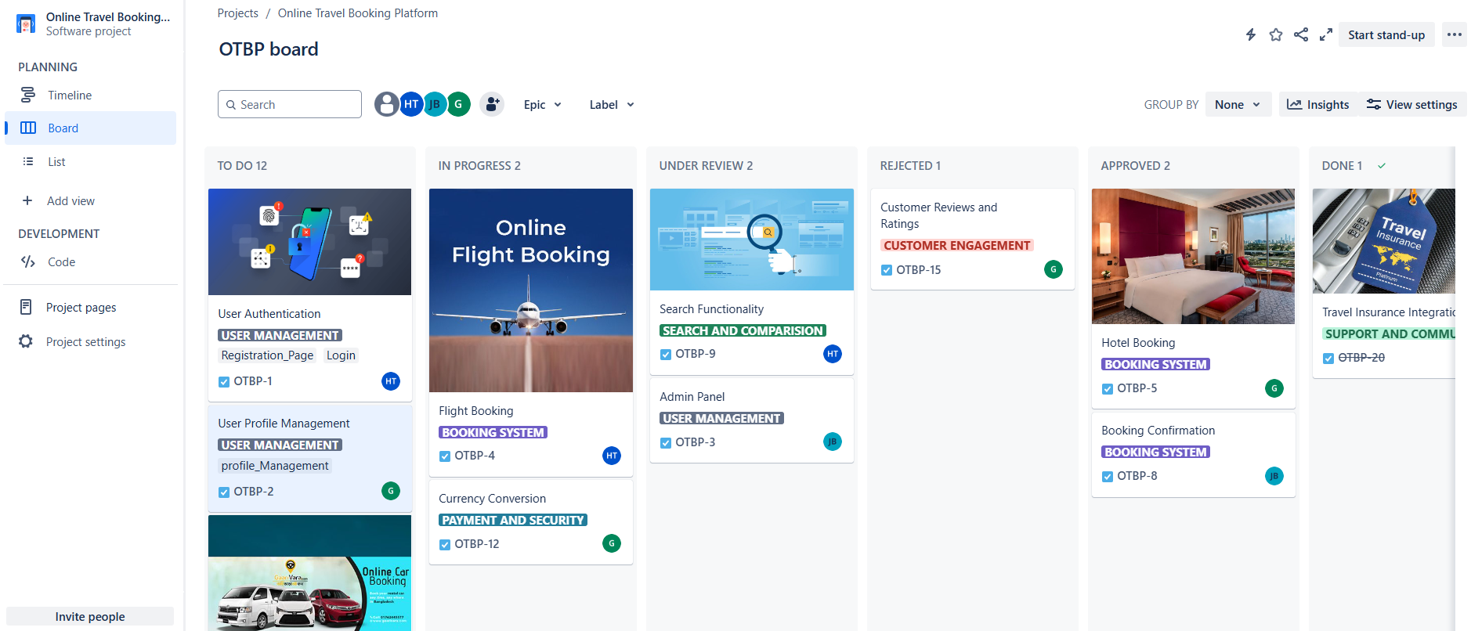
Integration with Tools: GitHub
Additionally, we will integrate GitHub with JIRA to streamline collaboration on development-related tasks. This will allow for continuous tracking of code changes directly linked to the tasks within JIRA, ensuring seamless coordination between project management and development efforts.
Connecting GitHub from Jira

Slide 18
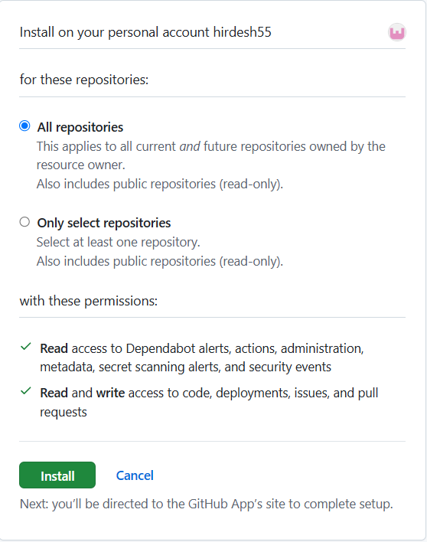
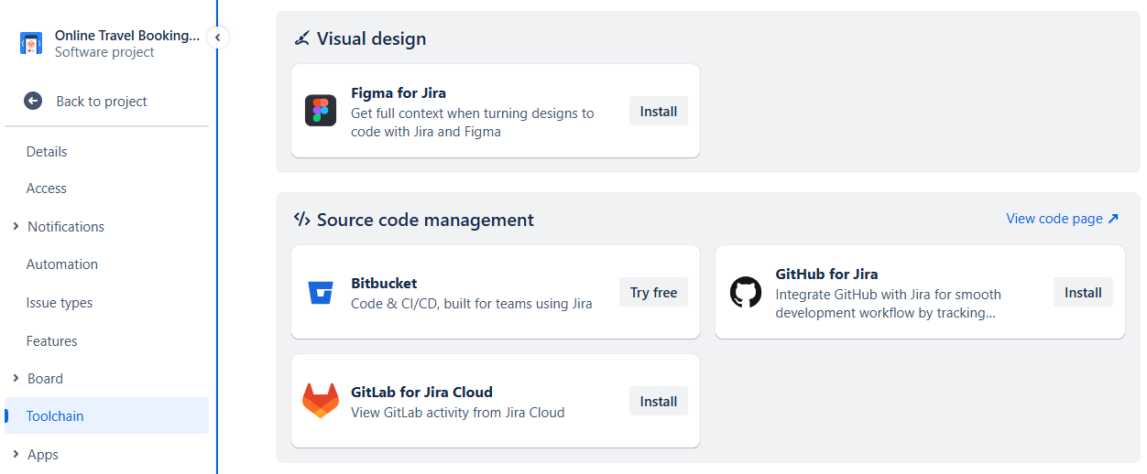
Integration with Tools: GitHub
Project Setting
Toolchain
Install
Connecting GitHub from Jira

Slide 19
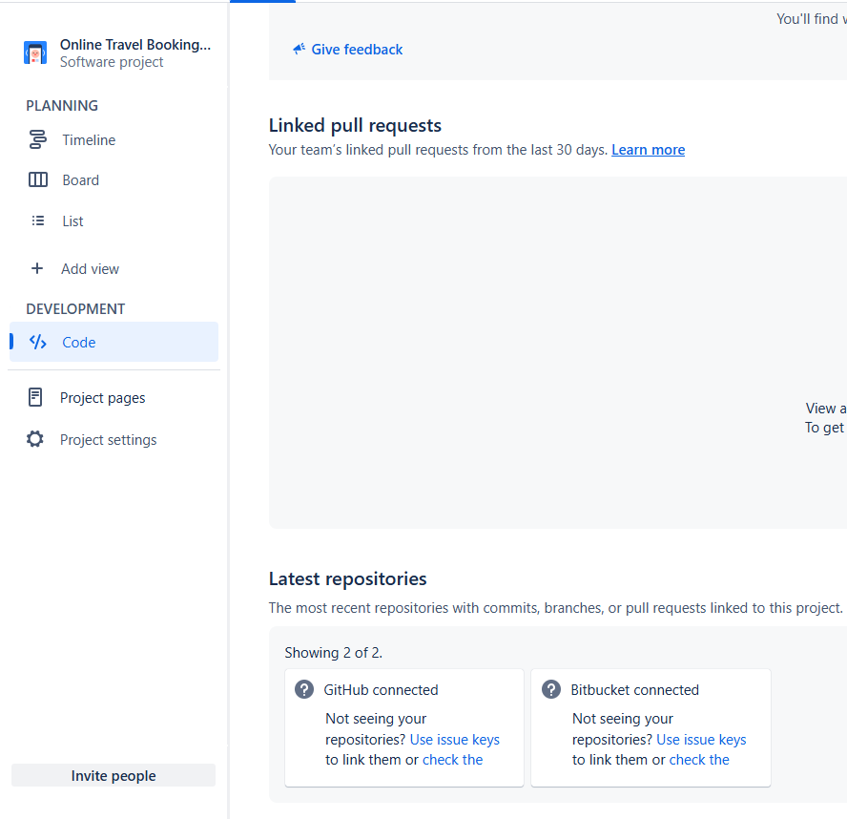
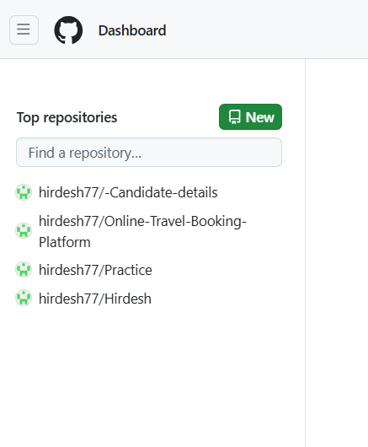
Integration with Tools: GitHub
Accessing GitHub Repositories from Jira

Slide 20
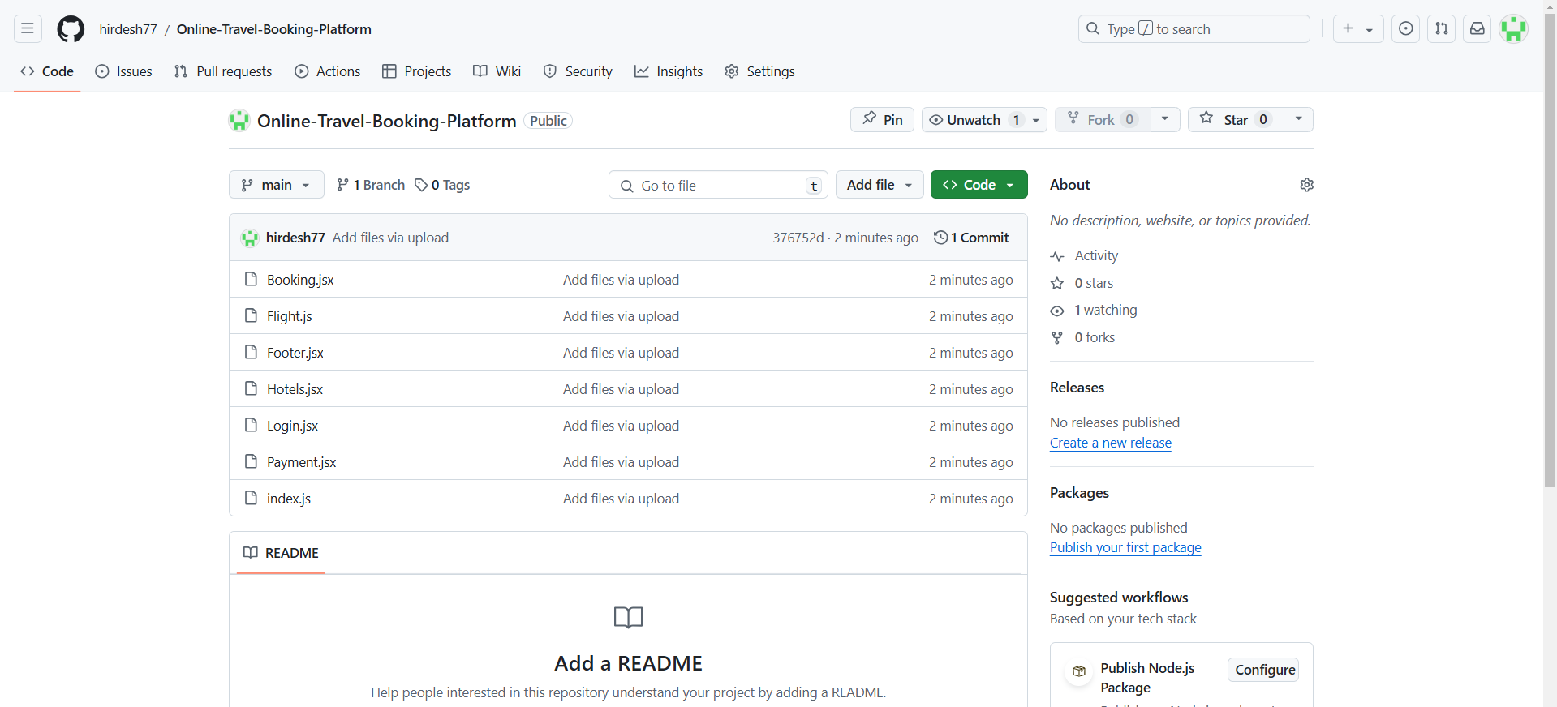
Integration with Tools: GitHub
Accessing GitHub files

Slide 21
Summary
In order to ensure effective planning and execution of the Online Travel Booking Platform project, we have developed a structured approach to project management. The following outlines the key components of our planning strategy, challenges, and the solutions we have implemented to maintain an efficient workflow.
Project Planning and Structure:
The project was structured into clear epics and tasks to define deliverables. Each task was assigned to specific team members, ensuring clarity in roles and responsibilities.
Task Management with JIRA:
JIRA was chosen as the primary tool for tracking tasks and progress. Team members will update the status of their tasks, allowing for real-time visibility into project progress.
Integration with GitHub:
To enhance collaboration, GitHub will be integrated with JIRA, enabling seamless tracking of code changes and ensuring alignment between development tasks and project management.
Regular Communication and Updates:
Weekly team meetings will be scheduled to discuss progress, address challenges, and adjust timelines. Continuous communication through JIRA comments and notifications will keep the team informed.

Slide 22
Summary
Challenges and Solutions
Task Overlap or Confusion:
To address this, a clear structure of epics and tasks was implemented, and team members were assigned specific responsibilities to avoid confusion.
Tracking Progress:
To ensure consistent tracking, JIRA will be used to monitor task statuses, and regular updates will be enforced. The integration with GitHub will facilitate tracking code changes linked to specific tasks.
Team Collaboration:
To enhance collaboration, GitHub will be integrated with JIRA, allowing for easy communication between team members and developers.
By implementing these strategies and tools, we aim to maintain a smooth workflow and effectively manage the day-to-day operations of the project.​

Slide 23
Any Questions??

Slide 24
Additional Resources:
Atlassian. (n.d.). JIRA documentation. Retrieved from https://www.atlassian.com/software/jira/guides
GitHub. (n.d.). GitHub documentation. Retrieved from https://docs.github.com/en
Agile Alliance. (n.d.). Agile project management guide. Retrieved from https://www.agilealliance.org/agile101/
Project Management Institute. (n.d.). Best practices for project management. Retrieved from https://www.pmi.org/learning/library/project-management-best-practices-8278

Slide 25
Contact Information
Hirdesh Timilsena
hirdeshtimilsena77@gmail.com
Gaurab Rijal
gaurabrijal45@gmail.com
Janak Bhandari
Jungkitbhandari001@gmail.com

Slide 26
Thank You

