Slide 1


Blood Glucose Prediction Model Applicable to Continuous Glucose Monitoring Systems
Master Thesis Defense
Author: Jiang Yijun
Supervisor: Prof. Shiming Zhang
Department of Electrical and Computer Engineering
The University of Hong Kong
June 2026

Slide 2

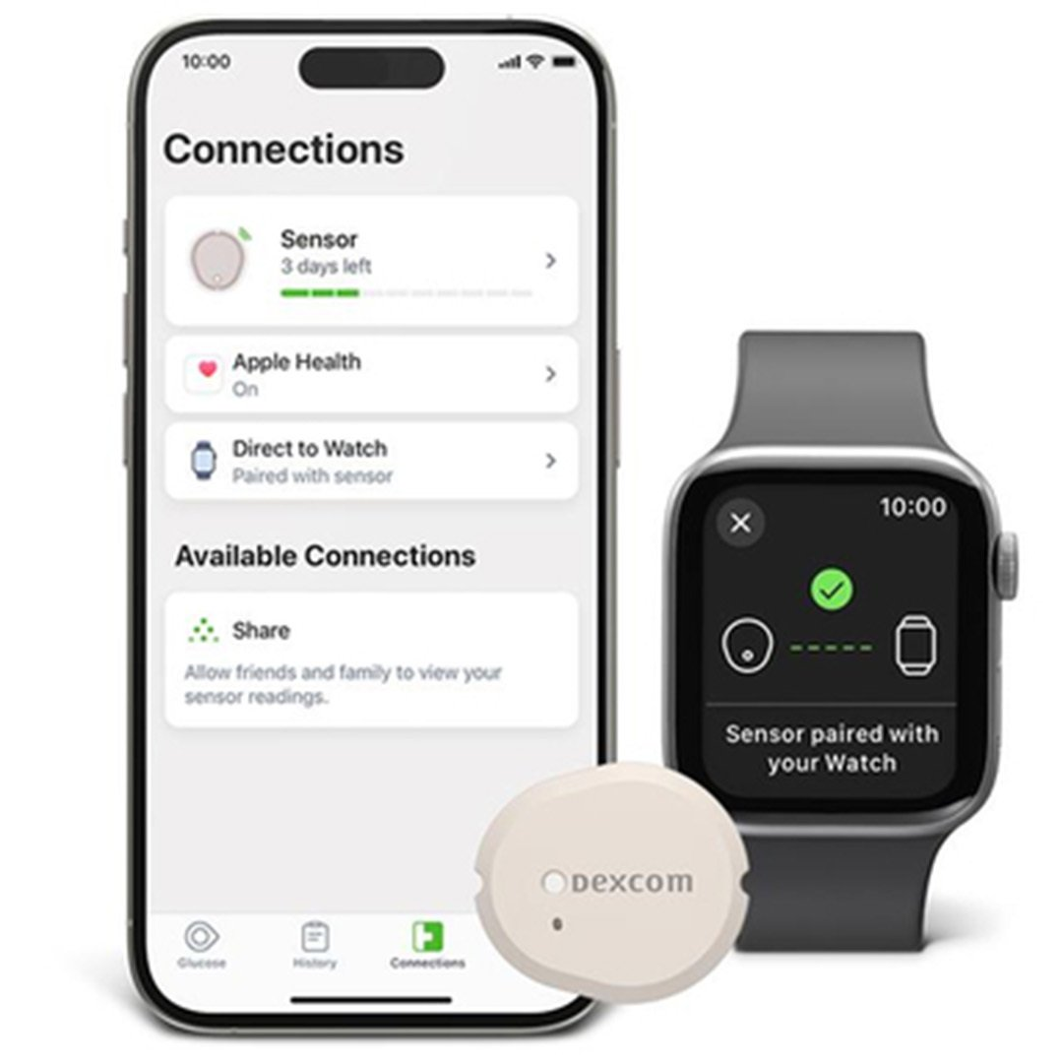
Background
Data Processing
General Models
Transfer Learning
Meta-Transfer
Conclusion
Introduction: A CGM Prediction System for Wearable Devices
If CGM becomes widely adopted (e.g., Apple Watch), what prediction system should we design?
Key requirements for an ideal CGM prediction system:
Real-time 30-minute ahead prediction
Accurate under rapid glucose changes
Personalized to individual physiology
Data-efficient: works with minimal calibration data
Privacy-preserving: local computation
This thesis proposes a complete pipeline using only CGM sequences + age + BMI
No meal logs, no insulin doses, no exercise records needed.

Slide 3
Background
Data Processing
General Models
Transfer Learning
Meta-Transfer
Conclusion
Challenges in CGM Data and Prediction Task
Physiological Delay
Sensor Noise & Drift
Data Missing
5-10 minute lag between interstitial fluid glucose and blood glucose. During rapid changes (post-meal, post-exercise), dynamic error becomes significant.
Electrochemical sensor degradation, motion artifacts, pressure-induced sensor attenuation (PISA), and electronic system noise.
Sensor signal loss, calibration interruption, device drop, wireless transmission failure lead to gaps in time series.
Prediction Target: 30-60 minutes ahead | Goal: From after-event monitoring to pre-event prediction

Slide 4
Background
Data Processing
General Models
Transfer Learning
Meta-Transfer
Conclusion
Heterogeneous Dataset Fusion and Standardization
Colas Dataset (T2D)
Hall Dataset (Healthy)
OhioT1DM Dataset (T1D)
Medtronic MiniMed iPro
NGT to prediabetes to T2D
High clinical heterogeneity
Dexcom G4 monitoring
"Glucotypes" concept
Healthy and sub-healthy
12 T1D subjects
Most severe fluctuations
Insulin pump treatment
Full Spectrum: Health → Prediabetes → T2D → T1D | 174 subjects, 117,570 observations
Standardization Pipeline
Table 2.1 Physiological Parameters
1. Field alignment: {id, time, gl, age, bmi}
2. Unit conversion: All to mg/dL
3. Linear resampling: Strict 5-min intervals
4. Missing data:
• ≤15 min: Cubic spline interpolation
• >15 min: Sequence segmentation (exclude <6h)
Metric | Mean±SD | Range
Age (year) | 54.7±13.2 | 25-88
BMI (kg/m²) | 29.1±4.6 | 18-44
Avg BG (mg/dL) | 111.5±38.4 | 40-350

Slide 5

Background
Data Processing
General Models
Transfer Learning
Meta-Transfer
Conclusion
Filtering Theory and Evaluation
Table 3.2 Comparison of Filtering Results
Index | Kalman | S-G Filter | Butterworth | Ideal
NRR (%) | -6.6±3.7 | 14.0±6.2 | 18.8±7.1 | High
SNR | 7.9±2.0 | 9.4±2.2 | 9.9±2.3 | High
PPR | 1.009±0.005 | 0.987±0.007 | 0.972±0.008 | ≈1.0
Phase Lag (min) | 1.7±2.4 | 0 | 0 | 0
Analysis & Conclusion
Kalman: Negative NRR and phase lag - not suitable for prediction input
Butterworth: Highest noise removal (18.8%) but attenuates peaks (PPR 0.972) - loses 3% per peak
S-G Filter: Best balance - moderate denoising (14.0%) with excellent peak preservation (PPR 0.987)
Conclusion: S-G selected for preserving local extrema without delay
Zero phase lag ensures strict timeline alignment; third-order polynomial fits glucose smooth curves

Slide 6
Background
Data Processing
General Models
Transfer Learning
Meta-Transfer
Conclusion
Comprehensive Performance Comparison
Table 4.1 Nine Models Comparison (30-min horizon)
Model | MAE | RMSE | MAPE(%) | RMSPE(%) | CEG A+B(%)
ARIMA | 5.80 | 8.96 | 4.47 | 6.91 | 99.8
Linear | 5.23 | 8.53 | 4.38 | 6.83 | 99.8
KNN | 11.33 | 15.63 | 9.95 | 13.63 | 93.4
Random Forest | 6.64 | 10.28 | 5.58 | 8.23 | 99.2
XGBoost | 8.22 | 12.33 | 6.98 | 10.14 | 98.1
CNN | 5.41 | 8.70 | 4.55 | 7.08 | 99.8
RNN | 7.47 | 11.03 | 6.33 | 8.93 | 99.0
LSTM | 5.02 | 8.19 | 4.27 | 6.74 | 99.8
Transformer | 6.50 | 9.14 | 5.78 | 8.00 | 99.6
Key findings: LSTM best overall (RMSE 8.19); Transformer close (9.14) with superior architecture for transfer learning; KNN unsuitable (15.63); All except KNN achieve >99% clinical safety

Slide 7
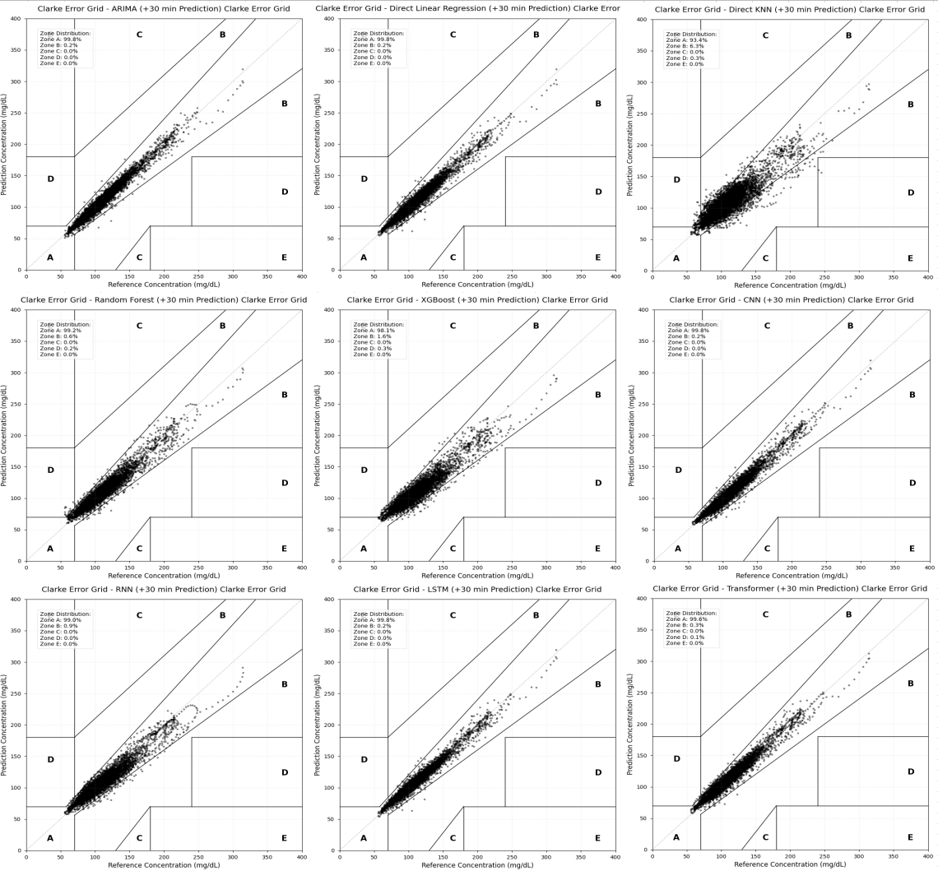
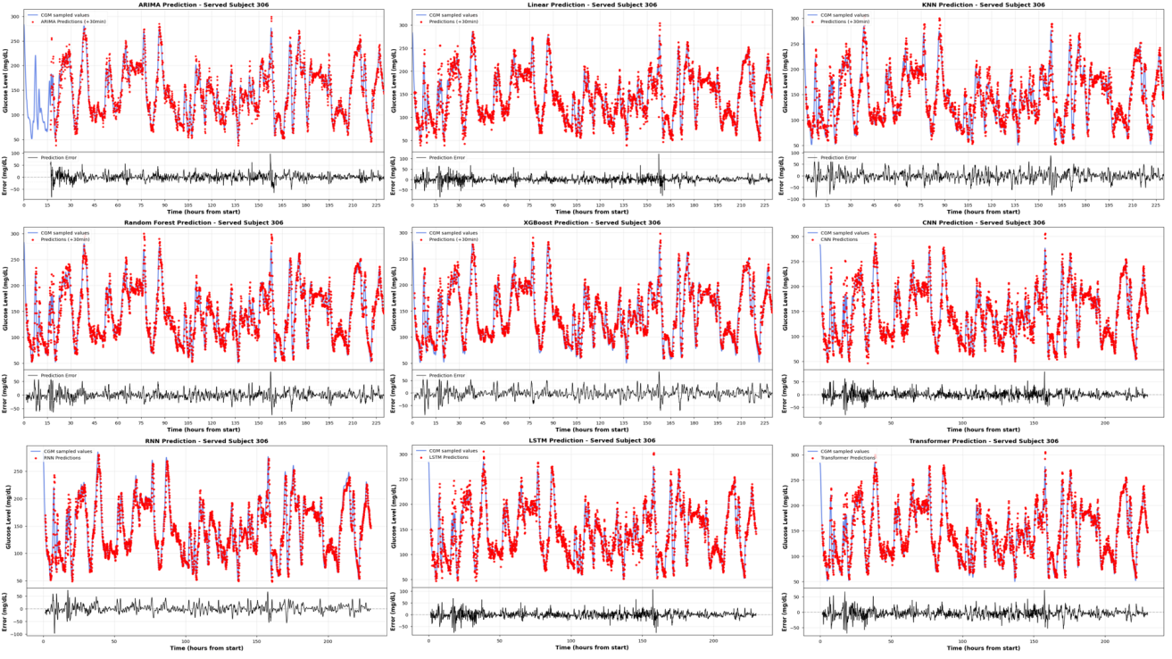
Background
Data Processing
General Models
Transfer Learning
Meta-Transfer
Conclusion
Clinical Safety (CEGA) and Waveform Analysis
Figure 4.10 CEG Clarke Error Grid for all 9 models
Figure 4.11 Waveform comparison on Subject 306
CEGA Results: All models except KNN achieve >99% in A+B zones. LSTM, Linear, CNN, ARIMA reach 99.8% Zone A.
Waveform Analysis (Subject 306):
• Stable period: All models similar - historical values provide sufficient info
• Rapid change: Traditional models show 5-10 min phase lag; LSTM/Transformer respond acutely
• Deep learning extracts second-order dynamics (acceleration, curvature) for trend anticipation

Slide 8
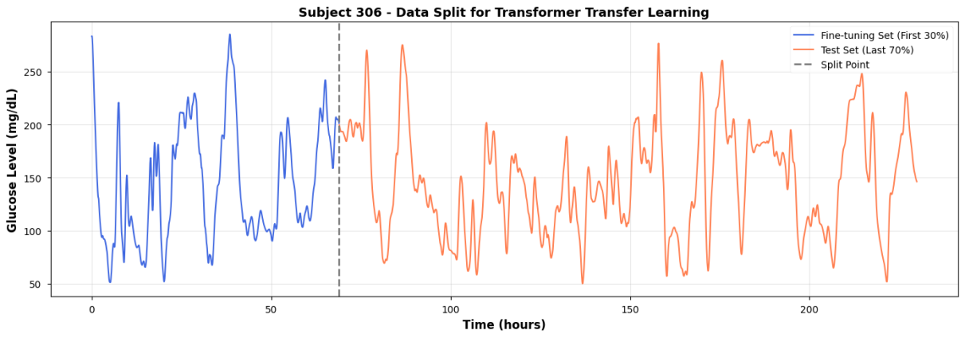
Background
Data Processing
General Models
Transfer Learning
Meta-Transfer
Conclusion
Transfer Learning Strategy: Freeze Encoder
Strategy: Pre-train → Fine-tune
Transformer decoupled into:
• Encoder: learns general glucose dynamics (shared)
• Regression Head: maps to individual-specific levels
Freeze encoder during fine-tuning, update only head
Why? 30% data (~2-3 days) too few to update all parameters
10 hold-out subjects for verification
Figure 5.1 Data split for transfer learning on Subject 306
Two-Step Process
1. Pre-train
Train on all population data
2. Fine-tune
Freeze encoder, update head
3. Personalized Model
Ready for prediction

Slide 9
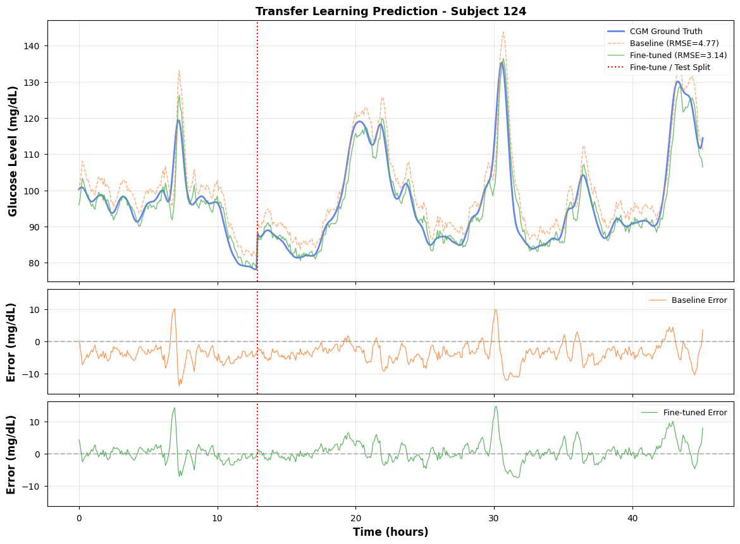
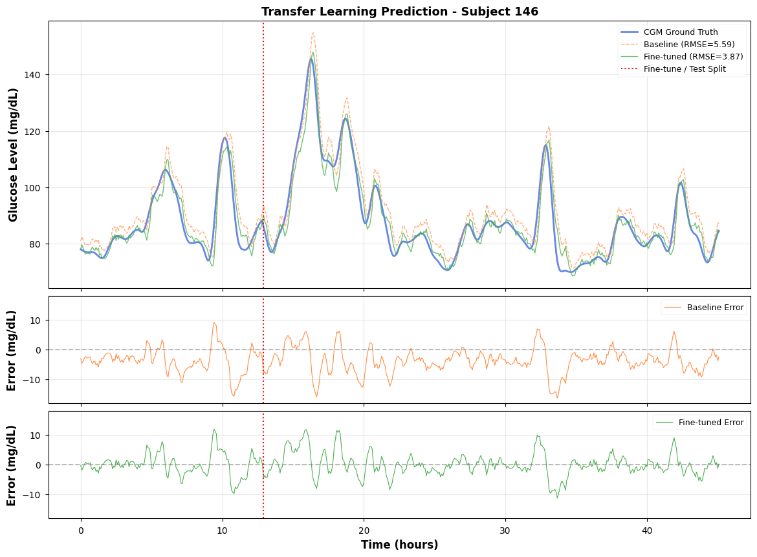
Background
Data Processing
General Models
Transfer Learning
Meta-Transfer
Conclusion
Transfer Learning Results and Waveform Improvement
Figure 5.2 Subject 124: RMSE improved 34.08%
Figure 5.3 Subject 146: RMSE improved 30.82%
Table 5.3 Transfer Learning on 10 Subjects (RMSE)
ID | 2 | 27 | 49 | 71 | 98 | 124 | 146 | 170 | 192 | 306
Baseline | 6.42 | 4.41 | 8.40 | 4.91 | 6.51 | 4.77 | 5.59 | 5.13 | 4.47 | 13.59
Improve | +18.9% | +16.6% | +9.2% | +35.5% | +1.4% | +34.1% | +30.8% | +19.6% | +32.3% | +6.6%
Average RMSE reduction across 10 subjects: 20.35%

Slide 10
Background
Data Processing
General Models
Transfer Learning
Meta-Transfer
Conclusion
Clinical Dilemma: Extreme Few-Shot Scenario
What if only one day data is available? 30-50 samples (~2.5 hours)
Standard transfer learning fails:
• Prediction head cannot move far enough from pre-trained weights
• Standard pre-training optimizes average loss across all subjects
• Not close to best weights for any one person
Meta-learning solution:
Instead of optimizing for average fit, optimize initialization for rapid adaptation
Find parameter point where a few gradient steps produce large error drop
FOMAML Key Difference
Standard Pre-training:
Minimize average loss: θ* = argmin ΣL(f_θ, D_i)
FOMAML:
Optimize for fast adaptation:
θ* = argmin ΣL(f_θ', D_i^query)
where θ' = θ - α∇L(f_θ, D_i^support)
Outer objective evaluates performance AFTER adaptation
First-Order approximation eliminates Hessian computation - suitable for resource-limited devices

Slide 11
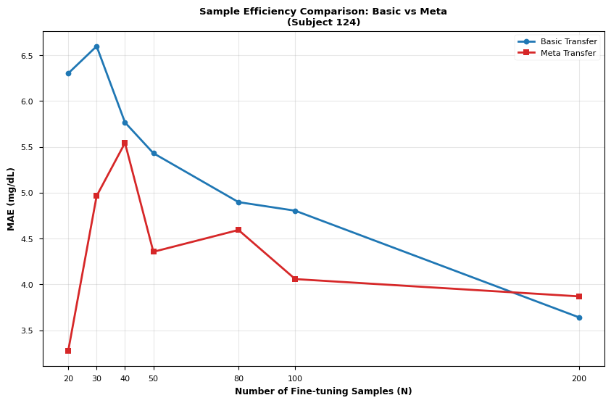
Background
Data Processing
General Models
Transfer Learning
Meta-Transfer
Conclusion
Learning Curves: Basic vs Meta Transfer
Key Findings
N < 100 samples:
MAE reduced by 25.67% on average
N < 40 samples:
MAE dropped by 31.58%
N > 150 samples:
Two methods converge
Value of meta-learning specifically in low-sample regime where starting point matters most
Table 6.2 N=30 Comparison
Metric | Basic | Meta
MAE | 5.94 | 5.38
RMSE | 6.49 | 6.21
Figure 6.2 Learning curve: Basic Transfer vs Meta Transfer (Subject 124)

Slide 12
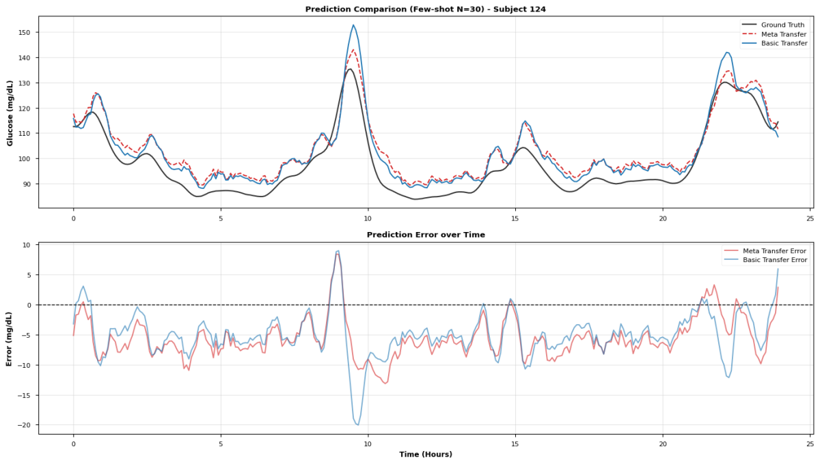
Background
Data Processing
General Models
Transfer Learning
Meta-Transfer
Conclusion
Few-Shot Waveform Consistency Analysis (N=30)
Detailed Observations
Rapid rise (post-meal):
• Meta Transfer tracks peak accurately
• Basic Transfer shows overshoot
Change points:
• Meta Transfer responds faster
• Significantly reduced phase lag
Stable phase:
• Similar average performance
• Meta Transfer has smaller variance
Meta Transfer: lower error + more stable
Figure 6.3 Prediction comparison on Subject 124 with only 30 samples (~2.5 hours)
Meta Transfer not only reduces average error but also reduces error fluctuation

Slide 13
Background
Data Processing
General Models
Transfer Learning
Meta-Transfer
Conclusion
Core Scientific Contributions
1
CGM-Only Dataset
2
Preprocess/Model Study Pipeline
3
Few-Shot Personalization(meta
learning based on transformer)
• Uses CGM sequence + age/BMI only; no meal, insulin, or exercise logs
• Fuses 174 subjects from Colas, Hall, and OhioT1DM
• Standardizes units, 5-min sampling, missing data, and S-G filtering
• Quantifies CGM noise and compares Kalman, S-G, and Butterworth filters
• Benchmarks 9 models under the same 30-min prediction setting
• Selects Transformer as the personalization-ready base model
• Frozen-encoder transfer learning reduces RMSE by 20.35%
• FOMAML improves N<40 adaptation by 31.58% MAE
• Enables day-one personalization from 30-50 CGM samples
Future Engineering Value
"Cloud pre-training + local fine-tuning" architecture:
• Cloud: Train general model on population data
• Device: Download pre-trained model
• Local: Fine-tune with user's first 2.5 hours of data
• Result: Personalized predictions from day one, no data uploaded to cloud

Slide 14

Thank You
Questions & Answers
Jiang Yijun
Department of Electrical and Computer Engineering
The University of Hong Kong
Supervisor: Prof. Shiming Zhang
June 2026

