Slide 1



Blood Glucose Prediction Model Applicable to Continuous Glucose Monitoring Systems
Department of Electrical and Computer Engineering
Midterm defense
[7, 2026]
Jiang Yijun

Slide 2
Research Progress
Conclusion
Dataset Construction
Build dataset contain:
Health → Prediabetes → T2D → T1D | 174 subjects, 117,570 observations
All the data is CGM-Only,without multimodal data
Standardization Pipeline
1. Field alignment: {id, time, gl, age, bmi}
2. Unit conversion: All to mg/dL
3. Linear resampling: Strict 5-min intervals
4. Missing data:
• ≤15 min: Cubic spline interpolation
• >15 min: Sequence segmentation (exclude <6h)

Slide 3
Research Progress
Conclusion
Data Filtering
The original data were filtered using Kalman filtering, S-G filtering, and Butterworth filtering respectively.
The performance of each method was compared, and based on comprehensive evaluation of NRR, SNR, PPR, and Phase Lag metrics, the S-G filtering results were ultimately selected as the final input.
Index | Kalman | S-G | Butterworth
NRR | -6.6±3.7 | 14.0±6.2 | 18.8±7.1
SNR | 7.9±2.0 | 9.4±2.2 | 9.9±2.3
PPR | 1.009±0.005 | 0.987±0.007 | 0.972±0.008
Phase Lag | 1.7±2.4 | 0 | 0
comparison of filtering results

Slide 4
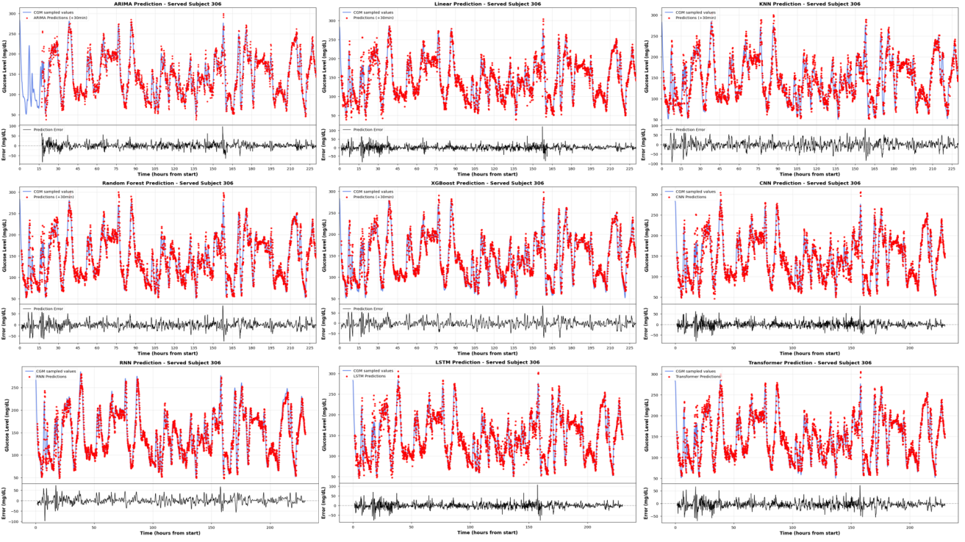
Research Progress
Conclusion
Model Building and Comparison
Select models such as ARIMA, Linear Regression, KNN, Random Forest, CNN, RNN, LSTM, and Transformer to predict blood glucose levels and compare results.
Using evaluation metrics including MAE, RMSE, MAPE, RMSPE, and CEG. Transformer was chosen as the foundation for subsequent few-sample transfer learning studies.
 | MAE (mg/dL) | RMSE (mg/dL) | MAPE(%) | RMSPE(%) | CEG(A+B)(%)
ARIMA | 5.7965 | 8.9621 | 4.4696 | 6.9105 | 99.8±0.2
Linear | 5.2298 | 8.5292 | 4.3827 | 6.8298 | 99.8±0.2
KNN | 11.3252 | 15.6312 | 9.9544 | 13.6284 | 93.4±6.3
Random Forest | 6.6398 | 10.2797 | 5.5753 | 8.2342 | 99.2±0.6
XGBoost | 8.2151 | 12.3310 | 6.9834 | 10.1447 | 98.1±1.6
CNN | 5.4077 | 8.6982 | 4.5519 | 7.0817 | 99.8±0.2
RNN | 7.4727 | 11.0343 | 6.3253 | 8.9341 | 99.0±0.9
LSTM | 5.0236 | 8.1853 | 4.2701 | 6.7352 | 99.8±0.2
Transformer | 6.5029 | 9.1394 | 5.7825 | 7.9993 | 99.6±0.3
comparison of different models’ prediction
Prediction results of different models on subject 306

Slide 5
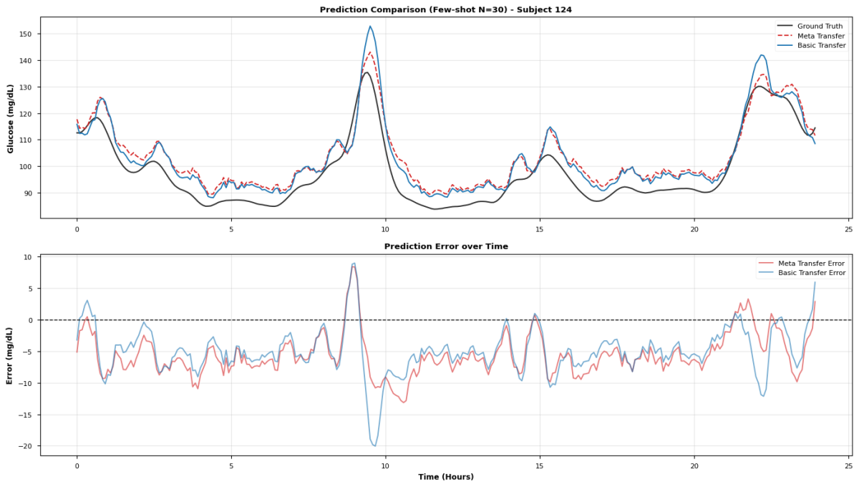
Research Progress
Conclusion
Transfer Learning
We employed a transfer strategy utilizing a frozen encoder, fine-tuning the regression head solely with 30% of new users' data (approximately 2–3 days) and achieving an average RMSE reduction of 20.35% across ten independent test sets.
Meta Learning
For extremely sparse scenarios with only a few hours of data, the First-Order Model-Agnostic meta-learning (FOMAML) algorithm is introduced to optimize initialization parameters.
With fewer than 100 samples, the meta-transfer strategy reduces the mean MAE by 25.67% compared to traditional transfer learning; in extreme cases with merely 30 samples (approximately 2.5 hours of data), the MAE reduction reaches as high as 31.58%.
The prediction of meta transfer and basic transfer on subject 124

Slide 6

Thesis Progress
Conclusion
Experiments (Done)
Thesis writing (Done)
Defense Preparing (In Progress)

Slide 7
Thank you
for listening!
Dissertation defense
[7, 2026]
Jiang Yijun

