Slide 1
FhanShare
Fan-to-Fan Ticket Sharing App

Slide 2
What is FhanShare?
FhanShare is a secure app that lets season ticket holders temporarily share matchday access with a trusted contact using a time-limited QR code.

Slide 3
Core Features
- Time-limited QR passes
- PIN protection
- Trusted contact system
- Stripe for unlock payments
- Admin view and controls

Slide 4
Why Clubs Should Support
- Reduces unauthorised QR sharing
- Supports safe, contact-only transfer
- No ticket resale or duplication
- Helps stewards and improves seat use clarity

Slide 5
Built for Fans
- Easy way to lend your seat
- Share only with trusted contacts
- Works offline
- Optional upgrades – one-time payment

Slide 6
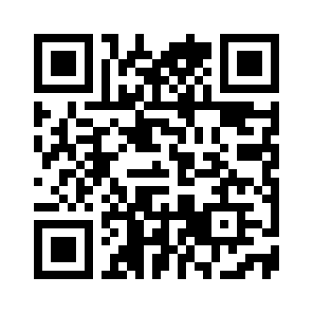
Scan the Demo
Scan this QR code to preview the FhanShare demo or share this slide with clubs.

