Slide 1
JavaGAT and Ibis
Demo
SP 3.1 high-performance distributed computing
Mid-term progress report page 24
Henri Bal
Niels Drost
Ceriel Jacobs
Jason Maassen
Rob van Nieuwpoort www.cs.vu.nl/ibis

Slide 2
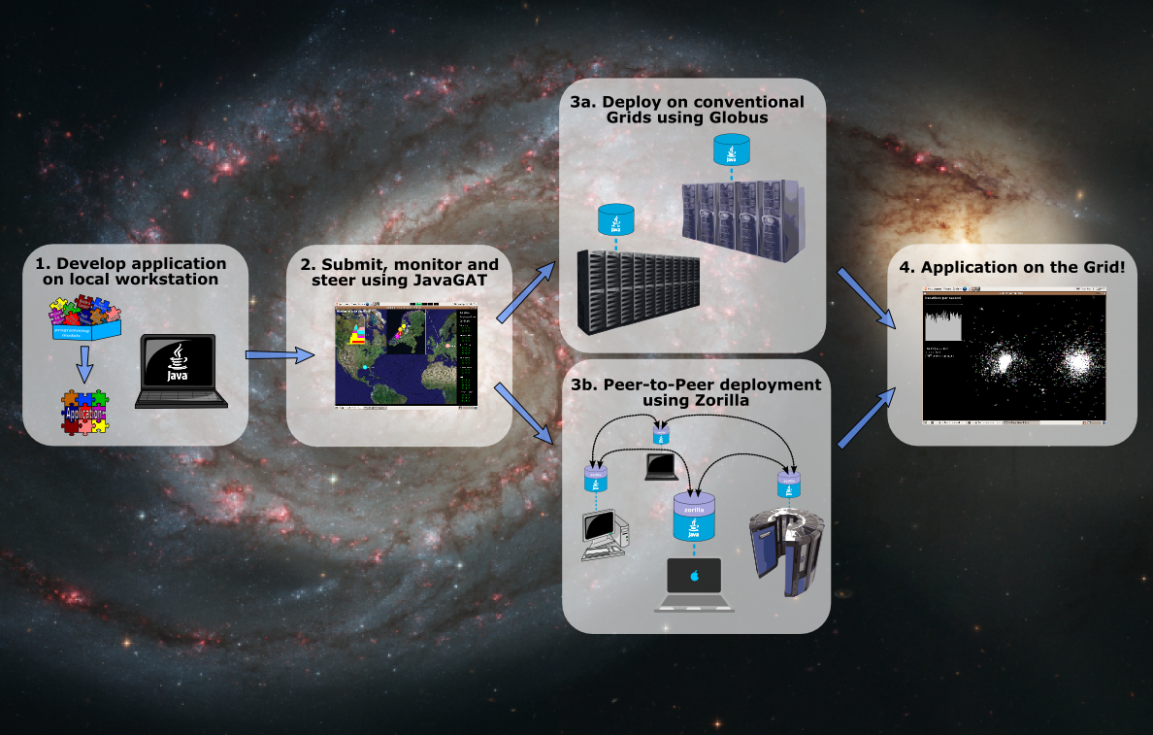
A Java-based approach

Slide 3
Ibis
programming models
(Satin)

Slide 4
Satin
One of the high-level programming models for the Ibis communication library
Provide a powerful programming model
  master/worker, divide-and-conquer, shared objects
Extremely easy to use
Satin allows applications to transparently deal with grid issues
  load balancing, malleability, migration, fault-tolerance, adaptivity, firewalls, heterogeneity

Slide 5
Satin Applications
Vl-e
  Grammar induction, SP 2.2
    Pieter Adriaans, Ceriel Jacobs
  N-body simulations (DEMO)
Grammar-based text analysis
VLSI routing
Satisfiability solver
Gene sequencing
Game-tree search
Raytracing
Numerical functions
...

Slide 6
Barnes-Hut
Nbody simulation

Slide 7

Barnes-Hut N-body simulation
Bodies (stars) are organized in a tree complexity is not N² but N log N

Slide 8
Barnes-Hut N-body simulation

Slide 9
Barnes-Hut N-body simulation

Slide 10
Barnes-Hut N-body simulation

Slide 11
Barnes-Hut N-body simulation

Slide 12
Java
Grid
Application
Toolkit
(JavaGAT)

Slide 13
The Java Grid Application Toolkit
API for developing and running portable grid applications independently of the underlying grid infrastructure and available services
Simple API
GAT Adaptors (“plugins”) connect GAT to grid services (Globus, Unicore, SSH, ProActive, …)

Slide 14
Java GAT users
The Virtual Labs for E-science project (Vl-e)
  AMOLF, Institute for Atomic and Molecular Physics, SP 1.6
  Vrije Universiteit Amsterdam, SP 3.1
  VU Medical Center Amsterdam, SP 1.3
  Vbrowser, SP 2.5 / SP 1.3
The Multimedian project
Max Planck Institute for Astrophysics in Garching
D-Grid, Astrogrid
Louisiane State University
University of Texas
The workflow system Triana (University of Cardiff)
Georgia State University
Zuse Institute Berlin, Germany
Download is anonymous, so we don't know

Slide 15
rapid prototyping environment: DAS-3
(also works on proof of concept environment)

Slide 16
Demo ...

Slide 17
Distributed supercomputing
Parallel processing on geographically distributed computing systems (grids)
Our goals:
  Don’t use individual supercomputers / clusters, but combine multiple systems
  Provide high-level programming support

Slide 18
Optimizing for the grid
Grids usually are hierarchical
  Collections of clusters, supercomputers
  Fast local links, slow wide-area links
Optimize algorithms to exploit hierarchy
  Message combining + latency hiding on wide-area links
  Collective operations for wide-area systems
  Successful for many applications

Slide 19
Satin master-worker
Master-worker parallelism
  Divide work into parts
  Spawn job for each part
  Solve parts in parallel
  Combine results

Slide 20
Satin divide-and-conquer
Parallel Divide-and-conquer
  Divide work into parts
  Spawn job for each part
  Solve parts in parallel
  Combine results
  But now recursively!
  sub-problems split the work up further and spawn their own sub-jobs

Slide 21
Satin
Divide-and-conquer
job1

Slide 22
Satin
Divide-and-conquer
job1
job2
job3

Slide 23
Satin
Divide-and-conquer
job1
job2
job3
job4
job4
job5
job6
job7

Slide 24
Satin
Divide-and-conquer
job1
job2
job3
job4
job4
job5
job6
job7

Slide 25
Satin
Divide-and-conquer
job1
job2
job3
job4
job4
job5
job6
job7
... millions of jobs ...

Slide 26
Satin
Fits hierarchical structure of Grids
job1
cluster1
cluster3
job2
job3
cluster2
job4
job4
job5
job6
job7
cluster4

Slide 27
The Grid
Satin explicitely targets the grid
Different architectures
Firewalls
Slow networks (latency)
Distributed memory
Machines come and go
Machines crash
Machines have different speeds

Slide 28
Barnes-Hut
Nbody code
// Marker interface that defines updateBodies as a global method.
interface BodiesInterface extends satin.GlobalMethods {
void updateBodies(BodyUpdates b, int iter);
}
// A shared object containing the tree of bodies.
class Bodies extends satin.SharedObject implements BodiesInterface {
BodyTreeNode root;
void updateBodies(BodyUpdates b, int iter) { // Global method.
root.applyUpdates(b, iter); // Update bodies in our tree.
}
BodyTreeNode getRoot() { // Local method.
return root;
}
}
// Mark the computeForces method as a spawn operation.
interface BHSpawns extends satin.Spawnable {
BodyUpdates computeForces(Subtree s, int iter, Bodies bodies);
}
class BarnesHut extends satin.SatinObject implements BHSpawns {
boolean guard_computeForces(Subtree s, int iter, Bodies bodies) {
return bodies.iter + 1 == iter;
}
// Spawnable method. The "bodies" parameter is a shared object.
BodyUpdates computeForces(Subtree s, int iter, Bodies bodies) {
if(s.hasNoChildren) {
computeSequentially(s, iter, bodies.getRoot());
} else { // Divide the work and spawn tasks (recursion step).
for(int i=0; i<s.nrChildren; i++) {
res[i] = computeForces(s.child[i], iter, bodies); // Spawn.
}
sync(); // Wait for the spawn operation to finish.
return mergeSubresults(res); // Merge results and return.
}
}
public static void main(String[] args) {
BarnesHut bh = new BarnesHut();
Bodies bodies = new Bodies(); // Create shared object.
for (int iter = 0; iter < N; iter++) {
results = bh.computeForces(root, iter, bodies); // Spawn.
sync(); // Wait for the spawn operation to finish.
bodies.update(results, iter); // Shared method invocation.
}
}
}

Slide 29
Barnes-Hut
Nbody code
// Marker interface that defines updateBodies as a global method.
interface BodiesInterface extends satin.GlobalMethods {
void updateBodies(BodyUpdates b, int iter);
}
// A shared object containing the tree of bodies.
class Bodies extends satin.SharedObject implements BodiesInterface {
BodyTreeNode root;
void updateBodies(BodyUpdates b, int iter) { // Global method.
root.applyUpdates(b, iter); // Update bodies in our tree.
}
BodyTreeNode getRoot() { // Local method.
return root;
}
}
// Mark the computeForces method as a spawn operation.
interface BHSpawns extends satin.Spawnable {
BodyUpdates computeForces(Subtree s, int iter, Bodies bodies);
}
class BarnesHut extends satin.SatinObject implements BHSpawns {
boolean guard_computeForces(Subtree s, int iter, Bodies bodies) {
return bodies.iter + 1 == iter;
}
// Spawnable method. The "bodies" parameter is a shared object.
BodyUpdates computeForces(Subtree s, int iter, Bodies bodies) {
if(s.hasNoChildren) {
computeSequentially(s, iter, bodies.getRoot());
} else { // Divide the work and spawn tasks (recursion step).
for(int i=0; i<s.nrChildren; i++) {
res[i] = computeForces(s.child[i], iter, bodies); // Spawn.
}
sync(); // Wait for the spawn operation to finish.
return mergeSubresults(res); // Merge results and return.
}
}
public static void main(String[] args) {
BarnesHut bh = new BarnesHut();
Bodies bodies = new Bodies(); // Create shared object.
for (int iter = 0; iter < N; iter++) {
results = bh.computeForces(root, iter, bodies); // Spawn.
sync(); // Wait for the spawn operation to finish.
bodies.update(results, iter); // Shared method invocation.
}
}
}
// Marker interface that defines updateBodies as a global method.
interface BodiesInterface extends satin.GlobalMethods {
void updateBodies(BodyUpdates b, int iter);
}
// A shared object containing the tree of bodies.
class Bodies extends satin.SharedObject implements BodiesInterface {
BodyTreeNode root;
void updateBodies(BodyUpdates b, int iter) {
root.applyUpdates(b, iter);
}
BodyTreeNode getRoot() {
return root;
}
}

Slide 30
Barnes-Hut
Nbody code
// Marker interface that defines updateBodies as a global method.
interface BodiesInterface extends satin.GlobalMethods {
void updateBodies(BodyUpdates b, int iter);
}
// A shared object containing the tree of bodies.
class Bodies extends satin.SharedObject implements BodiesInterface {
BodyTreeNode root;
void updateBodies(BodyUpdates b, int iter) { // Global method.
root.applyUpdates(b, iter); // Update bodies in our tree.
}
BodyTreeNode getRoot() { // Local method.
return root;
}
}
// Mark the computeForces method as a spawn operation.
interface BHSpawns extends satin.Spawnable {
BodyUpdates computeForces(Subtree s, int iter, Bodies bodies);
}
class BarnesHut extends satin.SatinObject implements BHSpawns {
boolean guard_computeForces(Subtree s, int iter, Bodies bodies) {
return bodies.iter + 1 == iter;
}
// Spawnable method. The "bodies" parameter is a shared object.
BodyUpdates computeForces(Subtree s, int iter, Bodies bodies) {
if(s.hasNoChildren) {
computeSequentially(s, iter, bodies.getRoot());
} else { // Divide the work and spawn tasks (recursion step).
for(int i=0; i<s.nrChildren; i++) {
res[i] = computeForces(s.child[i], iter, bodies); // Spawn.
}
sync(); // Wait for the spawn operation to finish.
return mergeSubresults(res); // Merge results and return.
}
}
public static void main(String[] args) {
BarnesHut bh = new BarnesHut();
Bodies bodies = new Bodies(); // Create shared object.
for (int iter = 0; iter < N; iter++) {
results = bh.computeForces(root, iter, bodies); // Spawn.
sync(); // Wait for the spawn operation to finish.
bodies.update(results, iter); // Shared method invocation.
}
}
}
// Mark the computeForces method as a spawn operation.
interface BHSpawns extends satin.Spawnable {
BodyUpdates computeForces(Subtree s, int iter, Bodies bodies);
}

Slide 31
Barnes-Hut
Nbody code
// Marker interface that defines updateBodies as a global method.
interface BodiesInterface extends satin.GlobalMethods {
void updateBodies(BodyUpdates b, int iter);
}
// A shared object containing the tree of bodies.
class Bodies extends satin.SharedObject implements BodiesInterface {
BodyTreeNode root;
void updateBodies(BodyUpdates b, int iter) { // Global method.
root.applyUpdates(b, iter); // Update bodies in our tree.
}
BodyTreeNode getRoot() { // Local method.
return root;
}
}
// Mark the computeForces method as a spawn operation.
interface BHSpawns extends satin.Spawnable {
BodyUpdates computeForces(Subtree s, int iter, Bodies bodies);
}
class BarnesHut extends satin.SatinObject implements BHSpawns {
boolean guard_computeForces(Subtree s, int iter, Bodies bodies) {
return bodies.iter + 1 == iter;
}
// Spawnable method. The "bodies" parameter is a shared object.
BodyUpdates computeForces(Subtree s, int iter, Bodies bodies) {
if(s.hasNoChildren) {
computeSequentially(s, iter, bodies.getRoot());
} else { // Divide the work and spawn tasks (recursion step).
for(int i=0; i<s.nrChildren; i++) {
res[i] = computeForces(s.child[i], iter, bodies); // Spawn.
}
sync(); // Wait for the spawn operation to finish.
return mergeSubresults(res); // Merge results and return.
}
}
public static void main(String[] args) {
BarnesHut bh = new BarnesHut();
Bodies bodies = new Bodies(); // Create shared object.
for (int iter = 0; iter < N; iter++) {
results = bh.computeForces(root, iter, bodies); // Spawn.
sync(); // Wait for the spawn operation to finish.
bodies.update(results, iter); // Shared method invocation.
}
}
}
public static void main(String[] args) {
BarnesHut bh = new BarnesHut();
Bodies bodies = new Bodies();
for (int iter = 0; iter < N; iter++) {
results = bh.computeForces(root, iter, bodies);
sync();
bodies.updateBodies(results, iter);
}
}

Slide 32
Barnes-Hut
Nbody code
// Marker interface that defines updateBodies as a global method.
interface BodiesInterface extends satin.GlobalMethods {
void updateBodies(BodyUpdates b, int iter);
}
// A shared object containing the tree of bodies.
class Bodies extends satin.SharedObject implements BodiesInterface {
BodyTreeNode root;
void updateBodies(BodyUpdates b, int iter) { // Global method.
root.applyUpdates(b, iter); // Update bodies in our tree.
}
BodyTreeNode getRoot() { // Local method.
return root;
}
}
// Mark the computeForces method as a spawn operation.
interface BHSpawns extends satin.Spawnable {
BodyUpdates computeForces(Subtree s, int iter, Bodies bodies);
}
class BarnesHut extends satin.SatinObject implements BHSpawns {
boolean guard_computeForces(Subtree s, int iter, Bodies bodies) {
return bodies.iter + 1 == iter;
}
// Spawnable method. The "bodies" parameter is a shared object.
BodyUpdates computeForces(Subtree s, int iter, Bodies bodies) {
if(s.hasNoChildren) {
computeSequentially(s, iter, bodies.getRoot());
} else { // Divide the work and spawn tasks (recursion step).
for(int i=0; i<s.nrChildren; i++) {
res[i] = computeForces(s.child[i], iter, bodies); // Spawn.
}
sync(); // Wait for the spawn operation to finish.
return mergeSubresults(res); // Merge results and return.
}
}
public static void main(String[] args) {
BarnesHut bh = new BarnesHut();
Bodies bodies = new Bodies(); // Create shared object.
for (int iter = 0; iter < N; iter++) {
results = bh.computeForces(root, iter, bodies); // Spawn.
sync(); // Wait for the spawn operation to finish.
bodies.update(results, iter); // Shared method invocation.
}
}
}
BodyUpdates computeForces(Subtree s, int iter, Bodies bodies) {
if(s.hasNoChildren) {
computeSequentially(s, iter, bodies.getRoot());
} else {
for(int i=0; i<s.nrChildren; i++) {
res[i] = computeForces(s.child[i], iter, bodies);
}
sync();
return mergeSubresults(res);
}
}

Slide 33
Barnes-Hut
Nbody code
// Marker interface that defines updateBodies as a global method.
interface BodiesInterface extends satin.GlobalMethods {
void updateBodies(BodyUpdates b, int iter);
}
// A shared object containing the tree of bodies.
class Bodies extends satin.SharedObject implements BodiesInterface {
BodyTreeNode root;
void updateBodies(BodyUpdates b, int iter) { // Global method.
root.applyUpdates(b, iter); // Update bodies in our tree.
}
BodyTreeNode getRoot() { // Local method.
return root;
}
}
// Mark the computeForces method as a spawn operation.
interface BHSpawns extends satin.Spawnable {
BodyUpdates computeForces(Subtree s, int iter, Bodies bodies);
}
class BarnesHut extends satin.SatinObject implements BHSpawns {
boolean guard_computeForces(Subtree s, int iter, Bodies bodies) {
return bodies.iter + 1 == iter;
}
// Spawnable method. The "bodies" parameter is a shared object.
BodyUpdates computeForces(Subtree s, int iter, Bodies bodies) {
if(s.hasNoChildren) {
computeSequentially(s, iter, bodies.getRoot());
} else { // Divide the work and spawn tasks (recursion step).
for(int i=0; i<s.nrChildren; i++) {
res[i] = computeForces(s.child[i], iter, bodies); // Spawn.
}
sync(); // Wait for the spawn operation to finish.
return mergeSubresults(res); // Merge results and return.
}
}
public static void main(String[] args) {
BarnesHut bh = new BarnesHut();
Bodies bodies = new Bodies(); // Create shared object.
for (int iter = 0; iter < N; iter++) {
results = bh.computeForces(root, iter, bodies); // Spawn.
sync(); // Wait for the spawn operation to finish.
bodies.update(results, iter); // Shared method invocation.
}
}
}
boolean guard_computeForces(Subtree s, int iter, Bodies bodies) {
return iter == bodies.iter + 1;
}

Slide 34
Application Example
Grid middleware (Globus)

Slide 35
Application Example
Barnes-Hut
Nbody simulation

Slide 36
Sequential Fibonacci
public long fib(int n) {
if (n < 2) return n;
long x = fib(n - 1);
long y = fib(n – 2);
return x + y;
}

Slide 37
Parallel Fibonacci
interface FibInterface extends ibis.satin.Spawnable {
public long fib(int n);
}
public long fib(int n) {
if (n < 2) return n;
long x = fib(n - 1);
long y = fib(n – 2);
sync();
return x + y;
}

Slide 38
Parallel Fibonacci
interface FibInterface extends ibis.satin.Spawnable {
public long fib(int n);
}
public long fib(int n) {
if (n < 2) return n;
long x = fib(n - 1);
long y = fib(n – 2);
sync();
return x + y;
}
Mark methods as
Spawnable.
They can run in parallel.

Slide 39
Parallel Fibonacci
interface FibInterface extends ibis.satin.Spawnable {
public long fib(int n);
}
public long fib(int n) {
if (n < 2) return n;
long x = fib(n - 1);
long y = fib(n – 2);
sync();
return x + y;
}
Mark methods as
Spawnable.
They can run in parallel.
Wait until spawned methods are done.

Slide 40
Compiling Satin Programs
JVM
source
Java
compiler
bytecode
bytecode
satinc bytecode
rewriter
JVM
JVM

Slide 41
Java GAT API features
Security (deal with passwords, credentials, etc)
Grid I/O
  File operations, remote file access, file replication
  Inter-process communication
Resource Management
  Resource brokering
  Forking grid applications, job management
Application Information Management
  Global repository for application specific information
  Query this information repository
Monitoring
  Grid monitoring
  Application monitoring and steering

Slide 42
Java GAT File example
public class RemoteCopy {
public static void main(String[] args) {
GATContext context = new GATContext();
URI src = new URI(args[0]);
URI dest = new URI(args[1]);
File file = GAT.createFile(context, src);
file.copy(dest);
GAT.end();
}
}

