Slide 1
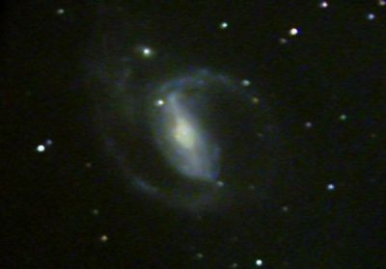
Galaxy Simulation Using Ibis
Ceriel Jacobs ceriel@cs.vu.nl
High Performance Distributed Computing Group
Vrije Universiteit Amsterdam

Slide 2
Outline
Distributed computing
Ibis
Galaxy simulation
Demo

Slide 3
Distributed Computing
Distributed computing: run application on a collection of computers instead of on a single processor
Why do it?
  The amount of data and processing is increasing all the time
  Processors are NOT getting faster; instead, we get more of them → multicore, clusters
  Processing that used to take hours, may now take days on a single processor
  Solution: use more computers, to make it run as fast as (or faster than) before

Slide 4


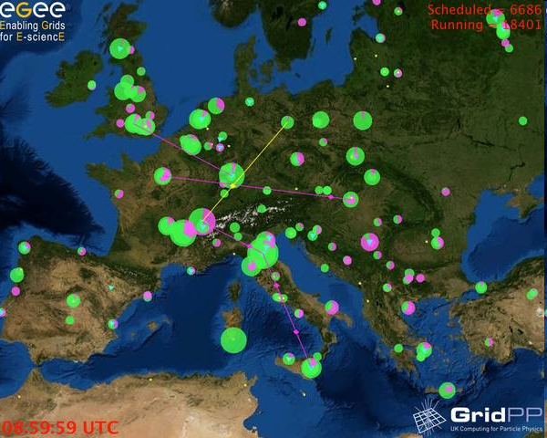
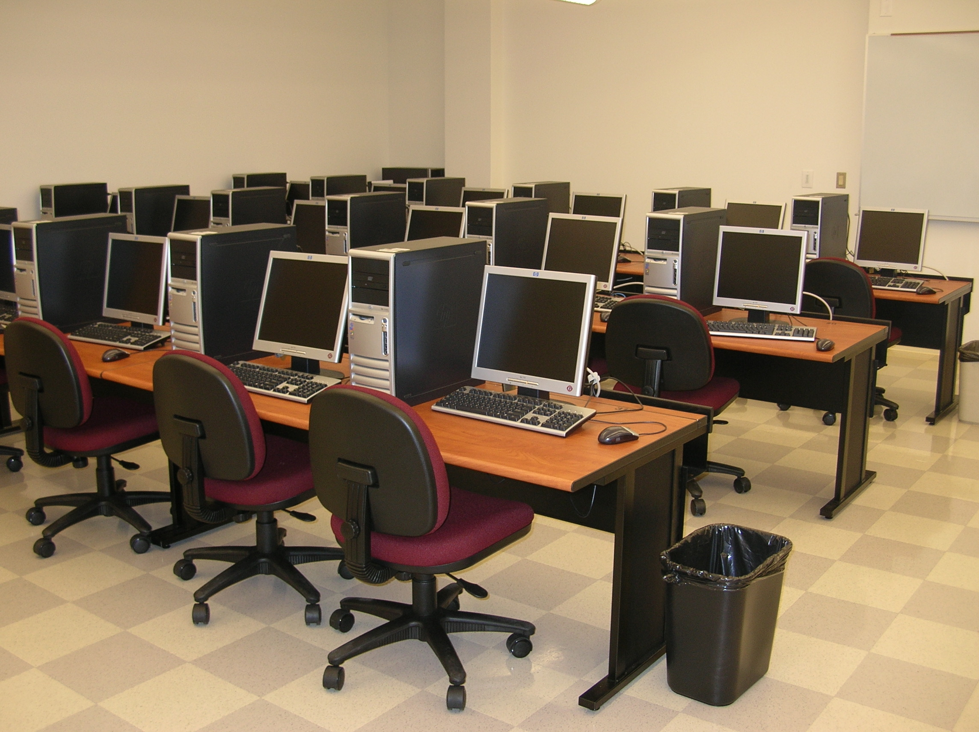
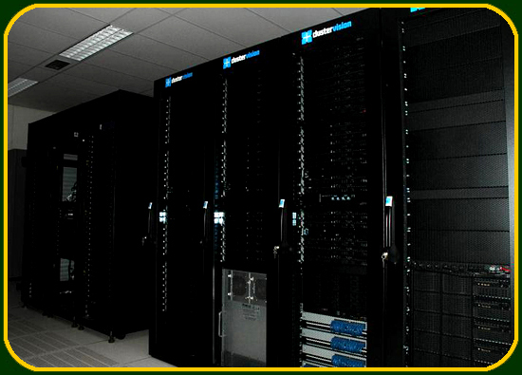
Distributed Computing with Ibis
Start with a laptop (in Intertain)
Get access to a cloud
(Amazon, Google, ...)
Use student or office machines
Get access to a grid (EGEE)
Get access to a cluster
(VU DAS-3)

Slide 5
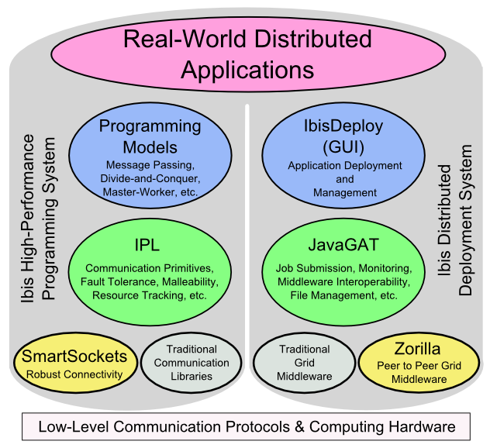
Ibis System

Slide 6
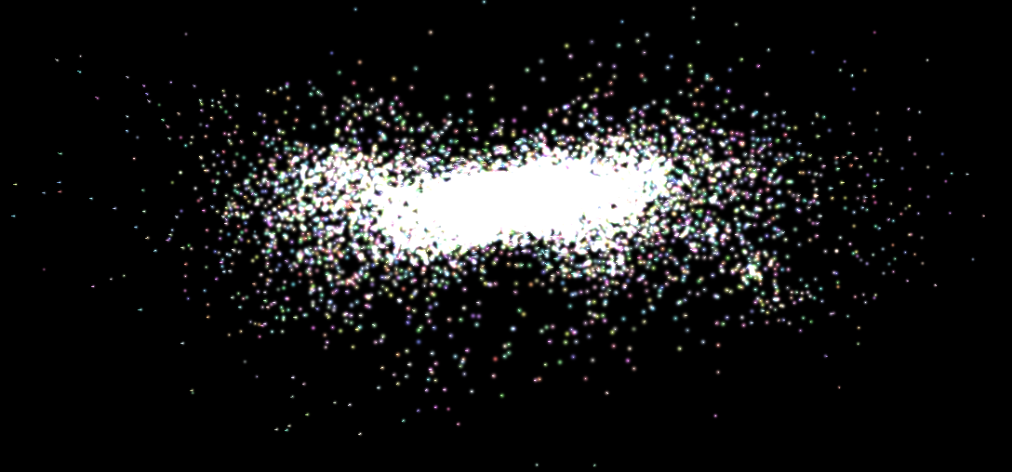
Galaxy simulation
A galaxy is a large group of stars, close together
Stars move, have a velocity
Stars have a mass, so have gravitational influence on each other
Velocity is affected over time
What will the galaxy look like in the future?
Simulation → prediction

Slide 7
Basic galaxy algorithm
Split time into "small enough" timesteps
for each timestep do
Compute forces between all stars
Compute new positions and velocities
od
Very expensive: 100 stars → 10000 interactions, 10^4 stars → 10^8 interactions (per timestep)
Far too expensive for realistic problems (galaxies)

Slide 8
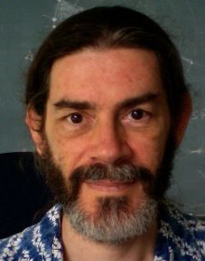

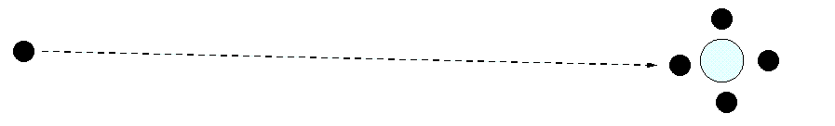
Barnes-Hut algorithm
Barnes and Hut designed an algorithm that works hierarchically
  Forces decrease rapidly with the distance between the stars
  Long-range interactions can be approximated: groups of stars are approximated by a single cell with combined mass and center-of-mass
Joshua Barnes
Piet Hut

Slide 9
Live Demo
Parallel implementation of the Barnes-Hut algorithm developed using Ibis
Deployment of visualization (locally) and computation (on VU DAS-3 cluster) using ibis-deploy

