Slide 1

Codmon-VM
A multi-platform modular test environment.

Slide 2
Outline
Introduction
Codmon
Codmon-VM
Codmon-VM in practice
Testing Codmon-VM
Discussion & Conclusion
Questions

Slide 3
Introduction
Background
  Many problems relates to lack of testing
  Testing on a single platform
  Configuring the test environments

Slide 4
Introduction
Different frameworks and environments
  JUnit
  Hudson and Jenkins

Slide 5
Introduction
Both have their (Dis)advantages(1)
  Junit
    Easy to add “functional” tests
    No out of the box performance tests
    No deployment tests

Slide 6
Introduction
Both have their (Dis)advantages(2)
  Hudson and Jenkins
    User interface
    Parformance and Deployment tests
    Not platform independent

Slide 7
Introduction
Is it possible to design a multi-platform, modular and user-friendly test environment?

Slide 8
Codmon
Test Framework for testing and monitoring Ibis applications on the DAS-2 computer built by Francois Lesuer in 2005.

Slide 9
Codmon
Both functional and performance tests
Represents the results on a web page
Alarm is raised in case of an error or when there is a performance drop

Slide 10
Codmon
Consists of two parts
  Part that controls Codmon
  Codmon core program.

Slide 11
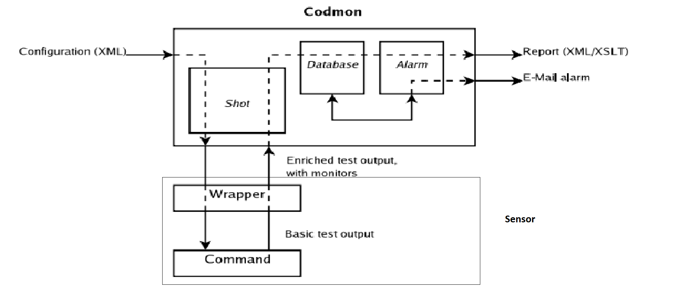
Codmon

Slide 12
Codmon
Controlling Codmon
  Controlled by a Sensor file.
  Decides the order of the tests
  Sensors describe the tests that will run
  Tests are implemented by a wrapper

Slide 13
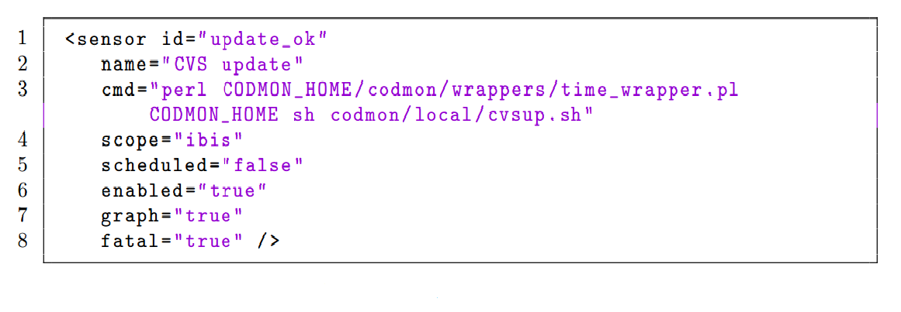
Codmon
Sensor Example

Slide 14
Codmon
The Codmon core program
  Executes the different Sensors
  Collects and stores the results
  Creates the graphs (if necessary)
  Raises an alarm in case of a failure

Slide 15
Codmon
Problems(1)
Multi-platform
  Platform dependent language(s)
  Perl scripts
  Shell scripts

Slide 16
Codmon
Problems(2)
Modularity
  Lots of different scripts and languages
  Difficult to add new modules or tests

Slide 17
Codmon
Problems(3)
User-friendliness
  Difficult to add new modules or tests
  Lots of configuration
  Supports only CVS

Slide 18
Codmon-VM
Goal: Design a multi-platform, modular and
user-friendly test environment.

Slide 19
Codmon-VM
Multiple-platform:
The same source, without making any modifications, can compile and run on multiple platforms.

Slide 20
Codmon-VM
Multiple-platform:
Java in stead of different platform dependent languages
Ant to connect a Java wrapper with a Java program

Slide 21
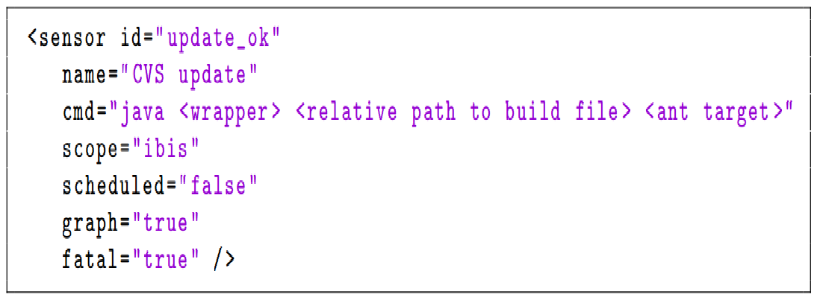
Codmon-VM

Slide 22
Codmon-VM
Modularity:
It must be possible for users to easily add new components to the Codmon-VM environment.

Slide 23
Codmon-VM
Different kinds of modularity
  Functional modules (e.g. Startup & Checkout)
  Tests
  The software that is tested

Slide 24
Codmon-VM
user-friendliness:
We don't want to bother the users of the Codmon-VN environment with its internal mechanisms or with the configuration of the environment.

Slide 25
Codmon-VM
user-friendliness:
  Download one or more of the Codmon-VM VM’s
  Install them into VM-ware or Virtual box.
  Add the details of the software he wants to test to the initialization ﬁle
  Create a Sensor file

Slide 26
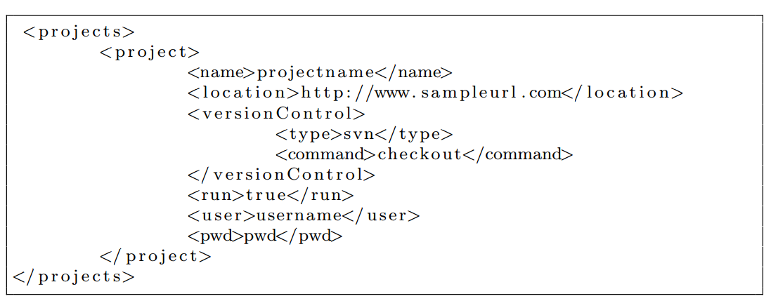
Codmon-VM in practice
Download and Install a Codmon-VM image
Create an initialization file

Slide 27
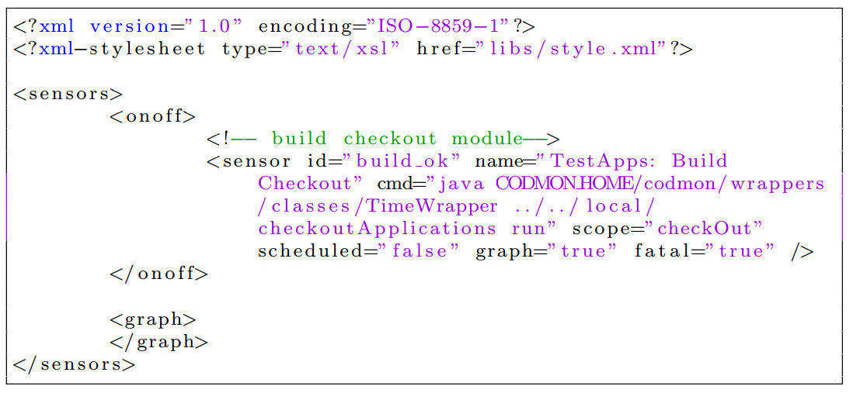
Codmon-VM in practice
3. Create a sensor file
4. Start Codmon-VM

Slide 28
Testing Codmon-VM
Test Setup:
  Independent test project (Marc4J)
    Java
    Contains JUnit tests
  Tested on different platforms
    Linux (Ubuntu)
    Windows 7
  Tested by an independent “Tester”

Slide 29
Testing Codmon-VM
Test Results:
  Same behaviour on both platforms
    Multi-platform
  Different modules are used
    Modular
  Easy to use for an external Person
    User Friendly

Slide 30
Discussion & Conclusion
Multi-platform
  Platform Independent language
  Same runtime behaviour on different platforms
  Yes: Codmon –VM is multi-platform

Slide 31
Conclusion & Discussion
Modular(1)
  Less straight forward than Multi-platform
    Test
    Functional modules
    What about the core program

Slide 32
Discussion & Conclusion
Modular(2)
  When we look at these three points we can only say that Codmon-VM is partially modular.

Slide 33
Discussion & Conclusion
User-Friendly(1)
  Even worse to determine
  Depends on the user’s preferences
    Easy in use
    Nice User interface

Slide 34
Discussion & Conclusion
User-Friendly(2)
  Pre-configured environments
  Easy in use: Marc4J project
  User has to edit xml-files manually
  User interface

Slide 35
Discussion & Conclusion
User-Friendly(3)
  Taken this into account we can say that Codmon-VM made a good start regarding User-friendliness

Slide 36
Questions?

