Slide 1
Some Ibis Project
Users
Jason Maassen Rob van Nieuwpoort
Niels Drost Roelof Kemp Frank Seinstra ibis@cs.vu.nl http://www.cs.vu.nl/ibis

Slide 2
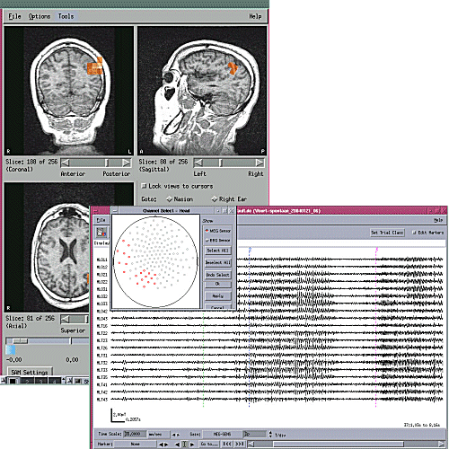
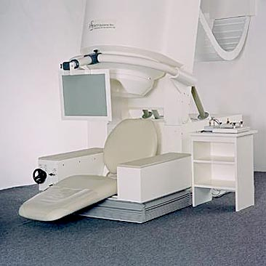
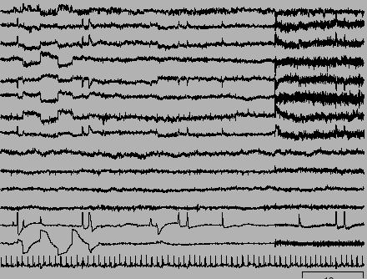
VU Medical Center
MEG Functional Imaging
Magneto
Encephalography
System (MEG)
courtesy
CTF MEG Systems
MEG signals
Analysis tool for MEG data
courtesy
VUMC MEG Centrum
Reconstructs source of electrical currents in the human brain based on magnetic fields measured just above the scalp
Multiple Sclerosis, Altzheimer, phantom pain

Slide 3
VU Medical Center
MEG Functional Imaging
Locating the sources of brain activation is computation intensive (fit data to model)
Existing commerically available non-Java software from MEG International Services
Test on local machine on test data set
Full test on 340 data sets, 116 Gigabytes, would take several weeks
Deploy to the grid to analyse scans of many patients in parallel
Runs for a less than two hours
Moved bottleneck from computation to medical doctors

Slide 4
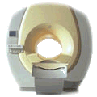
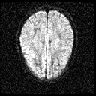
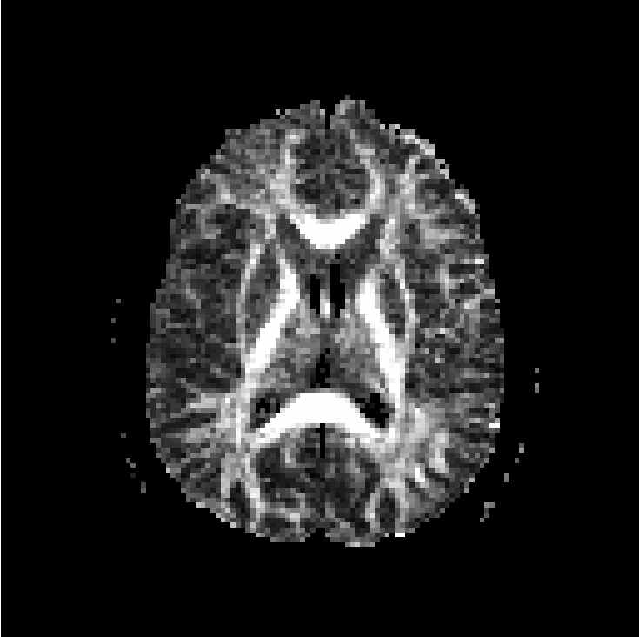
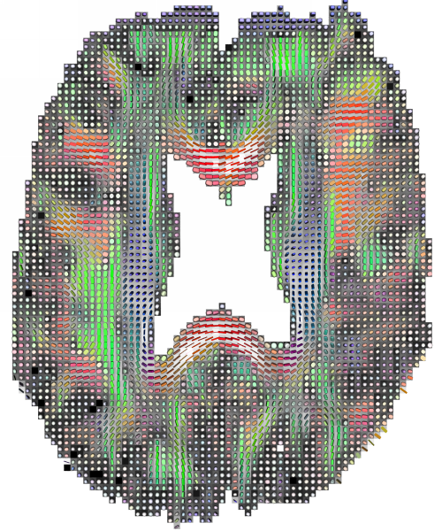
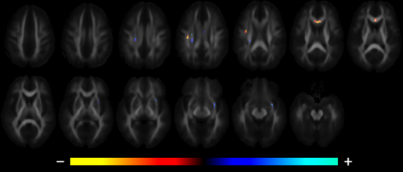
VU Medical Center / AMC: MRI
DTI-based Population Studies
MRI scanner
DTI scan
Eigenvalues
Fractional Anisotropy
Direction
Courtesy of the AMC,
TU Delft, Matthan Caan
Diffusion Tensor Imaging
Successful characterization of schizophrenic patients vs. controls

Slide 5
VU Medical Center / AMC: MRI
DTI-based Population Studies
New techniques to discriminate populations with pattern classification techniques
Tract-based spatial statistics (TBSS) was used as an analysis tool.
Image analysis is computation-intensive
Existing non-Java software, FSL written mainly by FMRIB Analysis Group, Oxford University, UK
3844 brains compared
Sequentially, this would take 12 weeks 24/7
Done in 1 weekend

Slide 6
VU Medical Center Tools
Generic task farming framework based on scripting
  Place executable in a directory
  Place data set in directory
  Parameter file
  Use JavaGAT to run executable on all datasets
  Monitor progress
  Copy back all results and output
  Security is of key importance
Keith Cover from the VUMC wrote the framework by himself! (with some support)

Slide 7
AMC: Vbrowser
Used by Medical Doctors
Runs on their desktops, typically MS Windows
Looks exactly like the windows explorer
Browse through data files
  Local disk
  Hospital storage resource broker
  The grid

Slide 8
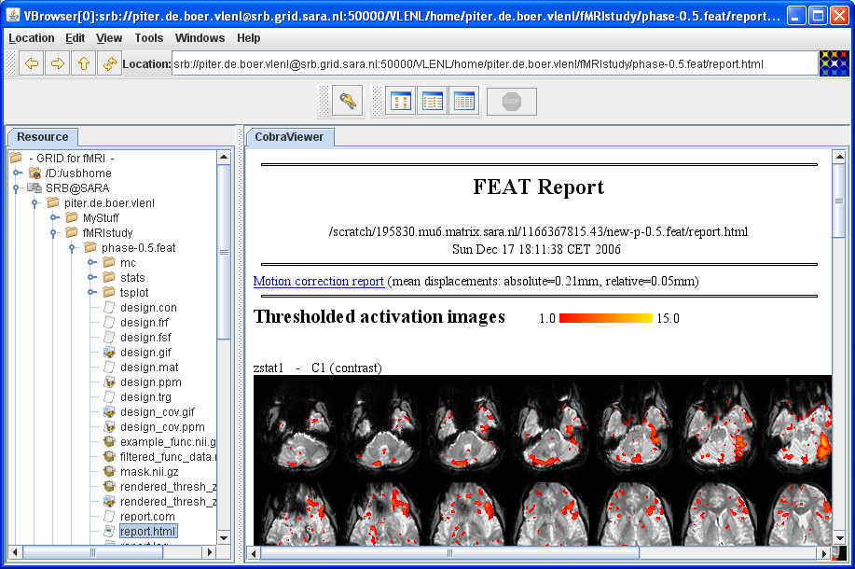
AMC: Vbrowser
medical data management

Slide 9
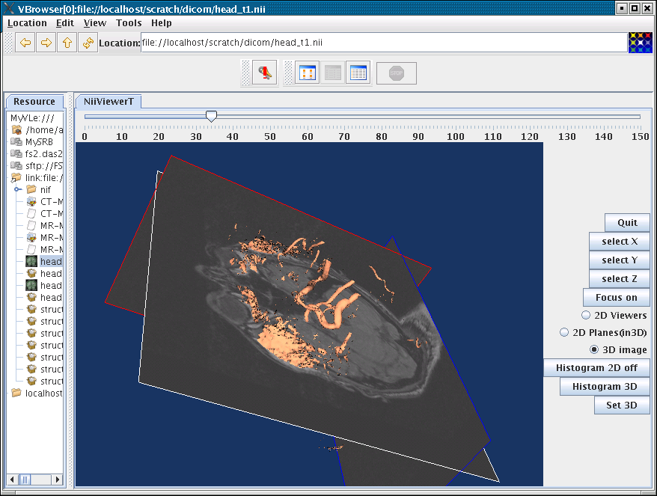
AMC: Vbrowser
medical data management

Slide 10
D-Grid
Large German Grid project
  HEP-Grid (High Energy Physics)
  C3-Grid (Climate Resaearch)
  WISENT (Energy Meteorology)
  InGrid (engineers)
  TextGrid (Textual Research)
  MediGrid (Medical Research)
  AstroGrid (Astronomical Research)
Several subprograms use JavaGAT
D-Grid Integration Project provides official JavaGAT support for D-Grid
ProC workflow engine

Slide 11

Analyse data of Planck Satelite
Analyse Cosmic Microwave Background

