Slide 1
SmartSockets:
Solving the Connectivity Problems in Grid Computing
Jason Maassen jason@cs.vu.nl

Slide 2
Until now...
We looked at how Ibis makes Grid middleware user friendly:
  JavaGAT provides an easy-to-use API for the various flavours of Grid middleware
  Zorilla provides a configuration free alternative to existing Grid middleware
Next step:
  Communication

Slide 3
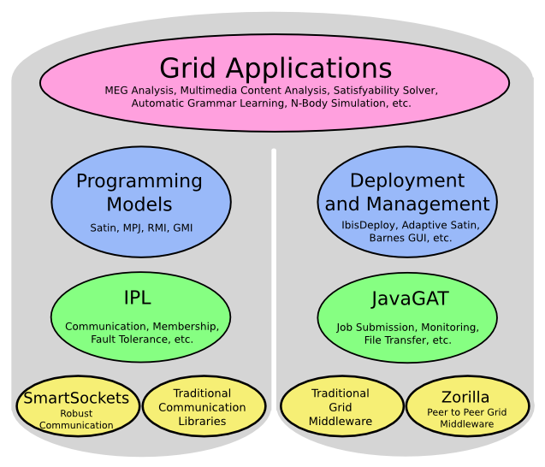
Overview

Slide 4
Communication is Difficult!
Many sites have connectivity issues
  Firewalls
  Network Address Translation (NAT)
  Non-routed networks
  Multi homing
  Mis-configured machines
  ...
This makes it hard to use a combination of sites

Slide 5
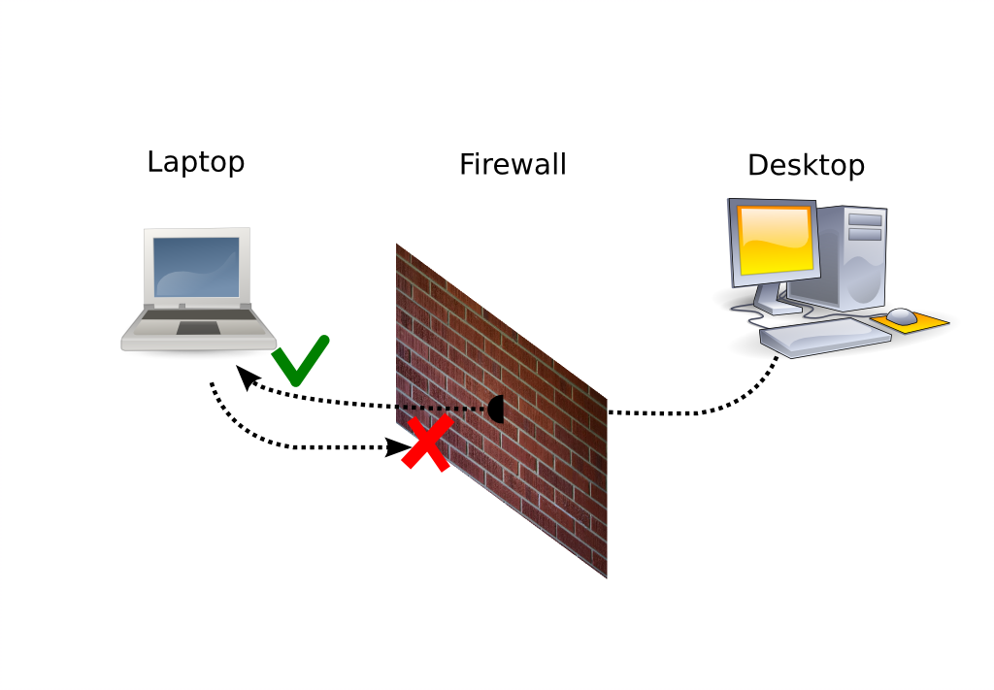
Problem 1:
Firewalls
Blocks 'inapropriate' traffic
  Usually only blocks incoming traffic
  Some also block outgoing traffic

Slide 6
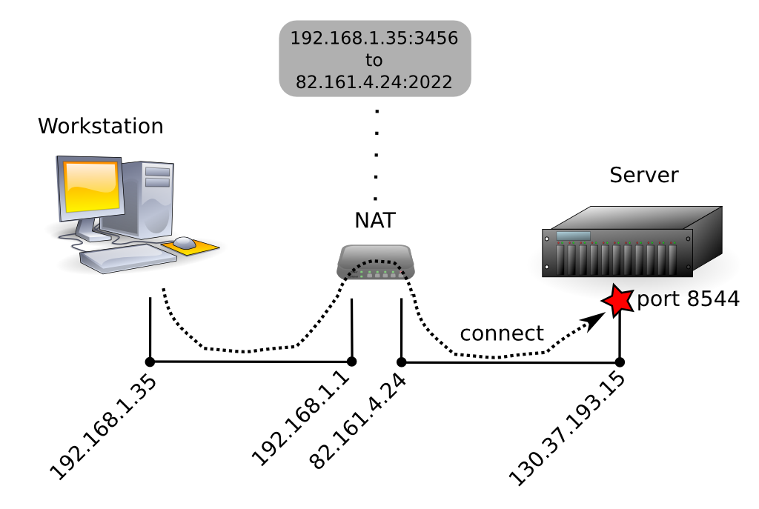
Problem 2: Network Address Translation
Maps IP from one range into another
  Works fine for outgoing connections

Slide 7
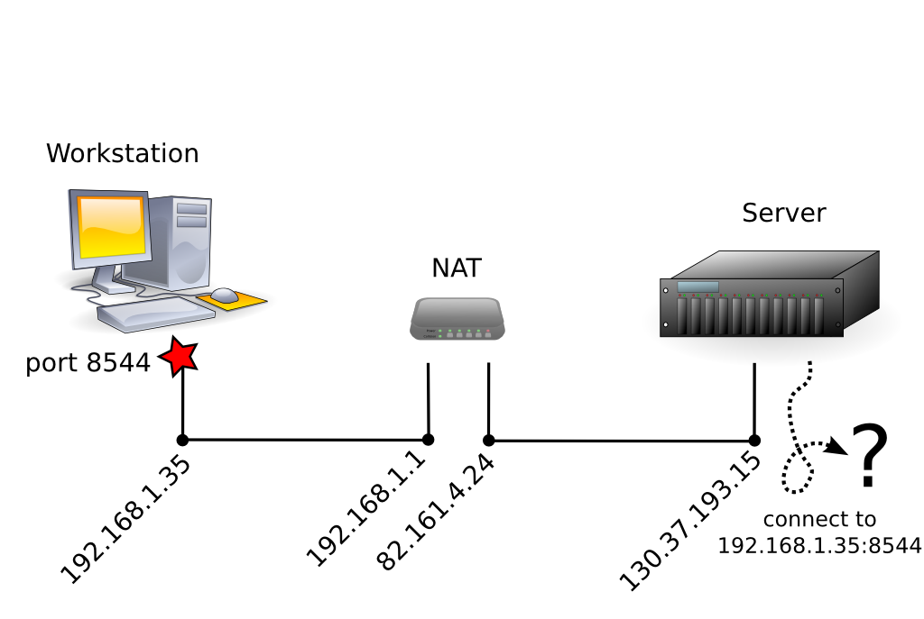
Problem 2: Network Address Translation
Problem: incoming connections
  Target address is invalid on internet

Slide 8
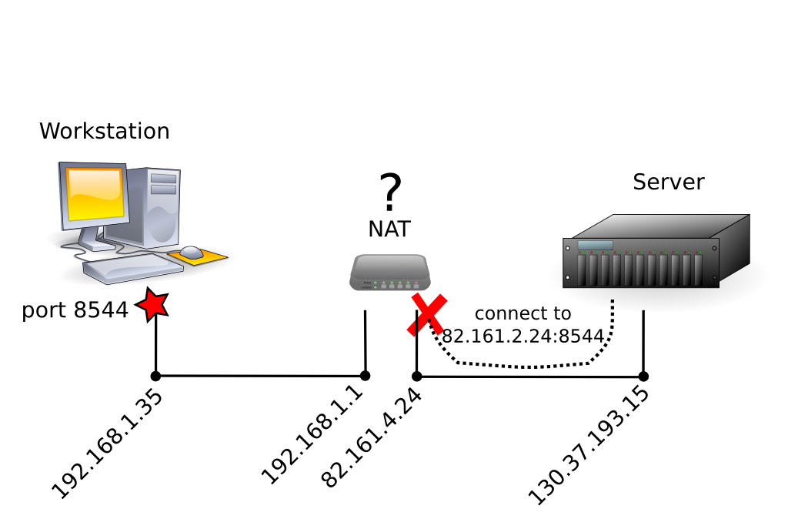
Problem 2: Network Address Translation
Problem: incoming connections
  Target address is invalid on internet
  NAT device does not know where to forward connection

Slide 9
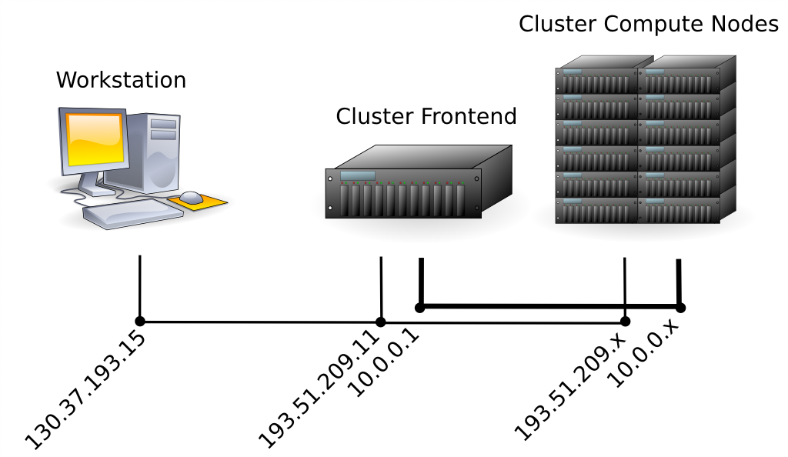
Problem 3:
Multi Homing
Some sites have multiple networks
  The target address depends on the source of the connection

Slide 10
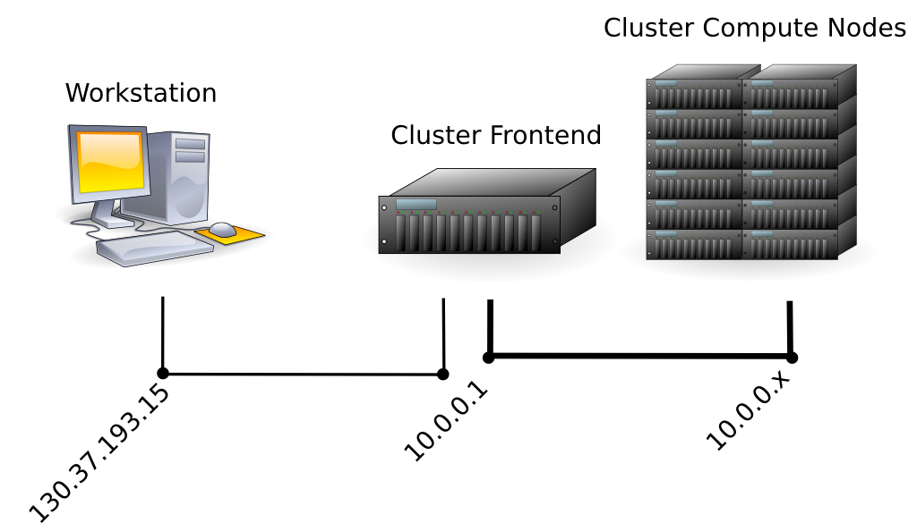
Problem 4:
Non-routed Networks
Some sites do not route between the local network and internet
  Only the frontend is reachable

Slide 11
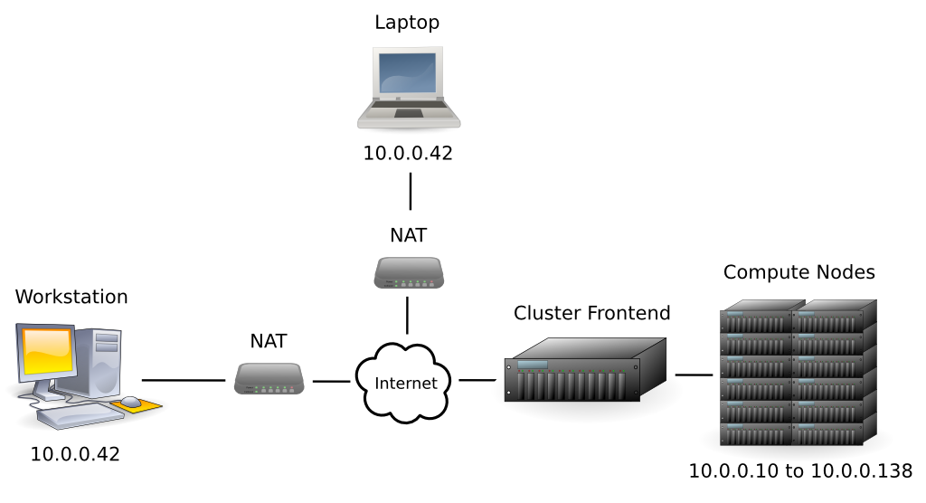
Problem 5:
Machine Identification
NAT/non-routed networks lead to machine identification problems

Slide 12
Current Solutions
There are many ad-hoc solutions:
  Open port ranges in the firewall
  Use port forwarding in NAT
  Explicitly specifying IP addresses
  SSH tunneling
  ...
These solutions work (sort of), but...

Slide 13
Current Solutions (Cont'd)
It all up to the user!
  What is wrong ?
  How it can be solved ?
A lot of work
  Need help from system administration
  May need changes to application
  Needs to be re-done whenever the testbed changes!

Slide 14
Before lunch ...
We looked at how Ibis makes Grids
user friendly:
  JavaGAT provides an easy-to-use API for the various flavours of Grid middleware
  Zorilla provides a configuration free alternative to existing Grid middleware
  SmartSockets provides an easy-to-use library that solves connectivity problems

Slide 15
Communication is Difficult!
Many sites have connectivity issues
  Firewalls
  Network Address Translation (NAT)
  Non-routed networks
  Multi homing
  Mis-configured machines
  ...
This makes it hard to use a combination of sites

Slide 16
SmartSockets
The SmartSockets library
  Offers a socket-like interface
    Addressing is different
  Detects connectivity problems
  Tries to solve them automatically
    With as little help from the user as possible
  Integrates existing and several new solutions into one library
User friendly connection setup!

Slide 17
Smart Addressing
SmartSockets extends addressing
  Not just a single IP:port combination
Add all machine addresses
Optionally add extra information
  External address + port (for NAT)
  UUID (if entire address is private)
  SSH contact information

Slide 18
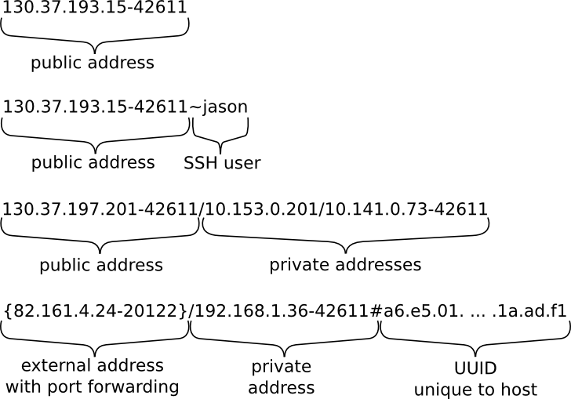
Addressing Examples

Slide 19
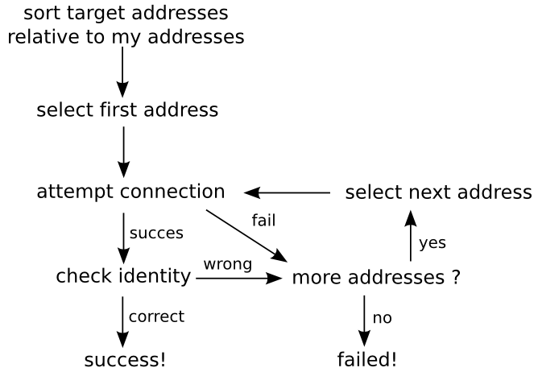
Creating a Connection

Slide 20
First Results
This solves multi homing and machine identification problems (3 & 5)
Assumes anyone can create a connection
  This will not help when the target is behind a NAT / Firewall
To solve this we need cooperation between machines....

Slide 21
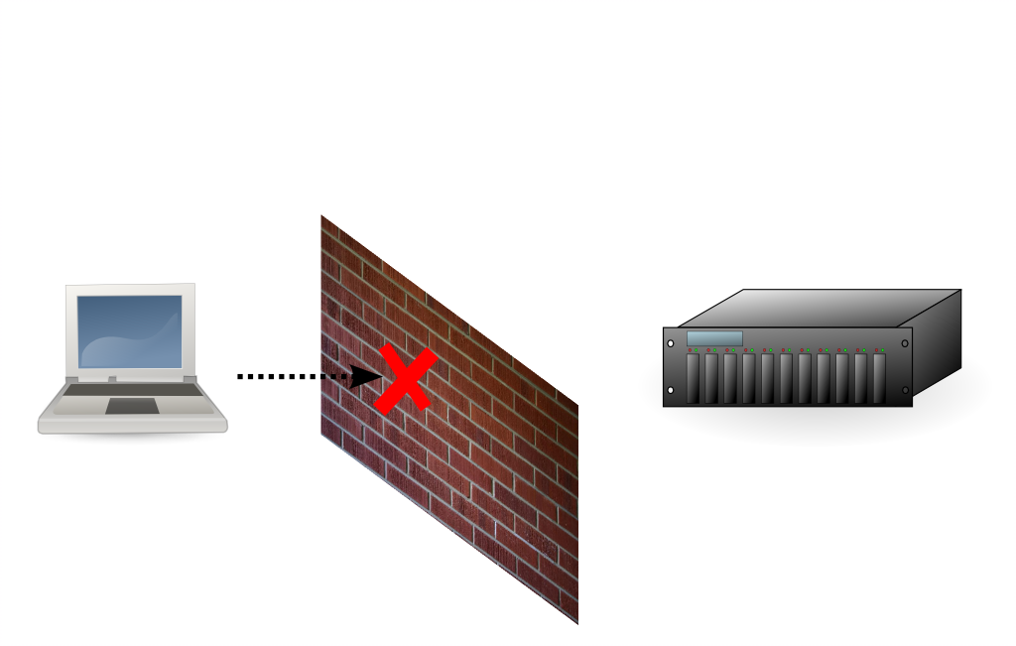
Cooperation

Slide 22
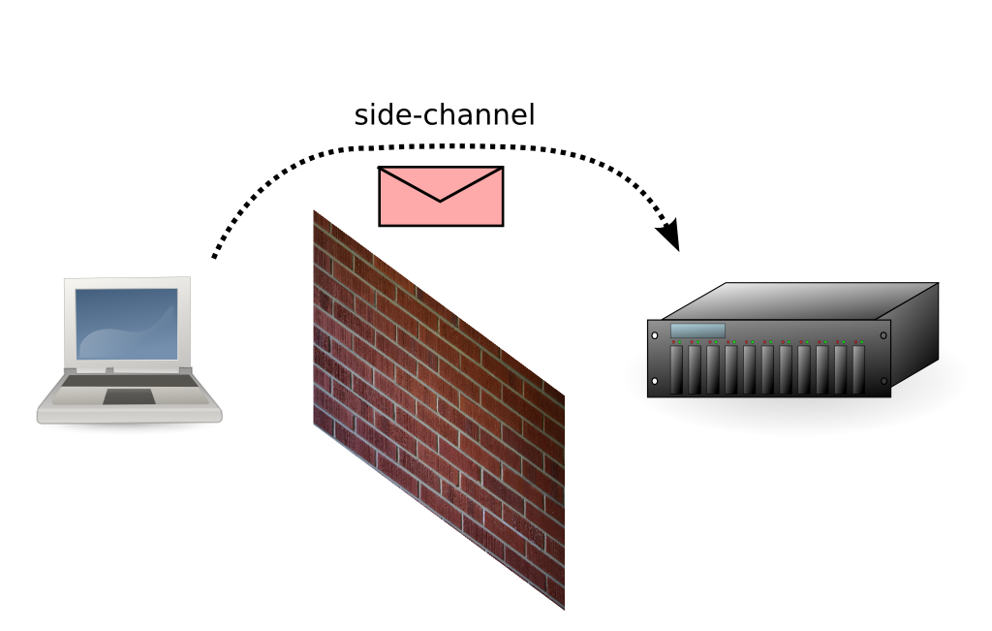
Cooperation

Slide 23
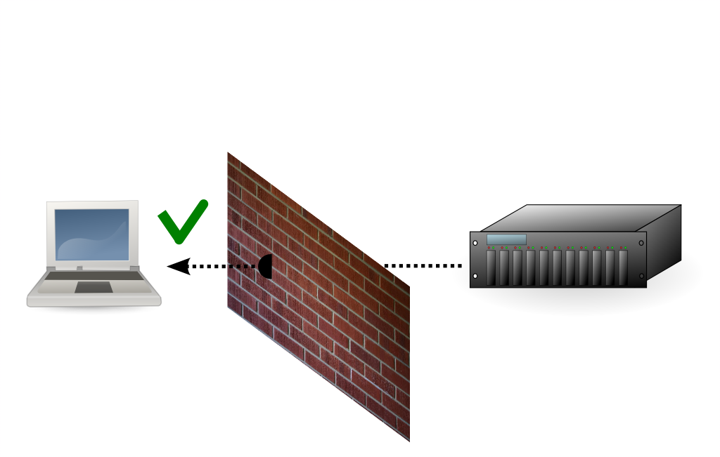
Cooperation

Slide 24
Side Channel
SmartSockets uses network of hubs to implement a side channel
  Support processes for the application
  Started in advance
Hubs are run on machines with 'more connectivity'
  Such as cluster frontends, 'open' machines, etc.

Slide 25
Hubs
Hub connect to each other
  Need to set up spanning tree (or better)
    Use direct connections and SSH tunnels
  Gossip information and client messages
    Automatically discover new hubs and routes
Clients connect to a 'local' hub
  When needed, use network of hubs as side channel for connection setup

Slide 26
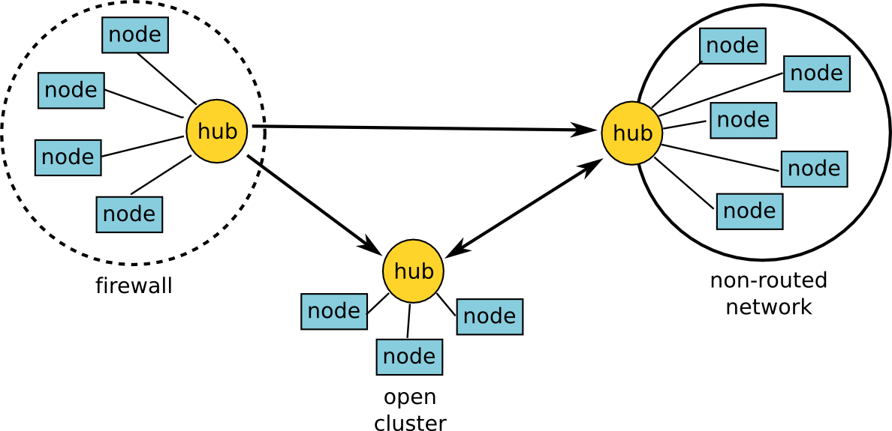
Example

Slide 27
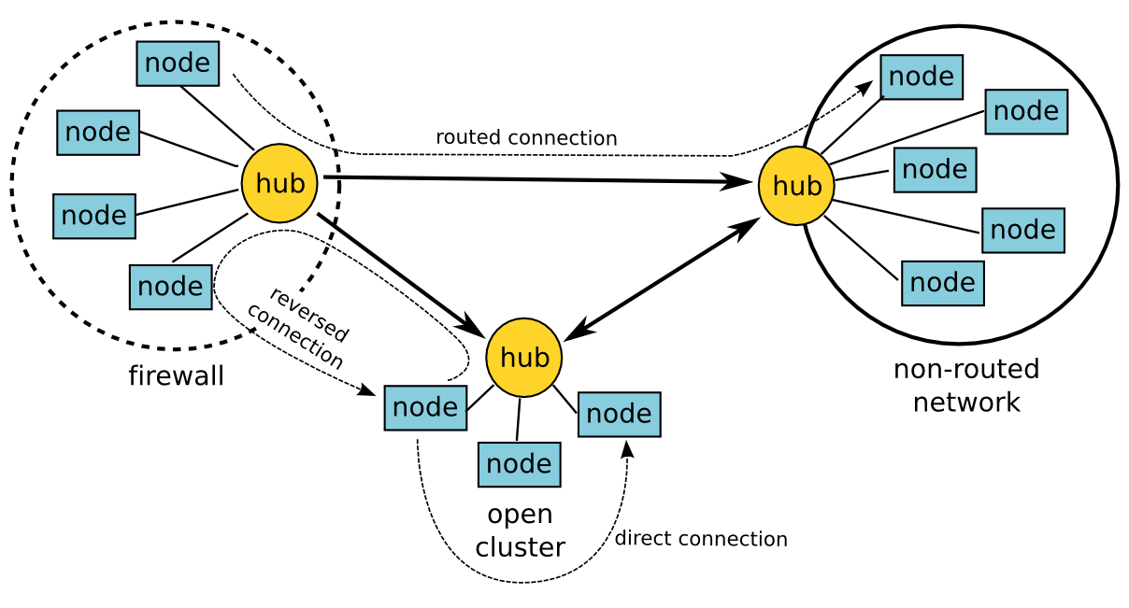
Example Cont'd

Slide 28
Reverse
Reverse direction of connection setup
  Send message to target using hub
  Wait for incoming (direct) connection
Results in direct connection
  Only connection setup is different
Solves Firewall/NAT problems (1 & 2)
  Assumes one side can create connection
  Does not work with multiple firewalls or NATs, or non-routed networks

Slide 29
Routed
Create virtual connection using hubs
  Forward all data over side channel
Results in indirect connection
  Usually lower performance
  Still looks like a socket!
Solves non-routed problem (4)
  Also solves the multi-firewall/NAT case

Slide 30
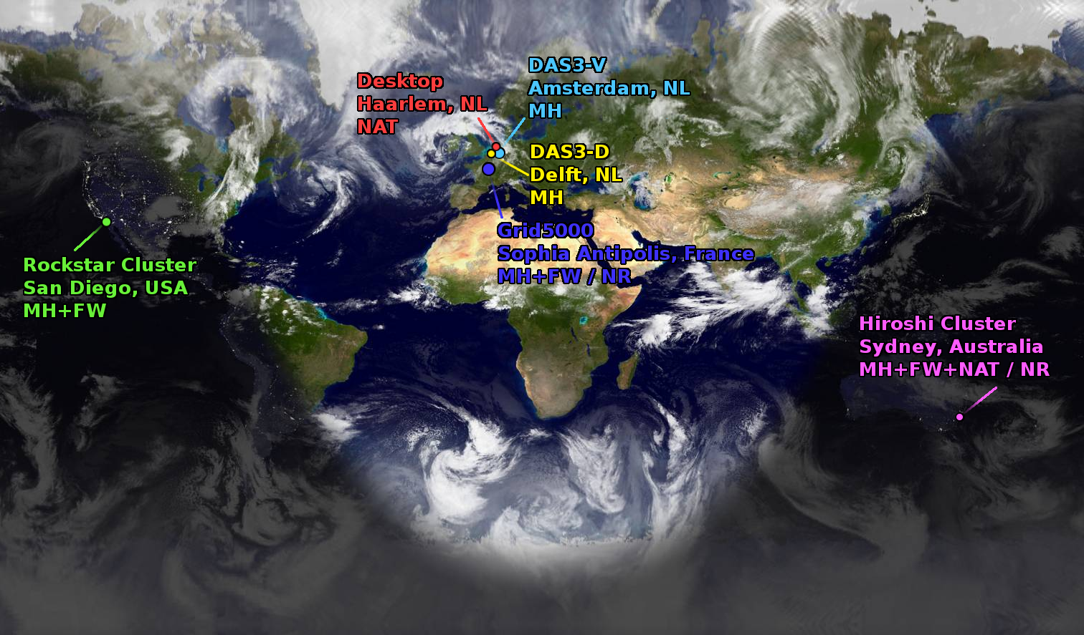
Examples

Slide 31
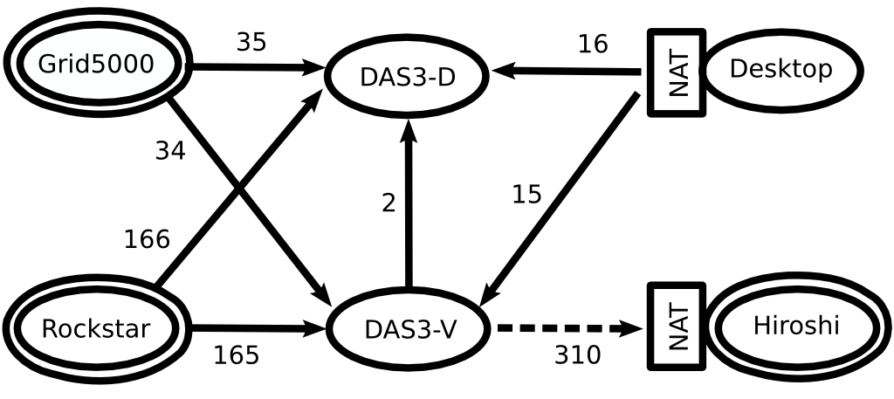
Hub Network

Slide 32
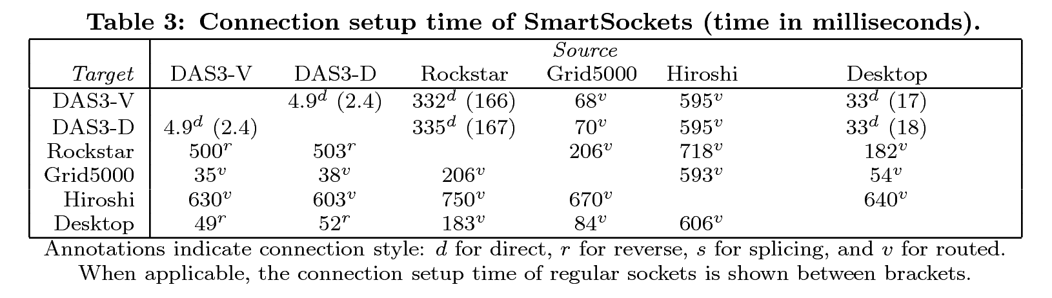
Evaluation

Slide 33
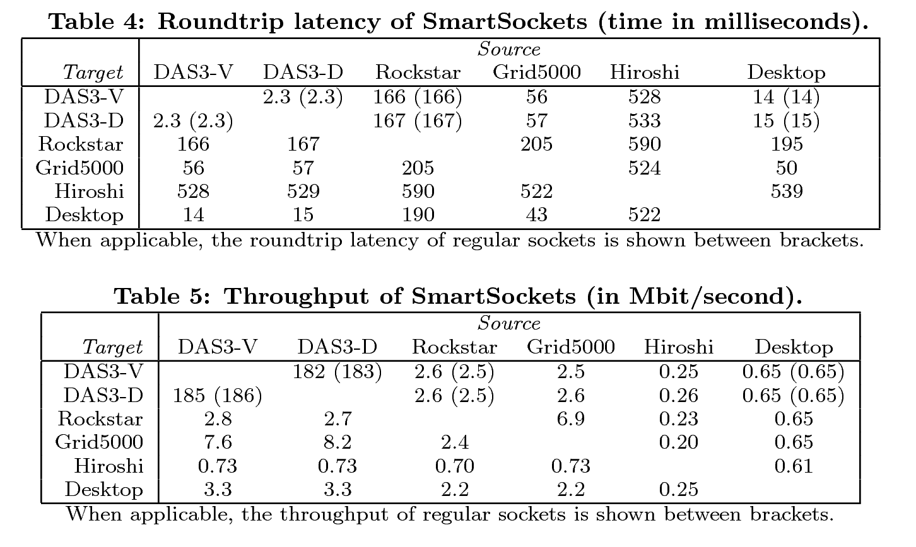
Evaluation

Slide 34
Future Work
Alternative protocols
  UDP instead of TCP
  Parallel streams
  Secure connections
Dynamically switching approach
  Find a better connection while the socket is in use!
Hub network scalability

Slide 35
Summary
Communicating on Grids is hard
  Many connectivity problems occur
  Takes a lot of work to find the problems and work around them
SmartSockets reduces this into a single problem:
  How to set up a spanning tree of hubs
The rest is done automatically!

Slide 37
Questions ?

Slide 38
Splicing
Both sites simultaneously set up a connection
  Connections meet in the middle
  NAT requires port mapping prediction
Results in direct connection
Solves multi-firewall/NAT problems
  Very sensitive to timing
    Not guaranteed to work
  Does not work for non-routed networks

Slide 39
Other Features
Reducing connectivity
  Explicit configuration needed
  Allows applications to simulate firewalls
  Can be combined with traffic shaping
    Simulate a Grid on your cluster!
Visualization of connections
  Gives insight into network problems

Slide 40
Visualization
SHOW EXAMPLE!

Slide 41
Programming Interface
Current (Java) implementation based on SocketFactory pattern
  Also used for SSL connections
Connection results in 'Socket'
  Compatible with existing applications
Main problem: Addressing!
Easy to plug into applications
  Provided that this model is used!

Slide 42
Multi Homing
Which address should be used ?
  Nodes can use both 193.x and 10.x addresses to connect to each other
    10.x is preferred
  A machine outside the cluster can only use 193.x to connect to a node
  How should the nodes advertise themselves ?

Slide 43
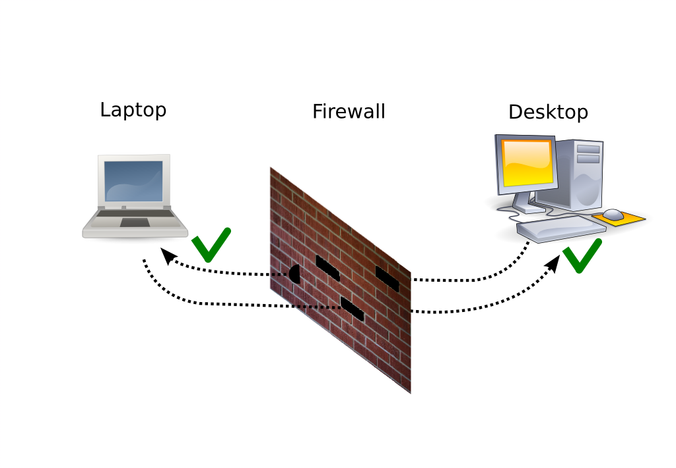
Current Solution:
Open port range
Several ports are 'open'
  Seen as a security hazard
  How do you find the port range ?

Slide 44
Current Solution:
Port Forwarding
Register ports at NAT device
  Tell it where to forward incoming connections
Problems:
  How does the external machine know what IP/port combination to use ?
  Not always supported
    Usually only in consumer devices
    Often 'switched off' (security problems)
  Several different protocols

Slide 45
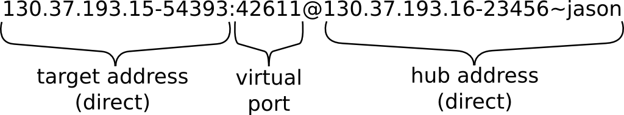
Virtual Addressing
Client addresses are extended with address of their hub
  Needed for side-channel communication

Slide 46
Order Caching
By default the following order is used:
direct, reverse, splice, routed
Once a connection is established, the targets hub address and succesfull scheme are cached
This scheme is tried first for the next connection to a target belonging to the same hub

Slide 47
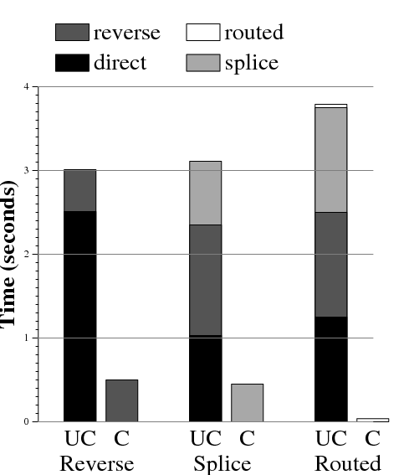
Order Caching Results

Slide 48
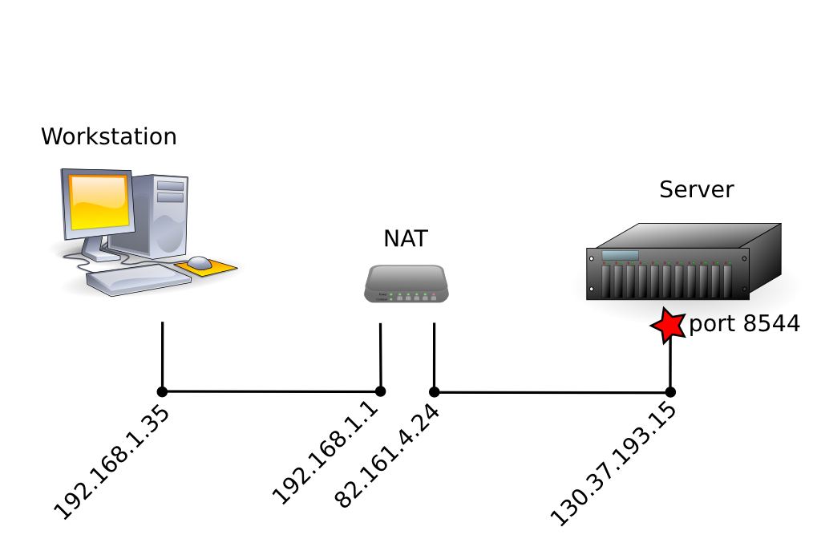
NAT: Outgoing connections

Slide 49
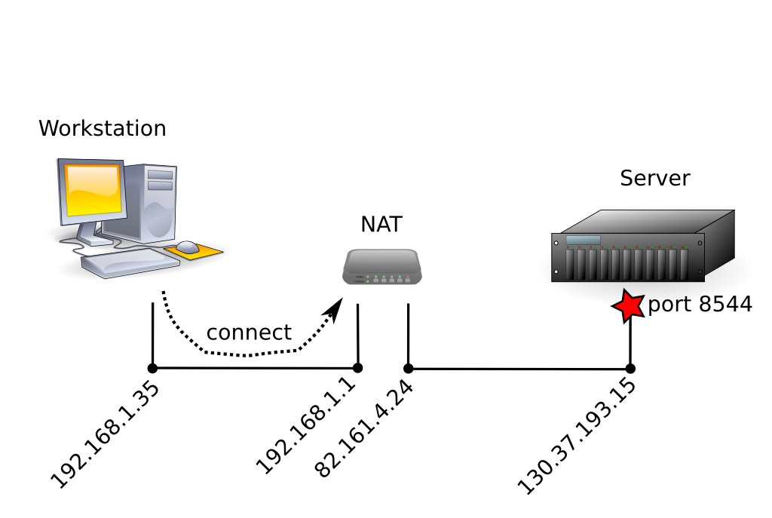
NAT: Outgoing connections

Slide 50
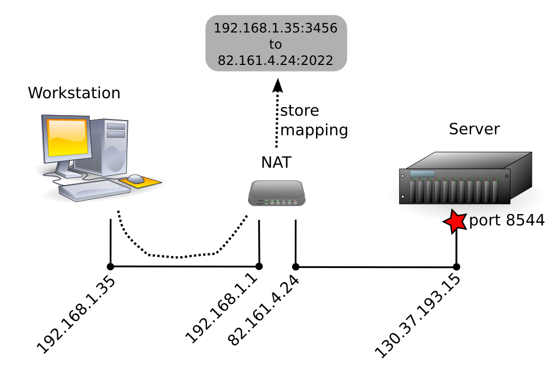
NAT: Outgoing connections

Slide 51
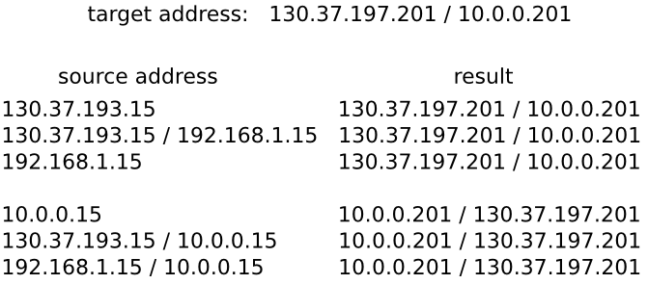
Sorting Addresses

Slide 52
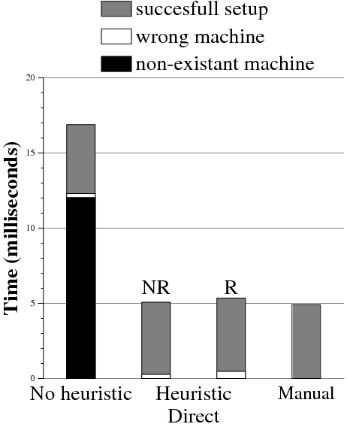
Sorting Effect
(DAS3-Delft to DAS3-VU)

Slide 53
Sorting Effect
(DAS3-Delft to DAS3-VU)

Slide 54
Virtual Connection Layer
Uses direct connection layer and hub network
Connection setup schemes require cooperation between sites
  (Direct)
  Reverse
  Splicing
  Routed
Mostly transparent to client!

Slide 55
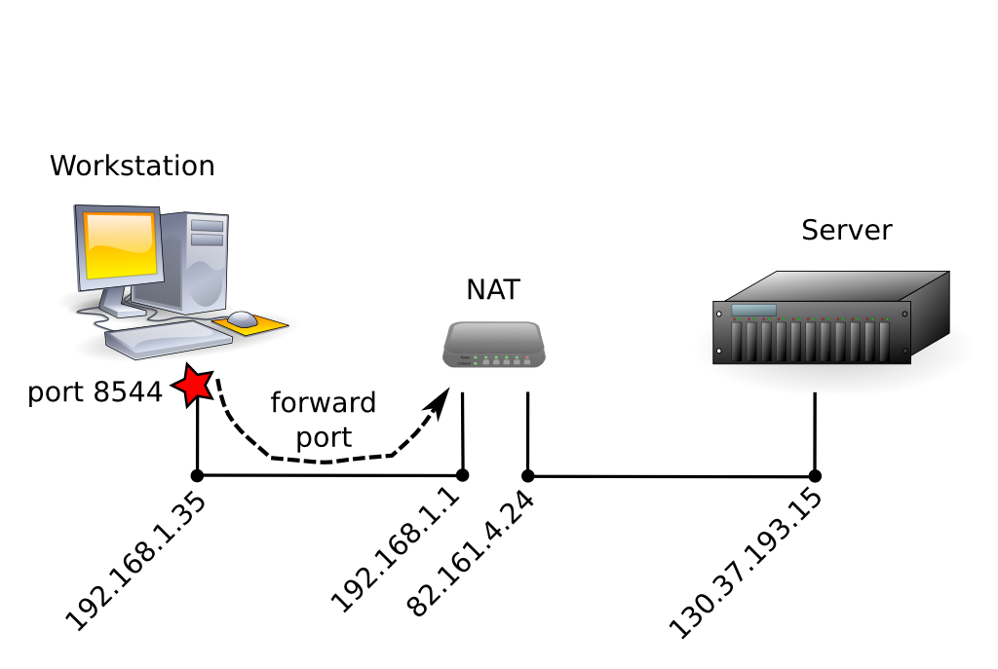
NAT: Port Forwarding

Slide 56
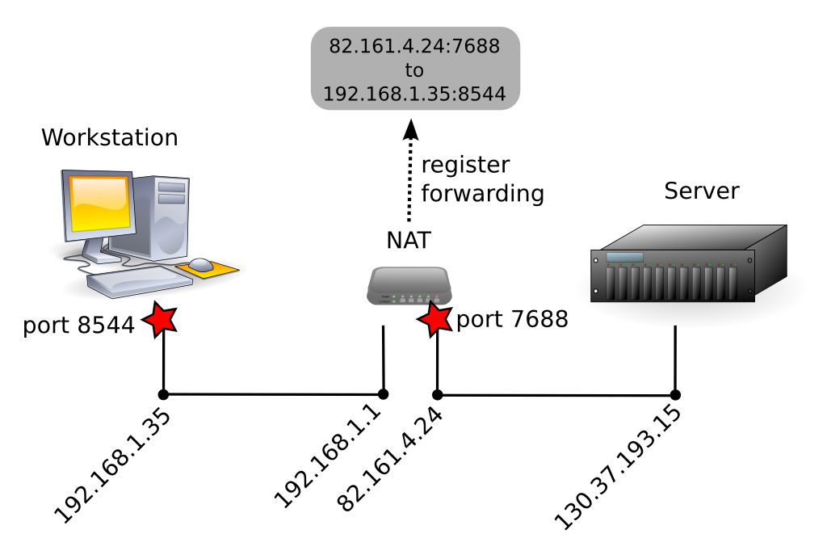
NAT: Port Forwarding

Slide 57
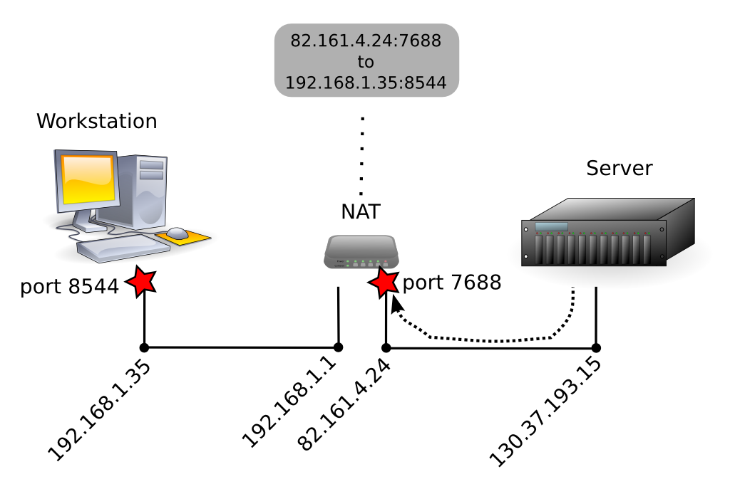
NAT: Port Forwarding

Slide 58

NAT: Port Forwarding

Slide 59
Grid Computing
(our definition)
To us a 'grid' is usually:
  A collection of clusters
    often a 'social collection'
      access often provided by (former) colleagues, friends, project partners, etc.
    several administrative domains
      difference in configurations, security settings and level of maintenance
  May include desktop systems
    Used for visualization, monitoring, steering

Slide 60
Heterogeneity
Grids are heterogeneous
We have developed languages and runtime systems that can handle the differences in processor and network speeds
However, many applications assume that the participants can (directly) communicate

