Slide 1
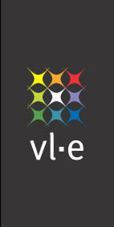

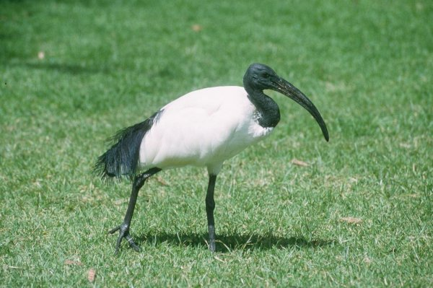
Ibis: a Java-centric Programming Environment for Computational Grids
Henri Bal
Vrije Universiteit Amsterdam
vrije Universiteit

Slide 2


Distributed supercomputing
Parallel processing on geographically distributed computing systems (grids)
Examples:
  SETI@home ( ), RSA-155, Entropia, Cactus
Currently limited to trivially parallel applications
Questions:
  Can we generalize this to more HPC applications?
  What high-level programming support is needed?

Slide 3

Grids versus supercomputers
Performance/scalability
  Speedups on geographically distributed systems?
Heterogeneity
  Different types of processors, operating systems, etc.
  Different networks (Ethernet, Myrinet, WANs)
General grid issues
  Resource management, co-allocation, firewalls, security, authorization, accounting, ….

Slide 4

Approaches
Performance/scalability
  Exploit hierarchical structure of grids
  (previous project: Albatross)
  Use optical (>> 10 Gbit/sec) wide-area networks
  (future projects: DAS-3 and StarPlane)
Heterogeneity
  Use Java + JVM (Java Virtual Machine) technology
General grid issues
  Studied in many grid projects: VL-e, GridLab, GGF

Slide 5
Outline
Previous work: Albatross project
Ibis: Java-centric grid computing
  Programming support
  Design and implementation
  Applications
Experiences on DAS-2 and EC GridLab testbeds
Future work (VL-e, DAS-3, StarPlane)

Slide 6
Speedups on a grid?
Grids usually are hierarchical
  Collections of clusters, supercomputers
  Fast local links, slow wide-area links
Can optimize algorithms to exploit this hierarchy
  Minimize wide-area communication
Successful for many applications
  Did many experiments on a homogeneous wide-area test bed (DAS)

Slide 7
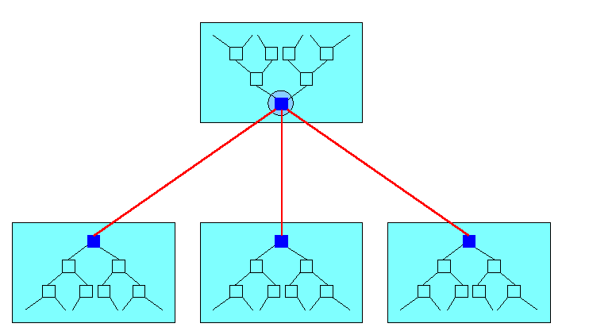
Wide-area optimizations
Message combining on wide-area links
Latency hiding on wide-area links
Collective operations for wide-area systems
  Broadcast, reduction, all-to-all exchange
Load balancing
Conclusions:
  Many applications can be optimized to run efficiently on a hierarchical wide-area system
  Need better programming support

Slide 8
The Ibis system
High-level & efficient programming support for distributed supercomputing on heterogeneous grids
Use Java-centric approach + JVM technology
  Inherently more portable than native compilation
    “Write once, run anywhere ”
  Requires entire system to be written in pure Java
Optimized special-case solutions with native code
  E.g. native communication libraries

Slide 9

Ibis programming support
Ibis provides
  Remote Method Invocation (RMI)
  Replicated objects (RepMI) - as in Orca
  Group/collective communication (GMI) - as in MPI
  Divide & conquer (Satin) - as in Cilk
All integrated in a clean, object-oriented way into Java, using special “marker” interfaces
  Invoking native library (e.g. MPI) would give up
  Java’s “run anywhere” portability

Slide 10
Compiling/optimizing programs
JVM
source
Java
compiler
bytecode
bytecode
rewriter
bytecode
JVM
JVM
Optimizations are done by bytecode rewriting
  E.g. compiler-generated serialization (as in Manta)

Slide 11
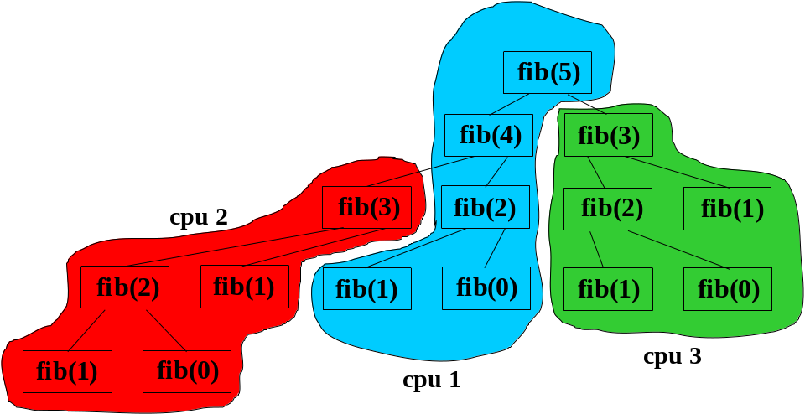
Satin: a parallel divide-and-conquer system on top of Ibis
Divide-and-conquer is
inherently hierarchical
More general than
master/worker
Satin: Cilk-like primitives (spawn/sync) in Java

Slide 12
Example
interface FibInter {
public int fib(long n);
}
class Fib implements FibInter {
int fib (int n) {
if (n < 2) return n;
return fib(n-1) + fib(n-2);
}
}
Single-threaded Java

Slide 13
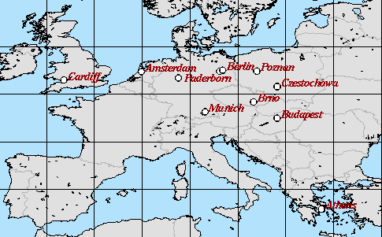
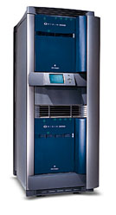
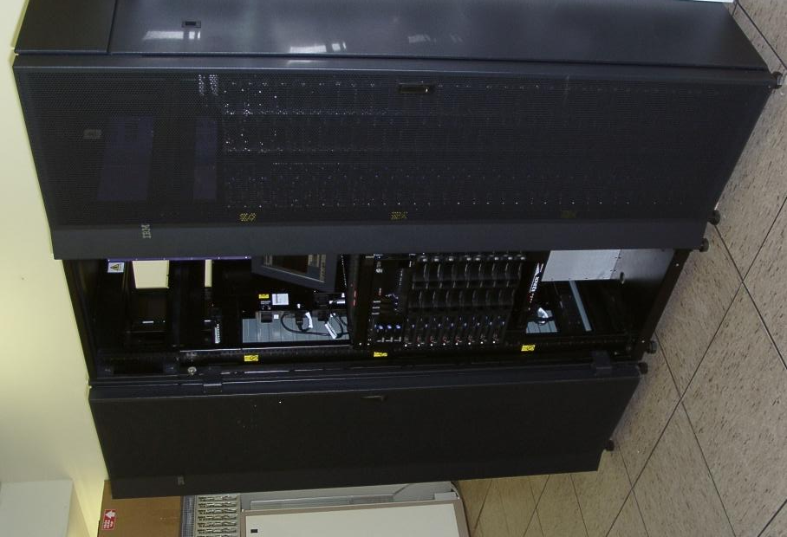
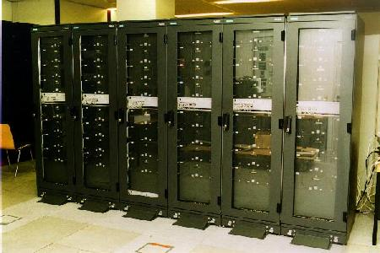
Example
interface FibInter
extends ibis.satin.Spawnable {
public int fib(long n);
}
class Fib
extends ibis.satin.SatinObject
implements FibInter {
public int fib (int n) {
if (n < 2) return n;
int x = fib (n - 1);
int y = fib (n - 2);
sync();
return x + y;
}
}
Java + divide&conquer
GridLab testbed

Slide 14
Ibis implementation
Want to exploit Java’s “run everywhere” property, but
  That requires 100% pure Java implementation,
  no single line of native code
  Hard to use native communication (e.g. Myrinet) or native compiler/runtime system
Ibis approach:
  Reasonably efficient pure Java solution (for any JVM)
  Optimized solutions with native code for special cases

Slide 15
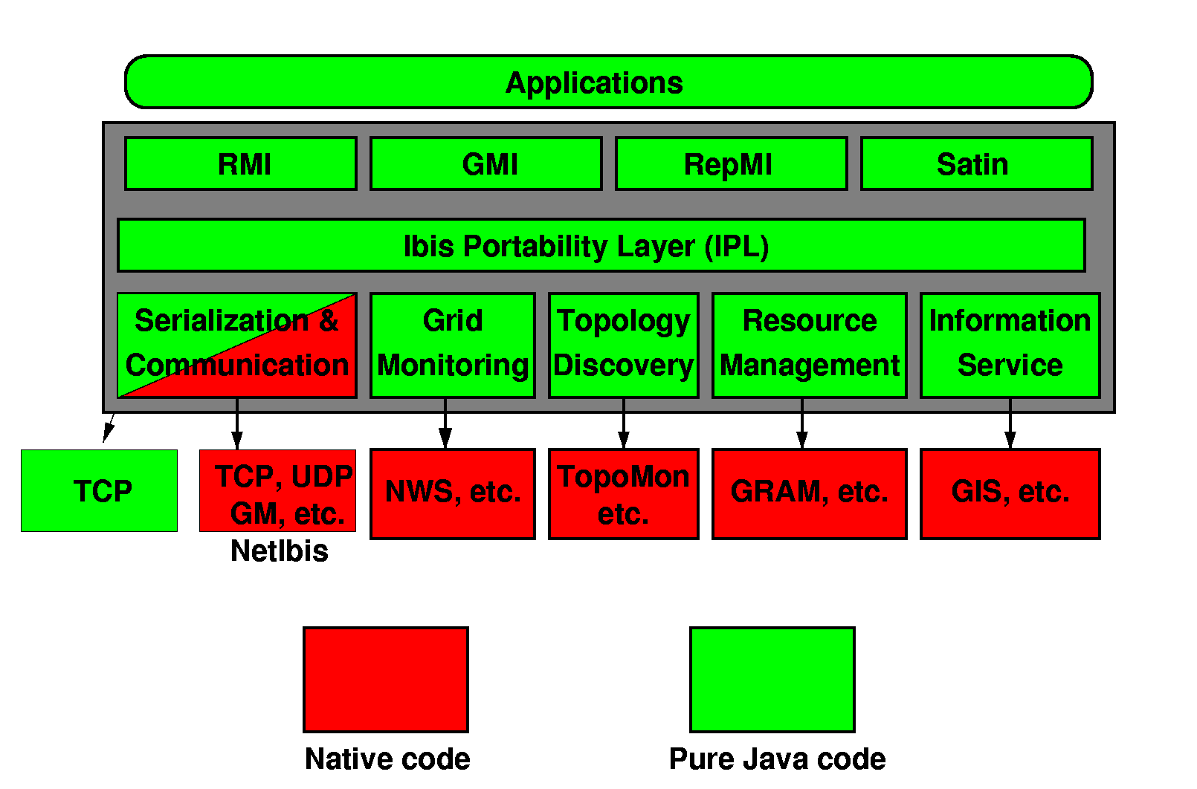
Ibis design

Slide 16
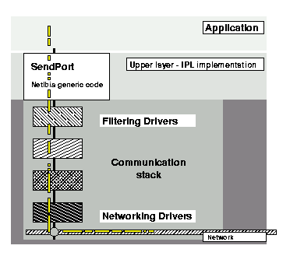
NetIbis
Grid communication system of Ibis
  Dynamic: networks not known when application is launched -> runtime configurable protocol stacks
  Heterogeneous -> handle multiple different networks
  Efficient -> exploit fast local networks
  Advanced connection establishment
  to deal with connectivity problems
  [Denis et al., HPDC-13, 2004]
Example:
  Use Myrinet/GM, Ethernet/UDP and TCP in 1 application
  Same performance as static optimized protocol
  [Aumage, Hofman, and Bal, CCGrid05]

Slide 17

Fast communication in pure Java
Manta system [ACM TOPLAS Nov. 2001]
  RMI at RPC speed, but using native compiler & RTS
Ibis does similar optimizations, but in pure Java
  Compiler-generated serialization at bytecode level
    5-9x faster than using runtime type inspection
  Reduce copying overhead
    Zero-copy native implementation for primitive arrays
    Pure-Java requires type-conversion (=copy) to bytes

Slide 18
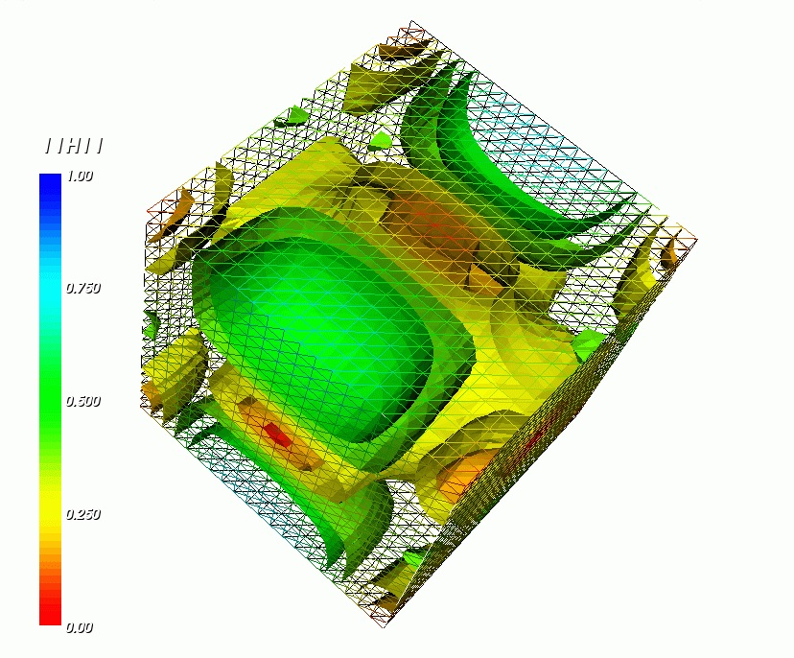
Applications
Implemented ProActive on top of Ibis/RMI
3D electromagnetic application (Jem3D)
in Java, on top of Ibis + ProActive
  [F. Huet, D. Caromel, H. Bal, SC'04]
Automated protein identification for
high-resolution mass spectrometry
Many smaller applications (mostly with Satin)
  Raytracer, cellular automaton, Grammar-based compression, SAT-solver, Barnes-Hut, etc.

Slide 19
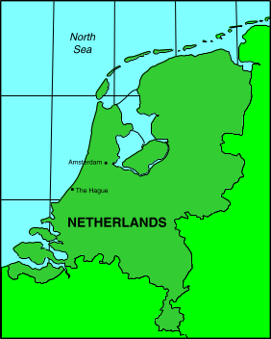
Grid experiences with Ibis
Using Satin divide-and-conquer system
  Implemented with Ibis in pure Java, using TCP/IP
Application measurements on
  DAS-2 (homogeneous)
  Testbed from EC GridLab project (heterogeneous)

Slide 20
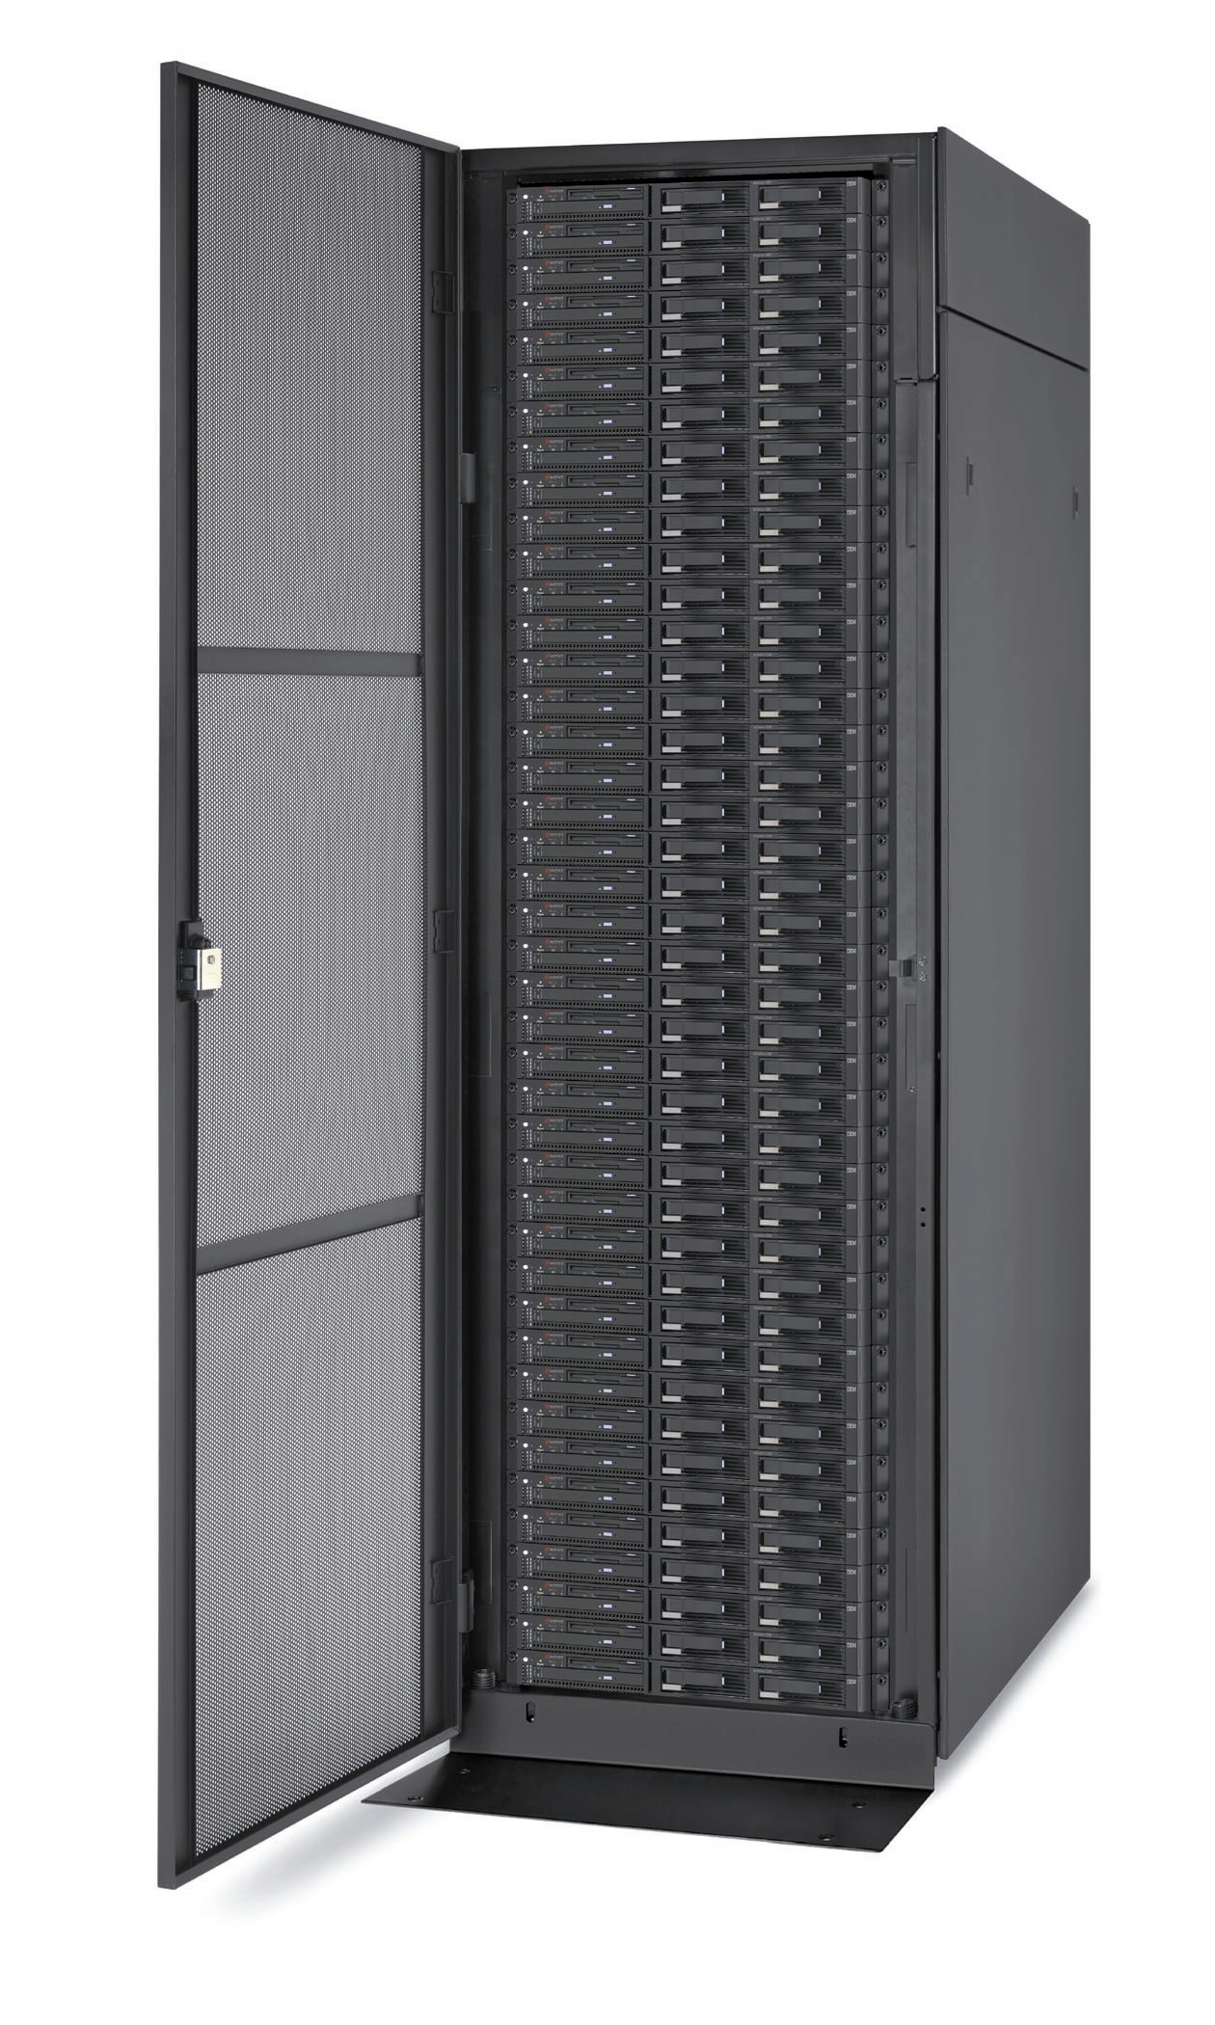
Distributed ASCI Supercomputer (DAS) 2
VU (72 nodes)
UvA (32)
Node configuration
Dual 1 GHz Pentium-III
>= 1 GB memory
Myrinet
Linux
GigaPort
(1 Gb)
Leiden (32)
Delft (32)
Utrecht (32)

Slide 21
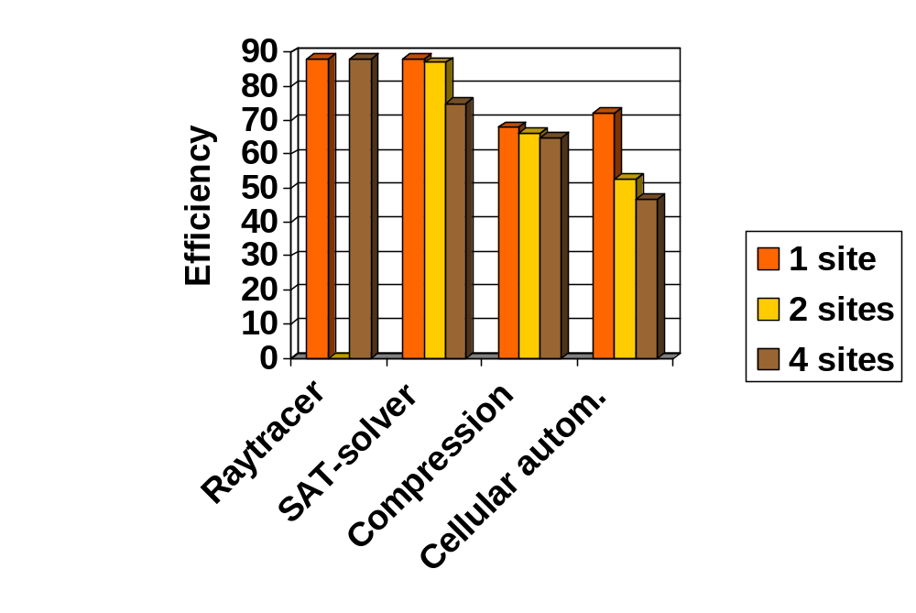
Performance on wide-area DAS-2
(64 nodes)
Cellular Automaton uses IPL, the others use Satin.

Slide 22

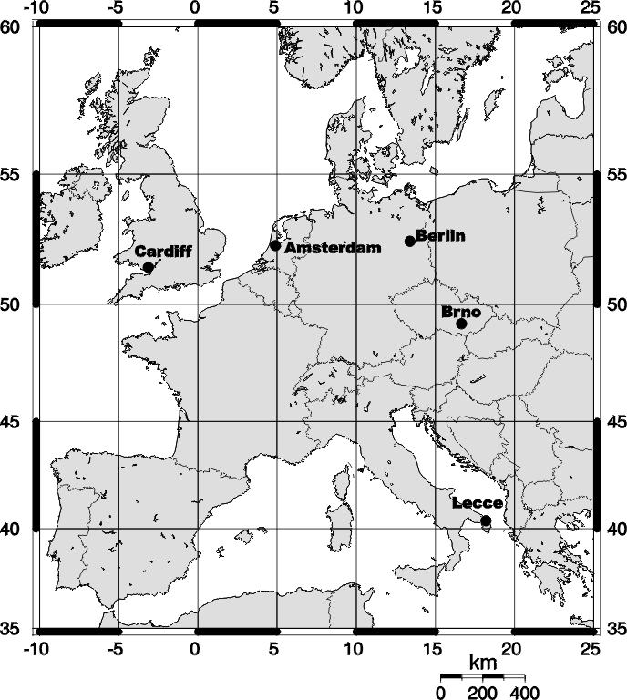
GridLab
Latencies:
  9-200 ms (daytime),
  9-66 ms (night)
Bandwidths:
  9-4000 KB/s

Slide 23
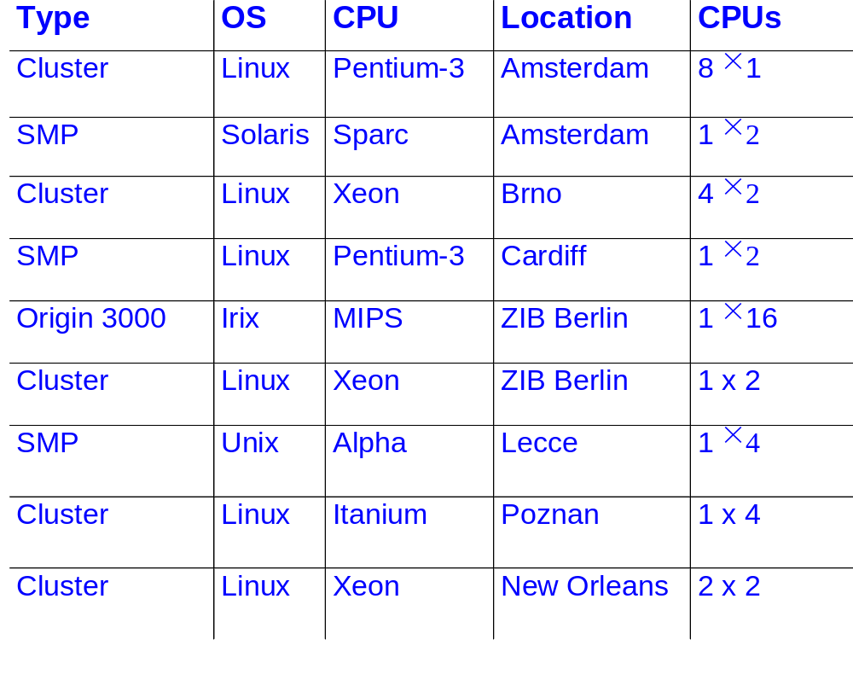
Testbed sites

Slide 24

Experiences
Grid testbeds are difficult to obtain
Poor support for co-allocation (use our own tool)
Firewall problems everywhere
Java indeed runs anywhere
modulo bugs in (old) JVMs
Divide-and-conquer parallelism works very well on a grid, given a good load balancing algorithm

Slide 25
Grid results
Program | sites | CPUs | Efficiency
Raytracer (Satin) | 5 | 40 | 81 %
SAT-solver (Satin) | 5 | 28 | 88 %
Compression (Satin) | 3 | 22 | 67 %
Cellular autom. (IPL) | 3 | 22 | 66 %
Efficiency based on normalization to single CPU type (1GHz P3)

Slide 26

Future work: VL-e
VL-e: Virtual Laboratories for e-Science
Large Dutch project (2004-2008):
  40 M€ (20 M€ BSIK funding from Dutch goverment)
20 partners
  Academia: Amsterdam, TU Delft, VU, CWI, NIKHEF, ..
  Industry: Philips, IBM, Unilever, CMG, ....
Our work:
  Ibis: P2P, management, fault-tolerance, optical networking, applications, performance tools

Slide 27
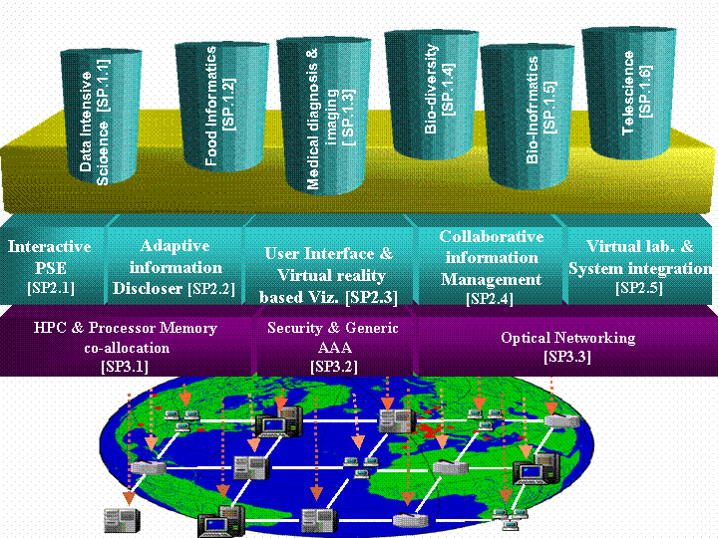
VL-e program

Slide 28

DAS-3
Next generation grid in the Netherlands
Partners:
  ASCI research school
  Gigaport-NG/SURFnet
  VL-e and MultimediaN BSIK projects
DWDM backplane
  Dedicated optical group of 8 lambdas
  Can allocate multiple 10 Gbit/s lambdas between sites

Slide 29
DAS-3
R
CPU’s
CPU’s
R
CPU’s
R
NOC
CPU’s
R
CPU’s
R

Slide 30
StarPlane project
Collaboration with Cees de Laat (U. Amsterdam)
Key idea:
  Applications can dynamically allocate light paths
  Applications can change the topology of the wide-area network at sub-second timescale
Challenge: how to integrate such a network infrastructure with (e-Science) applications?

Slide 31
Summary
Ibis: A Java-centric Grid programming environment
Exploits Java’s “run anywhere” portability
Optimizations using bytecode rewriting and some native code
Efficient, dynamic, & flexible communication system
Many applications
Many Grid experiments
Future work: VL-e and DAS-3

Slide 32
Acknowledgements
Kees van Reeuwijk
Olivier Aumage
Fabrice Huet
Alexandre Denis
Maik Nijhuis
Niels Drost
Willem de Bruin
Rob van Nieuwpoort
Jason Maassen
Thilo Kielmann
Rutger Hofman
Ceriel Jacobs
Kees Verstoep
Gosia Wrzesinska
Ibis distribution available from: www.cs.vu.nl/ibis

Slide 33
extra

Slide 34
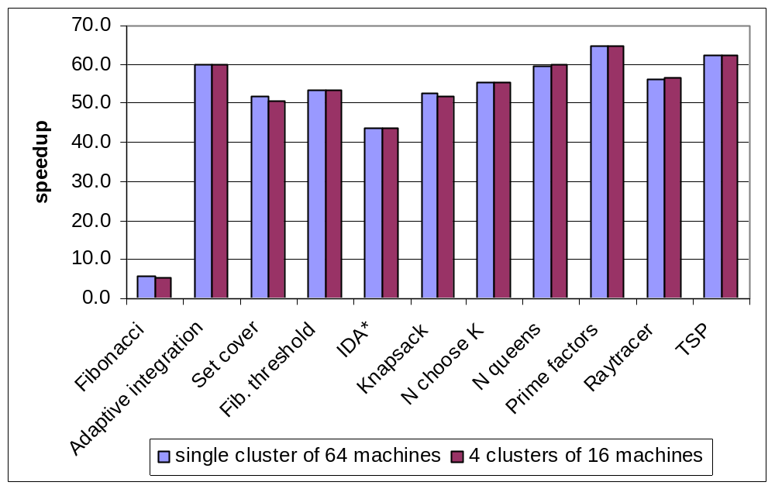
Satin on wide-area DAS-2

Slide 35
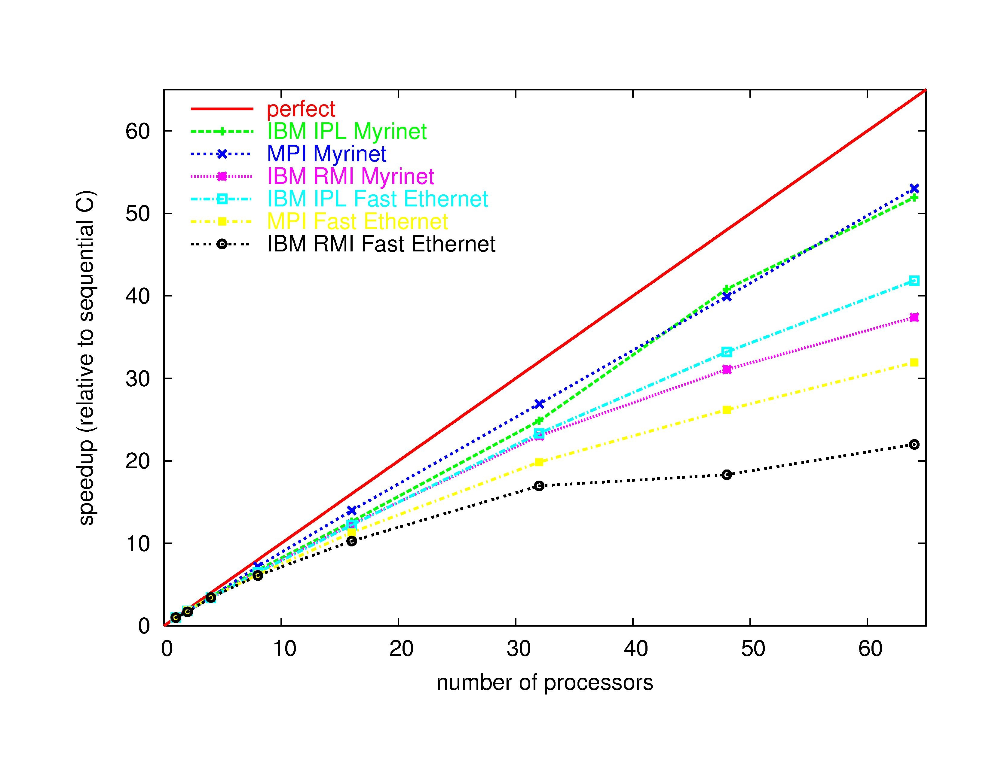
Java/Ibis vs. C/MPI on Pentium-3 cluster (using SOR)

