Slide 1
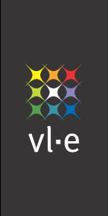

The Distributed ASCI Supercomputer (DAS) project
Henri Bal
Vrije Universiteit Amsterdam
Faculty of Sciences

Slide 2
Why is DAS interesting?
Long history and continuity
  DAS-1 (1997), DAS-2 (2002), DAS-3 (2006)
Simple Computer Science grid that works
  Over 200 users, 25 Ph.D. theses
  Stimulated new lines of CS research
  Used in international experiments
Colorful future: DAS-3 is going optical

Slide 3
Outline
History
  Organization (ASCI), funding
  Design & implementation of DAS-1 and DAS-2
Impact of DAS on computer science research in The Netherlands
  Trend: cluster computing ➔ distributed computing
  ➔ Grids ➔ Virtual laboratories
Future: DAS-3

Slide 4
Step 1: get organized
Research schools (Dutch product from 1990s)
  Stimulate top research & collaboration
  Organize Ph.D. education
ASCI:
  Advanced School for Computing and Imaging (1995-)
  About 100 staff and 100 Ph.D. students from TU Delft, Vrije Universiteit, Amsterdam, Leiden, Utrecht,
  TU Eindhoven, TU Twente, …
DAS proposals written by ASCI committees
  Chaired by Tanenbaum (DAS-1), Bal (DAS-2, DAS-3)

Slide 5


Step 2: get (long-term) funding
Motivation: CS needs its own infrastructure for
  Systems research and experimentation
  Distributed experiments
  Doing many small, interactive experiments
Need distributed experimental system, rather than centralized production supercomputer

Slide 6
DAS funding
Funding
#CPUs
Approval
DAS-1
NWO
200
1996
DAS-2
NWO
400
2000
DAS-3
NWO&NCF
~400
2005
NWO =Dutch national science foundation
NCF=National Computer Facilities (part of NWO)

Slide 7
Step 3: (fight about) design
Goals of DAS systems:
  Ease collaboration within ASCI
  Ease software exchange
  Ease systems management
  Ease experimentation
➔ Want a clean, laboratory-like system
Keep DAS simple and homogeneous
  Same OS, local network, CPU type everywhere
  Single (replicated) user account file

Slide 8
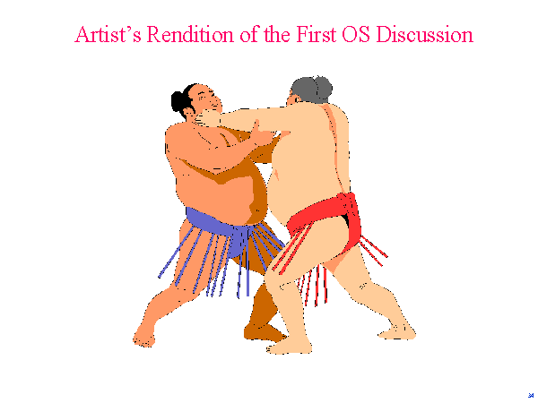
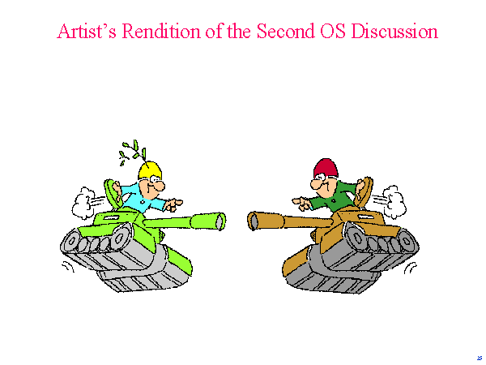
Behind the screens ….
Source: Tanenbaum (ASCI’97 conference)

Slide 9
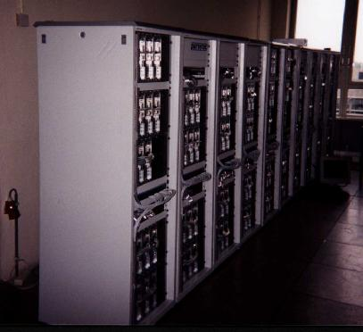
DAS-1 (1997-2002)
Configuration
200 MHz Pentium Pro
Myrinet interconnect
BSDI => Redhat Linux
VU (128)
Amsterdam (24)
6 Mb/s
ATM
Leiden (24)
Delft (24)

Slide 10
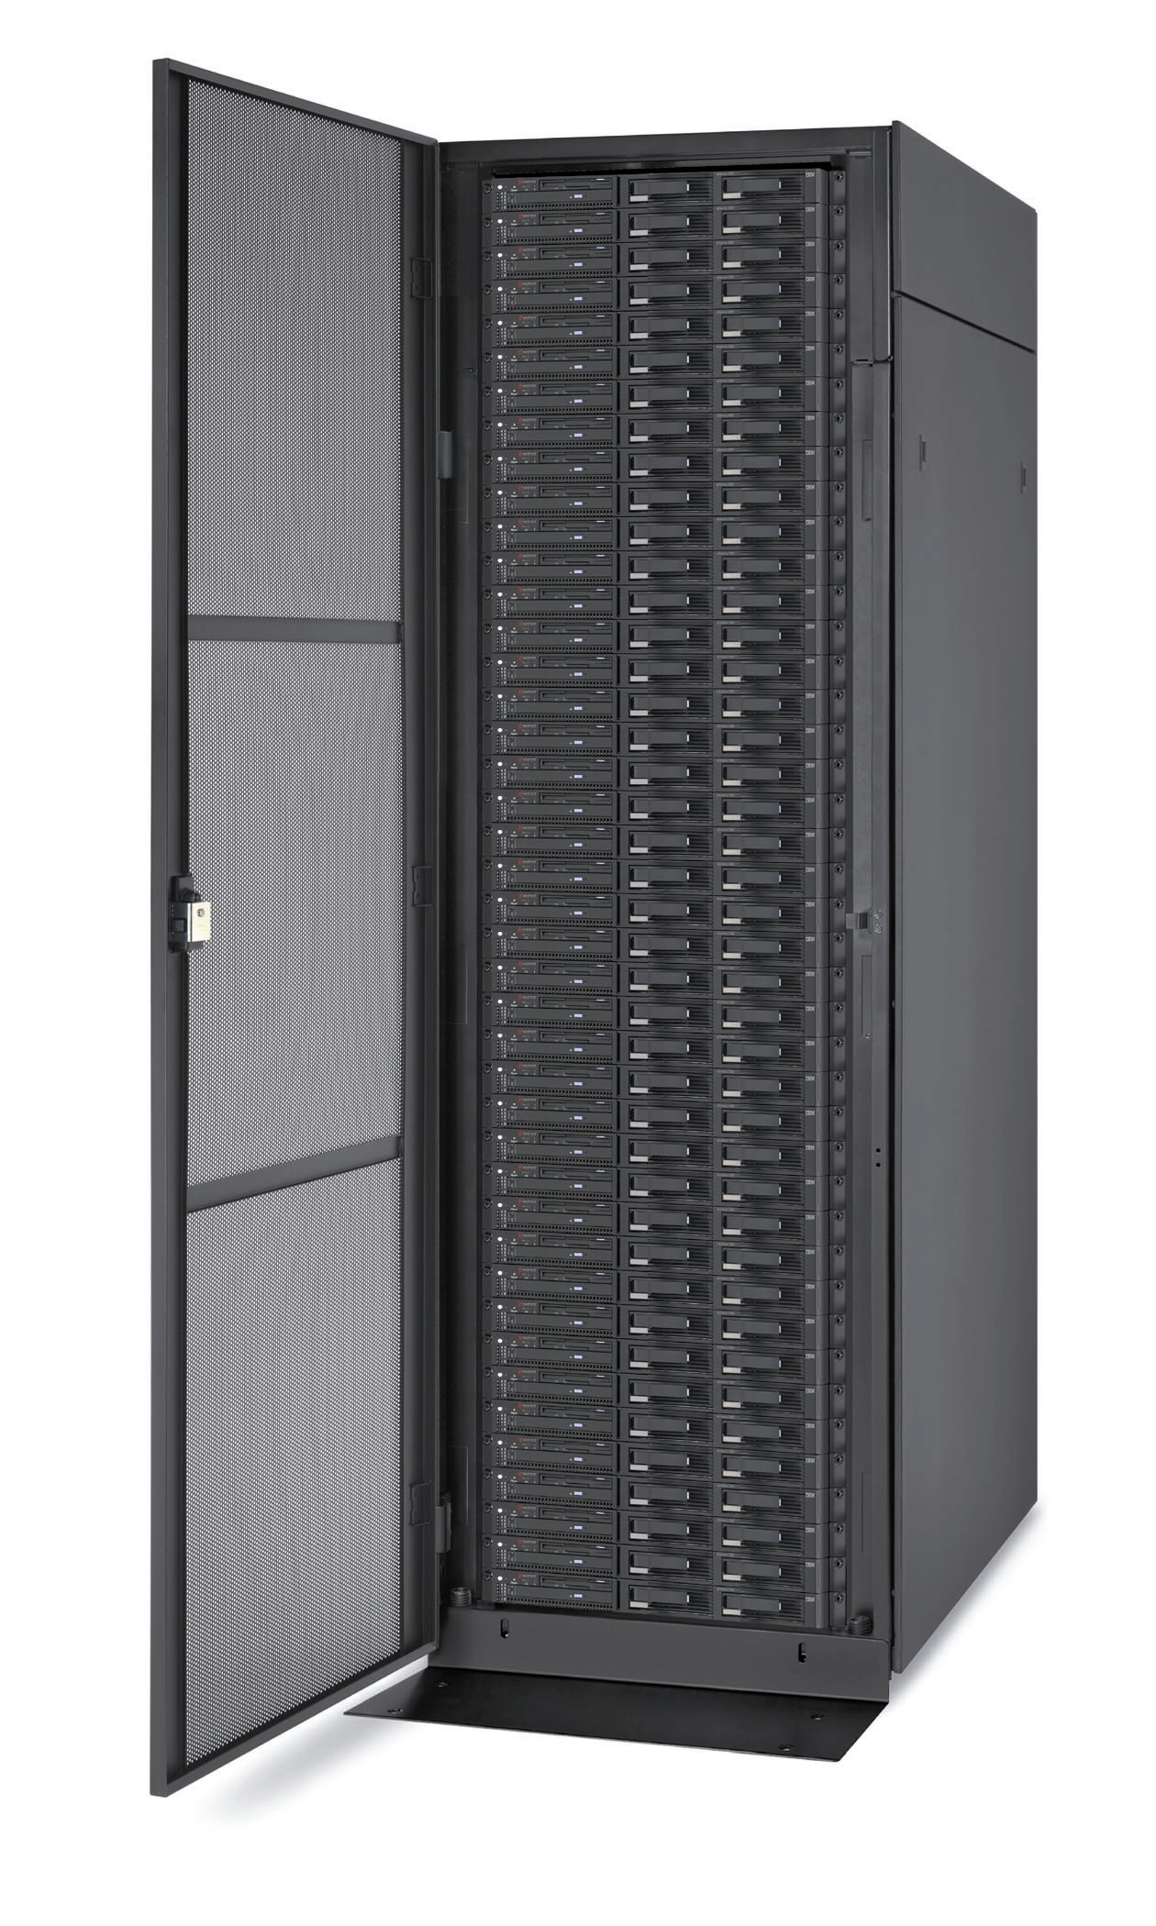
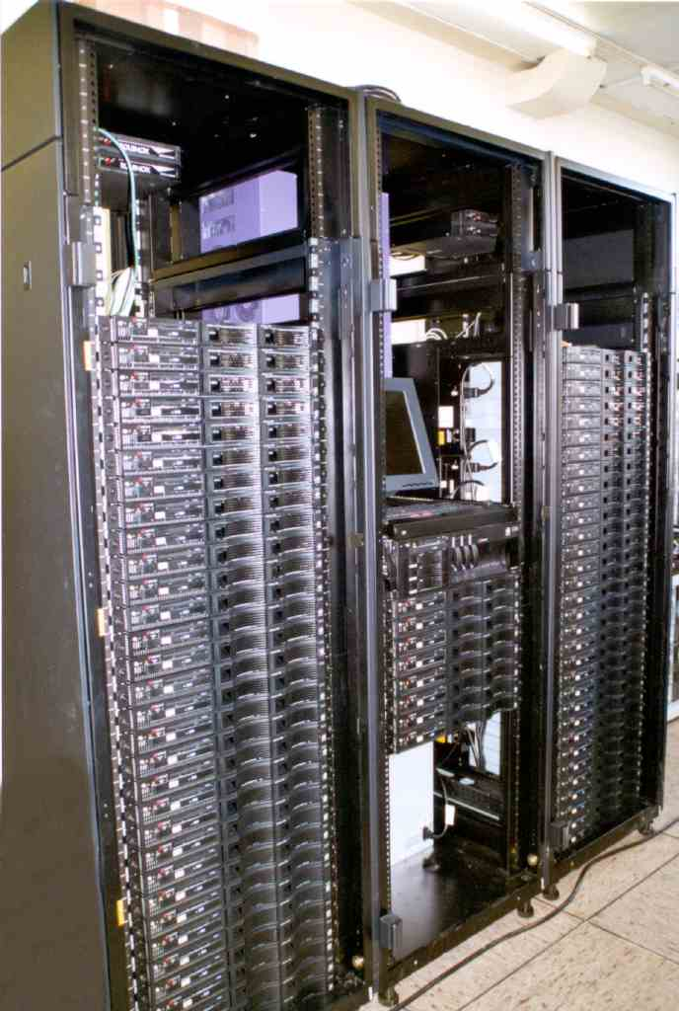
DAS-2 (2002-now)
Configuration
two 1 GHz Pentium-3s
>= 1 GB memory
20-80 GB disk
Myrinet interconnect
Redhat Enterprise Linux
Globus 3.2
PBS => Sun Grid Engine
VU (72)
Amsterdam (32)
SURFnet
1 Gb/s
Leiden (32)
Delft (32)
Utrecht (32)

Slide 11
Discussion
Goal of the workshop:
  Explain “what made possible the miracle that such a complex technical, institutional, human and financial organization works in the long-term”
DAS approach
  Avoid the complexity (don’t count on miracles)
  Have something simple and useful
  Designed for experimental computer science, not a production system

Slide 12
System management
System administration
  Coordinated from a central site (VU)
  Avoid having remote humans in the loop
Simple security model
  Not an enclosed system
Optimized for fast job-startups, not for maximizing utilization

Slide 13
Outline
History
  Organization (ASCI), funding
  Design & implementation of DAS-1 and DAS-2
Impact of DAS on computer science research in The Netherlands
  Trend: cluster computing ➔ distributed computing
  ➔ Grids ➔ Virtual laboratories
Future: DAS-3

Slide 14
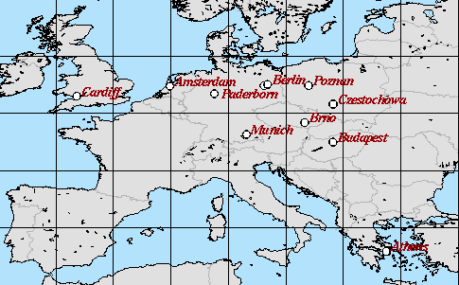
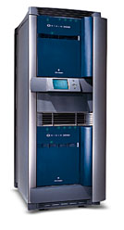
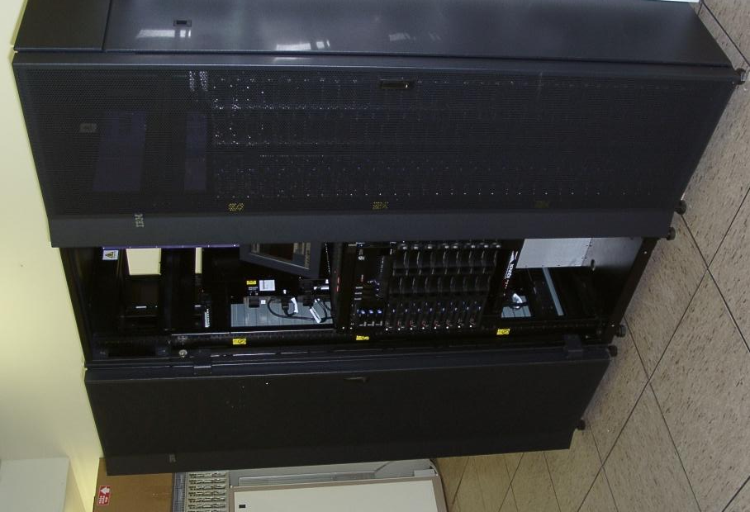
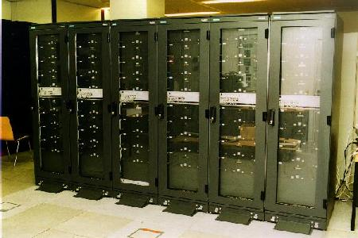
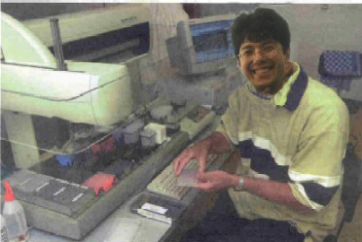

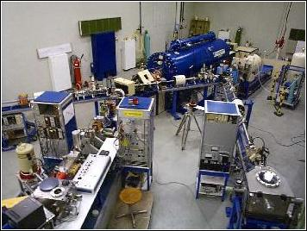




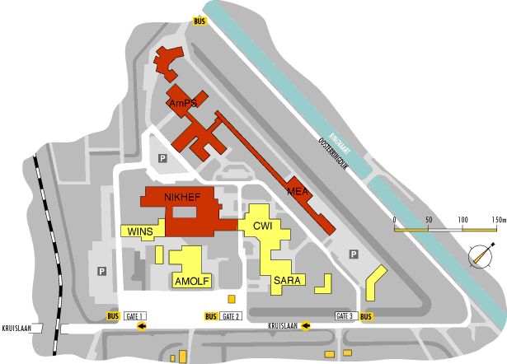

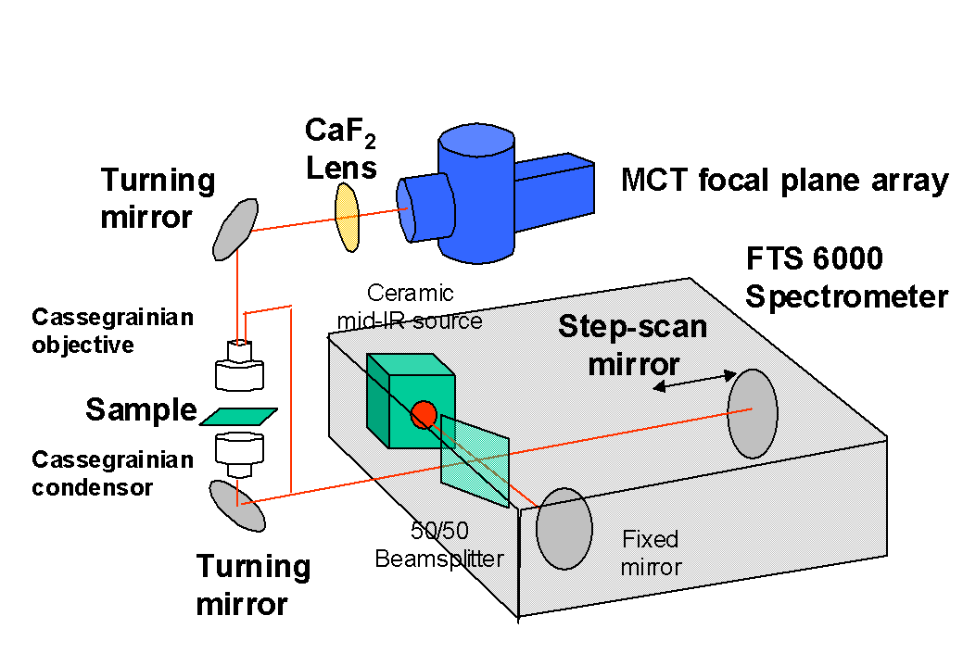

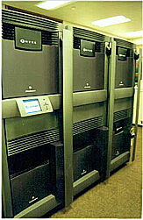
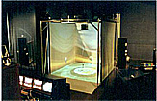
DAS accelerated research trend
Cluster computing
Distributed computing
Grids and P2P
Virtual laboratories

Slide 15
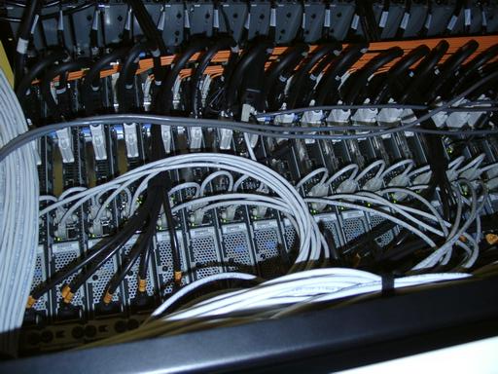
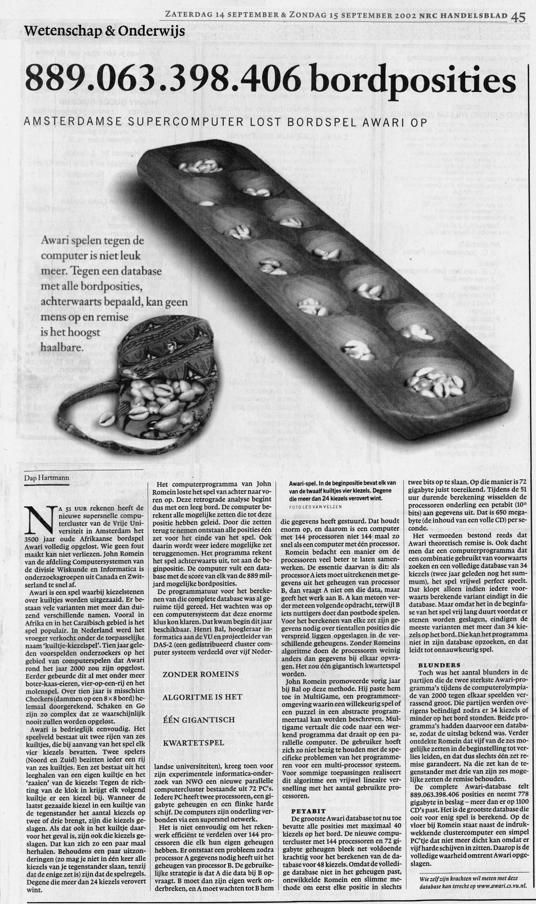
Examples cluster computing
Communication protocols for Myrinet
Parallel languages (Orca, Spar)
Parallel applications
  PILE: Parallel image processing
  HIRLAM: Weather forecasting
  Solving Awari (3500-year old game)
GRAPE: N-body simulation hardware

Slide 16
Distributed supercomputing on DAS
Parallel processing on multiple clusters
Study non-trivially parallel applications
Exploit hierarchical structure for
locality optimizations
  latency hiding, message combining, etc.
Successful for many applications

Slide 17
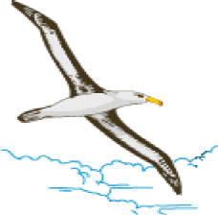
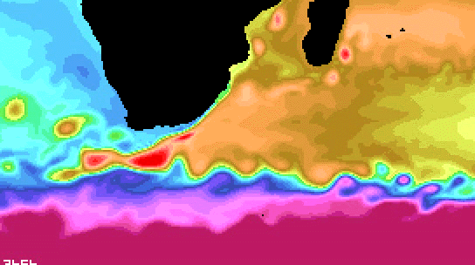
Example projects
Albatross
  Optimize algorithms for wide area execution
MagPIe:
  MPI collective communication for WANs
Manta: distributed supercomputing in Java
Dynamite: MPI checkpointing & migration
ProActive (INRIA)
Co-allocation/scheduling in multi-clusters
Ensflow
  Stochastic ocean flow model

Slide 18
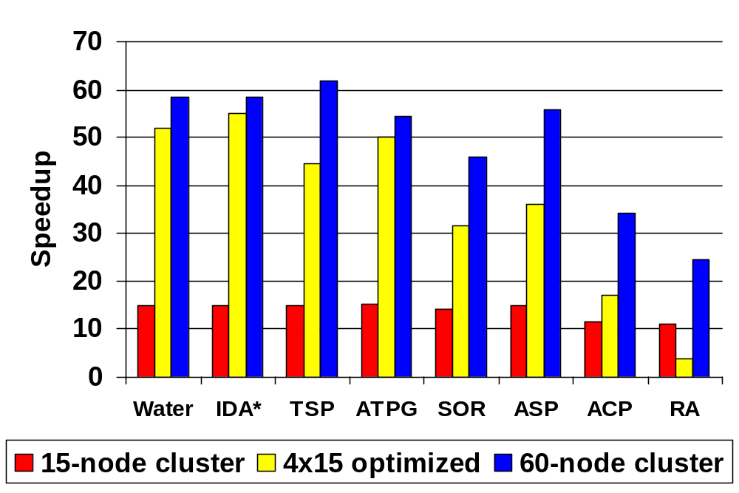
Experiments on wide-area DAS-2

Slide 19
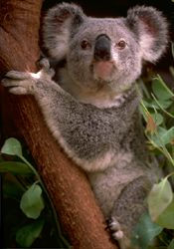
Grid & P2P computing
Use DAS as part of a larger heterogeneous grid
Ibis: Java-centric grid computing
Satin: divide-and-conquer on grids
KOALA: co-allocation of grid resources
Globule: P2P system with adaptive replication
I-SHARE: resource sharing for multimedia data
CrossGrid: interactive simulation and visualization of a biomedical system
Performance study Internet transport protocols

Slide 20
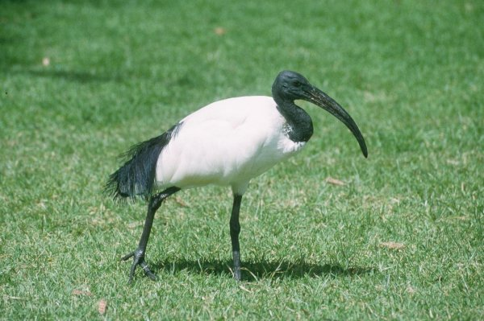
The Ibis system
Programming support for distributed supercomputing on heterogeneous grids
  Fast RMI, group communication, object replication, d&c
Use Java-centric approach + JVM technology
  Inherently more portable than native compilation
  Requires entire system to be written in pure Java
  Use byte code rewriting (e.g. fast serialization)
  Optimized special-case solutions with native code (e.g. native Myrinet library)

Slide 21
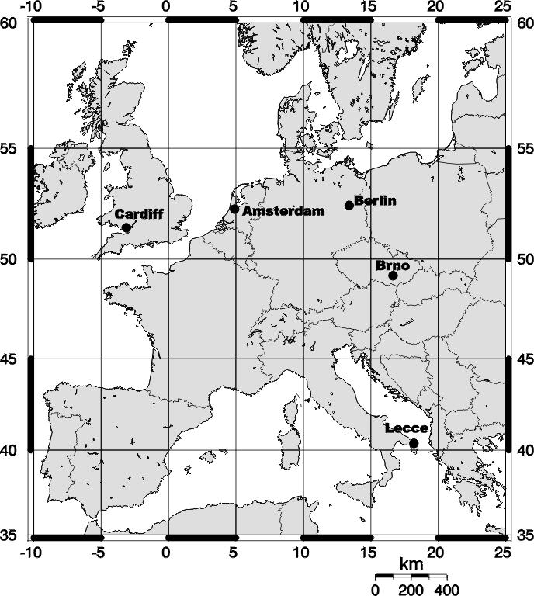

International experiments
Running parallel Java applications with Ibis on very heterogeneous grids
Evaluate portability claims, scalability

Slide 22
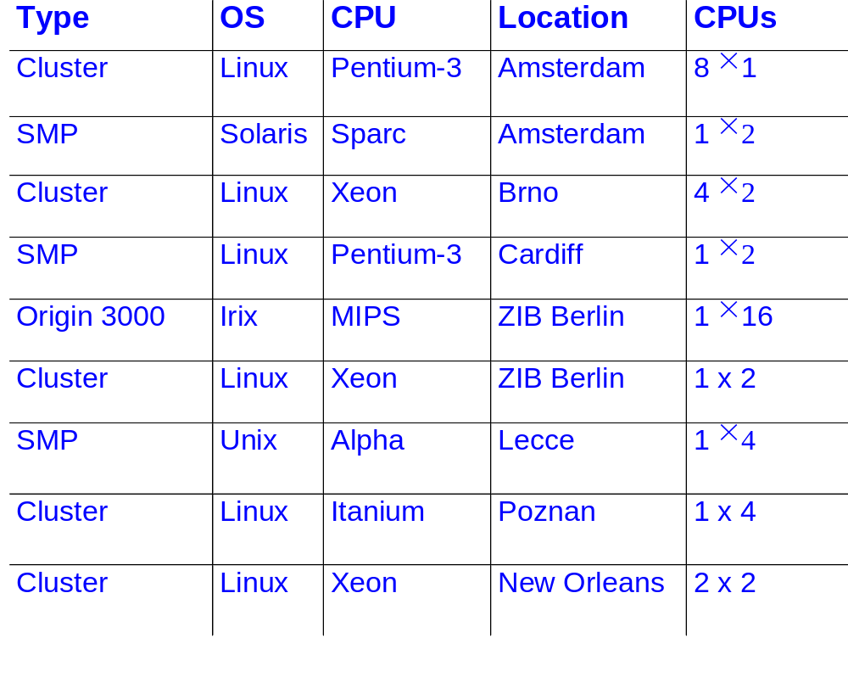
Testbed sites

Slide 23

Experiences
Grid testbeds are difficult to obtain
Poor support for co-allocation
Firewall problems everywhere
Java indeed runs anywhere
Divide-and-conquer parallelism can obtain high efficiencies (66-81%) on a grid
  See Kees van Reeuwijk’s talk - Wednesday (5.45pm)

Slide 24
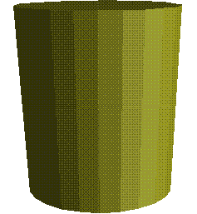
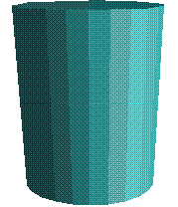
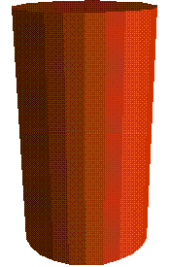
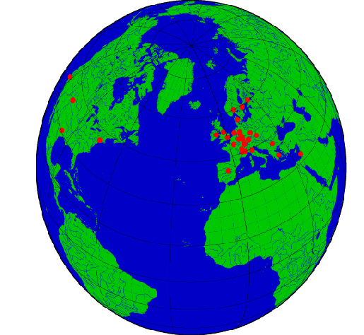


Virtual Laboratories
Application
Specific
Part
Application
Specific
Part
Application
Specific
Part
Potential Generic
part
Potential Generic
part
Potential Generic
part
Management
of comm. &
computing
Virtual Laboratory
Application oriented services
Management
of comm. &
computing
Management
of comm. &
computing
Grid
Harness multi-domain distributed resources

Slide 25

The VL-e project (2004-2008)
VL-e: Virtual Laboratory for e-Science
20 partners
  Academia: Amsterdam, VU, TU Delft, CWI, NIKHEF, ..
  Industry: Philips, IBM, Unilever, CMG, ....
40 M€ (20 M€ from Dutch goverment)
2 experimental environments:
  Proof of Concept: applications research
  Rapid Prototyping (using DAS): computer science

Slide 26
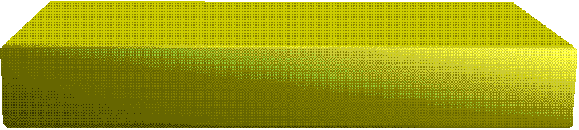

Virtual Laboratory for e-Science
Bio-diversity
Telescience
Data Intensive
Science
Food Informatics
Medical diagnosis &
imaging
Bio-Informatics
Interactive
PSE
Adaptive
information
disclosure
Collaborative
information
Management
Virtual lab. &
System integration
User Interfaces &
Virtual reality
based visualization
High-performance
distributed computing
Security & Generic
AAA
Optical Networking

Slide 27
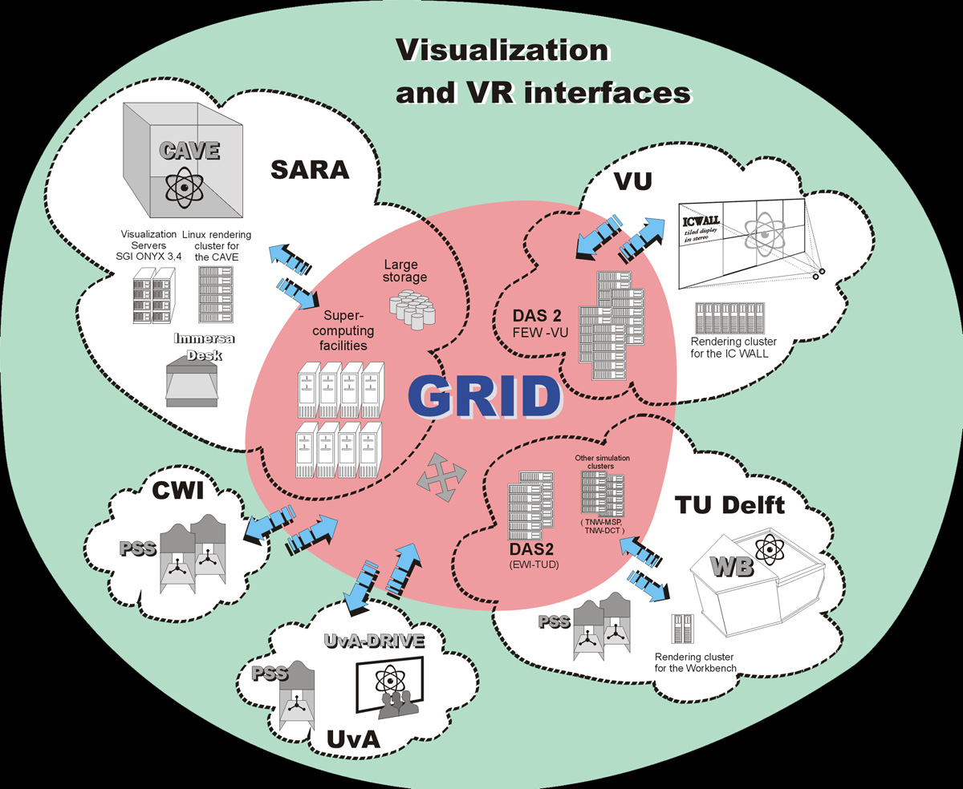
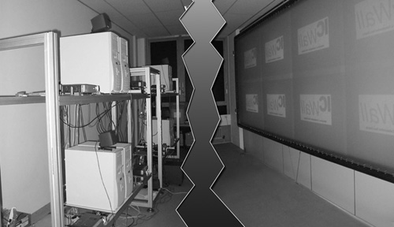
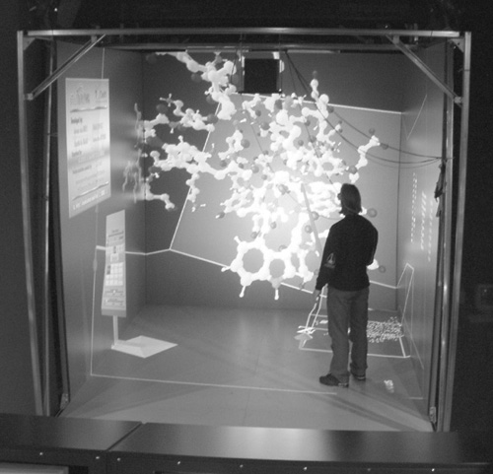
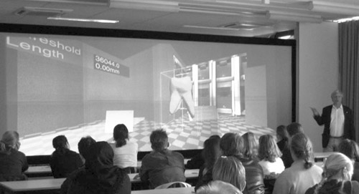
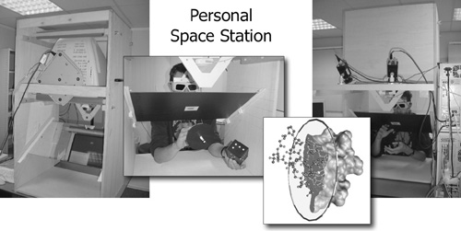
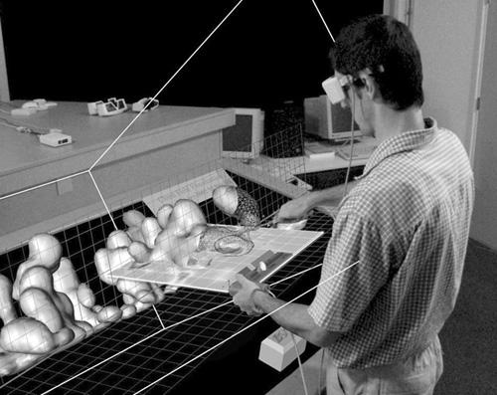
Visualization on the Grid

Slide 28

DAS-3 (2006)
Partners:
  ASCI, Gigaport-NG/SURFnet, VL-e, MultimediaN
More heterogeneity
Experiment with (nightly) production use
DWDM backplane
  Dedicated optical group of lambdas
  Can allocate multiple 10 Gbit/s lambdas between sites

Slide 29
DAS-3
R
CPU’s
CPU’s
R
CPU’s
R
NOC
CPU’s
R
CPU’s
R

Slide 30
StarPlane project
Key idea:
  Applications can dynamically allocate light paths
  Applications can change the topology of the wide-area network, possibly even at sub-second timescale
Challenge: how to integrate such a network infrastructure with (e-Science) applications?
(Collaboration with Cees de Laat, Univ. of Amsterdam)

Slide 31
Conclusions
DAS is a shared infrastructure for experimental computer science research
It allows controlled (laboratory-like) grid experiments
It accelerated the research trend
  cluster computing ➔ distributed computing
  ➔ Grids ➔ Virtual laboratories
We want to use DAS as part of larger international grid experiments (e.g. with Grid5000)

Slide 32
Acknowledgements
Andy Tanenbaum
Bob Hertzberger
Henk Sips
Lex Wolters
Dick Epema
Cees de Laat
Aad van der Steen
Peter Sloot
Kees Verstoep
Many others
More info: http://www.cs.vu.nl/das2/

