Slide 1
The Ibis Project or
Grids As Promised
(an Introduction)
Jason Maassen Rob van Nieuwpoort
Niels Drost Roelof Kemp Frank Seinstra ibis@cs.vu.nl http://www.cs.vu.nl/ibis

Slide 2
Grid Computing
(our definition)
A collection of clusters
Often a 'social collection'
  Access often provided by (former) colleagues, project partners, etc
Several administrative domains
  Difference in configurations, security settings and level of maintenance
May include desktop systems
    Used for visualization, monitoring, steering

Slide 3
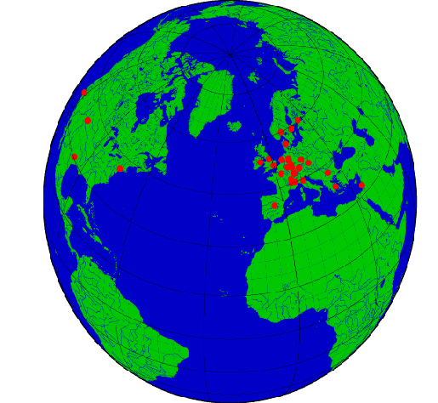




Parallel computing on Grids
Mostly limited to
  trivially parallel applications (parameter sweeps, master/worker)
  applications that run on one cluster at a time
  use grid to schedule application on a suitable cluster
Our goal: run efficient, high-performance parallel applications on a large-scale grid, using co-allocated resources

Slide 4
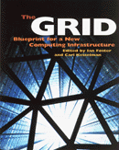
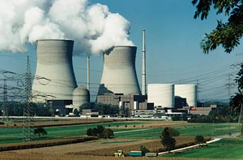
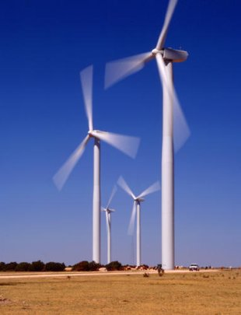
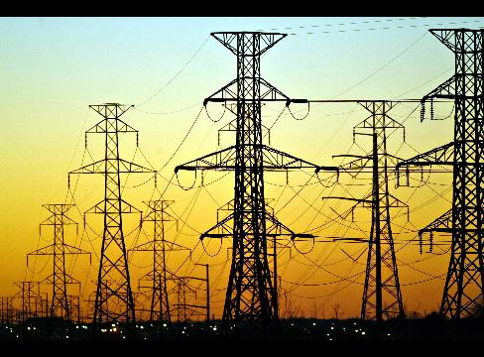
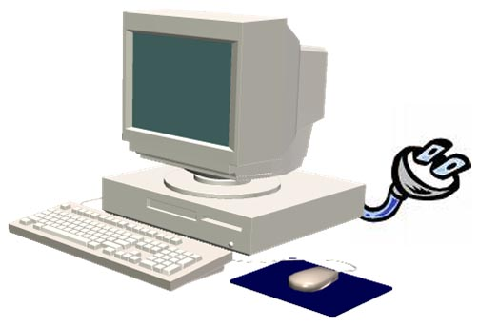
The ‘Promise of the Grid’
Efficient and transparent (i.e. easy-to-use) wall-socket computing over a distributed set of resources [Sunderam ICCS’2004, based on Foster/Kesselman]
Notes:
- Well, the need for such a tool has been acknowledged for some time already…
- … and for the last 10 years – at least - this idea has been the foremost visionary aim, or _promise_, of the field of Grid computing.
- Most commonly this promise of the Grid is presented as follows: the promise of efficient and transparent wall-socket computing over a distributed set of resources
- This promise has clear similarities with the way in which we use the electrical power grid every day:
- we simply plug in whatever type of electrical equipment, and it always works – but we are not at all aware of where the electricity that we use exactly comes from
- The idea of Grid computing is similar:
- we simply plug in our computer, and our programs will always run – but we are not at all aware of where the compute power that we use exactly comes from
- Well, where the electrical power grid already works well for many decades, the computing grid – unfortunately – is still only a promise today.

Slide 5

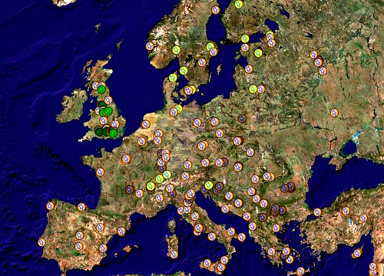
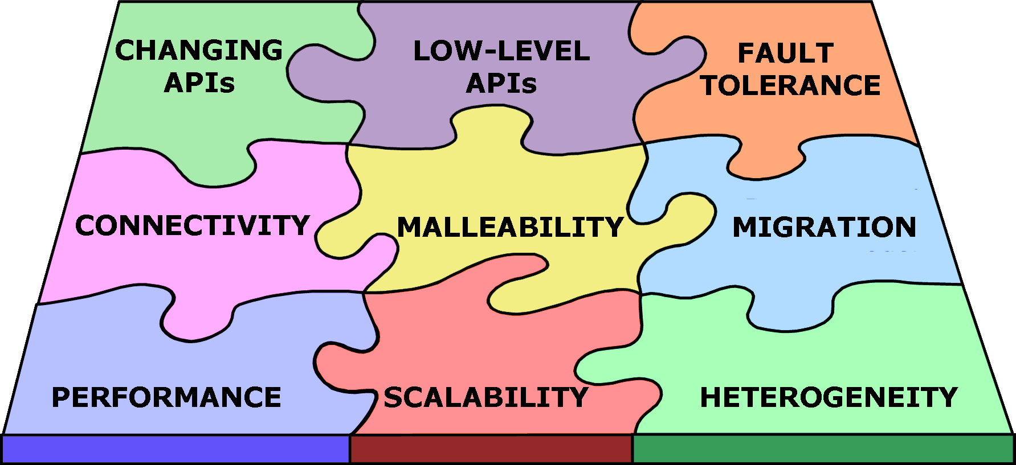
Reality: ‘Problems of the Grid’
Connectivity issues
Fault tolerance
Malleability
Performance &
scalability
Heterogeneous
Low-level & changing
programming interfaces
writing & deploying grid applications is hard
!
User
Wide-Area Grid Systems

Slide 6
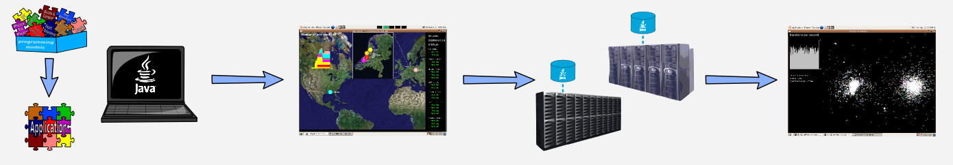
Ibis: Grids As Promised
Goal: offer all the functionality needed to create and run grid applications.
Java based, so highly portable
Designed for dynamic/hostile grid environments
Modular and flexible: can replace Ibis components by external ones

Slide 7
Grid HOWTO
Step 1: Create a user friendly Grid
  Resource discovery
  Access to resources
  Security (passwords, proxies, etc)
  Connectivity (firewalls, NATs, etc)
Step 2: Use the Grid
  Communication Library
  Programming models

Slide 8

Creating A User Friendly Grid:
JavaGAT
Java Grid Application Toolkit
Make applications independent of underlying grid
Used for file copying, resource discovery, job submission & monitoring, user authentication
API is currently standardized (SAGA)

Slide 9

Creating A User Friendly Grid:
Zorilla
Peer-to-Peer Grid middleware
  Supports running jobs on “random” collection of machines
Gossip based overlay network
Flood-scheduling mechanism
Job management

Slide 10
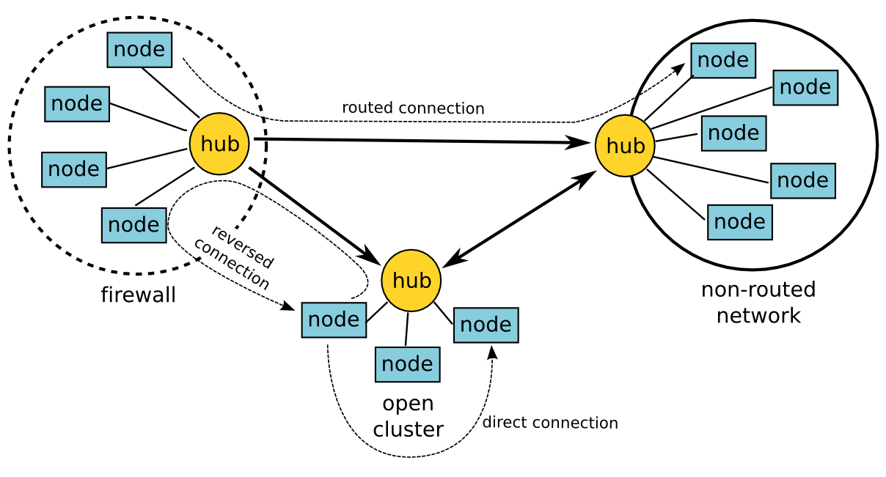
Creating A User Friendly Grid: SmartSockets
Solve connectivity problems automatically (firewalls, NAT, addressing problems)

Slide 11
Using The Grid:
IPL (Ibis Portability Layer)
Java-centric “run-anywhere” communication library
Easy to use
  Simple yet powerful model
  Flexible
Efficient communication
  Highly optimized Object serialization
Resource tracking
  Keep track of resources in “pool”

Slide 12
Using The Grid:
Programming Models
Remote Method Invocation (RMI)
Group Method Invocation (GMI)
MPJ (MPI Java 'standard')
Horus (User Transparent Parallel Multimedia Processing)
Satin (Divide & Conquer)

Slide 13
Satin: Divide-and-Conquer
Divide-and-conquer programing model
More general than master/worker
Cilk-like primitives
(spawn/sync) in Java
Supports malleability
and fault-tolerance
job1
job2
job3
job4
job4
job5
job6
job7

Slide 14
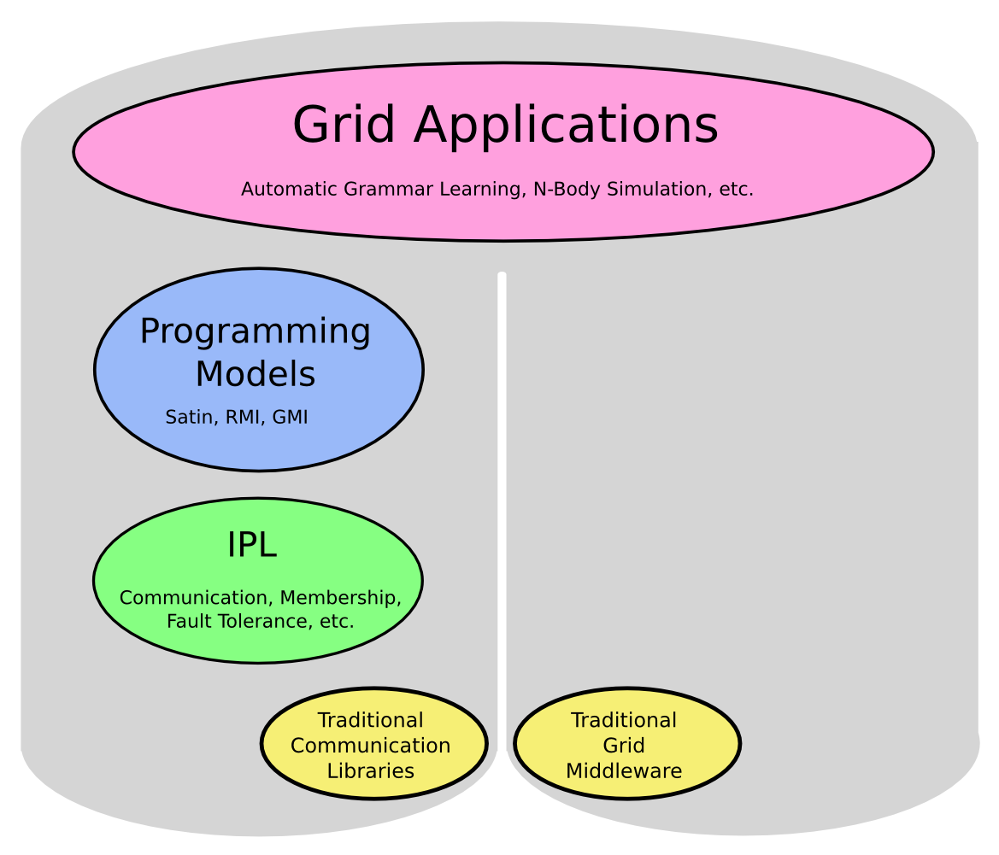
Ibis Overview, C.A. 2004

Slide 15
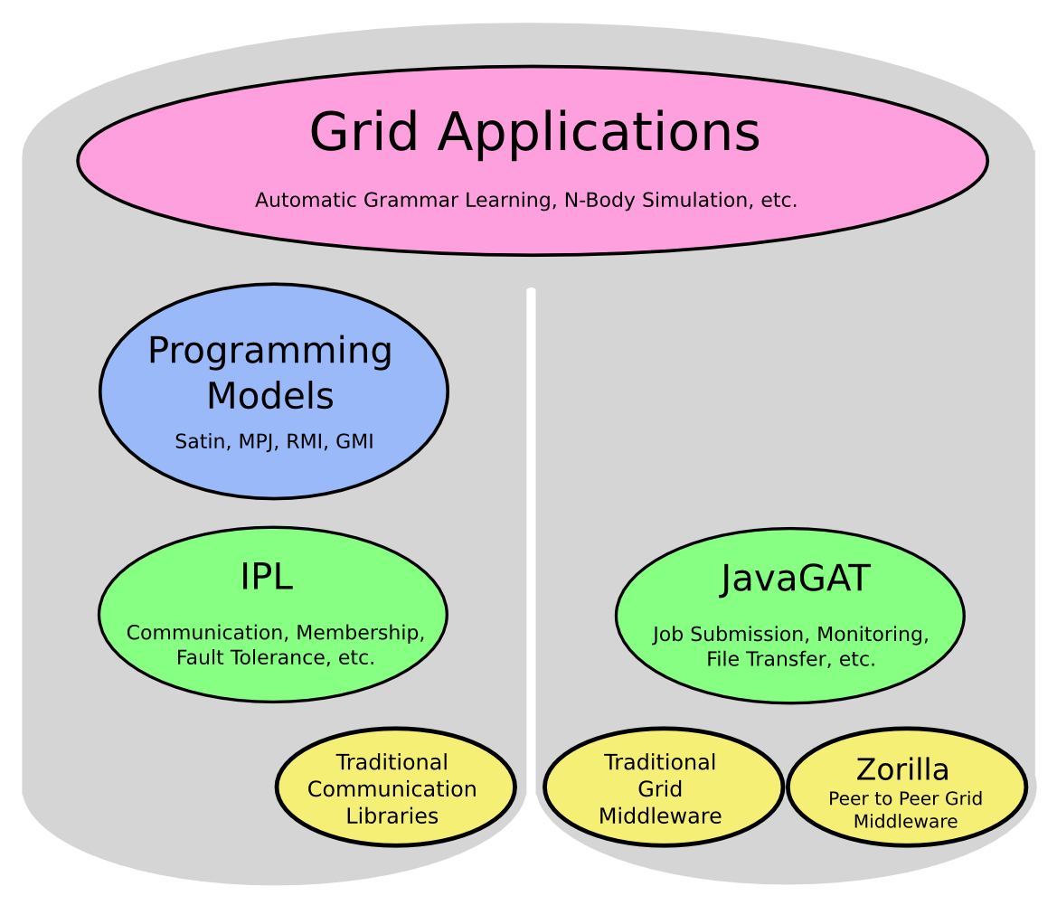
Ibis Overview, C.A. 2006

Slide 16
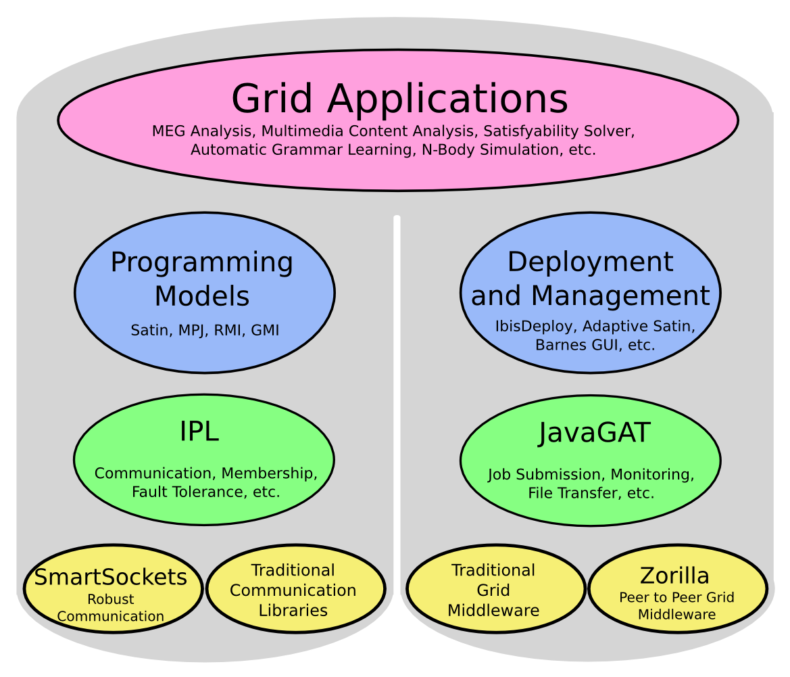
Ibis Overview, Current

Slide 17
Questions ?
ibis@cs.vu.nl
downloads, more info, slides for today:
www.cs.vu.nl/ibis

Slide 18
Program for Today
Introduction
Creating a user friendly grid
  JavaGAT
  Zorilla
  SmartSockets
Lunch break
Using the grid
  IPL
  Satin
  Other Programming Models
Real world examples

