Slide 1
The Zorilla Peer-to-Peer Middleware system
Niels Drost niels@cs.vu.nl

Slide 2
Current Middleware
Hard to install
Hard to maintain
Centralized (not very fault tolerant)
Usually no Co-Allocation

Slide 3
Alternative: Zorilla
Prototype Java Peer-to-Peer middleware
Fully distributed
Easy to setup (just add Java)
Fault tolerant (no single point of failure)
P2P: Limited trust/security
Interface: JavaGAT

Slide 4
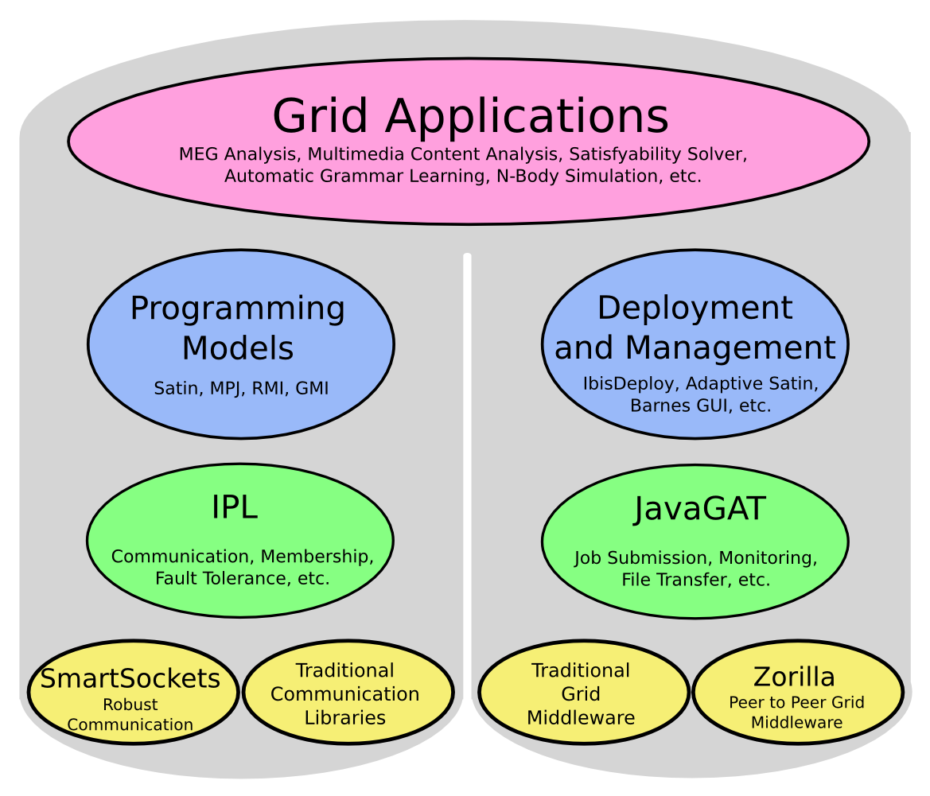
Zorilla in the Ibis project

Slide 5
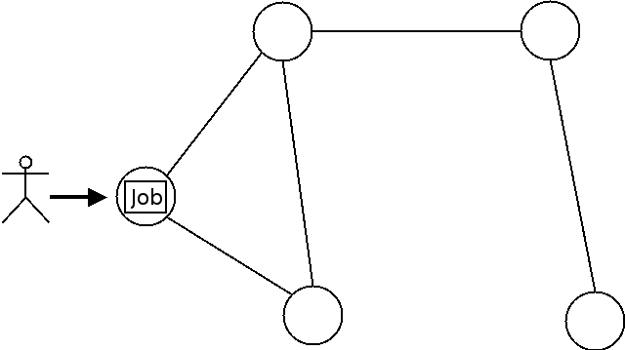
Life of a job (1/4)
Submit

Slide 6
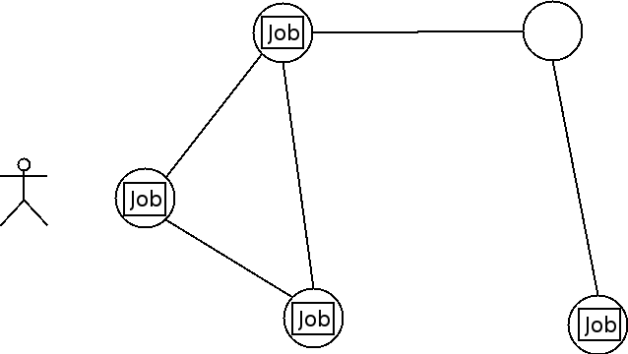
Life of a job (2/4)
Resource Location

Slide 7
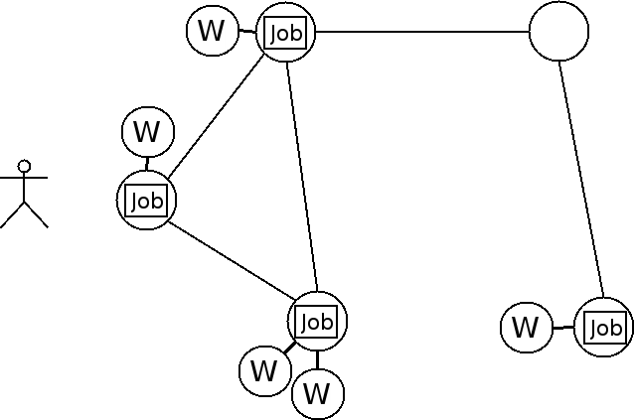
Life of a job (3/4)
Workers Started
W = Worker running Application

Slide 8
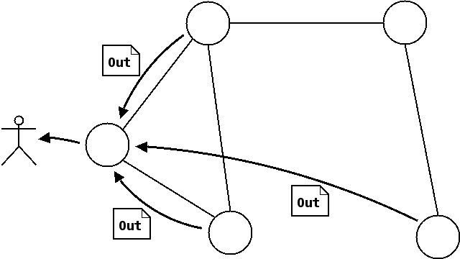
Life of a job (4/4)
Results returned to user

Slide 9
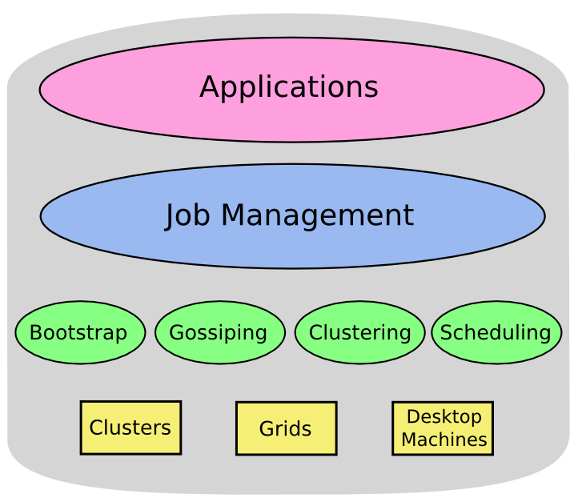
Zorilla Overview

Slide 10
Zorilla Components
Bootstrap
  Initial set of contact points
  UDP broadcast or provided by user
Gossip overlay network
  Actualized Robust Random Gossip (ARRG)
  Withstands Firewalls et al.
Clustering
  Nearest neighbor list
[Drost et al., HPDC’07 ]

Slide 11
Zorilla Components (2)
Flood scheduling
  Incrementally search for resources at more and more distant nodes
Job Management
  Status (scheduling, running, done, etc)
  File transfers
  Malleability / crashes

Slide 12
Zorilla Usage
1) Install recent JVM
2) Download Zorilla at
http://www.cs.vu.nl/ibis
3) Run “zorilla”
(see --help for options)
4) Repeat 1-3 for all machines
5a) Start application using JavaGAT
5b) Start application using “zubmit”

Slide 13
Desktop Grid Experiment
Small experimental desktop grid setup
  Student PCs running Zorilla overnight
  PCs with 1 CPU, 1GB memory, 1Gb/s Ethernet
Experiment: gene sequence application
  16 cores of DAS-3 with Globus
  16 core desktop grid with Zorilla
  Combination, using Ibis-Deploy

Slide 14
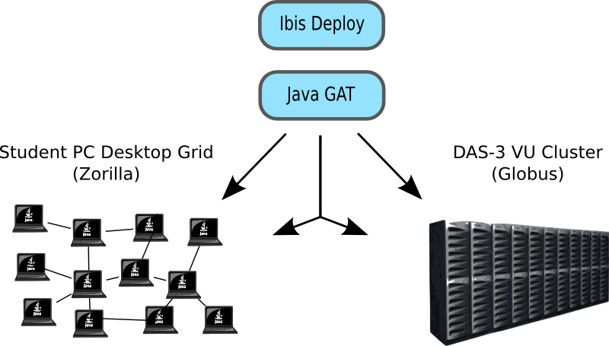
Desktop Grid Experiment
877 sec
3574 sec
1099 sec

Slide 15
Questions ?
ibis@cs.vu.nl
downloads, more info:
www.cs.vu.nl/ibis

