Slide 1
MPJ/Ibis, a Flexible and Efficient Message Passing Platform for Java
Rob van Nieuwpoort rob@cs.vu.nl

Slide 2
MPI
Message Passing Interface
Language independent specification
Language bindings
  C, C++, Fortran, ...
High performance
Available for many platforms
Widely used

Slide 3
MPI operations
MPI_Send(buf, BUFSIZE, MPI_CHAR, dest, TAG, MPI_COMM_WORLD);
MPI_Recv(buf, BUFSIZE, MPI_CHAR, from, TAG,
MPI_COMM_WORLD, &status);
Point-to-point
  Send / receive (only explicit!)
  Synchronous / asynchronous
Collective operations
  broadcast, reduce, scatter, gather, ...
Closed world

Slide 4
MPI bindings for Java
Many Java/MPI bindings:
  JavaMPI, JMPI, MPIJ, CCJ, etc.
MPJ: Proposed by the Java Grande Forum
  A Java language binding for MPI 1.1
  Developed benchmark suite
Implementations:
  MPIJava, built on top of native MPI library
  MPJ/Ibis, built on top of Ibis

Slide 5
MPJ
void Comm.send(Object buf, int offset, int count,
Datatype type, int dest, int tag)
throws MPJException
No status objects, but exceptions
Separate versions for primitive types
Parameter “buf” can be
  Array of a primitive type
  Array of objects
    Multidimensional arrays
    Arbitrarily complex data structure -> object serialization

Slide 6
MPJ/Ibis
First 100% Java MPJ implementation
Uses Ibis IPL for communication
Ibis provides highly efficient object serialization
Special grid connectivity support in Ibis
  Heterogeneous networks
  Communicate through firewalls
Very portable, ideal for grid computing

Slide 7
MPJ/Ibis latency P-III 1 GHz
round-trip
Implementation latency (us)
MYRINET
mpiJava (MPICH 1.2.6/GM) 28
Ibis (GM) 44
MPJ/Ibis (GM) 50
FAST ETHERNET
Ibis (TCP) 113
MPJ/Ibis (TCP) 120

Slide 8
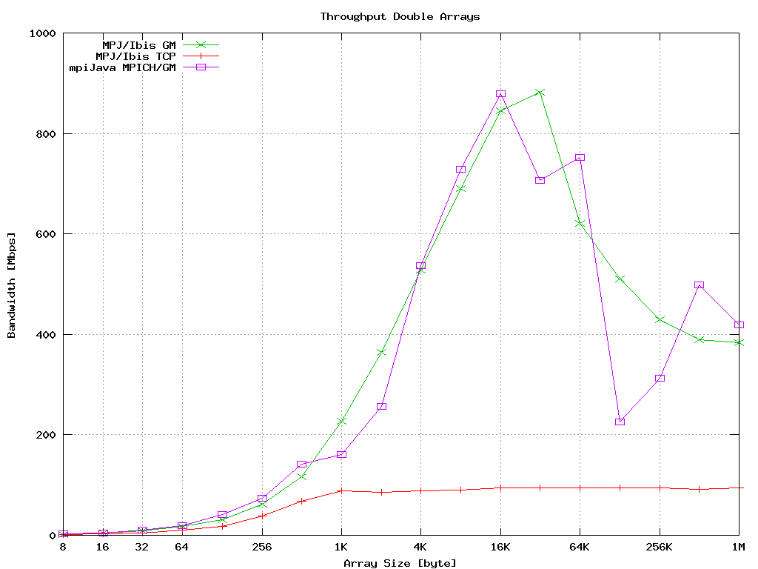

Slide 9
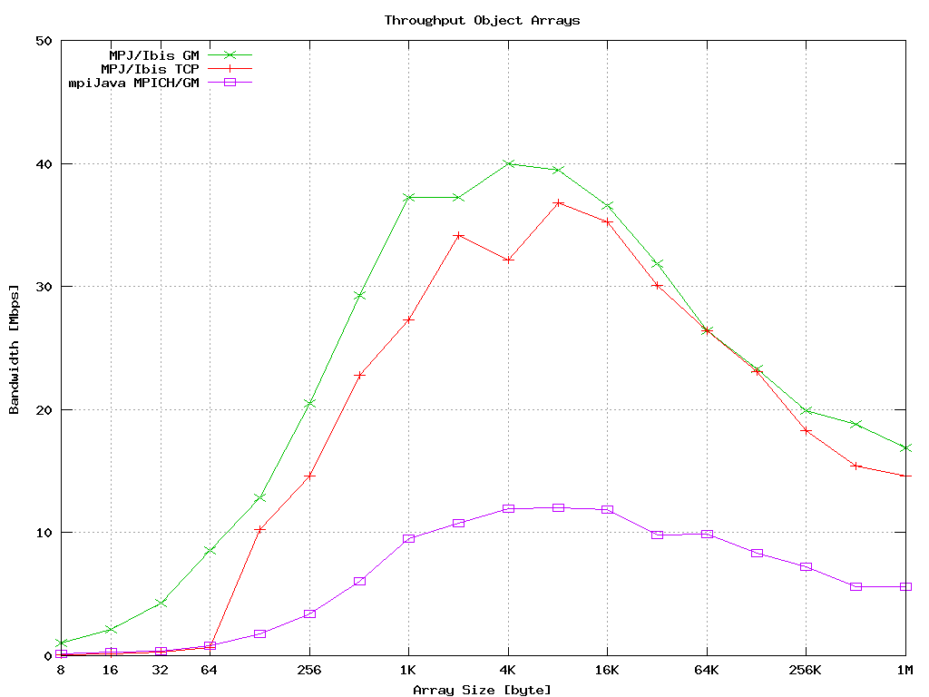

Slide 10
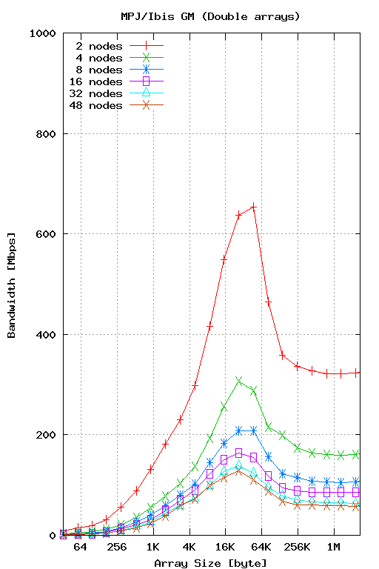
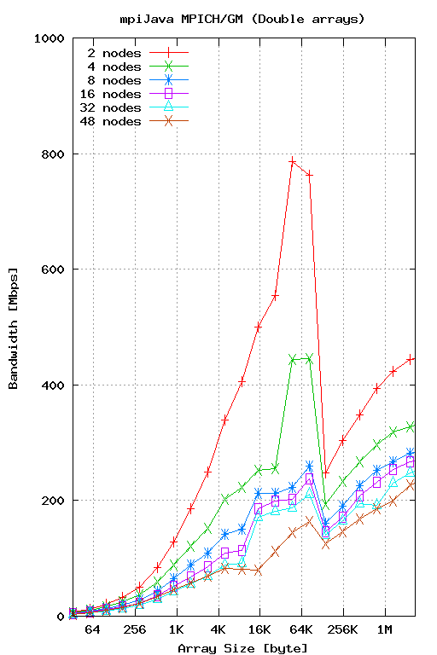

Slide 11
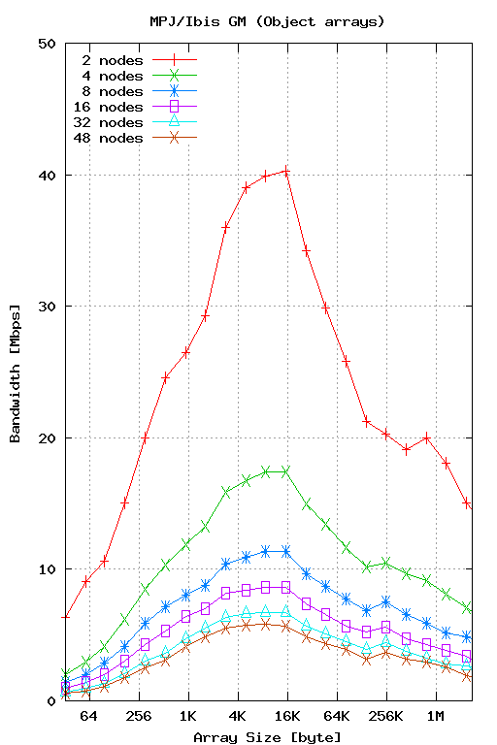
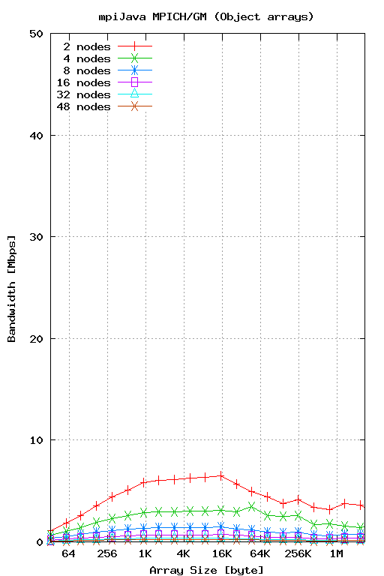

Slide 12
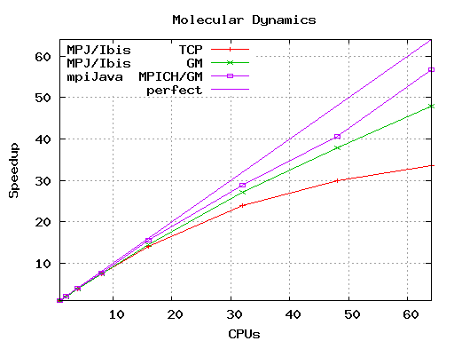
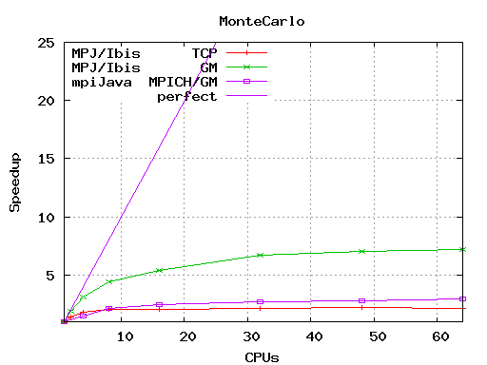
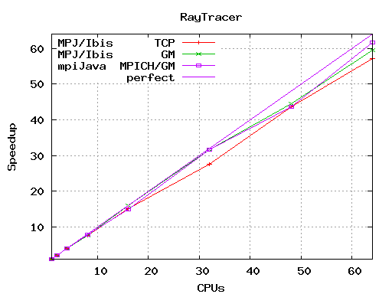
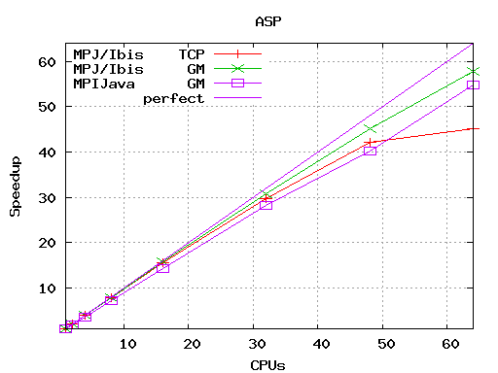

Slide 13
Conclusions
Targeted at grid environments
MPJ/Ibis is extremely flexible
  “run everywhere”
  Heterogeneous networks
  Communicate through Firewalls
Competitive performance
  Latency and Collectives are a bit slower than native implementation
  Object serialization is much faster
  Application-level performance is similar

Slide 14
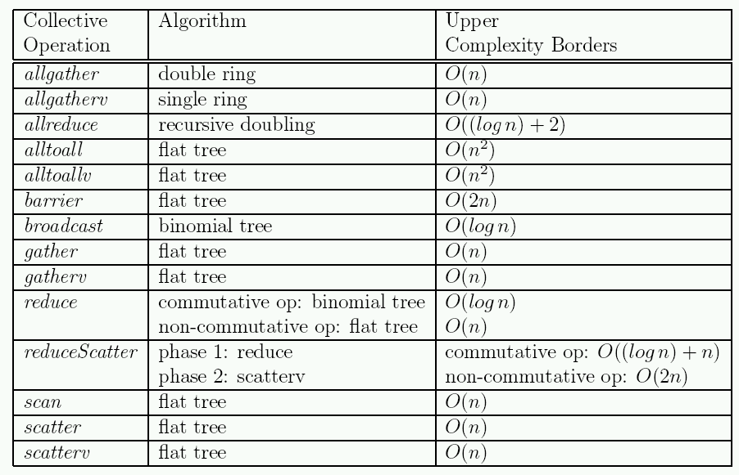
MPJ/Ibis collectives

Slide 15
Ibis RMI
Rob van Nieuwpoort rob@cs.vu.nl

Slide 16
Ibis RMI
Drop-in replacement for Sun RMI
  Has the same interface
  Used different stub compiler (rmic)
    Generates Ibis specific stubs/skeletons
object
interface
reference
thread

Slide 17
Ibis RMI
Drop-in replacement for Sun RMI
  Has the same interface
  Used different stub compiler (rmic)
    Generates Ibis specific stubs/skeletons
object
stub
skel
interface
reference
thread
network

Slide 18
Ibis RMI Limitations
Not interoperable with Sun RMI
  uses a different protocol
No socket factories
  Ibis doesn't have to use sockets!
No activatable objects

Slide 19
Ibis RMI Advantages
Uses Ibis / SmartSockets
  Can communicate through firewalls
  Does not suffer from NAT / multihoming problems
  Can use fast networks transparently (Myrinet, etc)
  Uses Ibis serialization
Much faster!

Slide 20
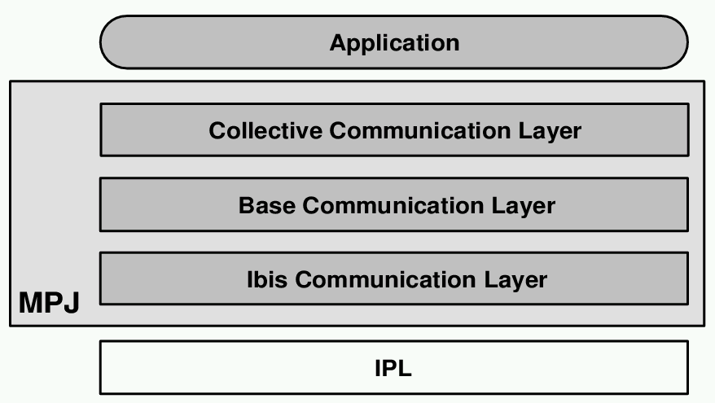
MPJ/Ibis structure

