Slide 1
Satin
Rob van Nieuwpoort,
Gosia Wrzesinska,
Ceriel Jacobs rob@cs.vu.nl

Slide 2
Until now...
We looked at how Ibis makes deployment user friendly:
  JavaGAT provides an easy-to-use API for the various flavours of Grid middleware
  Zorilla provides a configuration free alternative to existing Grid middleware
We discussed:
  Communication
  IPL model
Next Step:
  High-level grid programming models

Slide 3
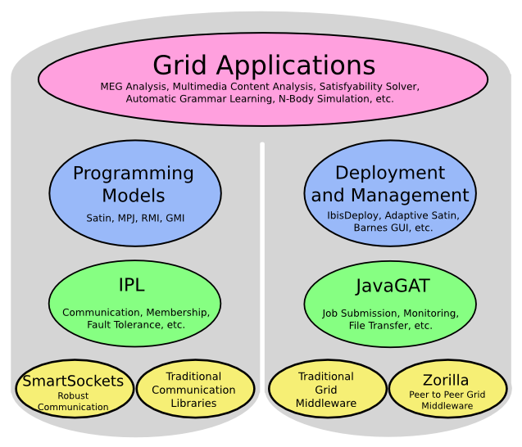
Overview

Slide 4
Distributed supercomputing
Parallel processing on geographically distributed computing systems (grids)
Our goals:
  Don’t use individual supercomputers / clusters, but combine multiple systems
  Provide high-level programming support

Slide 5
Optimizing for the grid
Grids usually are hierarchical
  Collections of clusters, supercomputers
  Fast local links, slow wide-area links
Optimize algorithms to exploit hierarchy
  Message combining + latency hiding on wide-area links
  Collective operations for wide-area systems
  Successful for many applications

Slide 6
Satin master-worker
Master-worker parallelism
  Divide work into parts
  Spawn job for each part
  Solve parts in parallel
  Combine results

Slide 7
Satin divide-and-conquer
Parallel Divide-and-conquer
  Divide work into parts
  Spawn job for each part
  Solve parts in parallel
  Combine results
  But now recursively!
  sub-problems split the work up further and spawn their own sub-jobs

Slide 8
Satin
Divide-and-conquer
job1

Slide 9
Satin
Divide-and-conquer
job1
job2
job3

Slide 10
Satin
Divide-and-conquer
job1
job2
job3
job4
job4
job5
job6
job7

Slide 11
Satin
Divide-and-conquer
job1
job2
job3
job4
job4
job5
job6
job7
... millions of jobs ...

Slide 12
Satin - Hierarchical
Fits hierarchical structure of Grids
job1
job1
cluster1
cluster3
job2
job2
job3
job3
cluster2
job4
job4
job4
job4
job5
job5
job6
job7
job6
job7
cluster4

Slide 13
Sequential Fibonacci
public long fib(int n) {
if (n < 2) return n;
long x = fib(n - 1);
long y = fib(n – 2);
return x + y;
}

Slide 14
Parallel Fibonacci
interface FibInterface extends ibis.satin.Spawnable {
public long fib(int n);
}
public long fib(int n) {
if (n < 2) return n;
long x = fib(n - 1);
long y = fib(n – 2);
sync();
return x + y;
}

Slide 15
Parallel Fibonacci
interface FibInterface extends ibis.satin.Spawnable {
public long fib(int n);
}
public long fib(int n) {
if (n < 2) return n;
long x = fib(n - 1);
long y = fib(n – 2);
sync();
return x + y;
}
Mark methods as
Spawnable.
They can run in parallel.

Slide 16
Parallel Fibonacci
interface FibInterface extends ibis.satin.Spawnable {
public long fib(int n);
}
public long fib(int n) {
if (n < 2) return n;
long x = fib(n - 1);
long y = fib(n – 2);
sync();
return x + y;
}
Mark methods as
Spawnable.
They can run in parallel.
Wait until spawned methods are done.

Slide 17
The Grid
Satin explicitly targets the grid
Different architectures --> Java
Firewalls --> Ibis
Slow networks (latency)
Distributed memory
Machines come and go
Machines have different speeds
Machines crash

Slide 18
Satin – Shared Objects
Allow machines to share 'global data'
Application controlled consistency (guard consistency)
Allow different implementations
  Special grid-aware multicast
  Gossiping techniques
  Point to point communication only

Slide 19
Satin – Load Balancing
Satin distributes jobs across machines
Need load-balancing
  Jobs can have different sizes
  Machines have different speeds
Load-balancing is done automatically

Slide 20
Satin – Load Balancing
Special load-balancing algorithms
  Master-Worker (MW)
  Multicore / singe cluster (RS)
  Multi-cluster / grid (CRS)
See publications on the Ibis web site for more information

Slide 21
Satin – Malleability
Add machines on the fly
  User can add machines if computation is slow or if more resource become available
Remove machines on the fly
  Machines can leave gracefully
  Reservations can end
Transparent for application

Slide 22
Satin – Malleability
Transparently add machines
job1
job1
cluster1
job2
job2
job3
job3
cluster2
job4
job4
job4
job4
job5
job5
job6
job7
job6
job7
cluster3

Slide 23
Satin – Malleability
Transparently add machines
job1
job1
cluster1
job2
job2
job3
job3
cluster2
job4
job4
job4
job4
job5
job5
job6
job7
job6
job7
Cluster3
cluster4

Slide 24
Satin – Malleability
Transparently add machines
job1
job1
cluster1
job2
job2
job3
job3
cluster2
job4
job4
job4
job4
job5
job5
job6
job7
job6
job7
cluster3
Cluster4

Slide 25
Satin – Fault Tolerance
Machines can leave suddenly
  Reservation can end without notification
  Crashes
    machines
    network
    software bugs
Whole clusters can leave or crash
The others continue the computation and automatically recompute lost work

Slide 26
Satin – Fault Tolerance
Transparent fault-tolerance
job1
job1
cluster1
cluster3
job2
job2
job3
job3
cluster2
job4
job4
job4
job4
job5
job5
job6
job7
job6
job7
cluster4

Slide 27
Satin – Fault Tolerance
Transparent fault-tolerance
job1
job1
cluster1
cluster3
job2
job2
job3
job3
cluster2
job4
job4
job4
job4
job5
job5
job6
job7
job6
job7
cluster4

Slide 28
Satin – Fault Tolerance
Transparent fault-tolerance
job1
job1
cluster1
?
job2
job2
?
cluster2
job4
job4
job4
job4
job5
job5
job7
job7
cluster4

Slide 29
Satin – Fault Tolerance
Transparent fault-tolerance
job1
job1
cluster1
job2
job2
job3
job3
cluster2
job4
job4
job4
job4
job5
job5
job6
job7
job6
job7
cluster4

Slide 30
Satin – Migration
Use malleability and fault tolerance
Add new machines
Remove old machines

Slide 31
Satin – Adaptivity
Automatically adapt number of machines
Depending on amount of parallelism in the application
  Remove machines if application spawns few jobs
  Add machines if application spawns many jobs, and machines are available
If machines or networks become highly overloaded

Slide 32
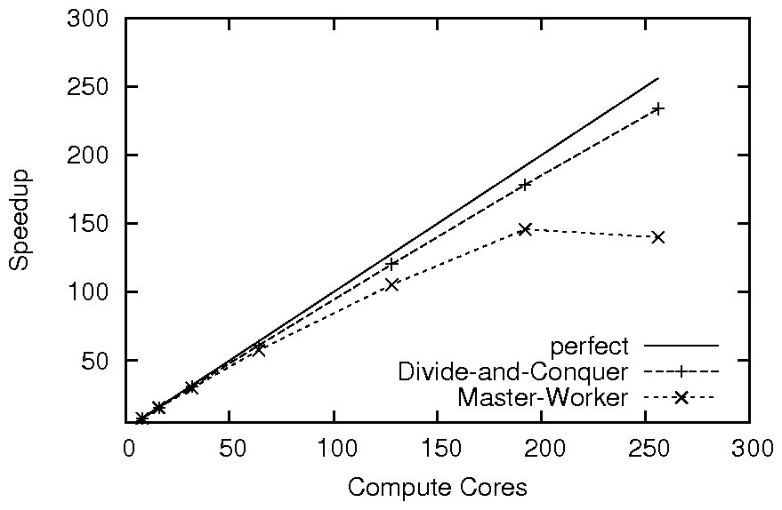
Gene Sequencing

Slide 33
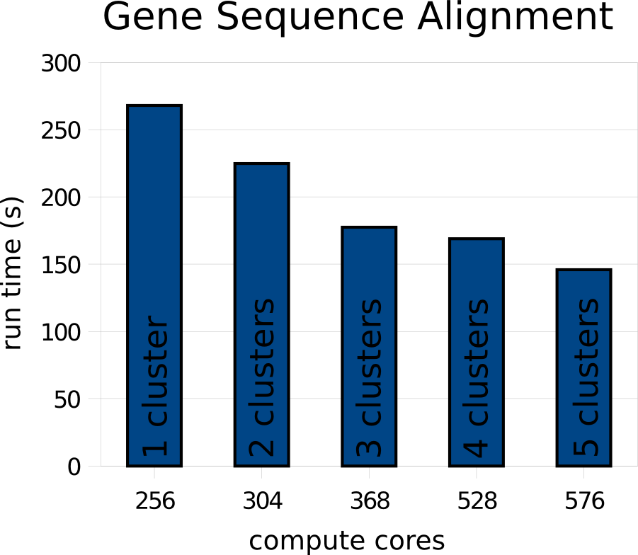

Slide 34
Satin Applications
VLSI routing
Satisfiability solver
Gene sequencing
N-body simulations
Natural language learning
Game-tree search
Raytracing
Numerical functions
...

Slide 35
Conclusion
Satin provides a powerful programming model
Extremely easy to use
Satin is optimized for grid applications
Satin allows applications to transparently deal with grid issues
  load balancing, malleability, migration, fault-tolerance, adaptivity, firewalls, heterogeneity
Satin 2.1
release available

Slide 36

Barnes-Hut N-body simulation
Bodies (stars) are organized in a tree

Slide 37
Barnes-Hut N-body simulation

Slide 38
Barnes-Hut N-body simulation

Slide 39
Barnes-Hut N-body simulation

Slide 40
Barnes-Hut N-body simulation

Slide 41
Barnes-Hut
Nbody code
// Marker interface that defines updateBodies as a global method.
interface BodiesInterface extends satin.GlobalMethods {
void updateBodies(BodyUpdates b, int iter);
}
// A shared object containing the tree of bodies.
class Bodies extends satin.SharedObject implements BodiesInterface {
BodyTreeNode root;
void updateBodies(BodyUpdates b, int iter) { // Global method.
root.applyUpdates(b, iter); // Update bodies in our tree.
}
BodyTreeNode getRoot() { // Local method.
return root;
}
}
// Mark the computeForces method as a spawn operation.
interface BHSpawns extends satin.Spawnable {
BodyUpdates computeForces(Subtree s, int iter, Bodies bodies);
}
class BarnesHut extends satin.SatinObject implements BHSpawns {
boolean guard_computeForces(Subtree s, int iter, Bodies bodies) {
return bodies.iter + 1 == iter;
}
// Spawnable method. The "bodies" parameter is a shared object.
BodyUpdates computeForces(Subtree s, int iter, Bodies bodies) {
if(s.hasNoChildren) {
computeSequentially(s, iter, bodies.getRoot());
} else { // Divide the work and spawn tasks (recursion step).
for(int i=0; i<s.nrChildren; i++) {
res[i] = computeForces(s.child[i], iter, bodies); // Spawn.
}
sync(); // Wait for the spawn operation to finish.
return mergeSubresults(res); // Merge results and return.
}
}
public static void main(String[] args) {
BarnesHut bh = new BarnesHut();
Bodies bodies = new Bodies(); // Create shared object.
for (int iter = 0; iter < N; iter++) {
results = bh.computeForces(root, iter, bodies); // Spawn.
sync(); // Wait for the spawn operation to finish.
bodies.update(results, iter); // Shared method invocation.
}
}
}

Slide 42
Barnes-Hut
Nbody code
// Marker interface that defines updateBodies as a global method.
interface BodiesInterface extends satin.GlobalMethods {
void updateBodies(BodyUpdates b, int iter);
}
// A shared object containing the tree of bodies.
class Bodies extends satin.SharedObject implements BodiesInterface {
BodyTreeNode root;
void updateBodies(BodyUpdates b, int iter) { // Global method.
root.applyUpdates(b, iter); // Update bodies in our tree.
}
BodyTreeNode getRoot() { // Local method.
return root;
}
}
// Mark the computeForces method as a spawn operation.
interface BHSpawns extends satin.Spawnable {
BodyUpdates computeForces(Subtree s, int iter, Bodies bodies);
}
class BarnesHut extends satin.SatinObject implements BHSpawns {
boolean guard_computeForces(Subtree s, int iter, Bodies bodies) {
return bodies.iter + 1 == iter;
}
// Spawnable method. The "bodies" parameter is a shared object.
BodyUpdates computeForces(Subtree s, int iter, Bodies bodies) {
if(s.hasNoChildren) {
computeSequentially(s, iter, bodies.getRoot());
} else { // Divide the work and spawn tasks (recursion step).
for(int i=0; i<s.nrChildren; i++) {
res[i] = computeForces(s.child[i], iter, bodies); // Spawn.
}
sync(); // Wait for the spawn operation to finish.
return mergeSubresults(res); // Merge results and return.
}
}
public static void main(String[] args) {
BarnesHut bh = new BarnesHut();
Bodies bodies = new Bodies(); // Create shared object.
for (int iter = 0; iter < N; iter++) {
results = bh.computeForces(root, iter, bodies); // Spawn.
sync(); // Wait for the spawn operation to finish.
bodies.update(results, iter); // Shared method invocation.
}
}
}
// Marker interface that defines updateBodies as a global method.
interface BodiesInterface extends satin.GlobalMethods {
void updateBodies(BodyUpdates b, int iter);
}
// A shared object containing the tree of bodies.
class Bodies extends satin.SharedObject implements BodiesInterface {
BodyTreeNode root;
void updateBodies(BodyUpdates b, int iter) {
root.applyUpdates(b, iter);
}
BodyTreeNode getRoot() {
return root;
}
}

Slide 43
Barnes-Hut
Nbody code
// Marker interface that defines updateBodies as a global method.
interface BodiesInterface extends satin.GlobalMethods {
void updateBodies(BodyUpdates b, int iter);
}
// A shared object containing the tree of bodies.
class Bodies extends satin.SharedObject implements BodiesInterface {
BodyTreeNode root;
void updateBodies(BodyUpdates b, int iter) { // Global method.
root.applyUpdates(b, iter); // Update bodies in our tree.
}
BodyTreeNode getRoot() { // Local method.
return root;
}
}
// Mark the computeForces method as a spawn operation.
interface BHSpawns extends satin.Spawnable {
BodyUpdates computeForces(Subtree s, int iter, Bodies bodies);
}
class BarnesHut extends satin.SatinObject implements BHSpawns {
boolean guard_computeForces(Subtree s, int iter, Bodies bodies) {
return bodies.iter + 1 == iter;
}
// Spawnable method. The "bodies" parameter is a shared object.
BodyUpdates computeForces(Subtree s, int iter, Bodies bodies) {
if(s.hasNoChildren) {
computeSequentially(s, iter, bodies.getRoot());
} else { // Divide the work and spawn tasks (recursion step).
for(int i=0; i<s.nrChildren; i++) {
res[i] = computeForces(s.child[i], iter, bodies); // Spawn.
}
sync(); // Wait for the spawn operation to finish.
return mergeSubresults(res); // Merge results and return.
}
}
public static void main(String[] args) {
BarnesHut bh = new BarnesHut();
Bodies bodies = new Bodies(); // Create shared object.
for (int iter = 0; iter < N; iter++) {
results = bh.computeForces(root, iter, bodies); // Spawn.
sync(); // Wait for the spawn operation to finish.
bodies.update(results, iter); // Shared method invocation.
}
}
}
// Mark the computeForces method as a spawn operation.
interface BHSpawns extends satin.Spawnable {
BodyUpdates computeForces(Subtree s, int iter, Bodies bodies);
}

Slide 44
Barnes-Hut
Nbody code
// Marker interface that defines updateBodies as a global method.
interface BodiesInterface extends satin.GlobalMethods {
void updateBodies(BodyUpdates b, int iter);
}
// A shared object containing the tree of bodies.
class Bodies extends satin.SharedObject implements BodiesInterface {
BodyTreeNode root;
void updateBodies(BodyUpdates b, int iter) { // Global method.
root.applyUpdates(b, iter); // Update bodies in our tree.
}
BodyTreeNode getRoot() { // Local method.
return root;
}
}
// Mark the computeForces method as a spawn operation.
interface BHSpawns extends satin.Spawnable {
BodyUpdates computeForces(Subtree s, int iter, Bodies bodies);
}
class BarnesHut extends satin.SatinObject implements BHSpawns {
boolean guard_computeForces(Subtree s, int iter, Bodies bodies) {
return bodies.iter + 1 == iter;
}
// Spawnable method. The "bodies" parameter is a shared object.
BodyUpdates computeForces(Subtree s, int iter, Bodies bodies) {
if(s.hasNoChildren) {
computeSequentially(s, iter, bodies.getRoot());
} else { // Divide the work and spawn tasks (recursion step).
for(int i=0; i<s.nrChildren; i++) {
res[i] = computeForces(s.child[i], iter, bodies); // Spawn.
}
sync(); // Wait for the spawn operation to finish.
return mergeSubresults(res); // Merge results and return.
}
}
public static void main(String[] args) {
BarnesHut bh = new BarnesHut();
Bodies bodies = new Bodies(); // Create shared object.
for (int iter = 0; iter < N; iter++) {
results = bh.computeForces(root, iter, bodies); // Spawn.
sync(); // Wait for the spawn operation to finish.
bodies.update(results, iter); // Shared method invocation.
}
}
}
public static void main(String[] args) {
BarnesHut bh = new BarnesHut();
Bodies bodies = new Bodies();
for (int iter = 0; iter < N; iter++) {
results = bh.computeForces(root, iter, bodies);
sync();
bodies.updateBodies(results, iter);
}
}

Slide 45
Barnes-Hut
Nbody code
// Marker interface that defines updateBodies as a global method.
interface BodiesInterface extends satin.GlobalMethods {
void updateBodies(BodyUpdates b, int iter);
}
// A shared object containing the tree of bodies.
class Bodies extends satin.SharedObject implements BodiesInterface {
BodyTreeNode root;
void updateBodies(BodyUpdates b, int iter) { // Global method.
root.applyUpdates(b, iter); // Update bodies in our tree.
}
BodyTreeNode getRoot() { // Local method.
return root;
}
}
// Mark the computeForces method as a spawn operation.
interface BHSpawns extends satin.Spawnable {
BodyUpdates computeForces(Subtree s, int iter, Bodies bodies);
}
class BarnesHut extends satin.SatinObject implements BHSpawns {
boolean guard_computeForces(Subtree s, int iter, Bodies bodies) {
return bodies.iter + 1 == iter;
}
// Spawnable method. The "bodies" parameter is a shared object.
BodyUpdates computeForces(Subtree s, int iter, Bodies bodies) {
if(s.hasNoChildren) {
computeSequentially(s, iter, bodies.getRoot());
} else { // Divide the work and spawn tasks (recursion step).
for(int i=0; i<s.nrChildren; i++) {
res[i] = computeForces(s.child[i], iter, bodies); // Spawn.
}
sync(); // Wait for the spawn operation to finish.
return mergeSubresults(res); // Merge results and return.
}
}
public static void main(String[] args) {
BarnesHut bh = new BarnesHut();
Bodies bodies = new Bodies(); // Create shared object.
for (int iter = 0; iter < N; iter++) {
results = bh.computeForces(root, iter, bodies); // Spawn.
sync(); // Wait for the spawn operation to finish.
bodies.update(results, iter); // Shared method invocation.
}
}
}
BodyUpdates computeForces(Subtree s, int iter, Bodies bodies) {
if(s.hasNoChildren) {
computeSequentially(s, iter, bodies.getRoot());
} else {
for(int i=0; i<s.nrChildren; i++) {
res[i] = computeForces(s.child[i], iter, bodies);
}
sync();
return mergeSubresults(res);
}
}

Slide 46
Barnes-Hut
Nbody code
// Marker interface that defines updateBodies as a global method.
interface BodiesInterface extends satin.GlobalMethods {
void updateBodies(BodyUpdates b, int iter);
}
// A shared object containing the tree of bodies.
class Bodies extends satin.SharedObject implements BodiesInterface {
BodyTreeNode root;
void updateBodies(BodyUpdates b, int iter) { // Global method.
root.applyUpdates(b, iter); // Update bodies in our tree.
}
BodyTreeNode getRoot() { // Local method.
return root;
}
}
// Mark the computeForces method as a spawn operation.
interface BHSpawns extends satin.Spawnable {
BodyUpdates computeForces(Subtree s, int iter, Bodies bodies);
}
class BarnesHut extends satin.SatinObject implements BHSpawns {
boolean guard_computeForces(Subtree s, int iter, Bodies bodies) {
return bodies.iter + 1 == iter;
}
// Spawnable method. The "bodies" parameter is a shared object.
BodyUpdates computeForces(Subtree s, int iter, Bodies bodies) {
if(s.hasNoChildren) {
computeSequentially(s, iter, bodies.getRoot());
} else { // Divide the work and spawn tasks (recursion step).
for(int i=0; i<s.nrChildren; i++) {
res[i] = computeForces(s.child[i], iter, bodies); // Spawn.
}
sync(); // Wait for the spawn operation to finish.
return mergeSubresults(res); // Merge results and return.
}
}
public static void main(String[] args) {
BarnesHut bh = new BarnesHut();
Bodies bodies = new Bodies(); // Create shared object.
for (int iter = 0; iter < N; iter++) {
results = bh.computeForces(root, iter, bodies); // Spawn.
sync(); // Wait for the spawn operation to finish.
bodies.update(results, iter); // Shared method invocation.
}
}
}
boolean guard_computeForces(Subtree s, int iter, Bodies bodies) {
return iter == bodies.iter + 1;
}

Slide 47
Satin – Load Balancing

Slide 48
Satin – Fault Tolerance and Malleability Performance
16 cpus Amsterdam
16 cpus Leiden
run time (s)

Slide 49
Satin - Migration
4 cpus Berlin
4 cpus Brno
8 cpus Leiden
(Leiden part
migrated to Delft)
run time (s)

Slide 50
Satin – Load Balancing
Automatic load-balancing
  On a cluster: Random Stealing
    Randomly select other node, and 'steal' the largest pending job it has available.
    Proven optimal in homogeneous systems.
  multiple clusters / grid: Cluster-aware RS.
    Randomly select node in other cluster and send asynchronous steal request
    Do RS in local cluster while waiting for reply.
    Not proven optimal, but works well

Slide 51
Spawning Jobs
If a job is executed on a remote machine, the parameters are sent over the network (i.e. copied)
If a job is executed locally, copying overhead should be avoided
  99% of all jobs run locally
Parameter passing semantics
  Cannot assume either call-by-value or call-by-reference
  If a parameter is changed, copy it first

Slide 52
Compiling Satin Programs
JVM
source
Java
compiler
bytecode
bytecode
satinc bytecode
rewriter
JVM
JVM

Slide 53
Summary: grid-enabling Satin
    The programming model itself
      divide-and-conquer is inherently hierarchical: maps well on the grid
    Grid-aware load-balancing algorithm
      Overlap wide-area communication with useful work
    Special consistency model for shared objects
      Application defines consistency model
      Allow different implementations
      Special grid-aware multicast (if needed at all)
    Malleability, fault tolerance, migration, adaptivity
    Communicate through firewalls (thanks to Ibis)
    Portable (thanks to Java)

