Slide 1


ScalaHDL Phase III Express and Test Hardware Designs in a Scala DSL
Collaborative Applied Research and Development Project
Yanqiang Liu, Yao Li, Weilun Xiong, Meng Lai, Cheng Chen, Zhengwei Qi
Notes:
My name is Yanqiang, and I have taken over the project since Li, Yao graduated. today I am going to give a report of the work done in the project ScalaHDL Phase III
Though the subtitle of the project is blabla, we have gone much further than what this objective says

Slide 2
Outline
Review of ScalaHDL Phase II
New contributions in Phase III
Motivation
Demo Demonstration
Methodology
Implementation
Evaluation
Conclusion and Future work
Notes:
However, what we have done is heavily based on the achievement of last phase. Thanks li, yao for building so solid foundations so that we are able to extend the project easily.
Firstly, I’ ll review the Phase II of ScalaHDL. And then I’ll focus on the new contributions in phase III including explanation of motivation, a demo video and some details of the project.
At last I am going to draw a conclusion and discuss the drawbacks of current implementation and possible future work

Slide 3
Outline
Review of ScalaHDL Phase II
New contributions in Phase III
Motivation
Demo Demonstration
Methodology
Implementation
Evaluation
Conclusion and Future work
Notes:
However, what we have done is heavily based on the achievement of last phase. Thanks li, yao for building so solid foundations so that we are able to extend the project easily.
Firstly, I’ ll review the Phase II of ScalaHDL. And then I’ll focus on the new contributions in phase III including explanation of motivation, a demo video and some details of the project.
At last I am going to draw a conclusion and discuss the drawbacks of current implementation and possible future work

Slide 4
Review – ScalaHDL Phase II
Notes:
This figure describes the overview architecture of the DSL we implemented in last phase named ScalaHDL. It is clear that the DSL consists of two series of libraries , one for hardware describing named design, and the other series for software emulation named test. That is to say, after phase II project of ScalaHDL, we are able to describe and test hardware design in scala context

Slide 5
Review – ScalaHDL Phase II
Notes:
Here are examples of variants of adder implementations. From the adder defined in ScalaHDl , the upper middle part, we can easily derive a more abstract implementation to left, that takes any arithmetic method as arg to generate specific arithmetic module. To the right, we can define test class by extending the adder and mixing the simulation traits. Downward, it is the generated Verilog code which is synthesizable , we give symbol view of the module at bottom left

Slide 6
Review – ScalaHDL Phase II
We build a Scala DSL aimed for supporting hardware design and test (emulation)
What we lack is the mechanism (framework) that allows us interact with the hardware modules!
Notes:
We have done so much in phase II,
But there is still a critical problem
We have no way to access the running hardware though we define it in Scalahdl
Here comes the motivation of phase III

Slide 7
Outline
Review of ScalaHDL Phase II
New contributions in Phase III
Motivation
Demo Demonstration
Methodology
Implementation
Evaluation
Conclusion and Future work

Slide 8
Motivation
Software developers demand the aid of hardware acceleration
Developers lack sophisticated knowledge of hardware design
Building a acceleration system requires multi-language and multi-framework integration
Traditional design pattern does not allow quick prototyping
ScalaHDL allows us to build a integrated framework to solve the problem!
Notes:
Acceleration systems are often required by software developers when dealing with large scale of data.
Traditional ways of building acceleration system require knowledge of not only hardware but also several languages and framework such c language opencl etc.
Since the architecture is complicated, learning cost is high and productivity is relatively low.
Phase III project is aimed for building a integrated framework that covers the design flow of acceleration system mostly in Scala context.
Next I’ll play a video to demonstrate the whole work flow of design configuration and invocation in ScalaHDL.

Slide 9
Outline
Review of ScalaHDL Phase II
New contributions in Phase III
Motivation
Demo Demonstration
Methodology
Implementation
Evaluation
Conclusion and Future work

Slide 10
Demo Video

Slide 11
Outline
Review of ScalaHDL Phase II
New contributions in Phase III
Motivation
Demo Demonstration
Methodology
Implementation
Evaluation
Conclusion and Future work

Slide 12
Methodology – Architecture
Notes:
To achieve the goal in Phase III, we extend the ScalaHDL to a full system. This figure gives an overview of the new architecture. since now ScalaHDL is no longer just a sort of DSL. It is now a framework for
Prototyping of acceleration system.

Slide 13
Methodology
Alteration in compilation
Generating configuration file to record interface information of the compiled module
Generating two new variants of the hardware module called Controller (one for debugging and the other for production)
Module driver libraries
Designed for interacting with the hardware in Scala context (Debugging or invocation)
Notes:
Our extension of Phase II work is summarized in three parts:
Firstly we need to modify the compilar trait. We need a configuration file to record the information of module interface to achieve communication
And two variants of controller code. Intuitively a controller is used to control the hardware module we need.
Secondly, we implement driver libraries to deal with the communication between host program and hardware. It reads configuration file and knows the
Name and order of each interface signal
These libraries can be configured to serve two purposes, Debugging or invocation

Slide 14
Methodology
Utilizing SoC (System on Chip)
Adopting Avalon-MM protocol
A sever lies between FPGA and the host program
Serial port communication
Notes:
We adopt a development board with SOC produced by altera.
It has an arm processor on the chip
The most complicated part is the server on this HPS. The server serves as a connection proxy between FPGA and the host program.
We define simple APIs for the driver libraries

Slide 15
Outline
Review of ScalaHDL Phase II
New contributions in Phase III
Motivation
Demo Demonstration
Methodology
Implementation
Evaluation
Conclusion and Future work

Slide 16
Implementation – Overview
Scala DSL
Add semantics for explicitly defining debugging or invoking interface
Add method for generating Verilog code for Controller and Configuration file in trait Compile
override val interface = List(("clk",1),("run",1),("we",1),
//For Debugging
def compileDebug : String = (for (module <- toCompile) yield compileDebug(module)).mkString("") def compileDebug(m:HDLModule): String = {…}
//For Invoking
def compileInvoke : String = (for (module <- toCompile) yield compileInvoke(module)).mkString("") def compileInvoke(m:HDLModule): String = {…}
//Config File
def compileConfig : String = {…}
Notes:
To implement the framework.
At software side, We have to modify the Scala DSL
This line is part of the definition of the interface
There is only one compile method in Original ScalaHDL , for the purpose of generating controller and configuration file, we need to add three more method in the compile trait

Slide 17
Implementation – Overview
Scala DSL
Implement driver libraries for hardware modules
class RAMController (s: Int, run: Int, clk: Int, we: Int, din: Int) {…}
def start : String = {…}
def printSignal(name: String) :Int = {…}
def setSignal(name: String) :Int = {…}
def nextSteps(n: Int) :Int = {…}
Notes:
We have to implement different drivers for different modules.
We take a RAMcontroller as example, later I’ll talk about this detailly

Slide 18
Implementation – Overview
SoC & FPGA
Generated Controller is downloaded to FPGA chip after being configured as a Avalon-MM slave device
A server implemented in C language lies between the FPGA and host PC to serve as a communication proxy by providing simple APIs
RAM in the Controller is mounted in the Linux running on HPS
Notes:
At hardware side of the implementation
Though we don’t need to mannully write the controller code, we have to design a universal pattern of the controller.
Ram in the controller is configured as a device in the linux where lies communication server
The server program builds an address mapping of the controller ram and manipulate this area as normal memory space.

Slide 19
Implementation – Controller
Automatic Generation
Controller for debugging
Wire every interface signal to the RAM by order
The first signal is a special signal “clk”
Controller for invocation
“clk” signal is wired to the real clock generator on the board
ram ins(buffer[0], buffer[1], buffer[2], buffer[3], dout, ready);
.clkin_export (CLOCK4_50)
Notes:
Next I will explain some important components in our implementation in detail.
Firstly the controller.
The controller Is like a wrapper, that contains the target module and a RAM
The ram holds all signals of the module interface. Especially the clk signal, so that we can control the behavior of the module by altering the ram.
There are two kinds of controller. For controller that is aimed for

Slide 20
Implementation – Controller
Avalon-MM protocol
An interface protocol for defining modules that interact with HPS
Controller
Defined as an Avalon-MM slave that maps the inner RAM to the virtual memory of the Linux in HPS
module ramController (
//input
clk,
rst,
addr,
read,
write,
write_data,
clkin,
//output
read_data,
);

Slide 21
Implementation – Server on HPS
Address Mapping
Build a mapping between RAM in Controller and virtual memory of Linux
APIs
Debug
s arg1 arg2 : buffer[arg1] <= arg2
p arg1 : print buffer[arg1]
n : flip clk signal
Invoke
s arg1 arg2 : buffer[arg1] <= arg2
r arg1 arg2 : run until buffer[arg1] is ready, and buffer[arg2] is the output data

Slide 22
Implementation – Driver Library
Provide a software abstract for the Controller
APIs for debugging
printSignal :
setSignal :
nextSteps :
APIs for invoking
start :
Marvelous!
class RAMController (s: Int, run: Int, clk: Int, we: Int, din: Int) {…}
def printSignal(name: String) :Int
def setSignal(name: String) :Int
def nextSteps(n: Int) :Int
def start : String
val ins = new RAMController(1,0,0,1,33) val ans = ins.start

Slide 23
Outline
Review of ScalaHDL Phase II
New contributions in Phase III
Motivation
Demo Demonstration
Methodology
Implementation
Evaluation
Conclusion and Future work

Slide 24
Evaluation – Resource Consumption
Resource consumptions of both variants (generated code/manual code). We measure the consumptions in ALMs, Pins and Registers
Module |  | #ALMs | #Pins | #Regs | Module |  | #ALMs | #Pins | #Regs
Basic circuits | RAM | 9 / 9 | 10 / 10 | 15 / 15 | Common circuits | Encoder | 2 / 2 | 8 / 8 | 0 / 0
 | ROM | 1 / 1 | 2 / 2 | 2 / 2 |  | Mealy FSM | 3 / 3 | 10 / 10 | 1 / 1
 | FIFO | 19 / 19 | 14 / 14 | 36 / 36 |  | Moore FSM | 7 / 7 | 8 / 8 | 7 / 7
 | Add | 4 / 4 | 18 / 18 | 6 / 6 |  | Hash Map | 102 / 107 | 58 / 58 | 119 / 116
 | Subtractor | 4 / 4 | 18 / 18 | 6 / 6 |  | Bitonic Sort | 3 / 3 | 6 / 6 | 6 / 6
 | And | 1 / 1 | 5 / 5 | 1 / 1 | Application systems | Mips CPU | 1356 / 1163 | 108 / 108 | 1094 / 1094
 | Or | 1 / 1 | 5 / 5 | 1 / 1 |  | Transcoder | 786 / 785 | 207 / 207 | 1349 / 1359

Slide 25
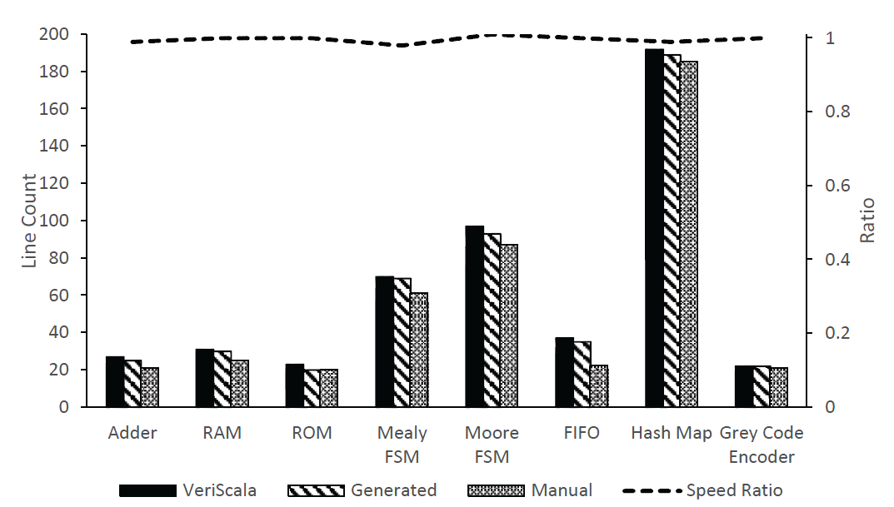
Evaluation – Line Counts Comparison
Line counts comparison among VeriScala, generated and manual implementation. Upper line shows the speed ratio of generated and manual implementation running the same test.
Notes:
这部分文字和上一页一模一样？

Slide 26
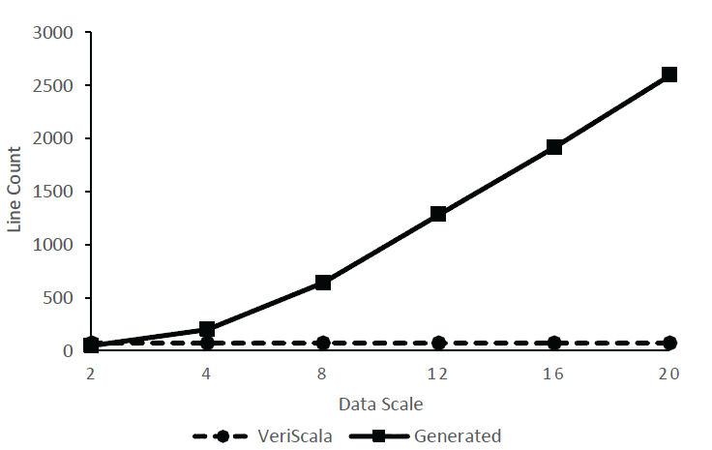
Evaluation – Line Counts Comparison
Line counts of Bitonic Sort implementation
with increasing amount of data to be sorted.

Slide 27
Evaluation – Usability
Steps
Divide ten people into two groups. One is called VeriScala group, and the other Verilog group
Read the prepared specification booklet of VeriScala or Verilog corresponding to their groups, implement a FlashLED module after reading, and record the total costed time
Swap the group, and do the jobs in last step again
Count the code lines of each implementation and check the correctness
Analyze the collected data

Slide 28
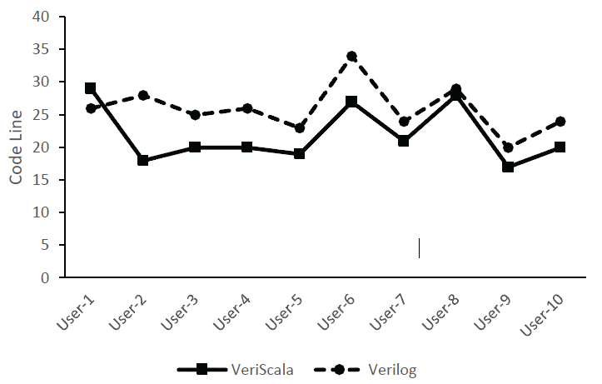
Evaluation – Usability
Line counts comparison between VeriScala and Verilog in implementing FlashLED circuit of ten volunteers

Slide 29
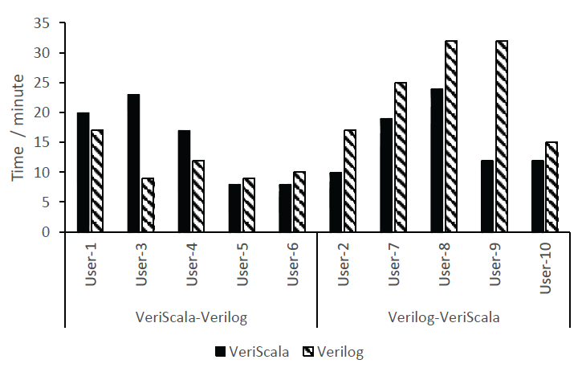
Evaluation – Usability
Time costs comparison between groups applying different implementing order. The left group firstly implement the VeriScala version, while the right group do the opposite

Slide 30
Outline
Review of ScalaHDL Phase II
New contributions in Phase III
Motivation
Demo Demonstration
Methodology
Implementation
Evaluation
Conclusion and Future work

Slide 31
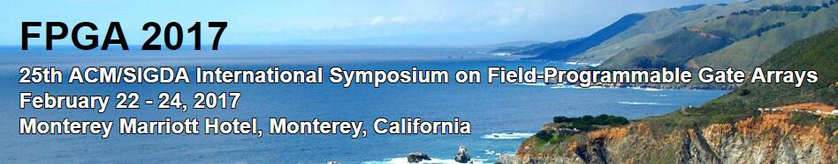
Conclusion
New framework based on ScalaHDL provides an integrated design flow for quick prototyping of hardware acceleration system
Interactive debugging
Directly function call in application context
Paper Scala Based FPGA Design Flow is accepted by FPGA 2017 (poster)

Slide 32
Conclusion
Problems
Serial port communication is primitive
Communication server on HPS is redundant
No streaming transmission supported

Slide 33
Future work
Provide a universal driver implementation
Simplify driver implementation
Support real-world acceleration application
Quick sorting
Matrix multiplication
Encryption
More language features
Float data
Optimization
ScalaHDL
ScalaHDL
Supporting highly abstracted object-oriented hardware defining, programmatical testing, and interactive on-chip debugging for FPGA-accelerated Scala Bigdata Applications

Slide 34

Q&A
Yanqiang Liu, Yao Li, Weilun Xiong, Meng Lai, Cheng Chen, Zhengwei Qi

