Slide 1
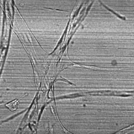
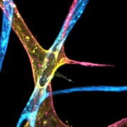
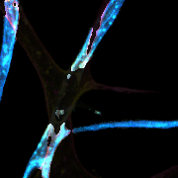
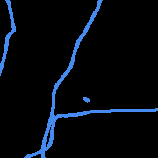
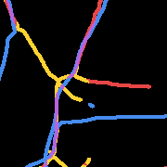
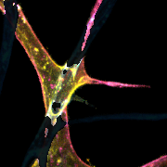
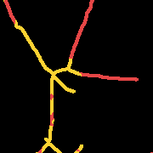
E
Single-plane
Brightfield
Depth-encoded
Fluorescence
Layer
Separation
Per-layer
Skeleton
Depth-aware
Quantification
Top (B>R)
B skel
LBBDM
Channel
Separation
Bot (R>B)
Skeletonize
+ Bridge
R skel
Combine
& Quantify
Area | Length | Junctions | Endpoints
Red Bottom Yellow Middle Blue Top Purple Overlap

Slide 2
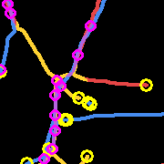
E (with morphometric markers)
Single-plane
Brightfield
Depth-encoded
Fluorescence
Layer
Separation
Per-layer
Skeleton
Depth-aware
Quantification
Top (B>R)
B skel
LBBDM
Channel
Separation
Bot (R>B)
Skeletonize
+ Bridge
R skel
Combine
& Quantify
Area | Length | Junctions | Endpoints
Red Bottom Yellow Middle Blue Top Purple Overlap ○ Endpoint ○ Junction

