Slide 1
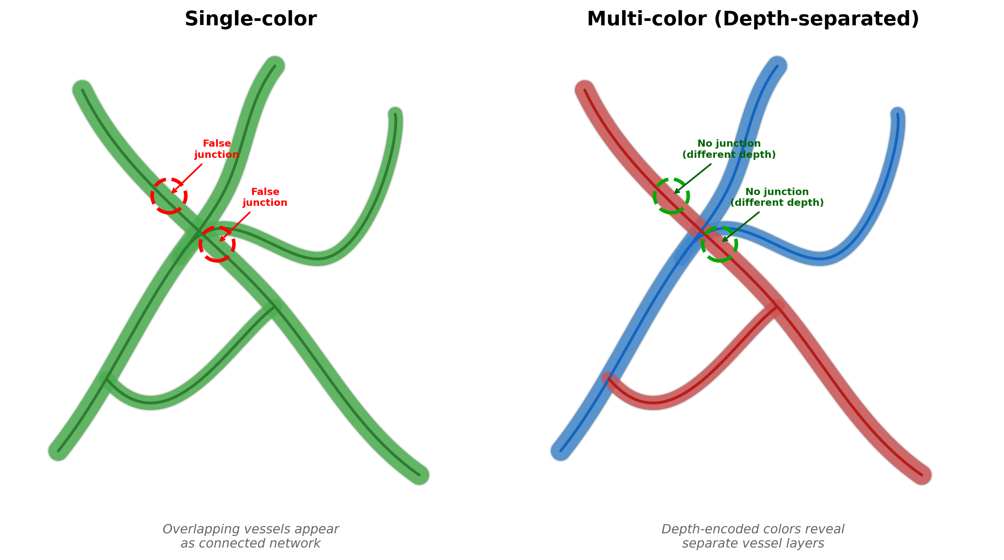
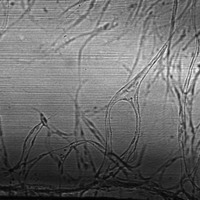
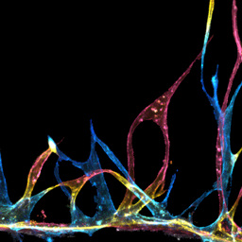
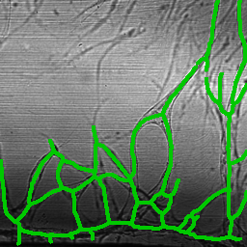
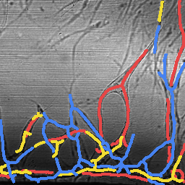
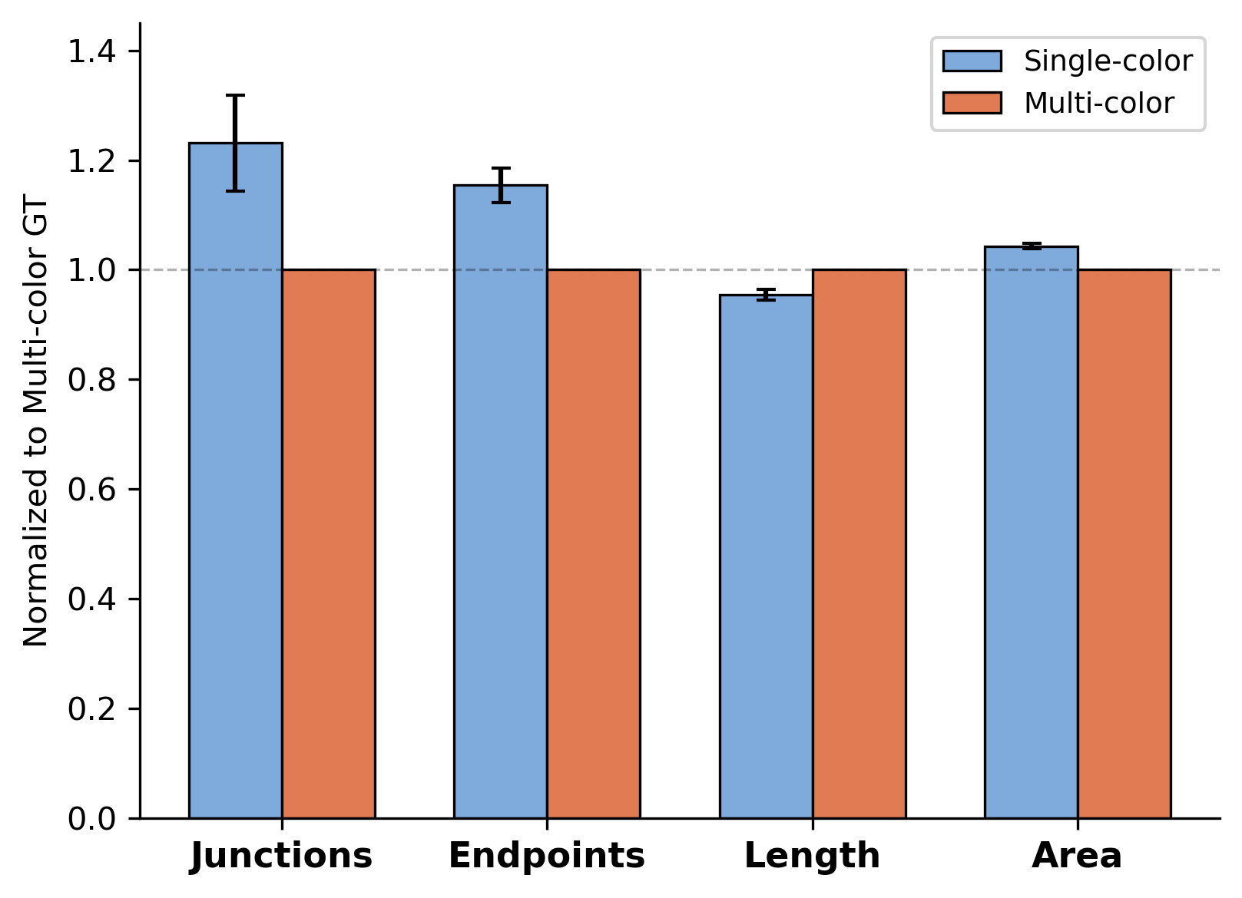
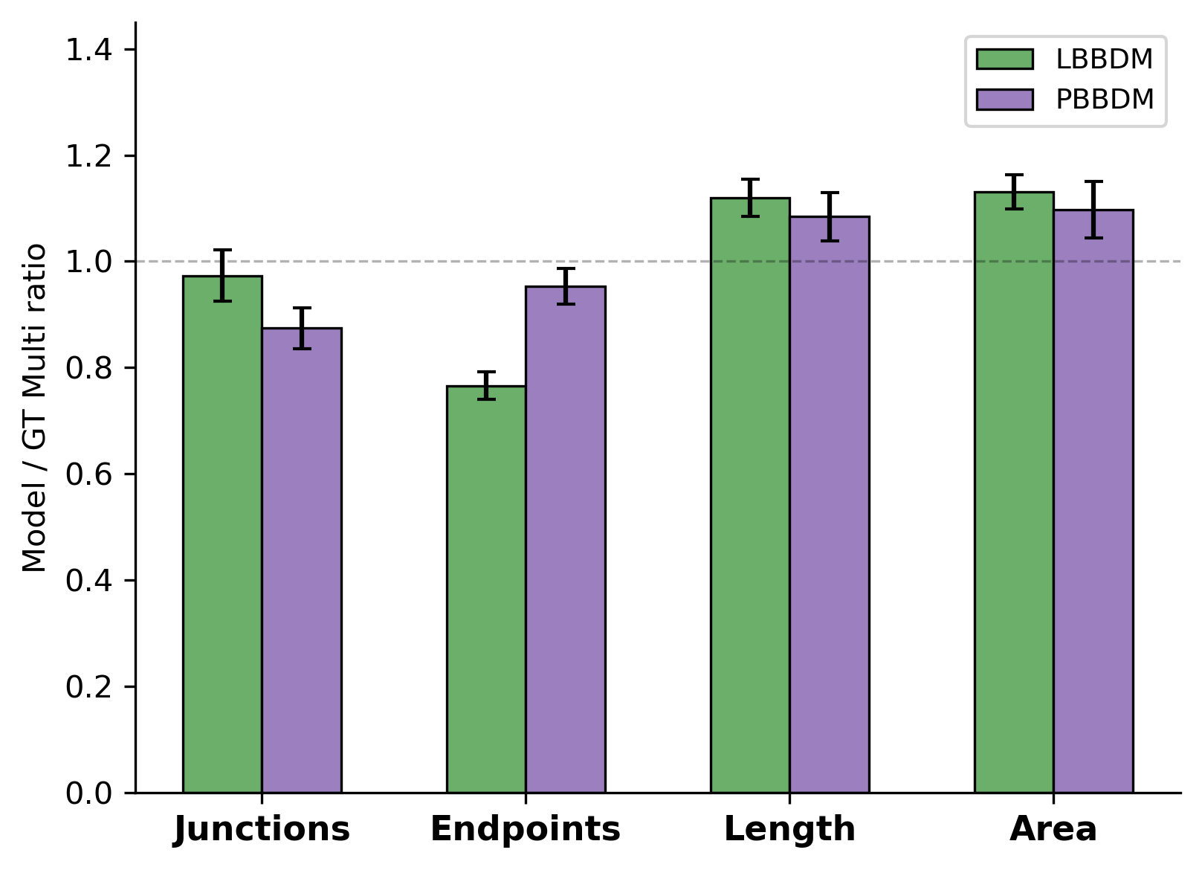
a
b
Brightfield
Multi-color FL (GT)
Single Skeleton
Depth-sep Skeleton
c
Metric | Single/Multi Ratio | SEM | p-value
Junction | 1.231 | 0.088 | **
Endpoint | 1.154 | 0.031 | ***
Length | 0.954 | 0.010 | ***
Area | 1.043 | 0.005 | ***
d
 | LBBDM Ratio | R² | PBBDM Ratio | R²
Junction | 0.973 | 0.787 | 0.874 | 0.857
Endpoint | 0.766 | 0.611 | 0.953 | 0.653
Length | 1.120 | 0.953 | 1.084 | 0.952
Area | 1.131 | 0.974 | 1.097 | 0.974
Bottom 20% excluded (ECM baseline). Hole-filling applied. Per-layer independent metrics. N=215.

Slide 2
Panel (a) - Editable Version
Single-color
Multi-color (Depth-separated)
False junction
No junction
(different depth)
Bottom (Red)
Top (Blue)
Single-color

