Slide 1
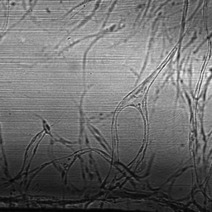
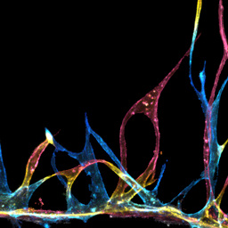
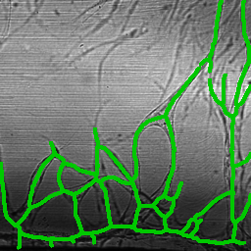
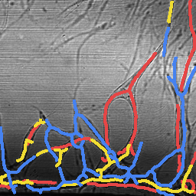
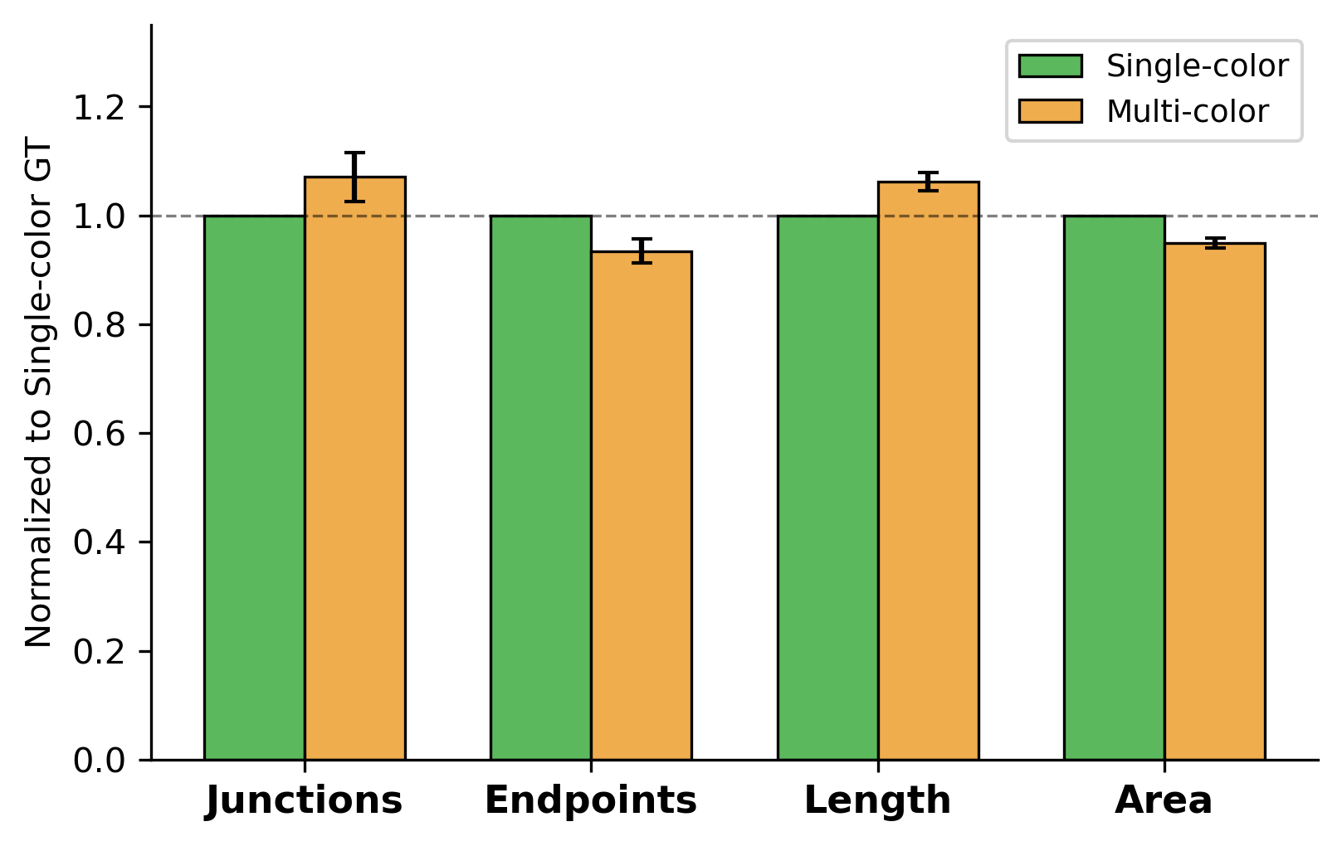
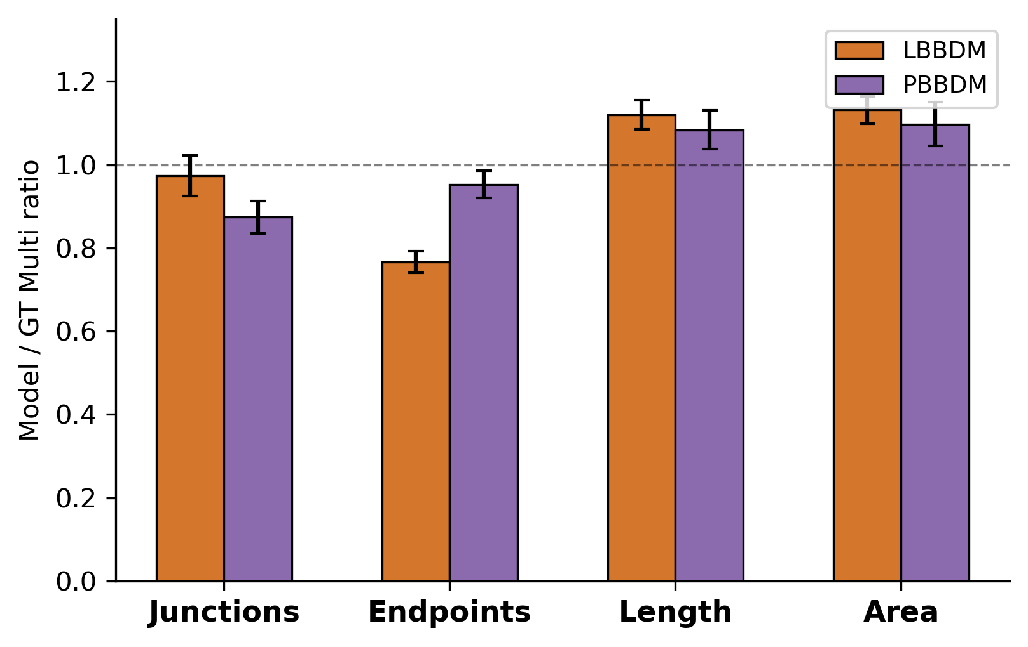
a
Panel A: Schematic
(Insert from depth_schematic_v9.pptx)
b
Brightfield
Multi-color FL (GT)
Single Skeleton
on BF
Depth-sep Skeleton
on BF
c
Single-color vs Multi-color GT (Normalized to Single-color GT = 1.0)
Metric | Multi / Single | p-value
Junctions | 1.071 | ns
Endpoints | 0.935 | **
Length | 1.063 | ***
Area | 0.949 | ***
d
Model Multi / GT Multi (Normalized to GT Multi-color = 1.0)
Metric | LBBDM ratio | R² | p | PBBDM ratio | R² | p
Junction | 0.973 | 0.787 | ns | 0.874 | 0.857 | **
Endpoint | 0.766 | 0.611 | *** | 0.953 | 0.653 | ns
Length | 1.120 | 0.953 | *** | 1.084 | 0.952 | ns
Area | 1.131 | 0.974 | *** | 1.097 | 0.974 | ns

