Slide 1
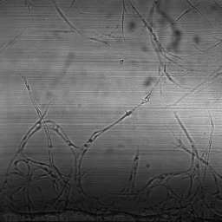
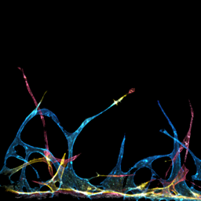
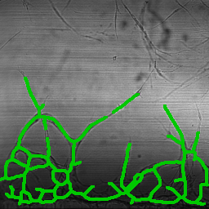
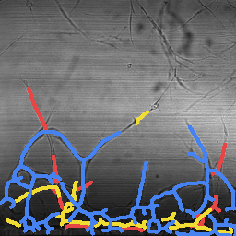
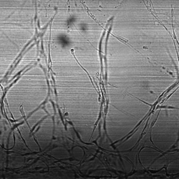
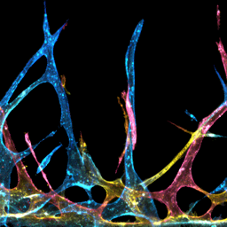
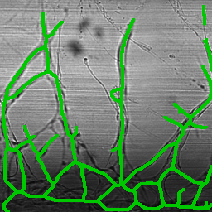
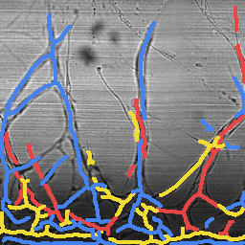
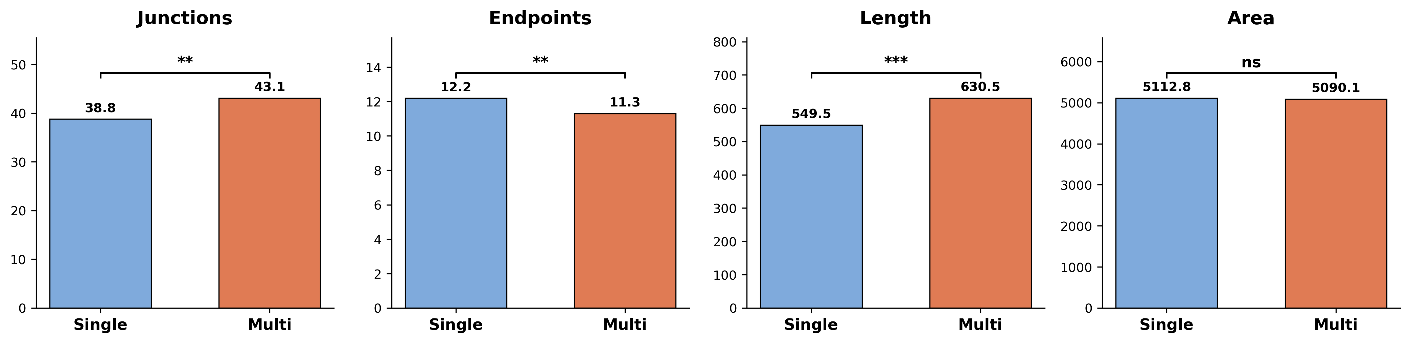
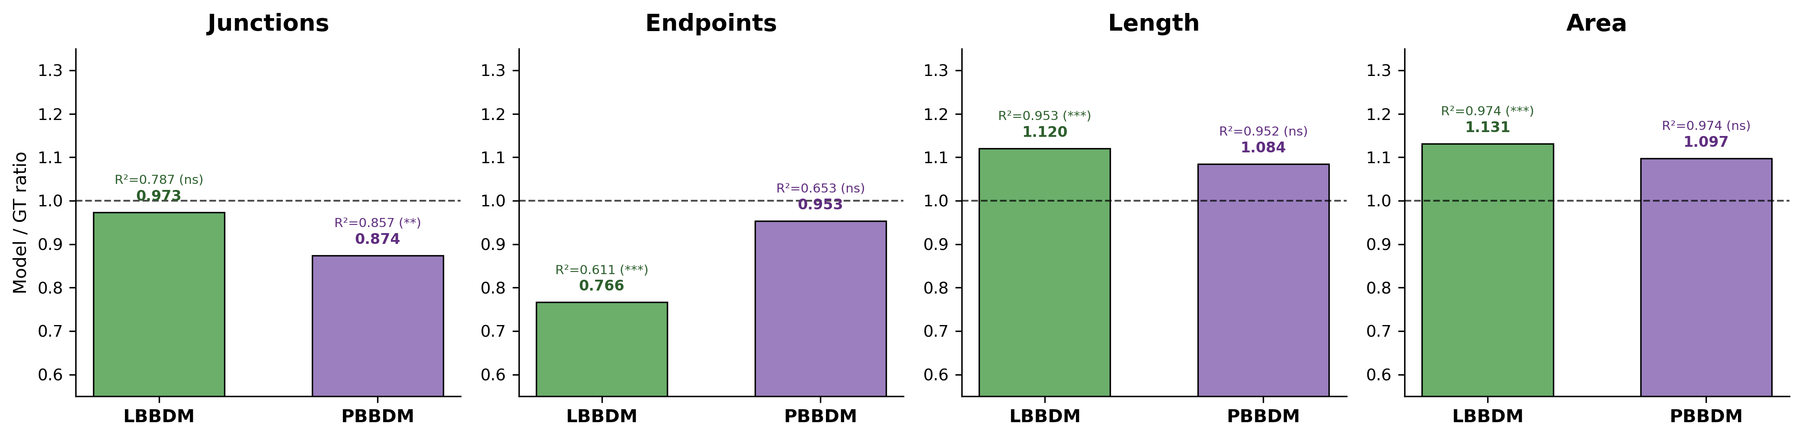
a
b
Brightfield
Multi-color FL (GT)
Single Skeleton
Depth-sep Skeleton
Schematic: Single-color vs Multi-color
Depth-separated Skeleton Analysis
(Insert refined schematic illustration)
Bottom (Red)
Middle (Yellow)
Top (Blue)
c
Single-color GT vs Multi-color GT (N=215, paired t-test)
Quantitative Summary
 | S vs M Ratio | LBBDM Ratio | R² | PBBDM Ratio | R²
Junction | 1.11** | 0.973 | 0.787 | 0.874 | 0.857
Endpoint | 0.93** | 0.766 | 0.611 | 0.953 | 0.653
Length | 1.15*** | 1.120 | 0.953 | 1.084 | 0.952
Area | 1.00 ns | 1.131 | 0.974 | 1.097 | 0.974
Green = ratio near 1.0 & R²>0.9 Red = significant deviation from GT
d
Model fidelity: Multi-color Model / Multi-color GT (dashed line = 1.0)
Methods: Bottom 20% excluded (ECM baseline). Hole-filling for crossing continuity. Per-layer independent metrics. N=215.

